Slide 1
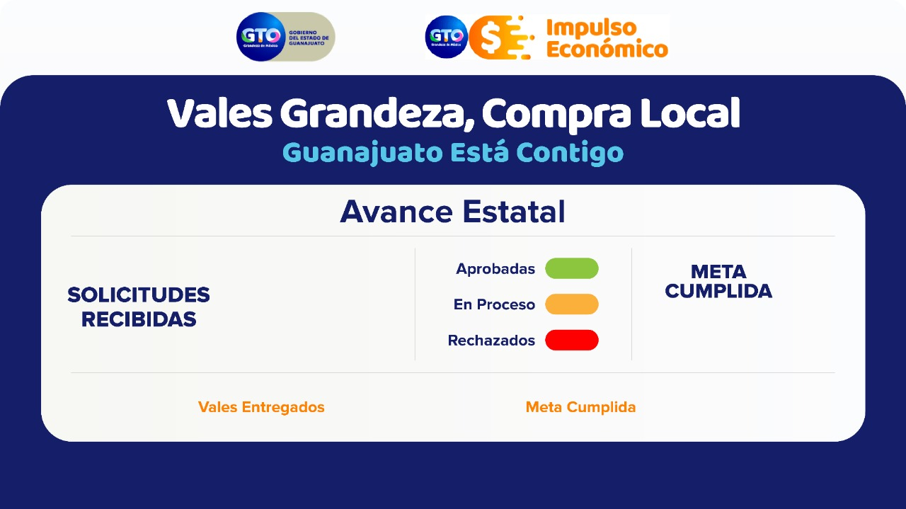
9298
14.3%
0
0%

Slide 2

1
3404
66.75%
0
0%

Slide 3
2
902
30.07%
0
0%

Slide 4
3
1929
10.51%
0
0%

Slide 5
4
593
15.61%
0
0%

Slide 6
5
869
15.52%
0
0%

Slide 7
6
897
6.43%
0
0%

Slide 8
7
704
4.63%
0
0%

