Slide 1

DEEP LEARNING FOR PNEUMONIA DETECTION IN CHEST X-RAY IMAGES
Alfonso Garcia Mateo-Sagasta
The Bridge – Data Science

Slide 2
TABLE OF CONTENTS
- DATASET → HYPOTHESIS
- IMAGE PROCESSING
- TRAINING THE MODEL
- PREDICTIONS
- SERVER
- CONCLUSIONS
- IMPROVEMENTS & FUTURE RESEARCH

Slide 3
DATASET
- CHEST X-RAY IMAGES
- GRAYSCALE IMAGES
- SIZES FROM (600X600) TO (2500X2500)
- 3 LABELS: HEALTHY, BACTERIAL PNEUMONIA, VIRUS PNEUMONIA

Slide 4
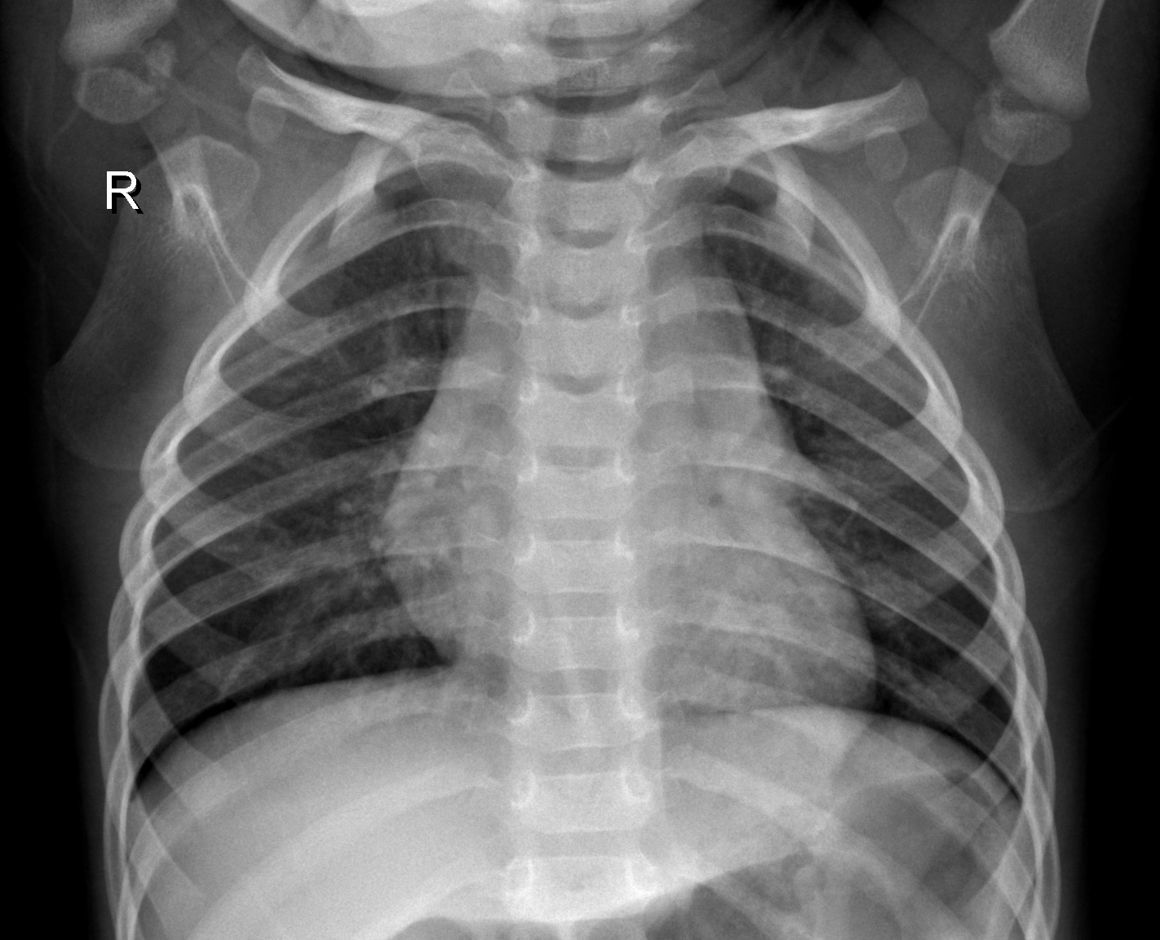
DATASET
Healthy Patient

Slide 5
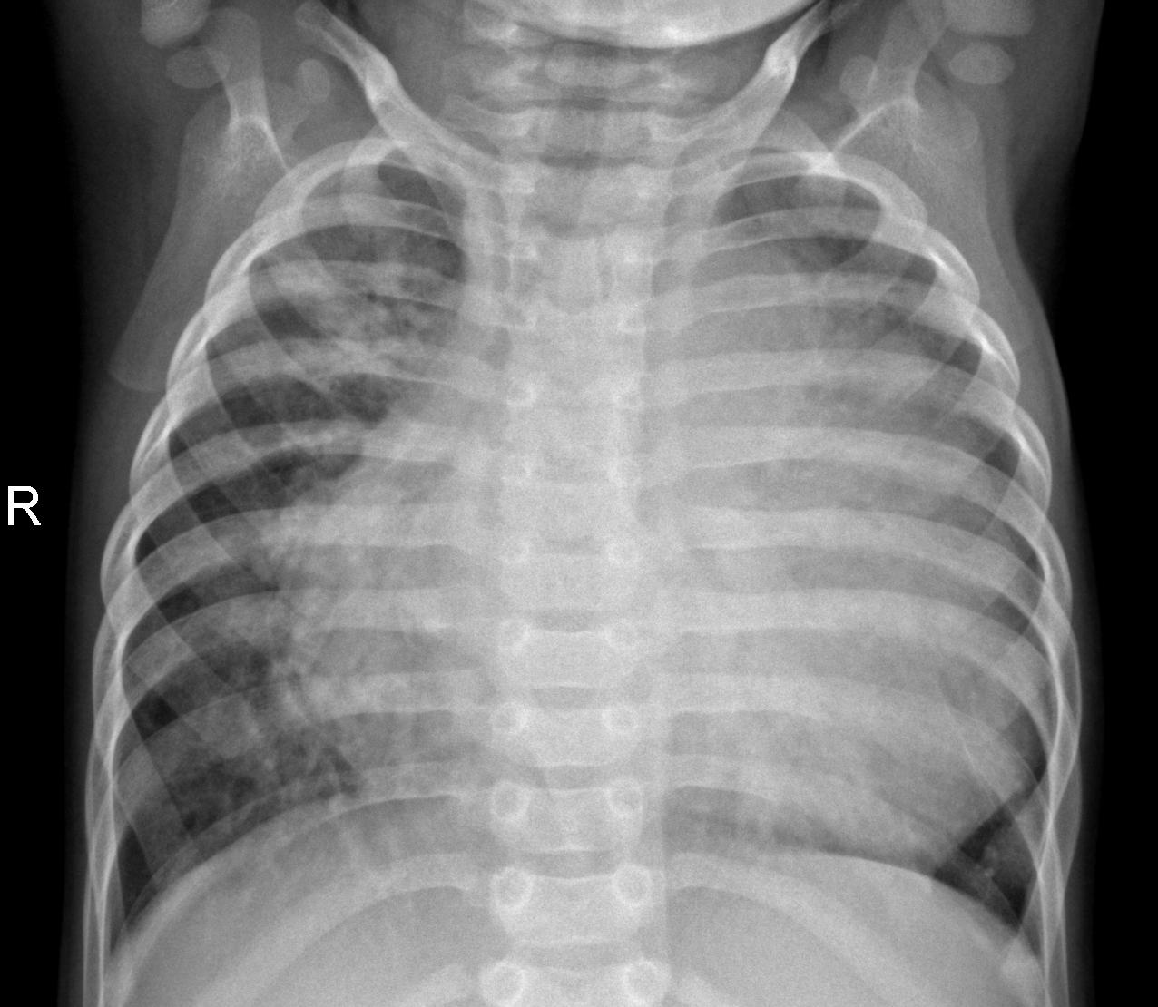
DATASET
Bacterial Pneumonia

Slide 6
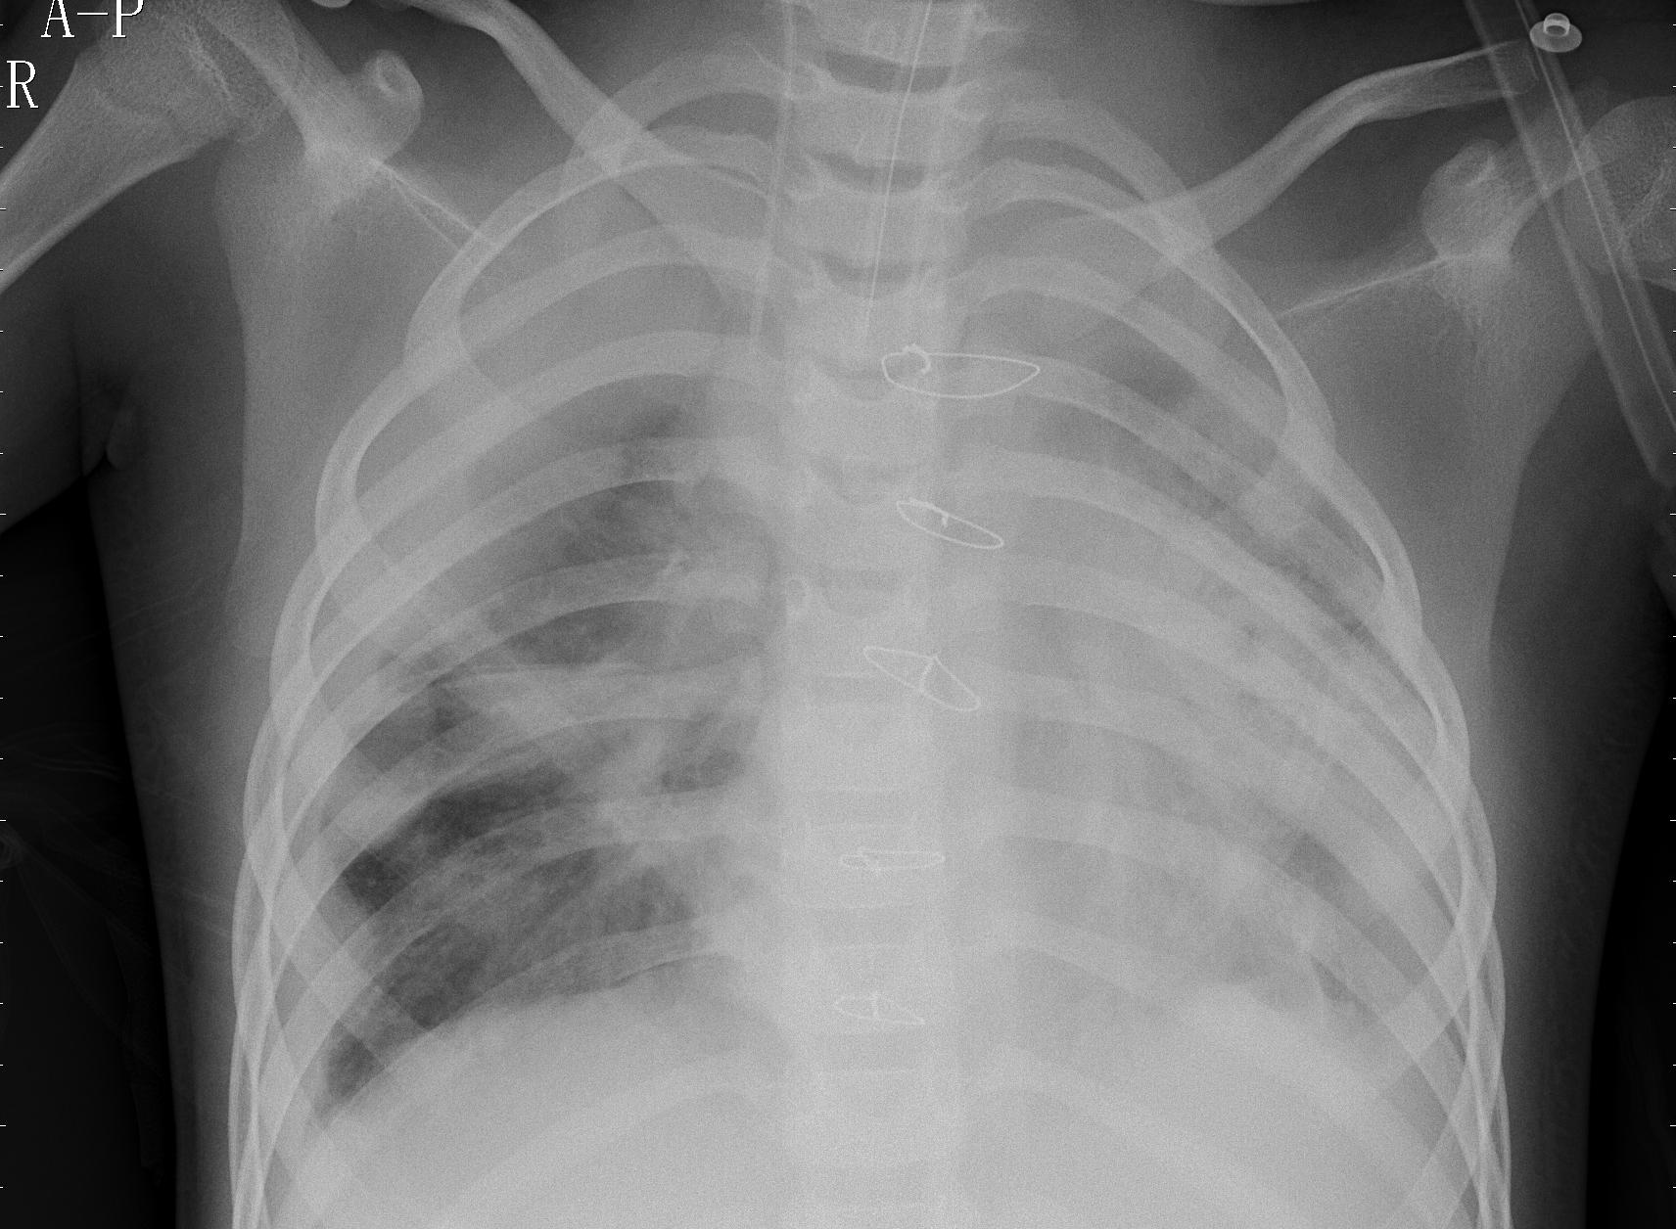
DATASET
Virus Pneumonia

Slide 7
DATASET
OBSERVING THE DATASET WE CAN FORMULATE OUR HYPOTHESIS/OBJECTIVE:
TRAIN A NEURAL NETWORK THAT CAN CLASSIFY A CHEST X-RAY IMAGE INTO HEALTHY, BACTERIAL PNEUMONIA OR VIRUS PNEUMONIA WITH AT LEAST 80% ACCURACY

Slide 8
POSSIBLE BIAS
DATASET
- Train images
- Normal Images: 1349
- Virus images: 1345
- Bacteria images: 2538
- Total: 5232
- Test images:
- Normal Images: 234
- Virus images: 148
- Bacteria images: 242
- Total: 624

Slide 9
IMAGE PROCESSING
- 2 MAIN PROCESSES:
1) IMAGE AUGMENTATION
2) IMAGE RESIZING

Slide 10
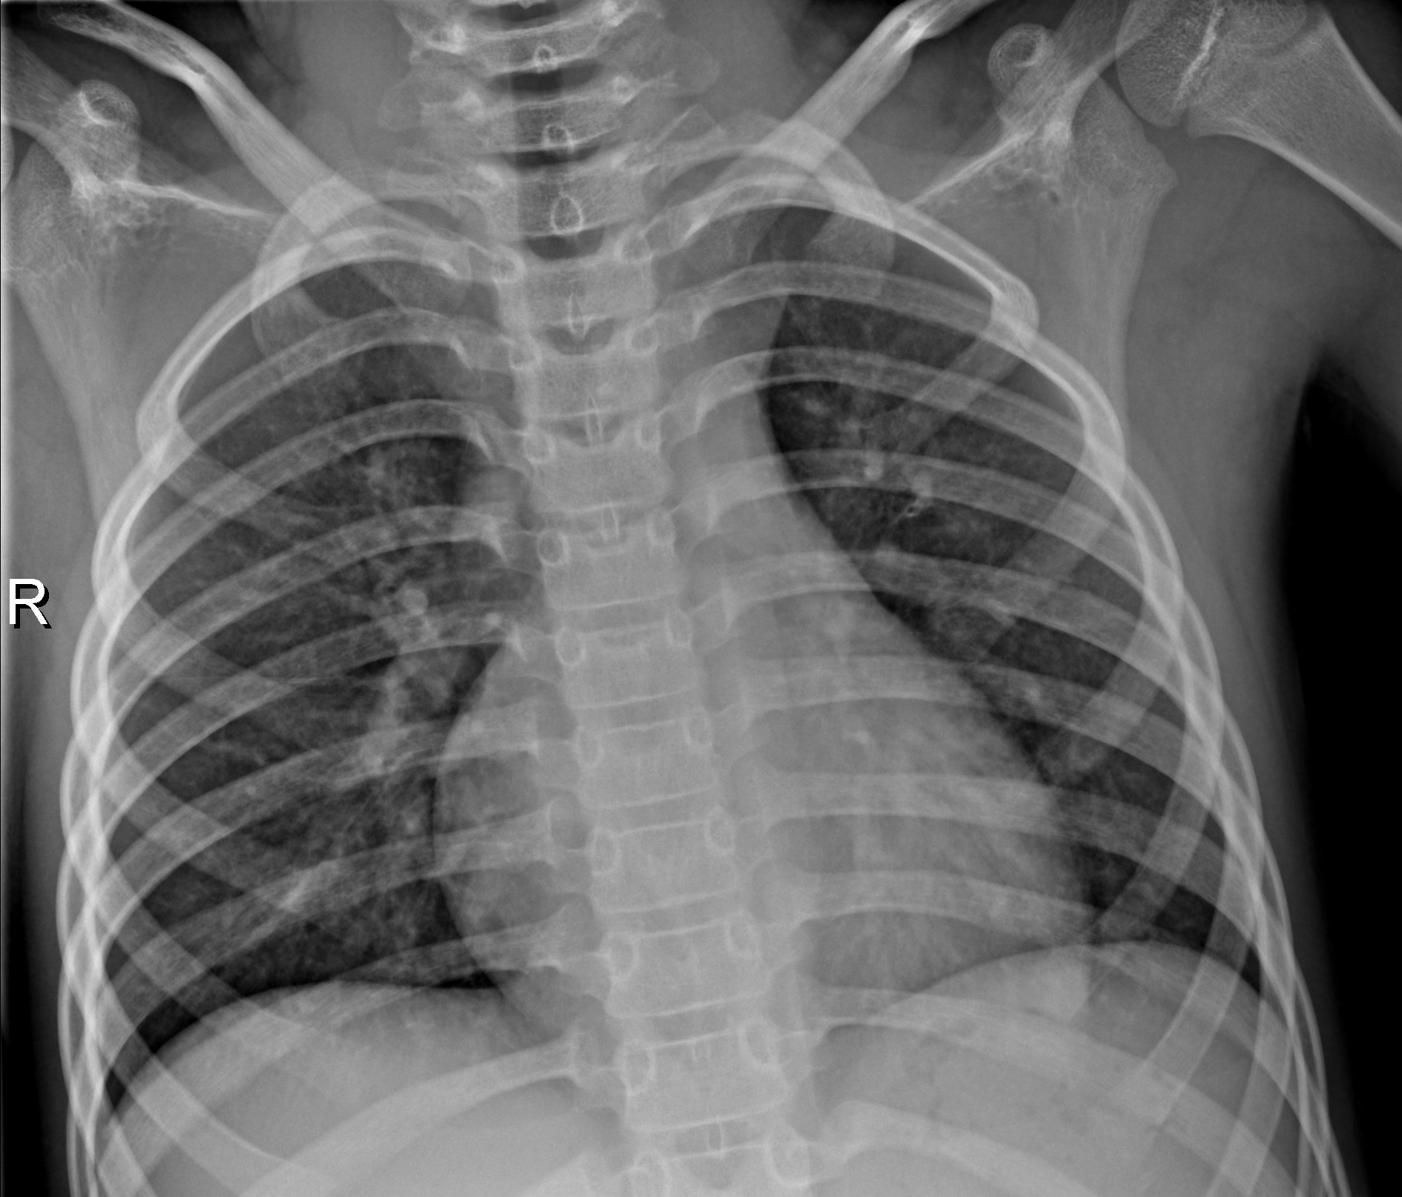

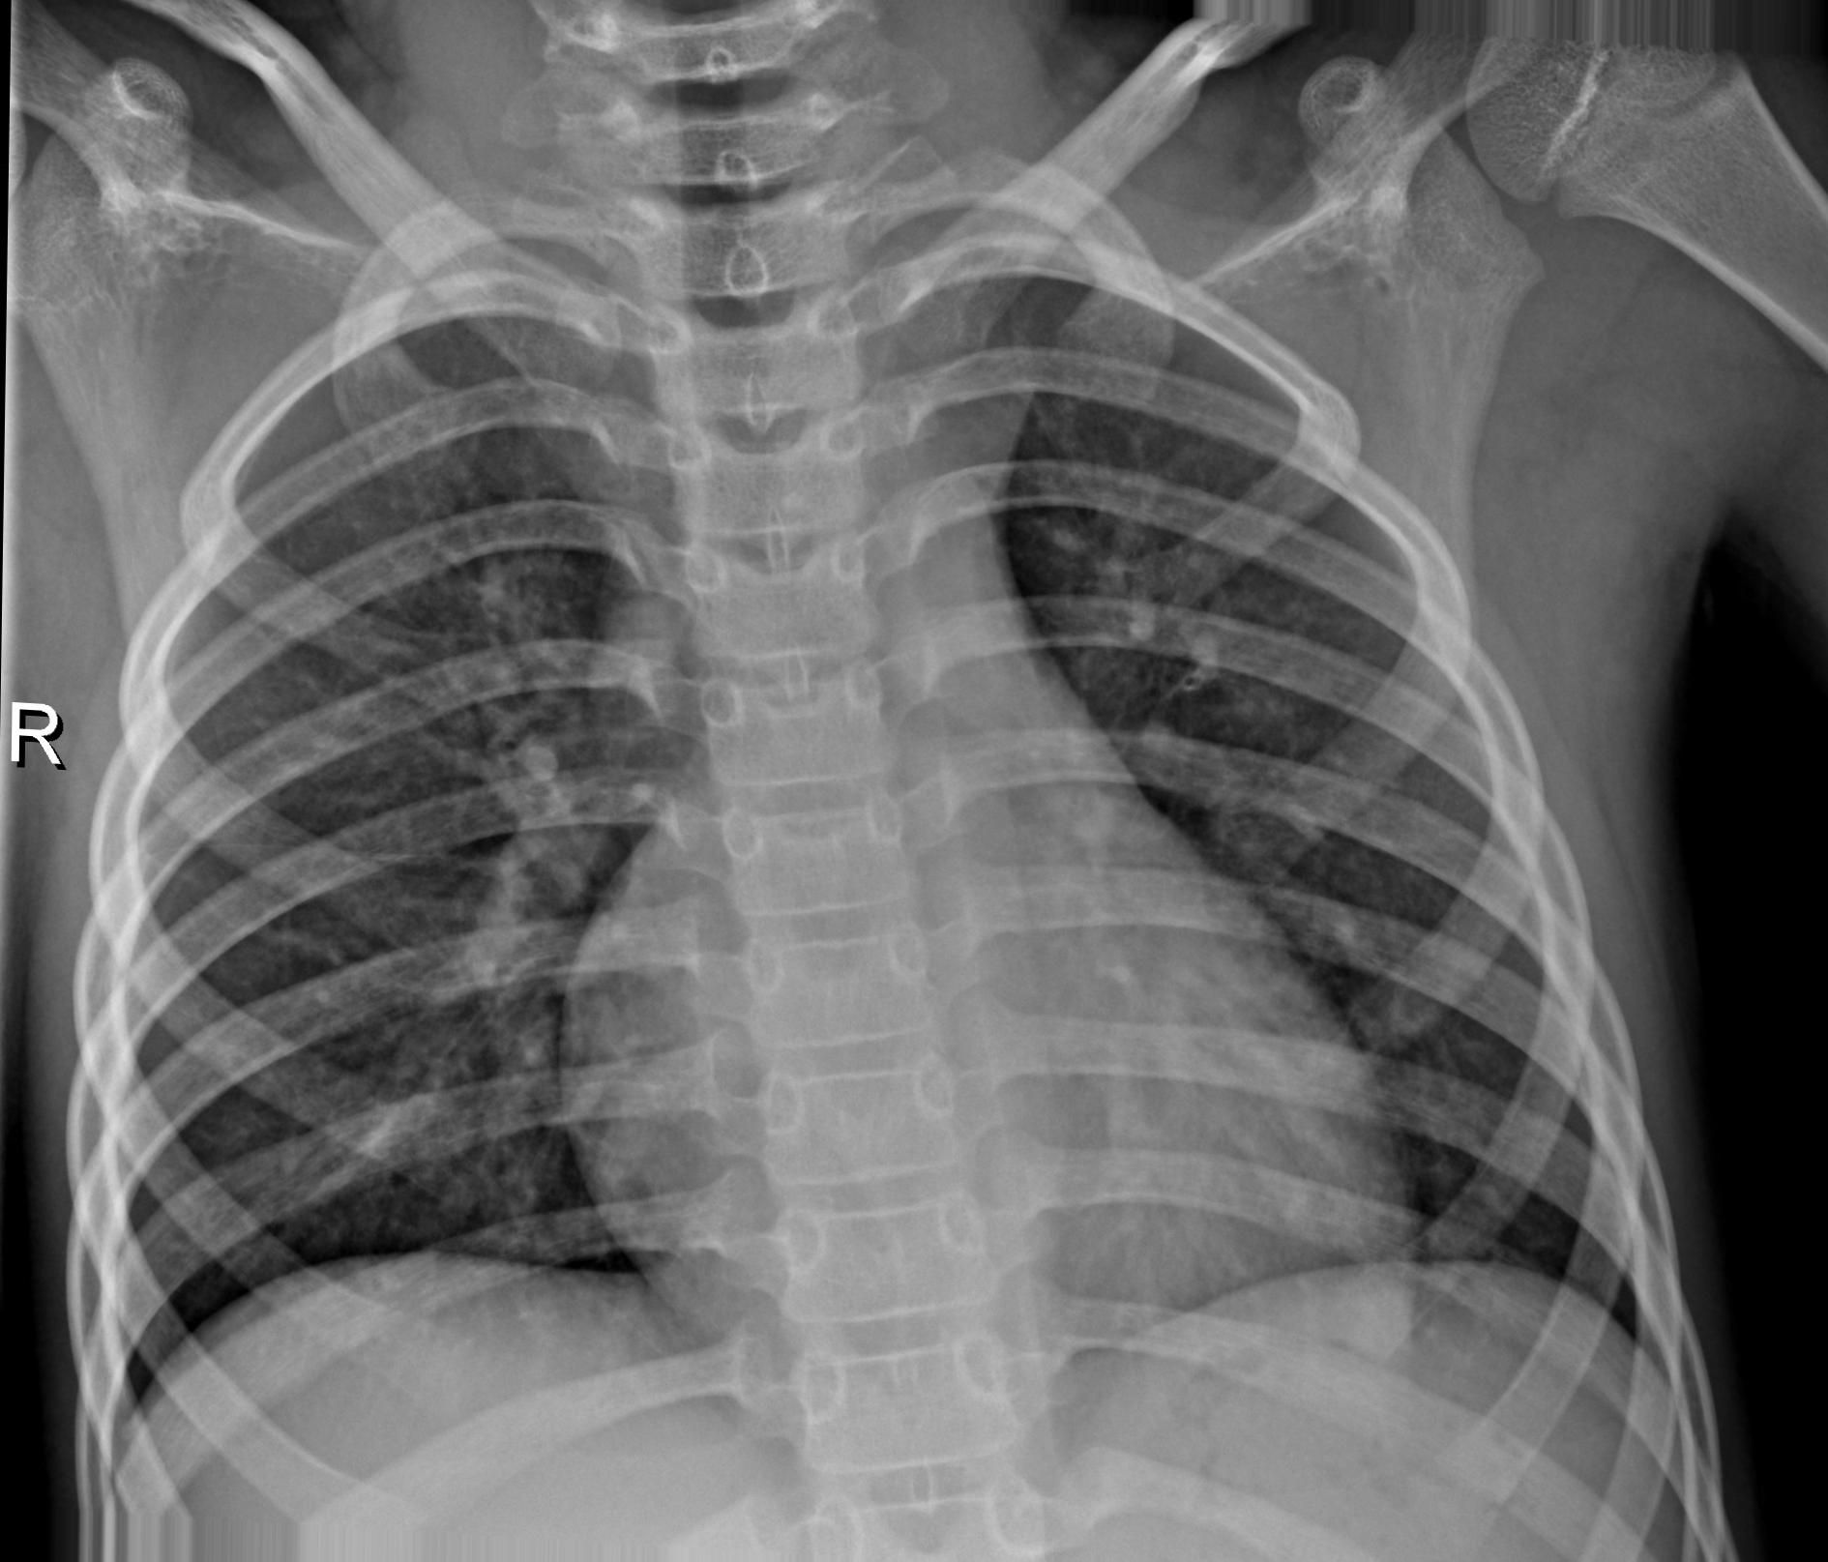
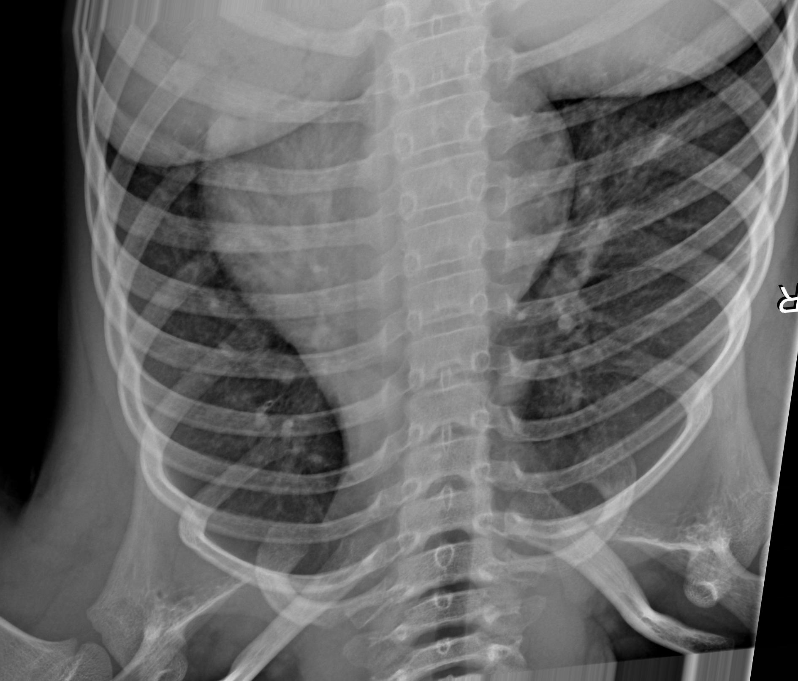
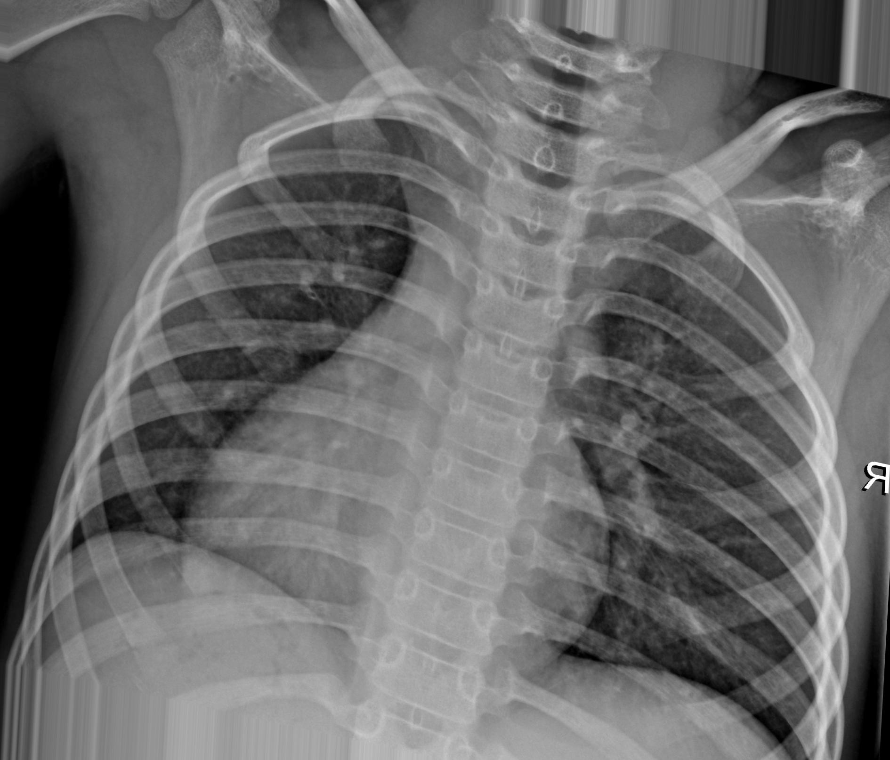
IMAGE AUGMENTATION

Slide 11
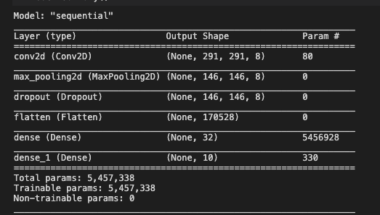
TRAINING THE MODEL

Slide 12
77% ACCURACY
PREDICTIONS
723 IMAGES PREDICTED: 557 CORRECT PREDICTIONS
LOSS OF THE MODEL
(SPARSE CATEGORICAL CROSS-ENTROPY)
22.63

Slide 13

SERVER
Localhost:6060

Slide 14
CONCLUSIONS
Initial hypothesis: Predictions with 80% or more accuracy if the patient has pneumonia and if yes distinguish between bacterial and virus are possible
- FAILED TO VERIFY OUR HYPOTHESIS
- MODEL CAN BE IMPROVED
- NEURAL NETWORKS HAVE A PROMISSING FUTURE IN MEDICAL DIAGNOSIS
- FLASK NOT SO TRIVIAL

Slide 15
IMPROVEMENTS & FUTURE RESEARCH
- MODEL PARAMETER OPTIMIZATION
- IMPROVE WEB DISPLAY
- FEEDING THE NERUAL NET WITH MORE DATA AND DATA TYPES
- IDENTIFY REGIONS THAT CAUSE PNEUMONIA
- WHY STOP AT PNEUMONIA?

Slide 16
THANK YOU FOR YOUR ATTENTION!!

Slide 17



CONTACT INFORMATION
www.linkedin.com/in/alfonso-garcía-mateo-sagasta
@alfonsogarcia-git
alfonsogarcia.ms@gmail.com

