Slide 1
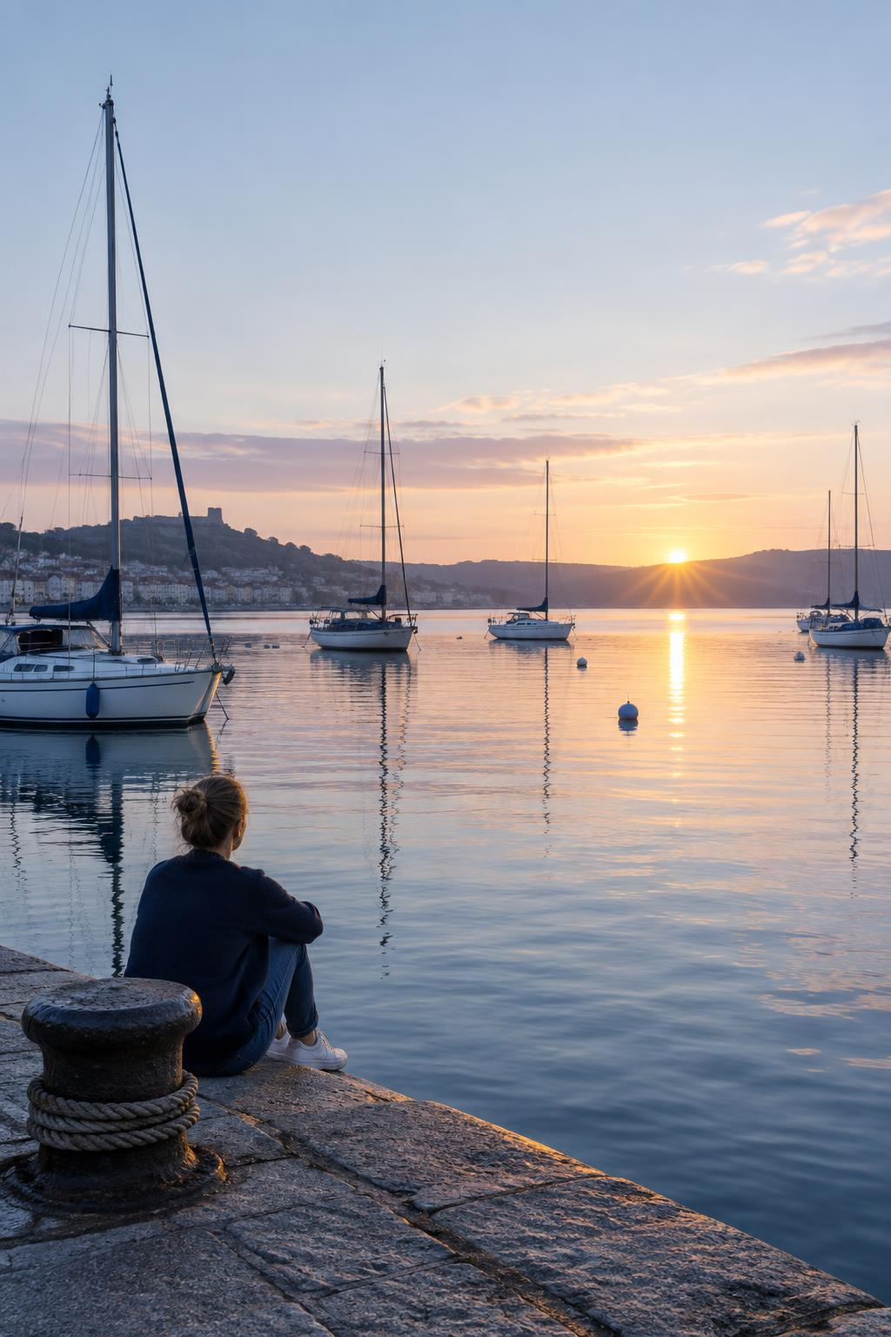
Moving day
Our new waterfront studio
More light, more room, and the harbour outside.

Slide 2

The studio
Room to think, right by the water
One open floor for the whole team.
Long tables for working side by side.
Daylight all day, from windows on three sides.
-
1

