Slide 1
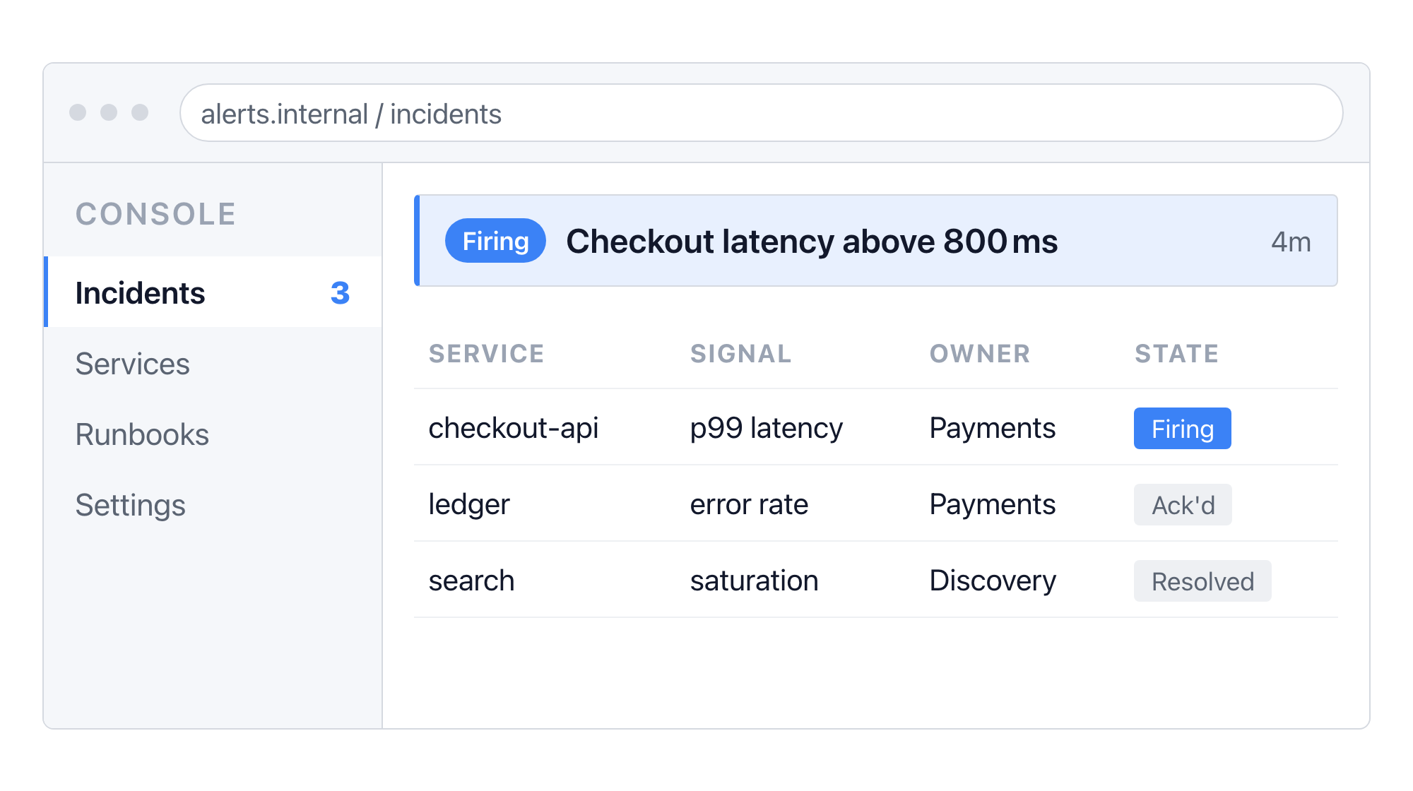
What the operator sees
One screen, three states
Every incident lands in one queue, so the on-call engineer never has to decide where to look first.
Firing alerts sort to the top, with the owning team attached
Acknowledging an alert keeps it visible instead of hiding it
Resolved alerts stay for the retro, then age out after a week
Incident queue · 3 open, 1 firing
-
1

