Slide 1

MW SUPPLY (MW0001)
Mario Chavez

Slide 2

AGENDA
Introduction
User App Module
Technical Information

Slide 3
INTRODUCTION
Upload from excel the FG Assemblies to the different GROUPS.
Validate that all the assemblies have a BOM in MDS.
Notify automatically by email when a BOM does not exist.
All this changes on MDS Supply Site for Short Analysis

Slide 4
USER app module
Enable only for Super User Account

Slide 5
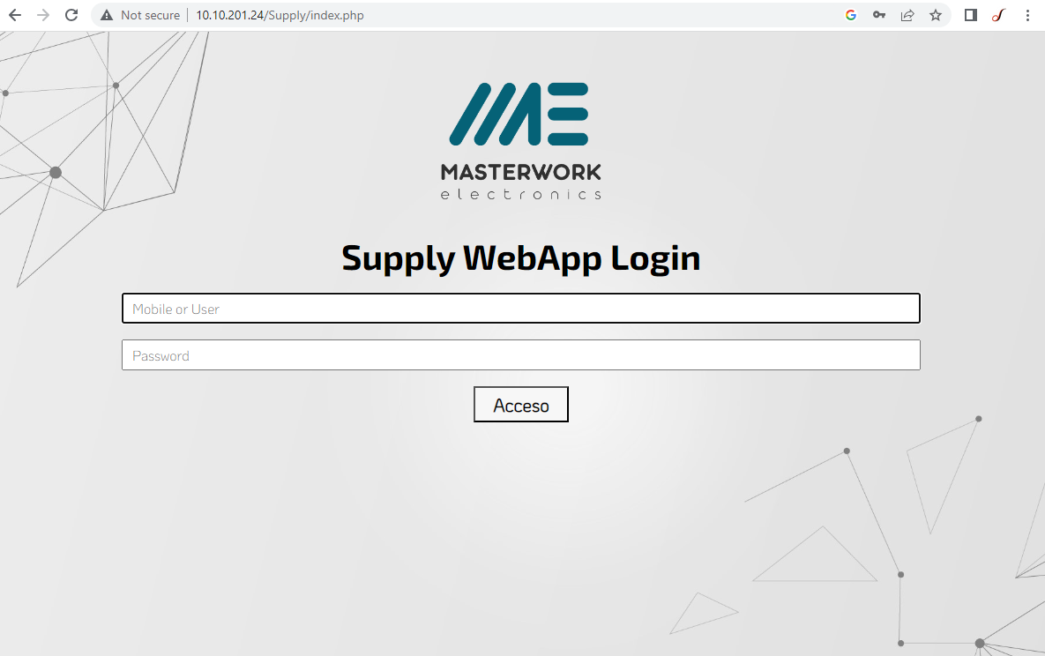

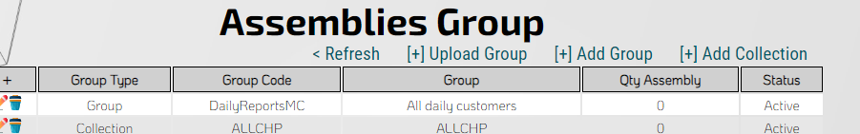
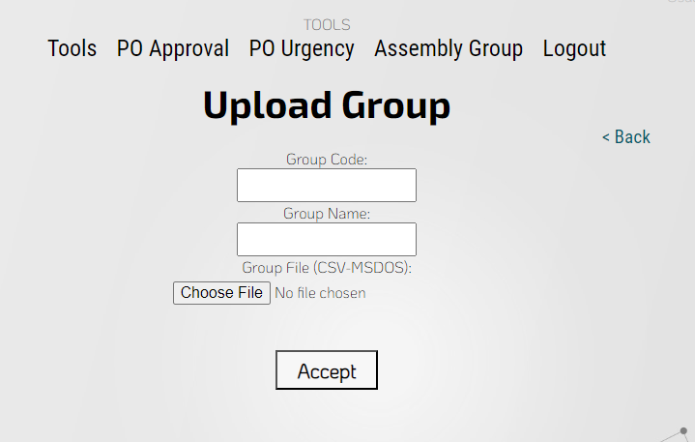
Access APP MODULE
1
2
3
4
Group Code: Define the code for group (only alpha numeric values).
Group Name: Define Group Name.
Group File: (MS-DOS) CSV File, with assembly part number in only one column.
5

Slide 6
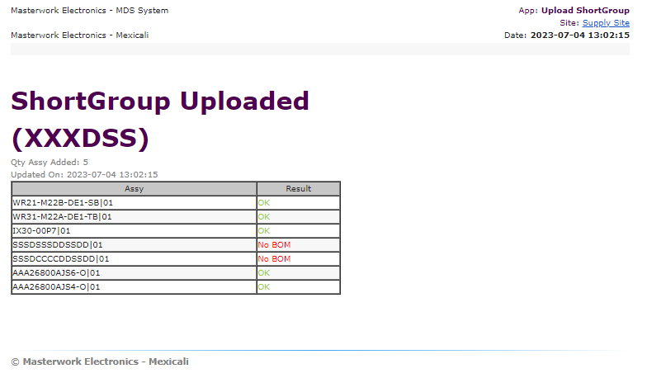
Email NOTIFICATION
After File Upload, the MDS review the file and send notification to the follow email address.
alejandro.ochoa y alejandro.ramirez
OK: Successfully Added
No BOM: BOM Not Found it

Slide 7
TECHNICAL INFORMATION
Program Definition

Slide 8
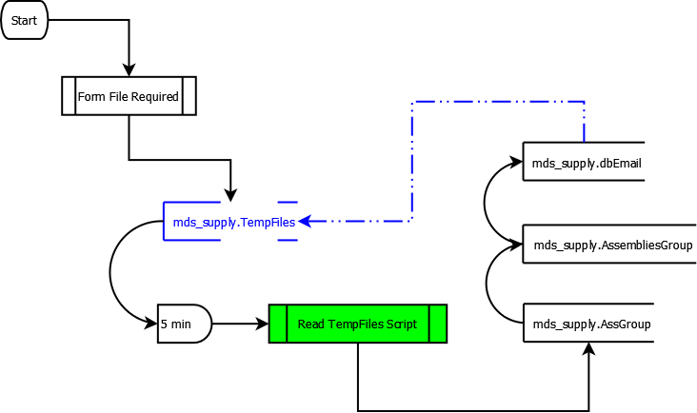
FLOW PROCESS

Slide 9
Files updated
Quotes.php, PPV.php
Add Column on INSERT INTO TempFiles
Tools.php
Add Case UploadGroup and sUploadGroup
ReadTempFiles.php
Add case ShortGroup
Update your local development files with this changes.

Slide 10
MYSQL TABLES updated
mds_supply.TempFiles
Add Column (txtValue) VARCHAR

Slide 11
THANK YOU
Mario Chavez
mario.chavez@softwaredevelopment.mx
www.softwaredevelopment.mx

