Slide 1
How to build packages and modules
Python Academy
May 2023

Slide 2
Agenda
01
02
03
04
05
What is a module?
Using modules
What is a package?
Using package
PIP and PyPI

Slide 3
Instructions

Slide 4
Installation
Programs and code
01
02
Now we download Pyhton and IDE for better development
Download Python3
PyCharm: the Python IDE
03
(Optional) VS Code

Slide 5
01
What is a module?
How do you divide a piece of software into separate but cooperating parts? This is the question. Modules are the answer.

Slide 6
What is a module?
Definitions..
A module is a file containing Python definitions and statements
A module can contain executable statements as well as function definitions. These statements are intended to initialize the module. They are executed only the first time the module name is encountered in an import statement.
Modules can import other modules.

Slide 7
Module example
idle
def hello():
print (“hello guys!”)
def bye(name):
print (“bye %s” % name)
import salutations
salutations.hello()
salutations.bye(“juan”)
salutations.py

Slide 8
02
Using modules
You an create your own modules, also python Python comes with a library of standard modules

Slide 9
Try using a module
Keywords: import / from
Import sys
Import math
Import datetime
Import platform

Slide 10
Builtin Module example
Import math
math.pi
math.sin(10)
Import sys, platform
platform.architecture()
from os import environ
environ["PATH"]
from math import *
Pi
sin(23)

Slide 11
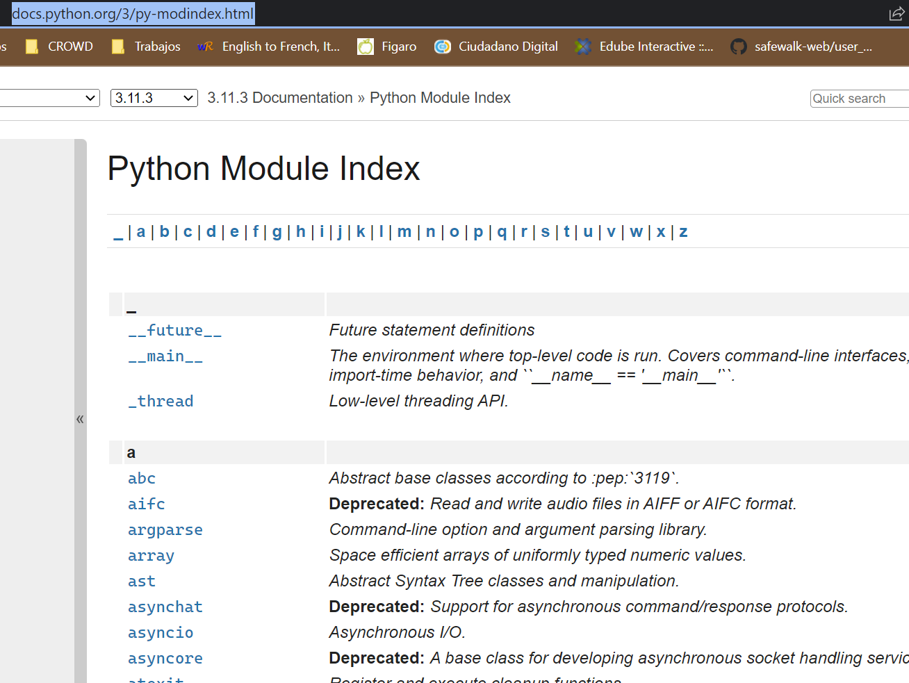
Python modules!
https://docs.python.org/3/py-modindex.html

Slide 12
03
What is a package?
Many code? Many information? Separate them into many modules!
And group by packages!

Slide 13
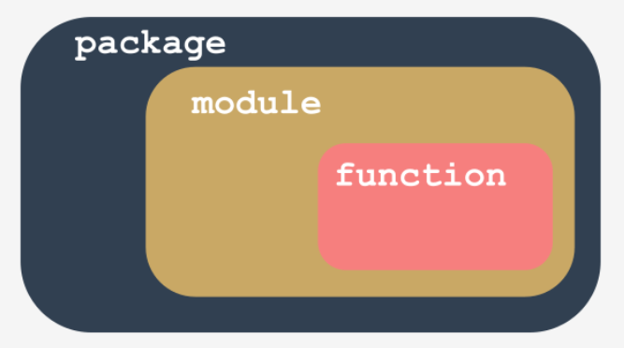
What is a package?
Definitions..
In the world of modules, a package plays a similar role to a folder/directory in the world of files.

Slide 14
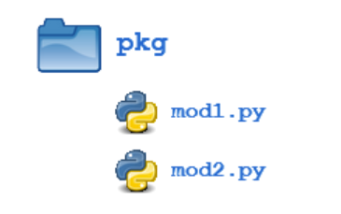
What is a package?
Definitions..
Packages allow for a hierarchical structuring of the module namespace using dot notation. In the same way that modules help avoid collisions between global variable names, packages help avoid collisions between module names.
Creating a package is quite straightforward, since it makes use of the operating system’s inherent hierarchical file structure. Consider the following arrangement:

Slide 15
04
Using package
Import… use the import again!

Slide 16
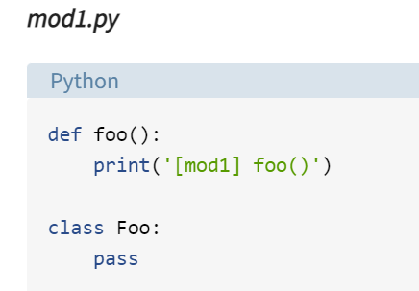
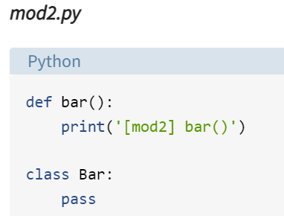
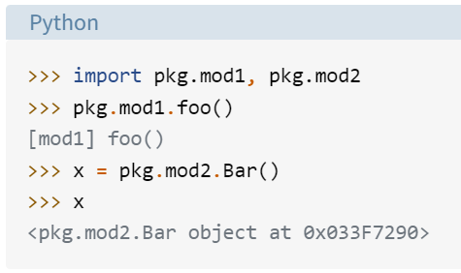
Try using a package

Slide 17
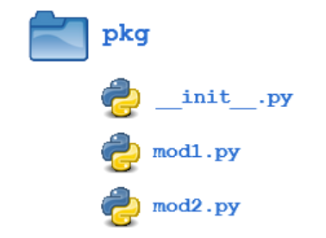
Package Initialization
If a file named __init__.py is present in a package directory, it is invoked when the package or a module in the package is imported. This can be used for execution of package initialization code, such as initialization of package-level data.

Slide 18
05
PIP and PyPI
Pip or pypi? Are the same?

Slide 19
PIP
PyPI
PIP is a package manager for Python packages
Installation:
https://pypi.org/project/pip/
NOTE: in general, python installer also install pip. Yes, algo in WINDOWS!
We can use pip for python 2 and 3.
When we need a module, we use pip to install them
Python Package Index also called the Cheese Shop
You can see more info here:
https://pypi.org/.
All code in the repo are free

Slide 20
Thank You
May 2023

