Slide 1
Course : 0553T / Multimedia System
Year : 2015
SOUND
Session 04

Slide 2
OUTLINE
The Power of Sound
Digital Audio
MDI ( Musical Instrument Digital Interface)
Audio File Format
Working with Sound
Guidelines for the Use of Sound

Slide 3
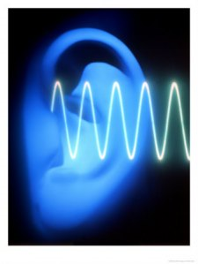
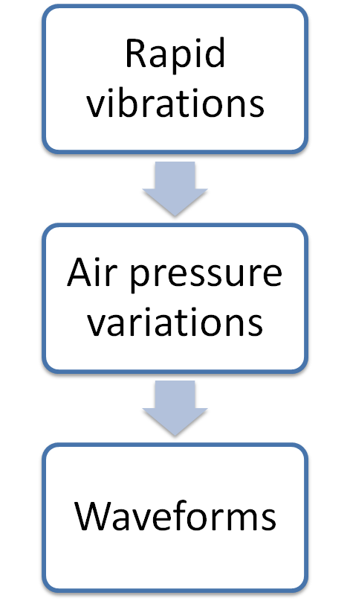
The Power of Sound
Definition of Sound :
transmitted as
manifest as

Slide 4
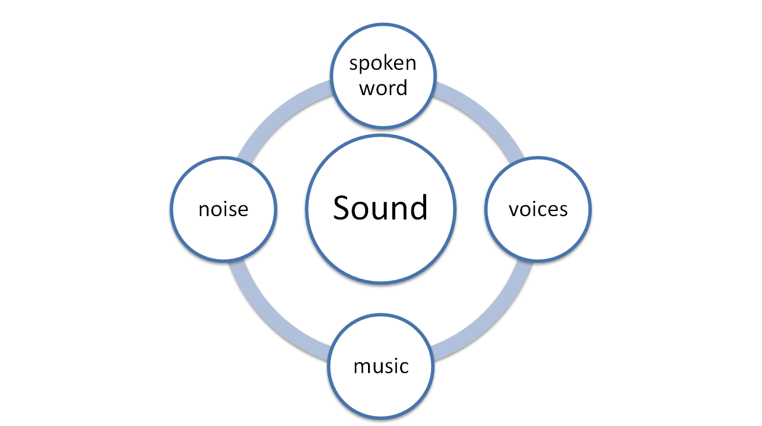
The Power of Sound
Many sound waves mixed together from :

Slide 5
The Power of Sound
Sine wave is a simple wave that regularly repeats a smooth transition from high to low pressure. ( Figure 4.1)
Time for one cycle
distance
along wave
Cycle
Amplitude(dB)
Time ( Second)
Figure 4.1 A sine wave

Slide 6
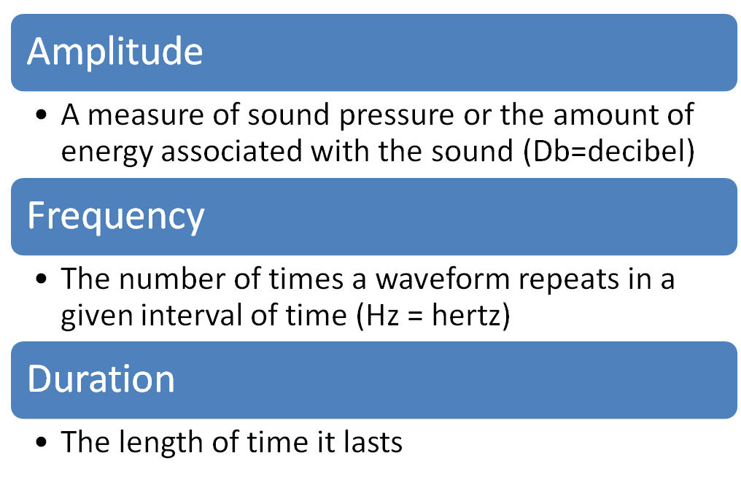
The Power of Sound
A sine wave captures three essential feature of sound :

Slide 7
Digital Audio
Digital Audio is created when you represent the characteristics of a sound wave using numbers.
Digitized sound is sampled sound.

Slide 8
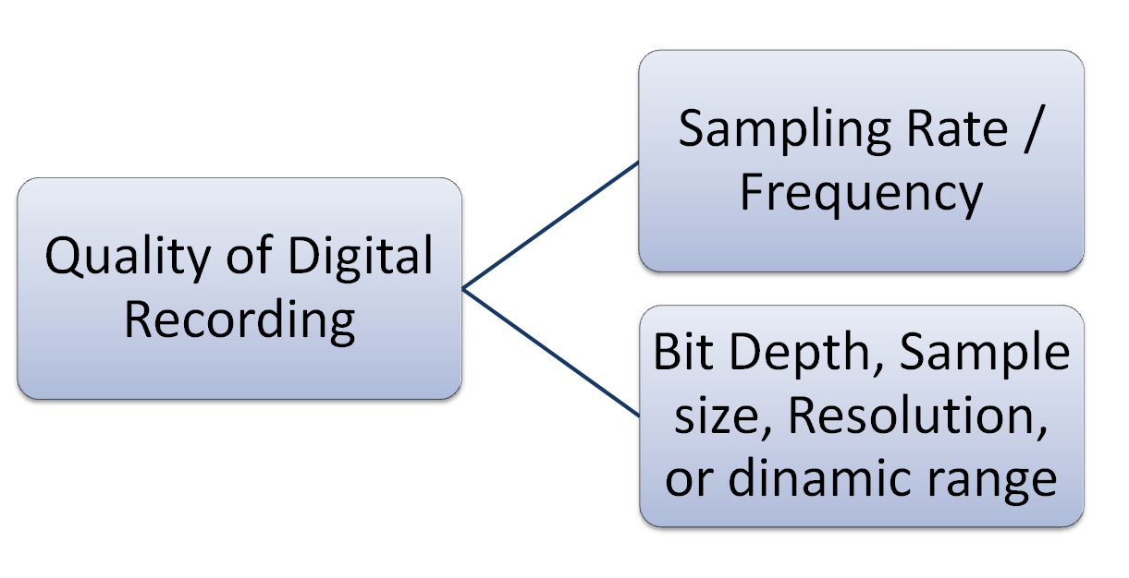
Digital Audio

Slide 9
Digital Audio
Sampling Rate : how often the samples are taken
Bit Depth : how many numbers are used to represent the value of each sample.
The more often take a sample and the more data store about that sample, the finer the resolution and quality of the captured sound when it is played back.

Slide 10
Digital Audio
Quantization : rounding a sample to the closest available value.
Quantization can produce an unwanted background hissing noise . The solution is to record with a higher sample resolution (example : using 16 bits rather than 8 bits)
Clipping : a different form of distortion related to wave amplitude.
Clipping can produce a harsh, distorted sound

Slide 11
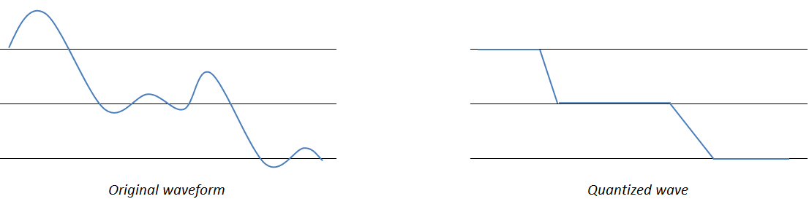
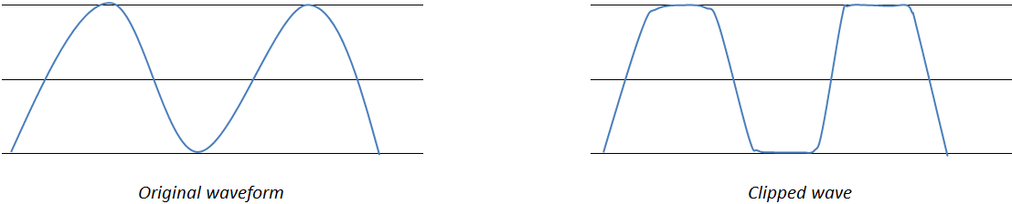
Digital Audio
Figure 4.3 Quantizing and Clipping
Quantizing
Clipping

Slide 12
Digital Audio
Formula for determining the size (in bytes) of a
digital recording :
  For a monophonic recording :
  Sampling rate x duration x ( bit resolution / 8) x 1
  For a stereo recording :
  Sampling rate x duration x ( bit resolution / 8) x 2
  Note : Sampling rate measured in kHz.
  Resolution measured in bits per sample

Slide 13
Digital Audio
Example :
  Calculate the file size for 1 minute, 44.1 KHz, 16 bits, stereo sound
  The size is 10.594.000 bytes
44100 * 60 * 16 *2
8

Slide 14
Digital Audio
Audacity : a free, open source sound-editing application for Windows, Macintosh, and Linux.
The Basic sound-editing operations :
  Trimming
  Splicing and Assembly
  Volume Adjustments
  Format Conversion
  Resampling or DownSampling

Slide 15
Digital Audio
The Basic sound-editing operations (continue) :
  Fade-ins and Fade-outs
  Equalization
  Time Stretching
  Digital Signal Processing (DSP)
  Reversing Sounds
  Multiple Tracks

Slide 16
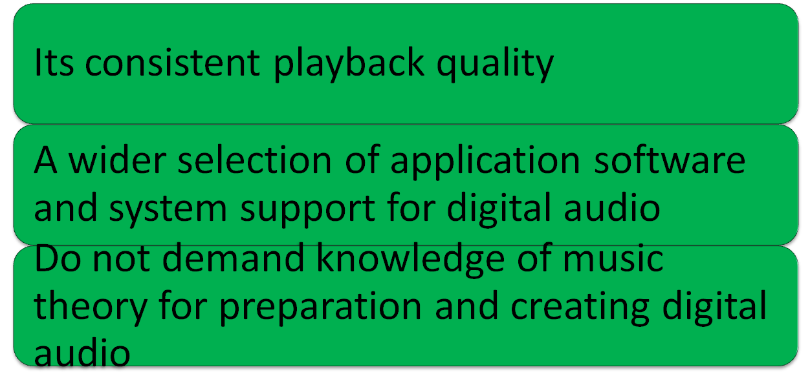
Digital Audio
The advantage of Digital Audio :

Slide 17
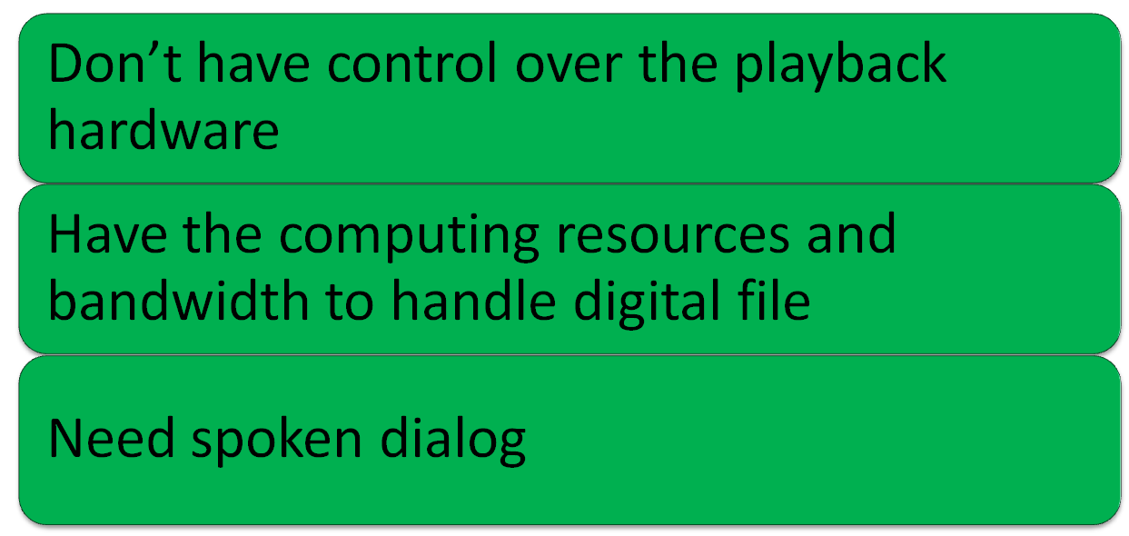
Digital Audio
In general , use digital audio in the following circumstances :

Slide 18
MIDI
MIDI (Musical Instrument Digital Interface) :
  A communication standard developed in the early 1980s for electronic musical instruments and computers
  It is not digitized sound
  Depends on the capabilities of sound system, the quality of the computerized musical instruments, and the capabilities of sound system.

Slide 19
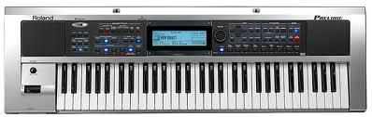
MIDI
011010111011011010110110110111011011110110111011011011101111011011010101000101101101101011011010011011011011011011011010101010100110011001001001100110011010011010111
Musical Instrument Digital Interface

Slide 20
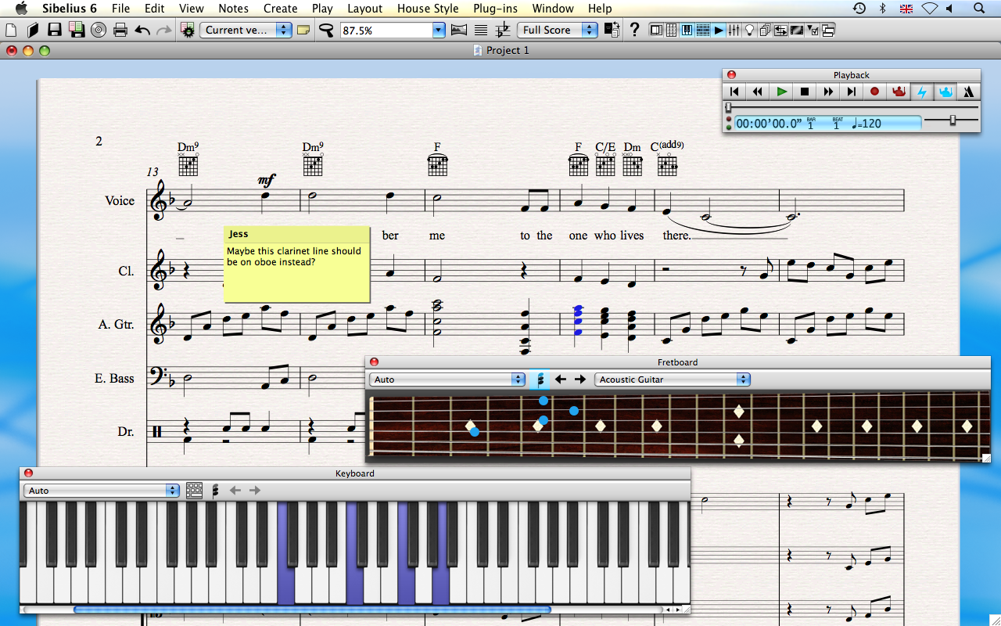
MIDI
To Make MIDI Scores :
  1. Notation Software

Slide 21
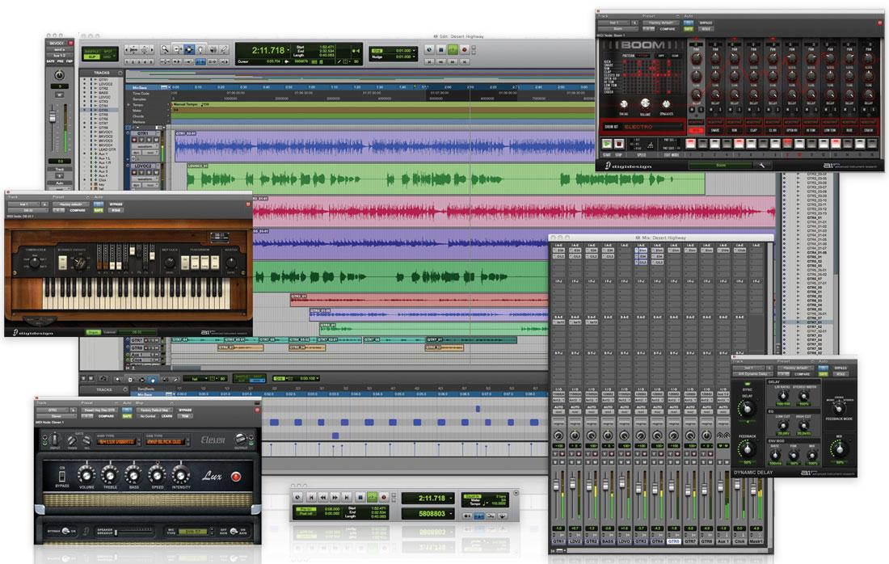
MIDI
To Make MIDI Scores :
  2. Sequencer Software

Slide 22
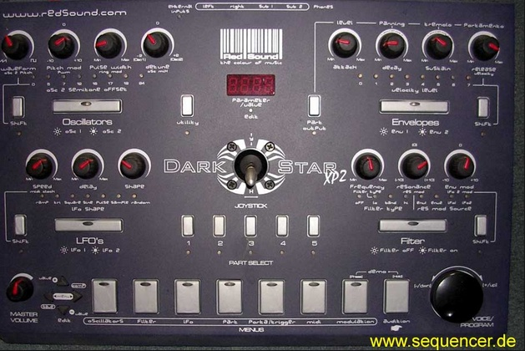
MIDI
To Make MIDI Scores :
  3. Sound Synthesizer

Slide 23
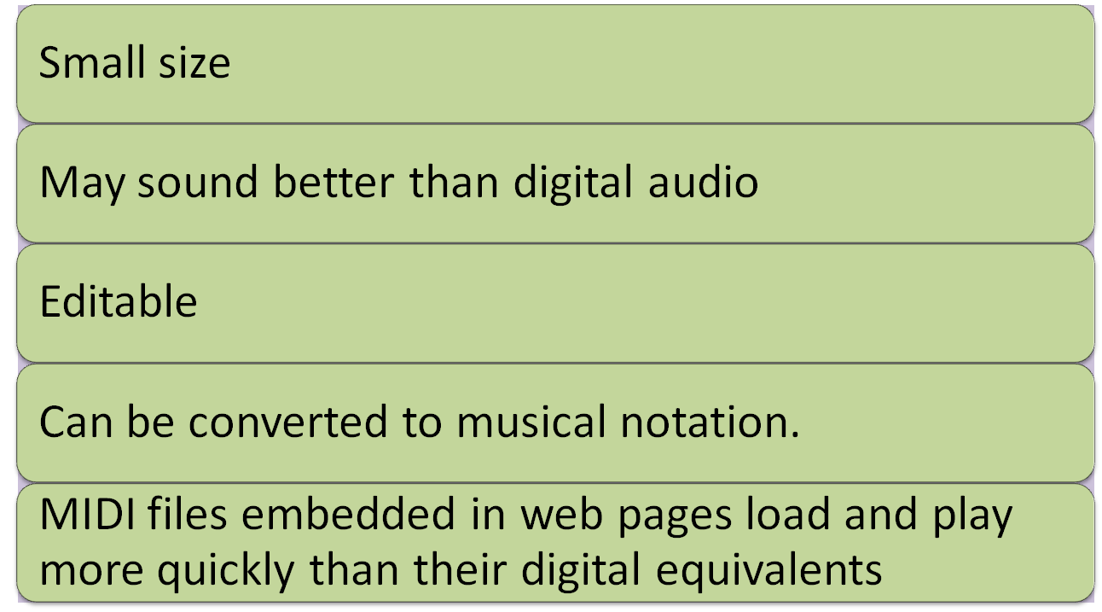
MIDI
Advantages of MIDI :

Slide 24
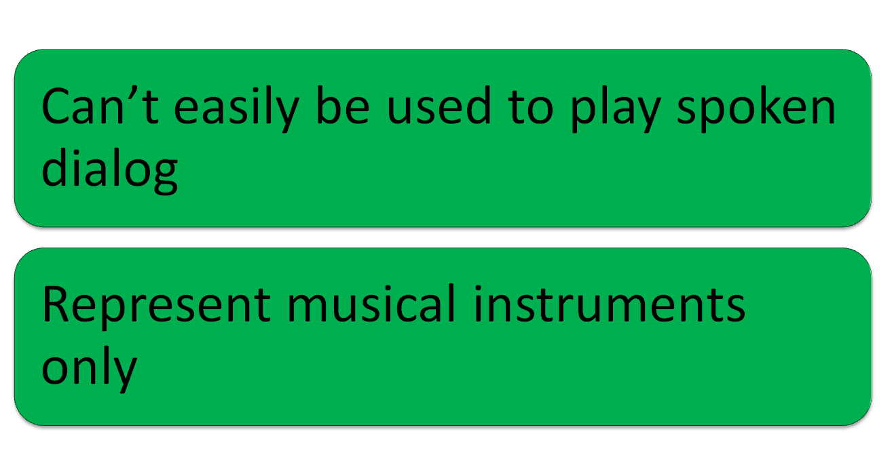
MIDI
Disadvantages of MIDI :

Slide 25
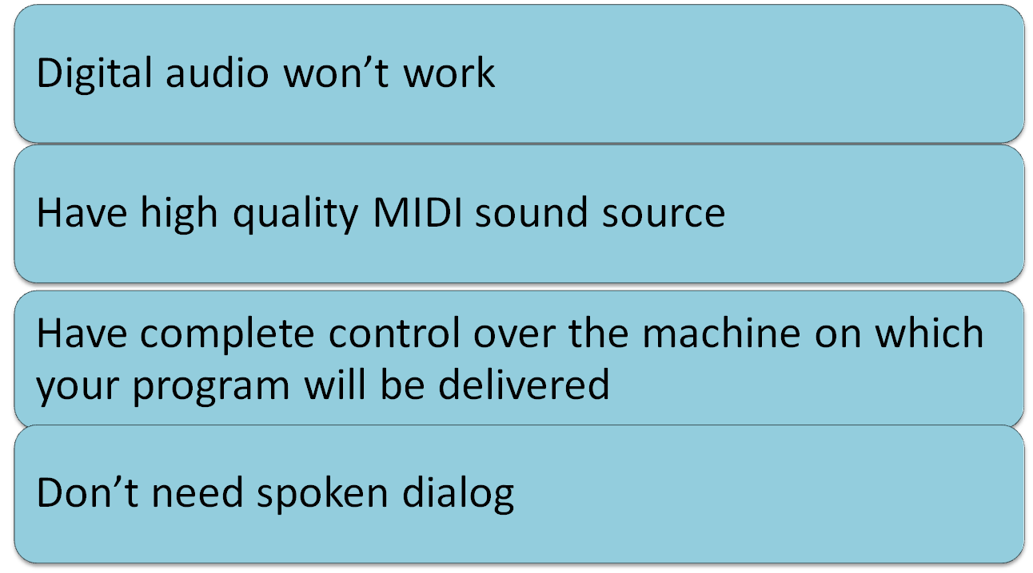
MIDI
Use MIDI in the following circumstances :

Slide 26
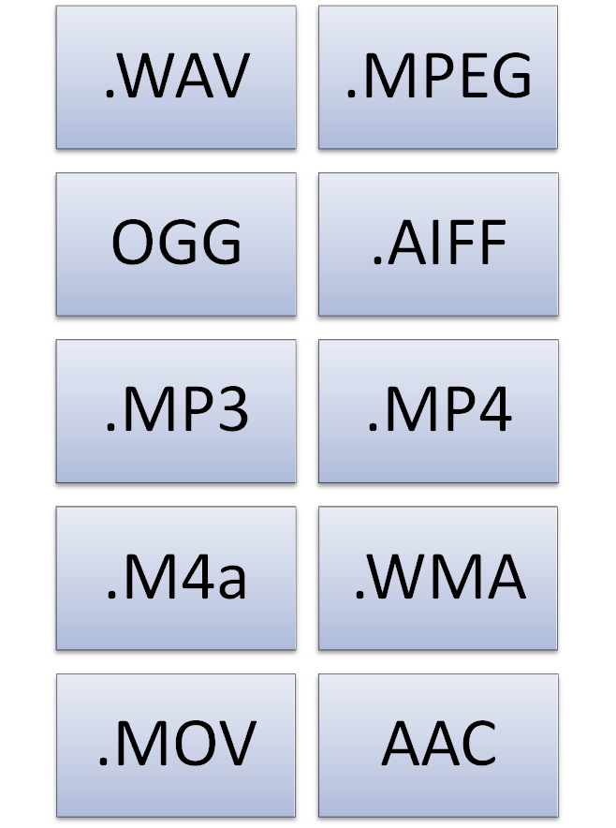
Audio File Format

Slide 27
Working with Sound
Vaughan’s Law of Multimedia Minimums :
There is an acceptable minimum level of adequacy that will satisfy the audience, even when that level may not be the best that technology , money, or time and effort can buy.

Slide 28
Working With
Sound
Brief overview of the process :
  Determine the file formats that are compatible with multimedia authoring software and the delivery medium
  Determine the sound playback capabilities
  Decide what kind of sound is needed
  Decide where and when to use either digital audio or MIDI data
  Acquire source material by creating it from scratch or purchasing it
  Edit the sounds to fit your project
  Test the sounds

Slide 29
Guidelines of The Use of Sound
Basic guidelines of the use of Sound :
  Identify the purpose of the sound
  Use high-quality sound
  Conserve file space
  Consider the playback environment
  Avoid excessive use of sound
  Organize sound files

Slide 30
SUPPORTING
MATERIAL
http://entertainment.howstuffworks.com/midi.htm
http://www.jiscdigitalmedia.ac.uk/guide/an-introduction-to-digital-audio
http://www.indiana.edu/~emusic/etext/MIDI/chapter3_MIDI.shtml

Slide 31
Exercise
Explain the function of sound wave quantize!
Calculate the file size totals that need for digital recording with specification below:
  Sampling rate = 66.2 KHz
  Bit Solution = 16 bits
  Duration = 2 minutes
  Stereo sound

