Slide 1
Course : 0553T / Multimedia System
Year : 2015
REVIEW I
Session 07

Slide 2
OUTLINE
Basic Principles of Multimedia
Text
Images
Sound
Animation
Video

Slide 3
Basic Principles of Multimedia
Multimedia :
  A woven combination of digitally manipulated text, photographs, graphic art, sound, animation, and video elements.
Interactive multimedia :
  End user can control what and when the element of multimedia are delivered
Hypermedia :
  There are structure of linked elements in the interactive multimedia through which the user can navigate

Slide 4
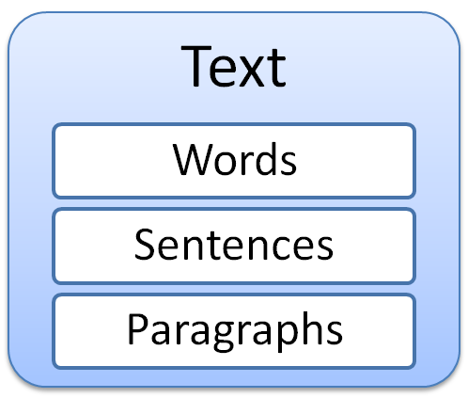
Text
Basic media for many multimedia systems
is used to communicate
thoughts, ideas and facts
in nearly every aspect of our lives

Slide 5
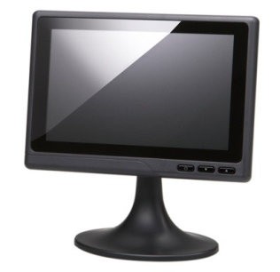
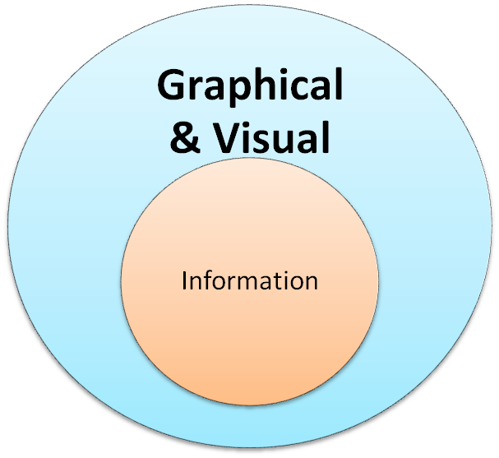

Images
What is an Image

Slide 6
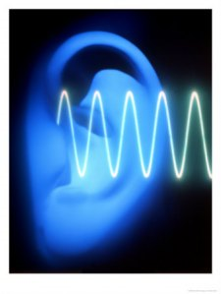
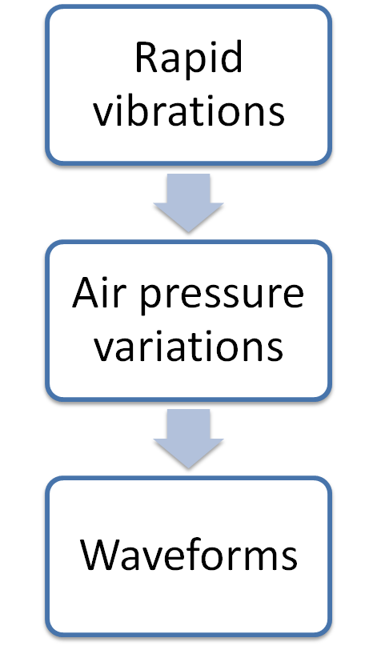
Sound
transmitted as
manifest as

Slide 7
Principles of Animation
Animation is an object actually moving across or into or out of the screen.
Animation is the primary source of dynamic action in multimedia presentation.
Quickly changing the viewed image is the principle of an animatic, a flip book, or a zoetrope.

Slide 8

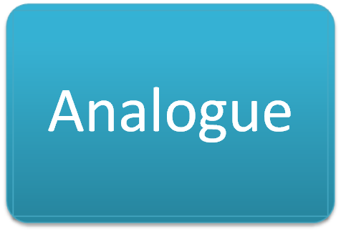

Video

Slide 9
Exercise
What is the basic principles of multimedia?
Explain the definition of text!
Describe the definition of image!
How to generate a sound?
Explain the principles of animation!
There are two type of video. Explain them briefly!

Slide 10
Q & A

