Slide 1
Course : 0553T / Multimedia System
Year : 2015
DELIVERING MULTIMEDIA
Session 11

Slide 2
OUTLINE
Introduction
Testing
Delivering on CD-ROM
Delivering on DVD
Delivering on the World Wide Web
Delivering through an App Store

Slide 3

Introduction
Testing will confirm your system requirements which is a description of the minimum platform
Example Angry Birds Star War
Source : Play.google.com

Slide 4
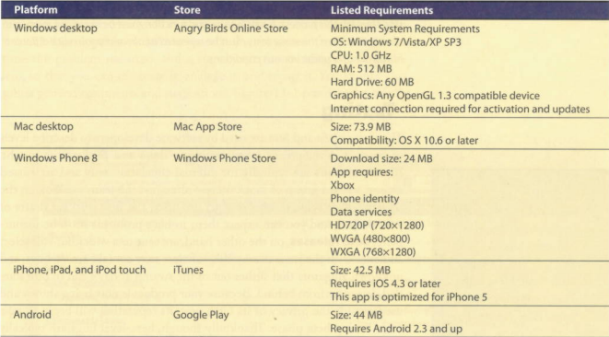
Introduction
Angry Birds’ system requirement for different platform

Slide 5
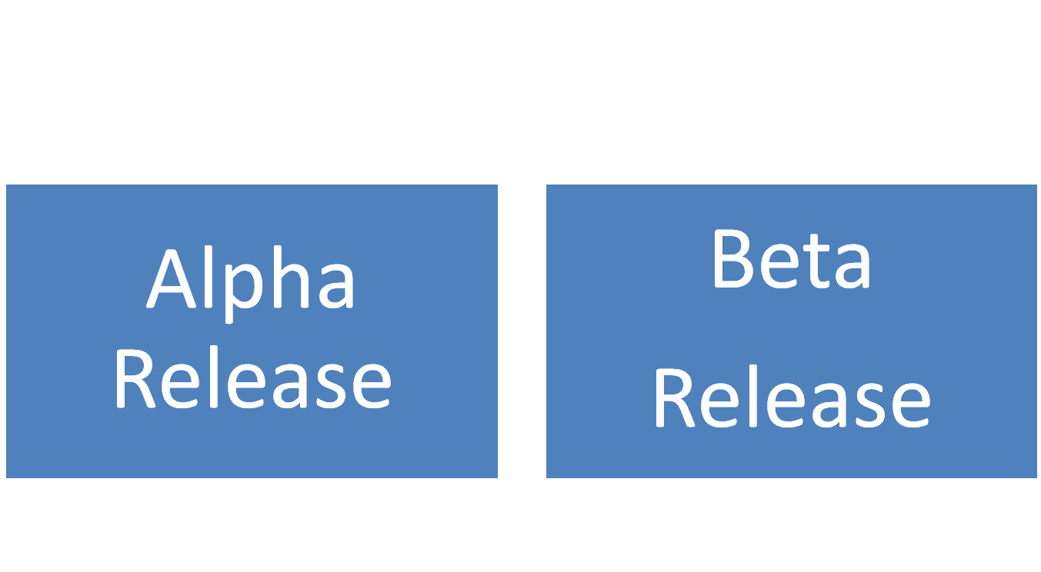
Testing
Levels of product development when testing is done and feedback is sought

Slide 6
TESTING
Alpha Release
  Typically for internal circulation only
  passed among a select group of mock users ( team working on the project)
Beta Release
  Sent to wider but still select audience with the same qualification
  May contain errors, and bugs

Slide 7
Delivering on
CD-ROM
Preparing for Delivery
  provide a single program that acts as an installer so that end users can easily and automatically set up project or application on their own computers.
The majority of multimedia projects sold into retail and business channels are delivered on CD-ROM or DVD.

Slide 8
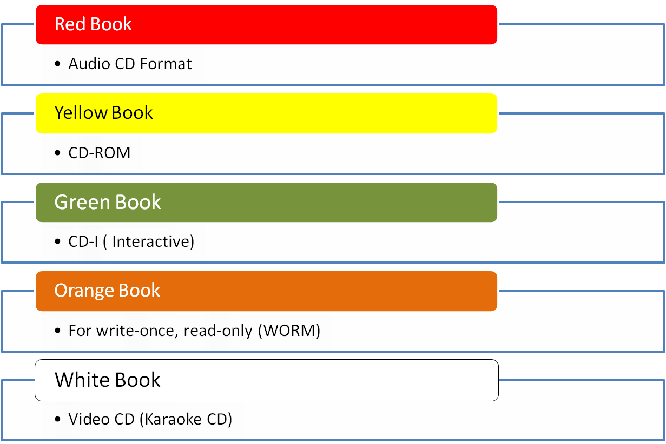
Delivering on
CD-ROM
Compact Disc Standard

Slide 9
Delivering on DVD
Delivering on DVD (Digital Versatile Discs) :
  A different (multilayer, high density) manufacturing process
  Provide 15.9GB of storage on a single disc on a single disc in :
    Double-Sided,
    Dual-Layered Format (DVD-18)
  More Common and readily are :
    Single Side
    Single Layered offering 4.37GB of storage (DVD-5)

Slide 10
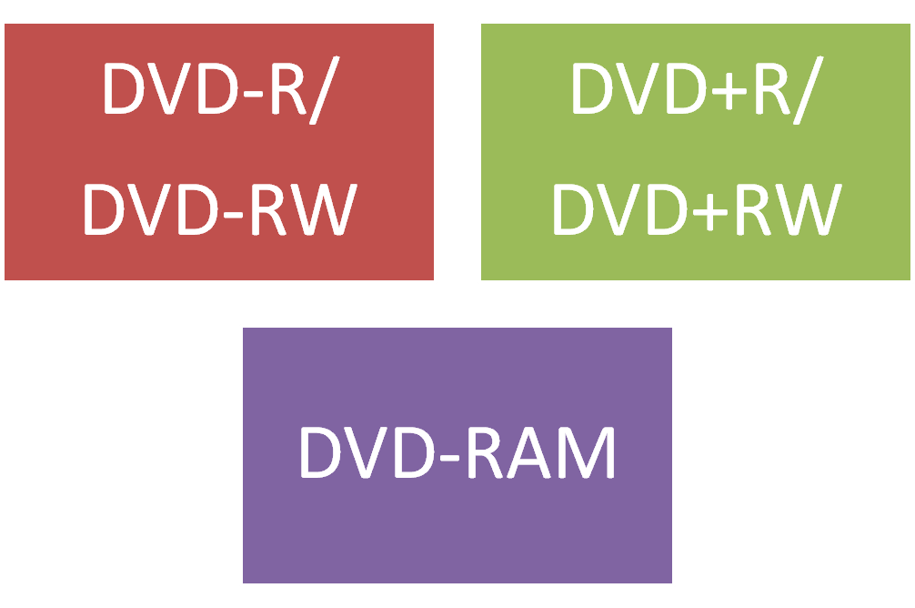
Delivering on DVD
DVD Standards :

Slide 11
Delivering on the WWW
Delivering on the World Wide Web (WWW)
  Designing, building, and testing within “web space” throughout the development of the project.
If own or host the delivery web server :
  Must have better security control
  Better integration of the project into internal LAN or Intranet
  The ability to fine-tune the server’s configuration parameters and specify and install any special software that needed.

Slide 12
Delivering on the WWW
If have control of the server :
  Provide secure commerce services for credit card transactions, encryption and passwords, special databases, and custom CGI programming.
For multimedia project requiring streaming technologies such as RealAudio or video conferencing, purchase and install the necessary software on the server.

Slide 13
Delivering on the WWW
If the project reside at a site hosted by an Internet service provider (ISP) or on a company’s own internal intranet :
  Define the host’s limitation and design the project with the limitation.

Slide 14
Delivering through an APP Store
Apps are usually available only at store within a device manufacturer’s walled garden.
Jailbreaking and rooting allow owners to install a wide variety of apps.
Platform / store owner :
  Apple
  Microsoft
  Google
  Barnes & Noble
  Amazon Kindle Fire

Slide 15
Supporting Materials
http://cemca.org.in/ckfinder/userfiles/files/Section8.pdf

Slide 16
Exercise
List ten different kinds of content that can be used to develop a multimedia project!
List the source that can get free content in the public domain!

