Slide 1
Course : 0553T / Multimedia System
Year : 2015
REVIEW II
Session 13

Slide 2
OUTLINE
Making Multimedia
Multimedia Project(Planning, Costing, Delivery and Producing)
Content and Talent
Delivering Multimedia
Multimedia Design Advanced

Slide 3
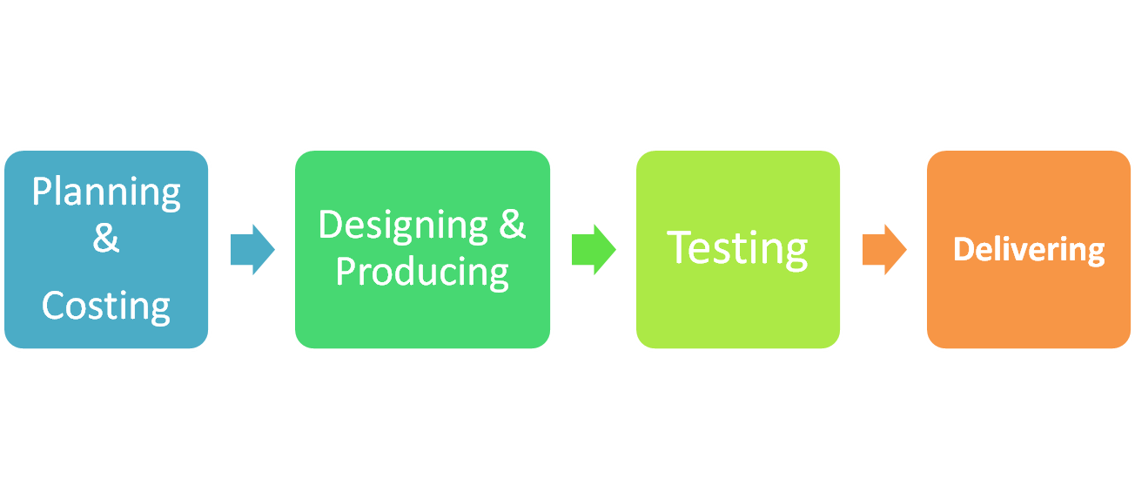
Making Multimedia
The four basic stages in a multimedia project :

Slide 4
Multimedia Project I
The stepwise process of making multimedia
The Idea
Alpha Development
Analysis
Focus
Group
Revision
Evaluation / Report
Revision
Evaluation / Report
Bail Out
Beta Development
Pretesting
Revision
Evaluation / Report
Revision
Delivery
Evaluation / Report
Bail Out
Prototype Development
Ship Product
➔
Focus
Group
Revision
Bail Out
Bina Nusantara
Evaluation / Report

Slide 5
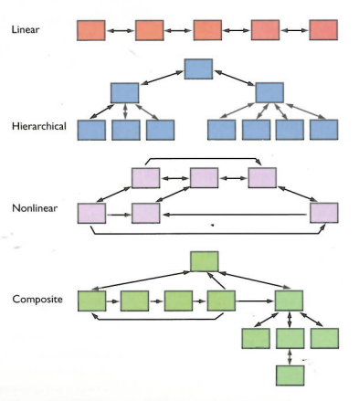
Multimedia Project II
Four Primary navigational structures used in Multimedia :

Slide 6
Multimedia Project II
The User Interface of multimedia product :
  A blend of its graphic elements and its navigation system.
There are two types of end users :
  Those who are computer literate (Expert)
  Thos who are not (Novice)
Modal Interface :
  The simplest solution for handling varied levels of user expertise

Slide 7
Content and Talent
Using Content Created by Others
  When use other’s content in a broadcast or reproduction , should be granted to its creator
  Electronic rights :
    The rights to publish a work in a computer-based storage and delivery medium such as on a DVD or on the Web.

Slide 8
Delivering Multimedia
Delivering on CD-ROM
Delivering on DVD
Delivering on the World Wide Web
Delivering through an App Store

Slide 9
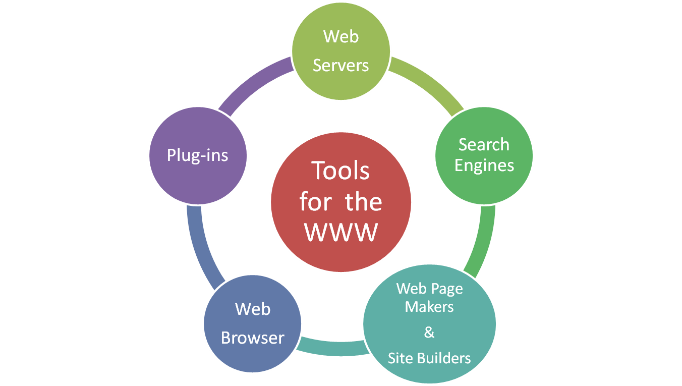
Multimedia Advanced
Multimedia on the Web

Slide 10
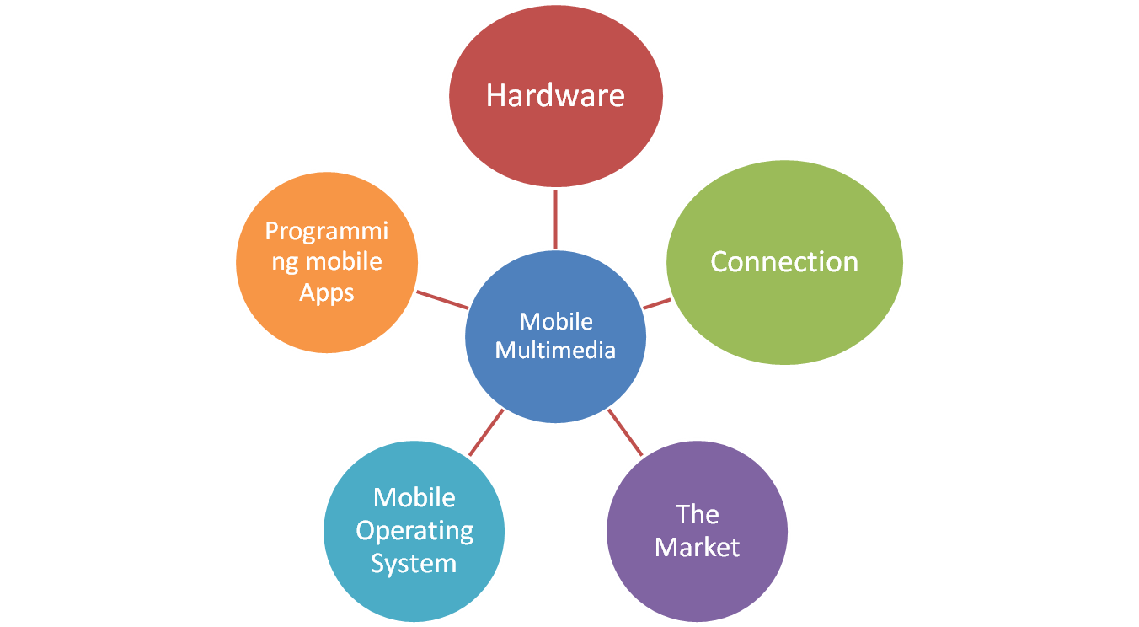
Multimedia Advanced
Mobile Multimedia

Slide 11
Exercise
Explain the process of making multimedia !
Explain the different between develop multimedia project on web and mobile !

Slide 12
Q & A

