Slide 1
Algorithm
Assessment
Go to GitHub Repository

Slide 2
Features
Generate Dungeons based on Rooms and Connected Corridors
Render Tiles over Generated Rooms
Have Morc Travel through 2 points using specified Algorithms
Pathfinding Algorithm: Recursive DFS, Breadth First, Dijkstra and A star
Block and unblock nodes and paint out connected rooms

Slide 3
Controls
Pathfinding Algorithm
U → Skip through 1000 steps (configurable) when generating path
O → Fast-forward generation
P → Pause the Pathfinding Algorithm
I → Step 1 step of the Pathfinding Algorithm
Movement
Ctrl → Speed up Morc’s Movement
Left Click → Set Destination of Morc
Right Click → Teleport Morc to node
Node Edit
Hold D + Left Click → Blocks Node
Hold D + Right Click → Unblock Node

Slide 4
Maze Generation

Slide 5
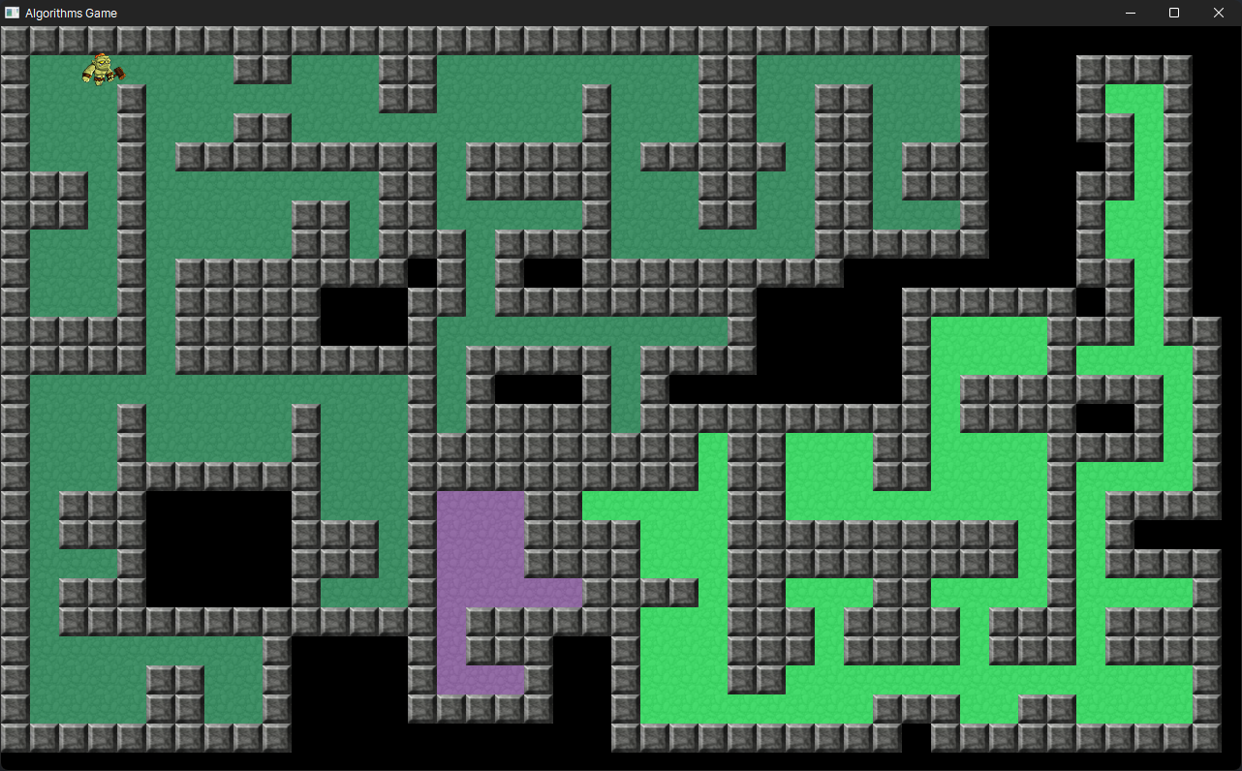
High Scale
private const int SCALE = 30;
private const int MIN_ROOM_SIZE = 2;

Slide 6
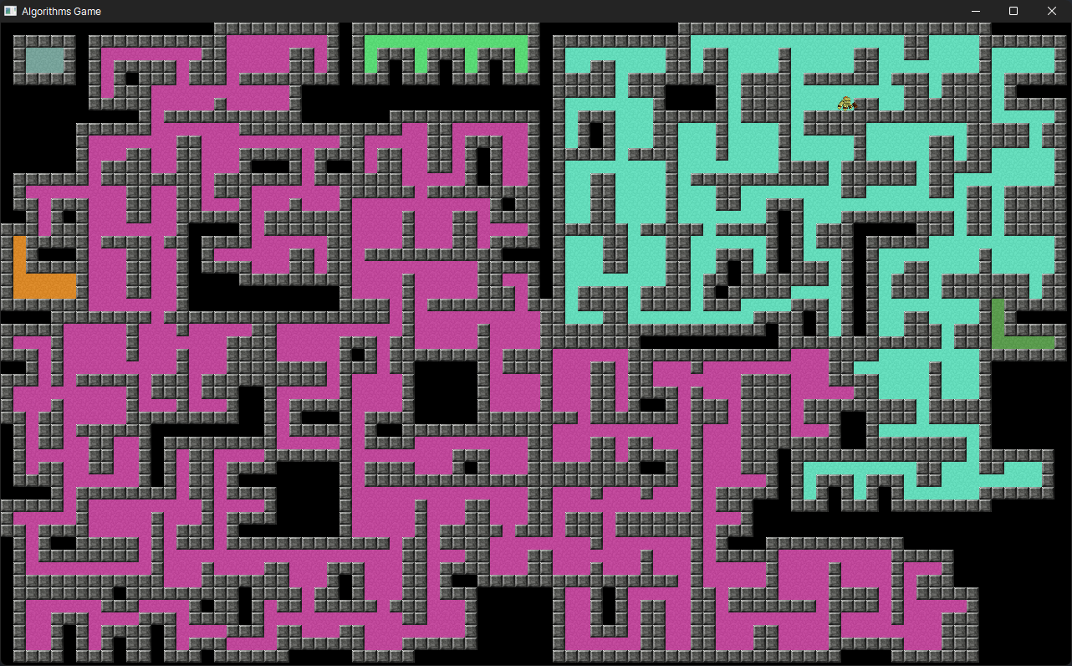
Low Scale
private const int SCALE = 15;
private const int MIN_ROOM_SIZE = 2;

Slide 7
Pathfinding Agent

Slide 8
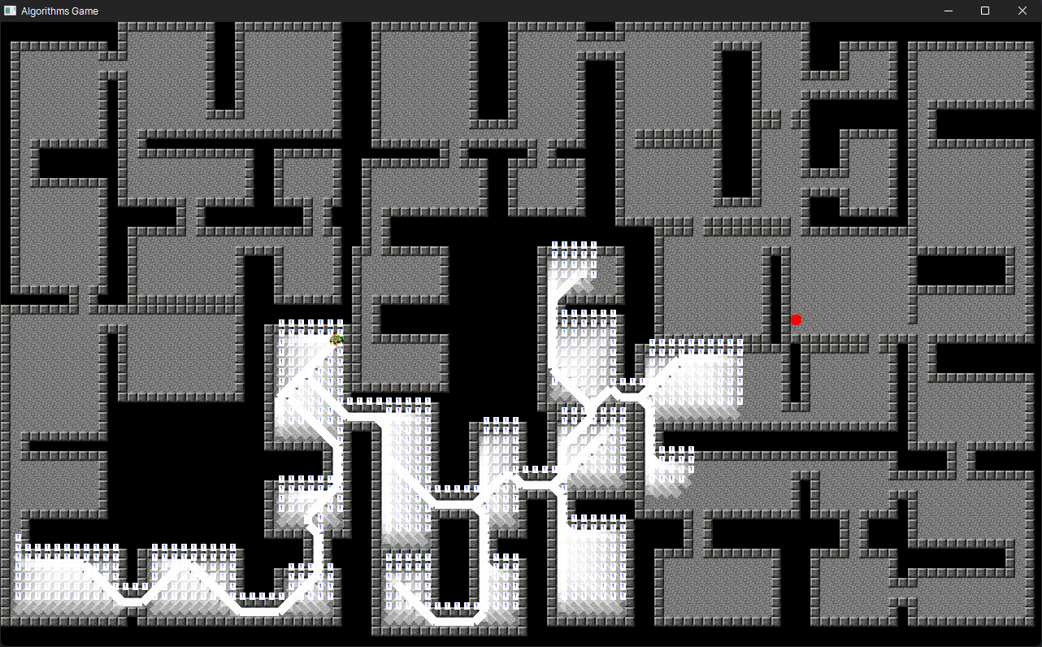
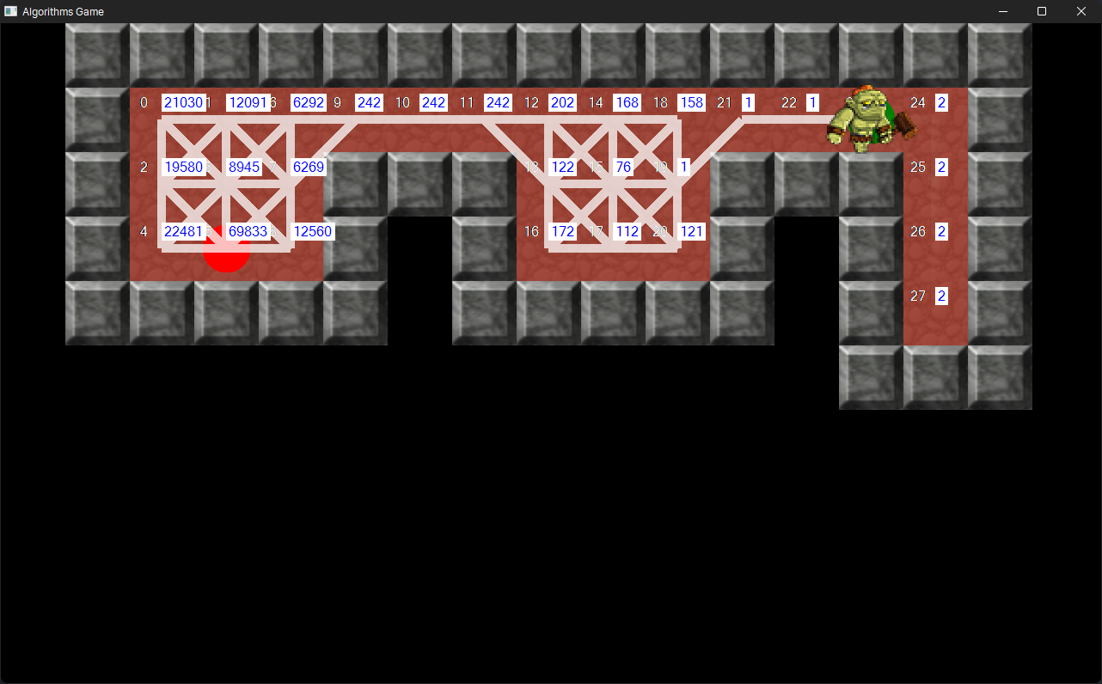
Recursive (Depth First Search)

Slide 9
Breadth First Search

Slide 10
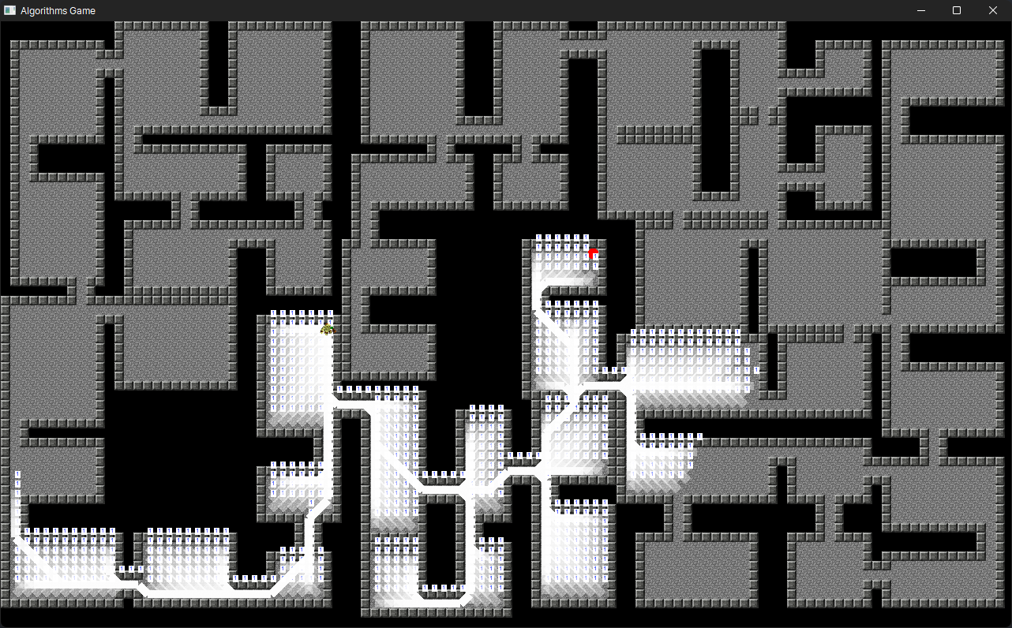
Dijkstra

Slide 11
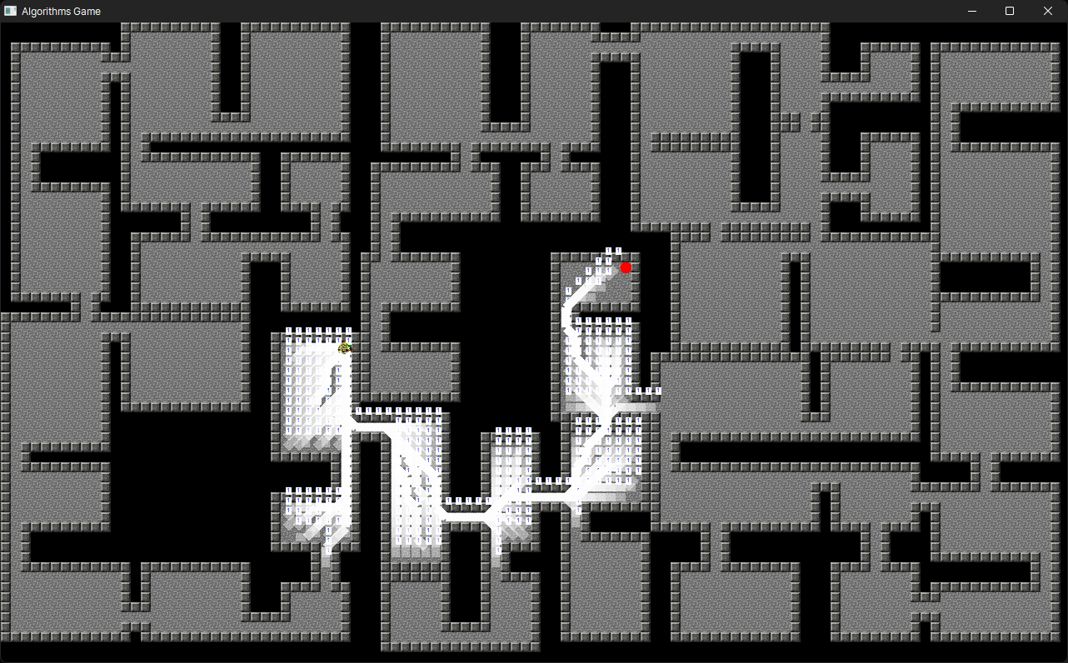
A-star

Slide 12
Code Flow (Pathfinding)
Partial Algorithm

Slide 13
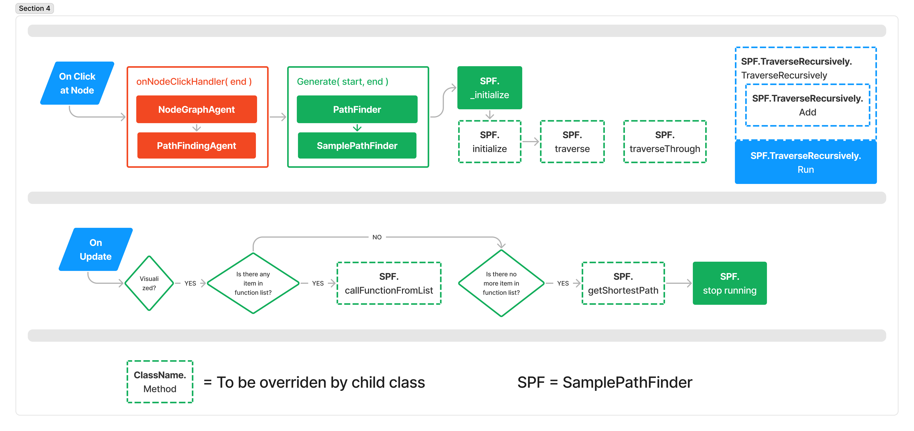
Code Flow

Slide 14
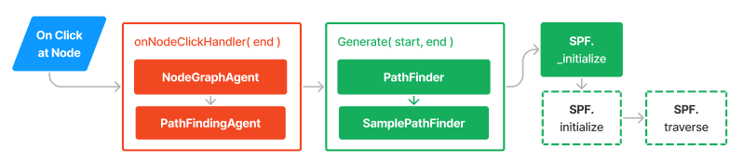
Code Flow, generally
On Generate Path,
Initialize the required variables
Check if path generation is visualized
If visualized, then traverse the node but return null (at the moment)
Set the machine as running
If not, then traverse the node and return the shortest path

Slide 15
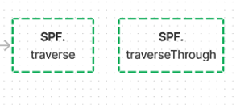
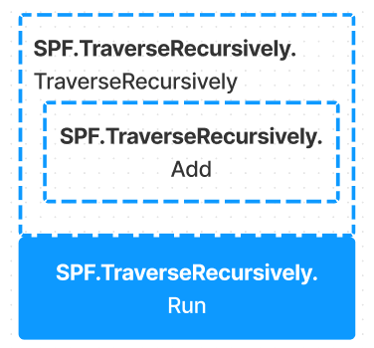
Code Flow
Traverse,
It is expected to call the TraverseThrough method
TraverseThrough
It is expected to instatiate the Function (TraverseRecursively) Object
Instantiating the TraverseRecursively Object
Creates new object,
Initialize parameter
Add this object to Static List

Slide 16
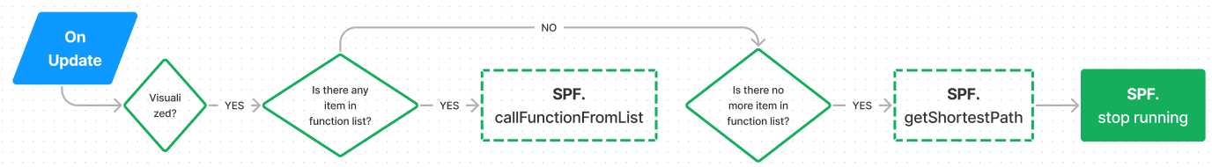
Code Flow
On Update,
Check if the path generation is visualized
If yes, check if there is any item in function list
If yes, then call function from list and remove that This depends on the data structure of child class
If no item in function list, then get shortest path.
Stop Running

Slide 17
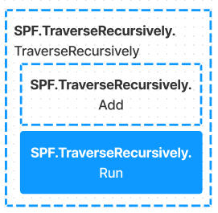

Code Flow
On Running the Function,
Register the traverse for graphical and diagnostic purposes
Add current node to travel path
Traverse using the traverse function
Remove current node from travel path

Slide 18
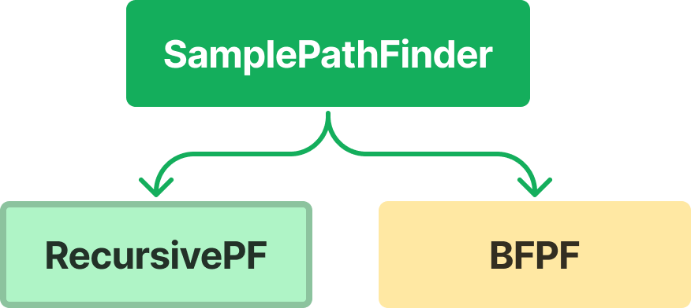
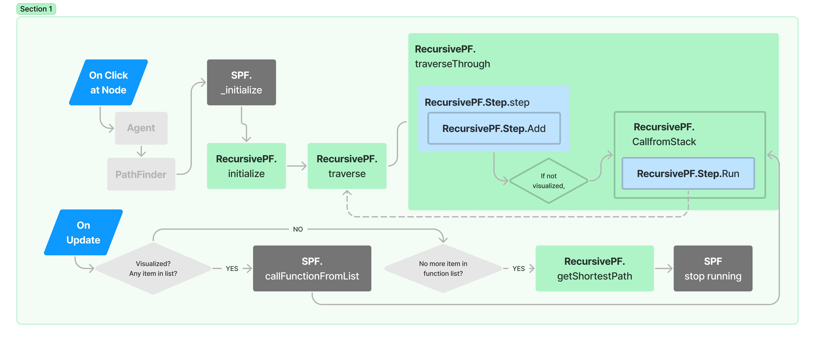
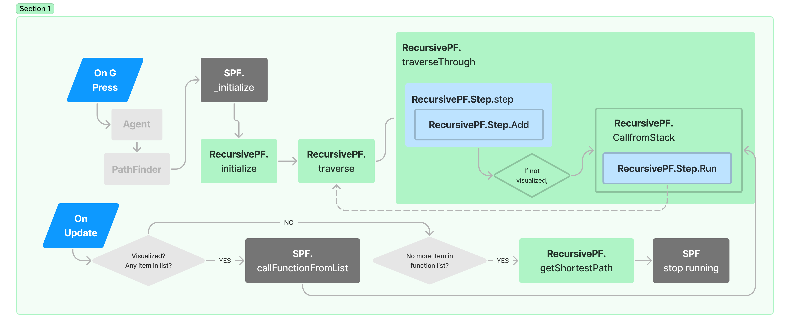
Recursive

Slide 19
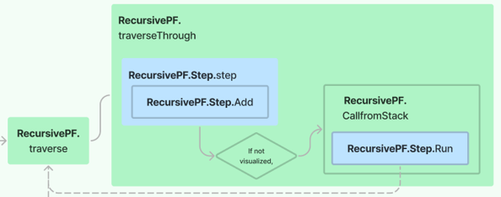
Recursive Traversal
Traverse Current Node
Foreach child node in current node
If traveled path does not contains child node
If child node is not the destination and the distance of child node is less than shortest path
Mark as the shortest node
Else, traverseThrough child Node

Slide 20
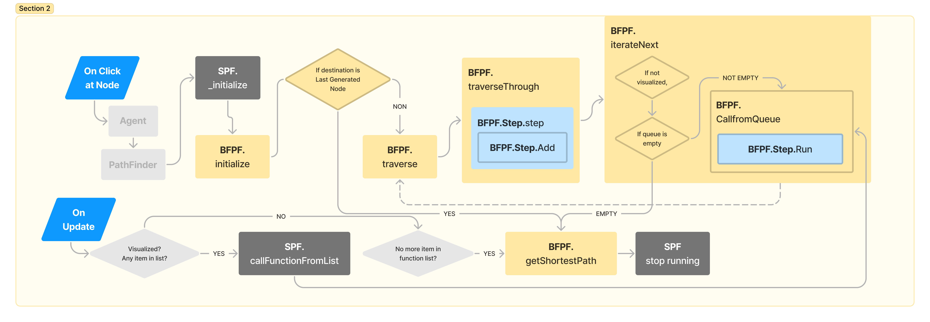
Breadth First Search

Slide 21
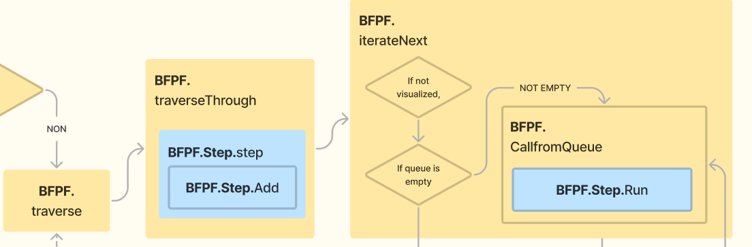
BFS Traversal
Traverse Current Node
Foreach child node in current node
If predecessor node list does not contains child node
Set predecessor node of child.
If destination is not empty (for pregeneraiton) OR child is not the destination AND predecessor node list does not contain child
TraverseThrough child
Finally, if not visualized iterate next loop.

Slide 22
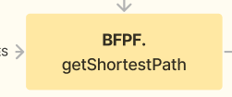
BFS Getting Shortest Path
Getting Shortest Path
Create new list of path
Start at destination path as current node
Add current node to path list
While predecessor path list does not contain current node
Set current node to the predecessor node
Check if current node is null (to stop)
If it is null, then return path.
Add this current node (which is now predecessor) to path list
If does not enter while loop means that path not found.
Return null.

Slide 23
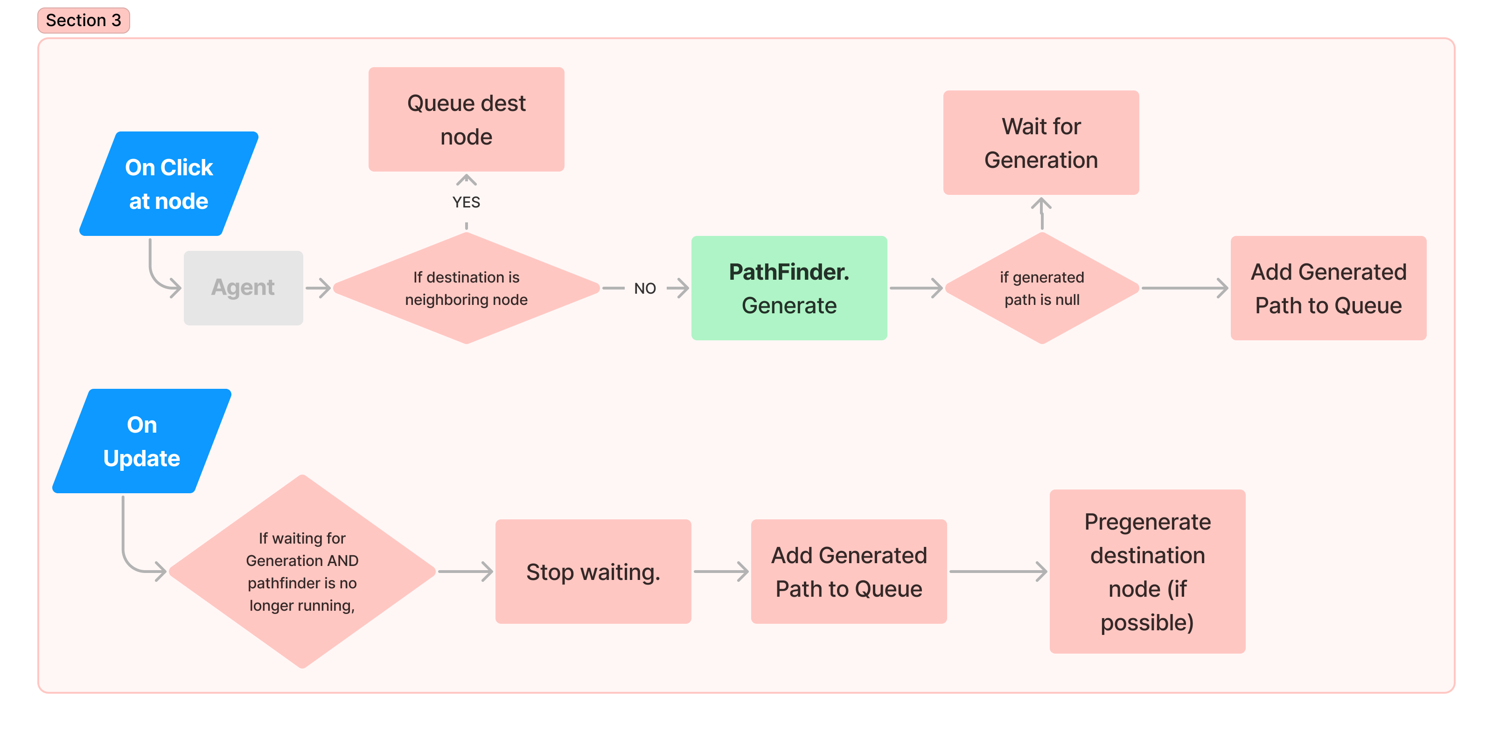
PathFinding Agent

Slide 24
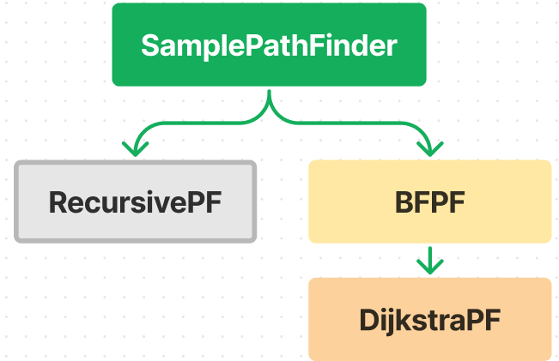
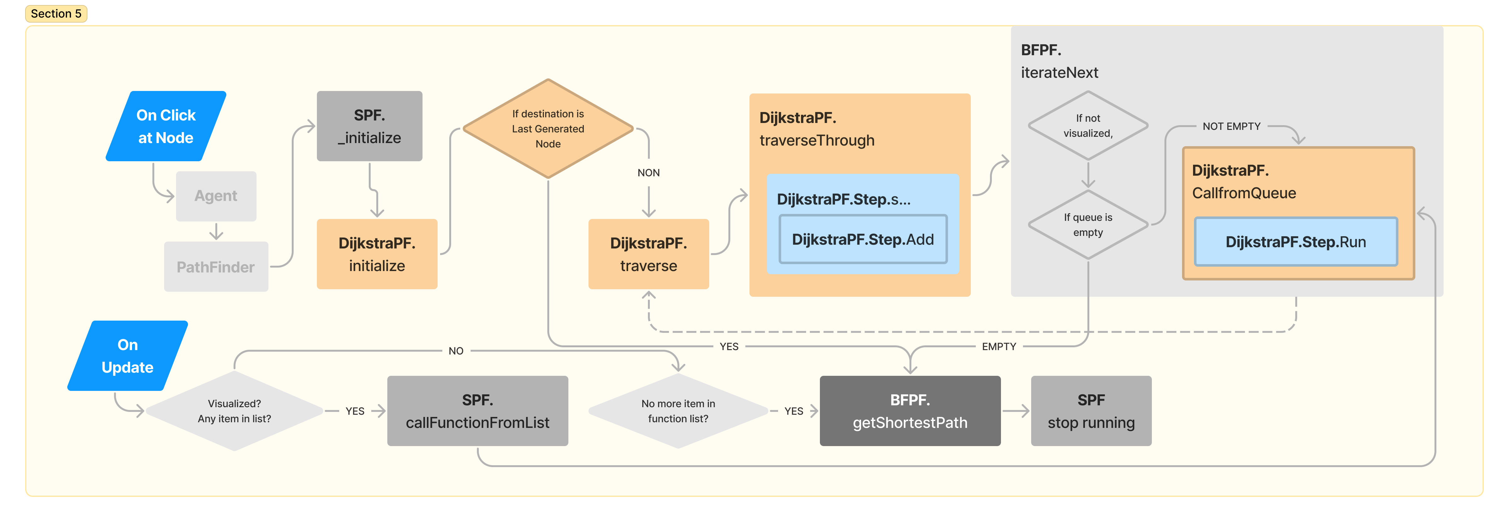
Dijkstra

Slide 25
Thank You

