Slide 1
Data Science UW
Methods for Data Analysis
SVD, More Regression and Intro to Time Series
Lecture 6
Nick McClure

Slide 2
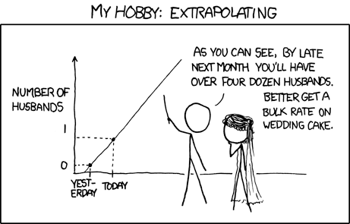

Slide 3
Topics
Review
Linear Algebra overview
Decomposition Methods
Lasso Regression
Ridge Regression
Logistic Regression
Binary Classification
Time Series

Slide 4
Review
Linear Regression
Multiple Regression
Introduction to Python / iPython
Introduction to Graph Theory
Gephi Visualization
Degree Distribution Tests

Slide 5
Linear Algebra
Matrix: a rectangular array of values, with dimensions n by m (n rows, m columns).
Vector: a one dimensional array of values (n | m = 1).
Square matrix: a n x n matrix.
Identity matrix: a square matrix with 1’s on the diagonal and 0’s elsewhere.
R demo.

Slide 6
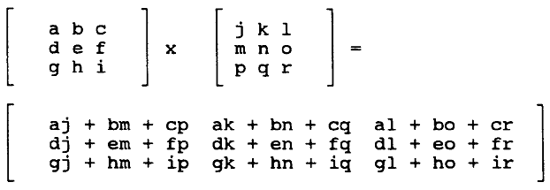
Linear Algebra
Algebraic Properties of Matrices:
Add/subtract matrices: Must be of the same dimensions
Multiplication of matrices:
Inner dimensions must match.
[n x m] * [m x p] = [n x p]
Note that matrix multiplication is not commutative

Slide 7


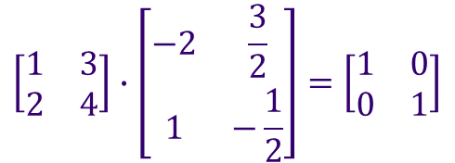
Linear Algebra
Transpose (given an element in position i,j, the transpose has the same element in position j,i.)
Inverse:
Just like the multiplicative inverse of n is 1/n, matrices also have multiplicative inverses:
$$A_{nxn}∙A_{nxn}^{−1}=I_{nxn}$$
$${A_{nxn}^{−1}∙A}_{nxn}=I_{nxn}$$
$$\left[\begin{matrix}1 & 3 \\ 2 & 4\end{matrix}\right]∙\left[\begin{matrix}−2 & \frac{3}{2} \\ 1 & −\frac{1}{2}\end{matrix}\right]=\left[\begin{matrix}1 & 0 \\ 0 & 1\end{matrix}\right]$$

Slide 8

Linear Algebra
For a 2x2 matrix:
What if (ad-bc) = 0? That means that ad=bc or a/c = b/d.
If a/c = b/d, then one of the columns is a multiple of the other!
These columns are dependent on each other.
If these were columns in our numerical data frame, then one column would be a multiple of the other.
Examples: Using Fahrenheit and Celsius as separate predictors.
$$A=\left[\begin{matrix}a & b \\ c & d\end{matrix}\right],A^{−1}=\frac{1}{ad−bc}\left[\begin{matrix}d & −b \\ c & d\end{matrix}\right]$$

Slide 9


Linear Algebra
Eigenvalues: Given a nxn matrix, A, is an eigenvalue if there exists a vector X such that:
Finding the eigenvectors of A involves lots of computation.
If A rotates and shifts a vector X, then we can think of eigenvalues as a geometric hinge on which the ‘A’ operation acts.
Eigenvalues have corresponding eigenvectors.
This may seem insignificant at the moment, but eigenvalues and eigenvectors play an important role in manipulating our data.
$$λ$$
$$AX=λX$$

Slide 10
Linear Algebra
Matrix Decompositions allow us to write a matrix, A, in many different forms.
The one that is the most used, is Singular Value Decomposition (SVD).
The SVD is a way to express a transformation from one nxn space (the space A lies in) to another nxn space by writing A as a product of three matrices.
This transformation is a type of right angle (orthogonal) transformation as we will see later.
These three matrices, say, X,Y,Z, (A = XYZ), have very specific properties that we can use to our advantage when describing a data set.
R-demo.

Slide 11
Deriving Independent Features from Dependence
With larger data sets, we’ve seen that no matter the quality, we can find a explanatory feature.
If we consider our data as a matrix, we know that having dependent columns is a problem.
Solutions:
Remove columns that do not contain enough ‘information’.
Too much missing data.
Low Variance.
Remove columns that are correlated
Maybe we can transform our axes such that our data is more independent?

Slide 12
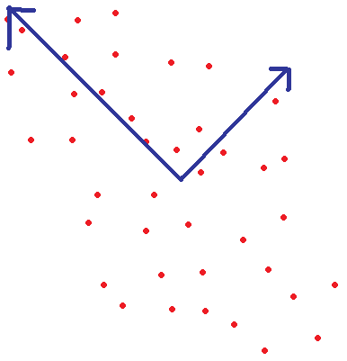
Possible Axis Transformations
If two variables are correlated, we can transform both of the axes to directions in which they are not correlated.
These new axes are called the Principal Components.
x
x'
y'
y

Slide 13
SVD
This transformation is called the Singular Value Decomposition, or SVD.
It holds true for as many features (dimensions) as we wish to choose, up to the number of original dimensions.
Each of the new axes is some function of all the old axes.
The SVD assures us that:
The first axis explains the most variation, the second axis the most variation after the first, and so on.
All axes are right-angled to each other (orthogonal).
Usually, we keep less than the original amount of axes, so that we can reduce the amount of dimensions we have to keep track of.

Slide 14

SVD
Know that instead of our original system:
We now have the system:
The f functions are called our principle components.
The f function outputs are guaranteed to be independent of each other.
We can no longer interpret our linear model coefficients!
$$y_{i}=β_{0}+β_{1}x_{1}+β_{2}x_{2}+…$$
$$y_{i}=β_{0}+β_{1}{f_{1}(x}_{1},x_{2}, …)+β_{2}{f_{2}(x}_{1},x_{2}, …)+…$$

Slide 15
SVD
SVD returns the same amount of components as our number of features.
Since these are all orthogonal, the first few will explain much more variance than the last few axes. How do we decide how many to keep?
We look at the magnitude of the associated eigenvalues for each principal component.
R-demo.

Slide 16
SVD
This seems like an awful lot of work for little improvement and loss of interpretability.
But note that we lost the dependence in the data set!
There are other applications as well…

Slide 17
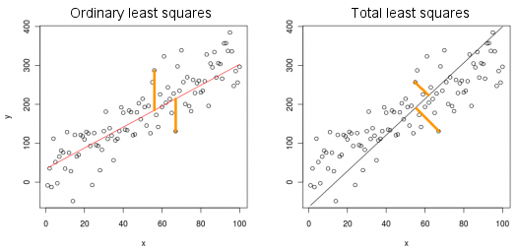
SVD, as a type of regression
Also, looking at the first principal component, we can consider SVD as a new type of regression, which is called total least squares. (Also called Deming regression or PCA Regression)
R demo
Regressing y on x
SVD Primary Principal Component

Slide 18
SVD, as a type of regression
When to use total least squares:
If we want to control for error in x as well as y.
We are minimizing the distance from the point to the line as opposed to the distance between the y-values.
R-squared doesn’t really apply here, at least in the way we have defined it.

Slide 19
SVD, as a way to compress information
We can group together similar points via SVD and store them as multiples of principal components.
R-demo.

Slide 20
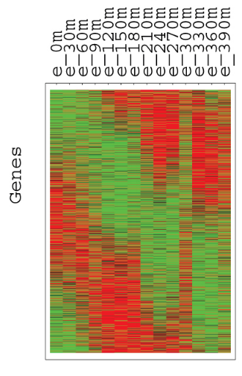
SVD, as a way to cluster data
We can group together similar points via which SVD component is closest to representing original point.
One of the most common uses is clustering individuals or genes as it pertains to RNA expression.
In the microarray to the right, red represents absence of expression and green represents over expression.
Each row is a gene (thousands of them) and each column is a sample (or patient).

Slide 21
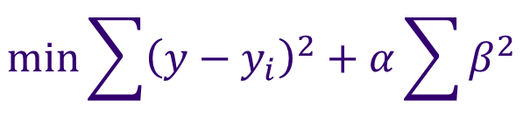
Ridge Regression
Ridge regression is a way to limit the amount of independent variables in the regression.
Our regular least squares criterion minimizes the least squares of the error plus a regularization term that is a product of a constant and the sum of squared coefficients :
Essentially this is preventing the partial slope terms from getting too large.
$$min⁡\sum{{\left(y−y_{i}\right)}^{2}+α\sum{β^{2}}}$$

Slide 22



Lasso Regression
Lasso regression is another way to limit the amount of independent variables in the regression.
Our regular least squares criterion minimizes the least squares of the error:
Lasso regression minimizes the same with the addition of a ‘regularization’ term:
Here, y is the predicted for j points. There are i terms with beta coefficients. Lambda is a fixed value that limits the betas.
$$min⁡\sum{{\left(y−y_{i}\right)}^{2}}$$
$$min⁡\sum{{\left(y−y_{j}\right)}^{2}}$$
$$\sum{\left|β_{i}\right|}<λ$$
Such that

Slide 23
Using Linear Regression to Predict Limited Dependent Variables
Let’s say we wanted to predict if someone evacuated their home during hurricane Katrina.
R demo.

Slide 24
Logistic Regression
The purpose of logistic regression is to use linear regression to predict a limited dependent variable.
Usually our dependent variable has 2 outcomes (1 or 0) or occurrence.
Examples:
Bank gives a yes (1) or no (0) outcome to loan applications.
Success/Failures of clinical trials.
Morbidity outcomes.
Marketing outcomes (will a user click on an add).
Logistic predictions will result in a probability of success.

Slide 25
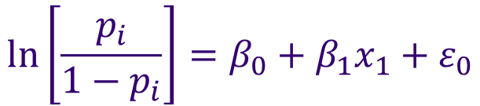

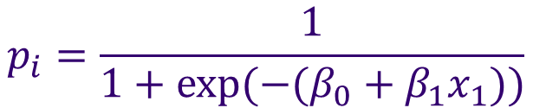
Logistic Regression
Logistic regression is also called the ‘logit’ model:
Original model:
Logit model:
So estimated probabilities follow: (solving for p)
$$y_{i}=β_{0}+β_{1}x_{1}+ε_{0}$$
$$ln⁡\left[\frac{p_{i}}{1−p_{i}}\right]=β_{0}+β_{1}x_{1}+ε_{0}$$
Log-odds-ratio
$$p_{i}=\frac{1}{1+exp⁡({−(β}_{0}+β_{1}x_{1}))}$$

Slide 26
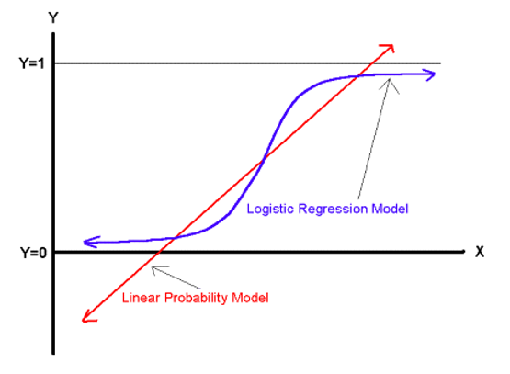

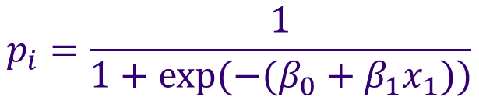


Logistic Regression
$$p_{i}=\frac{1}{1+exp⁡({−(β}_{0}+β_{1}x_{1}))}$$
As gets really big, p approaches 1.
As gets really small, p approaches 0.
$$(β_{0}+β_{1}x_{1})$$
$$(β_{0}+β_{1}x_{1})$$
$$\frac{1}{1+exp⁡(−x)}$$

Slide 27
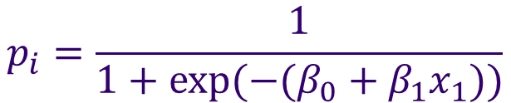
Logistic Regression
Differences between linear and logistic regression.
Predictions
Linear regression outcomes are unbounded.
Logistic regression outcomes are bounded between 0 and 1.
Error distribution
Linear regression errors are normally distributed.
Logistic regression errors are Bernoulli distributed.
R demo
$$p_{i}=\frac{1}{1+exp⁡({−(β}_{0}+β_{1}x_{1}))}$$

Slide 28

Time Series Modeling
Time series measurements are represented by observations over time:
Stochastic Process is a process that evolves over time.
Regular statistical analysis is concerned with estimations of repeated samples.
With time series, we usually cannot measure repeatedly and have to observe over time how something changes.
E.g.: Mortality Rate, Temperature, …
A stochastic process is said to be ‘stationary’ if there is no trend in the data.
This is a nice assumption because it implies the correlation of a process is fixed over time. I.e. any two points should have the same relationship.
$Y=(Y_{1},Y_{2},Y_{3}$,…, $Y_{T})$

Slide 29
Time Series Modeling
Fields dedicated to time series:
Dynamical Systems
Population growth, radioactive decay, chemical reactions,…
Signal Processing
De-noising, deblurring…
Operations Research
Industrial processes, quality control,…
Financial Analysis/Mathematics
Financial Assets, Economic Indices,…
Time Series Analysis Objectives
Estimate True values in the presence of noise or trend
Forecast future values

Slide 30
Time Series Modeling
Representations
Continuous Functions: Solutions to ODEs, PDEs…
Random processes
A collection of random variables that depend on the previous observation.
Sum of Periodic functions
Daily Trend + Weekly Trend + Seasonal Trend + …
Arbitrary function of historical values
Moving Average, weighted averages, …

Slide 31



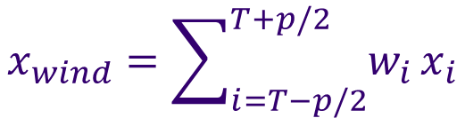

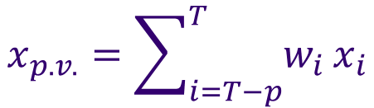
Moving Average
Given data in the from where
Past value smoothing
Based on a set of past values.
Moving window smoothing
Based on a surrounding window from current point
Moving averages suffer from lag and smoothing extremes (amplitude error).
Moving averages are very sensitive to the window lengths
R-demo
$$\left(t_{i},x_{i}\right)$$
$$t_{i}<t_{i+1}$$
$$x_{p.v.}={\sum_{i=T−p}^{T}{w_{i}}x}_{i}$$
$$\sum{w_{i}}<1$$
$$x_{wind}={\sum_{i=T−p/2}^{T+p/2}{w_{i}}x}_{i}$$
$$\sum{w_{i}}<1$$

Slide 32
Assignment
Complete Homework 6:
Perform Lasso-Logistic Regression on a subset of Microarray data.
Description, dataset and homework hint on Moodle.
Data comes from:
http://www.ncbi.nlm.nih.gov/pubmed/21532620
You should submit:
A R-script.
Read Introduction to Data Science, Chapter 16.
Read two articles about p-values and reproducible research.

