Slide 1
Data Science UW
Methods for Data Analysis
Introduction and Data Exploration
Lecture 1
Nick McClure

Slide 2
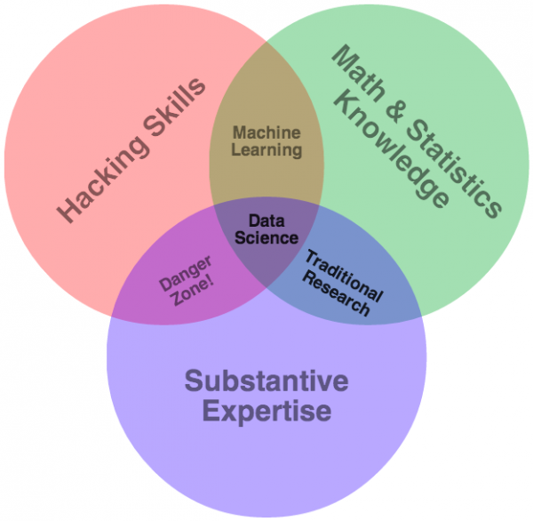

Slide 3
Course Purpose
This course isn’t designed to make you an expert
This course is designed to point you in the right direction
Course Objectives:
Statistical tools for data exploration
The use of R to apply these tools to real data
Using inferential statistics to interrogate data
Testing and experimental design
Bayesian and classical statistics
See syllabus for more information

Slide 4
Course Outline

Slide 5
Course Requirements and Grading
This course will be graded by attendance, homework, and an individual project.
Attendance: You MUST attend at least 8 out of 10 classes. This is non-negotiable, a UW requirement.
Homework must be completed by the start of the next class. (Assigned weeks 1-8).
Returned as a 0,1, or 2.
0 = Not done or a major part wrong/missing.
1 = Completed, but missing or got wrong 1 or 2 parts.
2 = Completed with at most minor issues. Demonstrates full understanding of subject.
Individual Project: Due at the start of the last class.
Counts as 8 points.

Slide 6
Course Requirements and Grading
There is a total of 24 possible points. (16 pts for hmk + 8 project)
Must get 18 total points to pass.
4 homework assignments must be made in a production level script (every other one = 1,3,5,7).
4 homework assignments are regular script writing (every other one = 2,4,6,8).
The individual project must be production level code.

Slide 7
Office Hours and Contact Information
List of ways to contact me:
nickmc@uw.edu
Linkedin group
When I’m usually available:
Off/on for simple things during work. (M-F 8am-5pm PST)
Tuesday-Thursday 7pm-10pm.
Sunday various afternoon/evening times.
Emergency contact: 402-980-3192

Slide 8
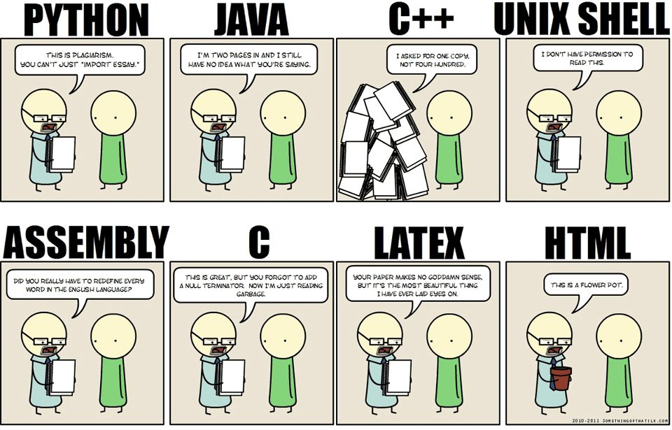
Review

Slide 9
R Review
R resources:
R page:
http://www.r-project.org/other-docs.html
Stackoverflow:
http://www.stackoverflow.com
‘Little’ R intro:
http://cran.r-project.org/doc/contrib/Rossiter-RIntro-ITC.pdf
Quick R:
http://statmethods.net/
There are many tutorials available online, e.g.,
http://cyclismo.org/tutorial/R/
Notes from a two day course at UW:
http://faculty.washington.edu/tlumley/Rcourse/
Google’s Style Guide:
http://google-styleguide.googlecode.com/svn/trunk/google-r-style.html

Slide 10

Statistics Review
Familiar Concepts:
Discrete vs. Continuous Distributions
Probability
y = mx + b vs
This area is the emphasis of the course.

Slide 11
SQL Review
SQL (to know):
Create tables
Drop tables
Joins (Inner, outer, right, left)
Temp tables
Coalesce, Cast, Case
(Accessing SQLite in R Demo)
Access to SQLite Files:
Windows: http://www.yunqa.de/delphi/doku.php/products/sqlitespy/index
Mac OS X: https://www.sqlitepro.com/

Slide 12

Counting Review
Factorials
Count # ways to order N things = N!
Permutations
Count # of ways to order R things from N things = N!/(N-R)!
Ordering matters
P(N,R)
Combinations
Count # of ways to group R things from N things = N!/(R!(N-R!))
Ordering doesn’t matter
C(N,R) or
$$\left(\begin{matrix}N \\ R\end{matrix}\right)$$

Slide 13
Data Distributions (Discrete)
Discrete Distribution Properties
Sum of all events must equal 1.
Probability of event equal to value of distribution at point.
No Negative values or values greater than 1.

Slide 14
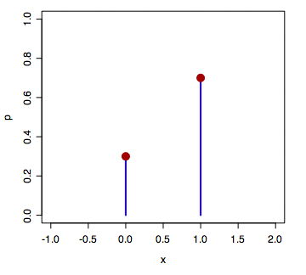
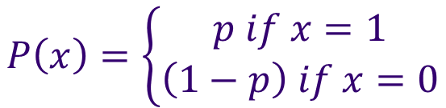


Data Distributions (Discrete)
Bernoulli (1 event, e.g.: coin flip)
Mean = p
Variance = p(1-p)
$$P\left(x\right)=\left\{\begin{aligned}p if x=1 \\ \left(1−p\right) if x=0\end{aligned}\right.$$
$$P\left(x\right)=p^{x}{(1−p)}^{(1−x)}$$
$$x∈\{0,1\}$$

Slide 15
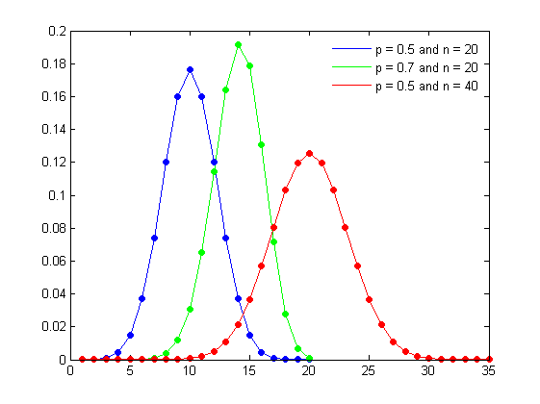
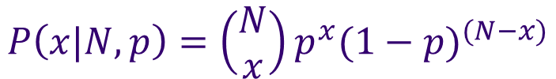
Data Distributions (Discrete)
Binomial (Multiple Bernoulli's Events)
Multiple Independent events = Product of Bernoulli Probabilities
Mean = np
Variance = np(1-p)
$$P\left(x|N,p\right)=\left(\begin{matrix}N \\ x\end{matrix}\right)p^{x}{(1−p)}^{(N−x)}$$
Note: for larger n, we approximate this by a normal distribution.

Slide 16
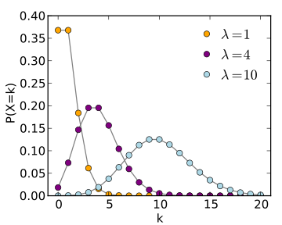

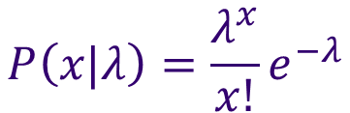

Data Distributions (Discrete)
Poisson (Count of number of events in a time span)
Mean =
Variance =
$$P\left(x|λ\right)=\frac{λ^{x}}{x!}e^{−λ}$$
$$λ$$
$$λ$$
Interpret as the rate of occurrence of an event is equal to lambda in a finite period of time.

Slide 17
Data Distributions (Continuous)
Continuous Distribution Properties
Area under the curve must be equal to 1.
Probability of event equal to AREA under curve.
No negative values.
Probability of a single, exact value is 0.

Slide 18
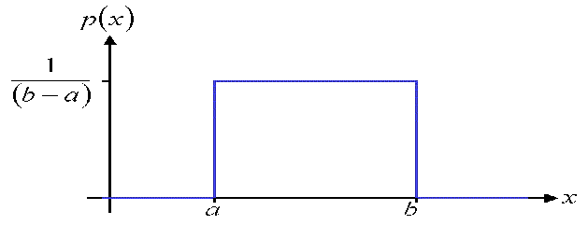

Data Distributions (Continuous)
Uniform (flat, bounded)
Very useful for parameter priors. (future discussion)
Mean=(a+b)/2
Variance=(1/12)(b-a)^2
$$P\left(x\right)=\left\{\begin{aligned}\frac{1}{(b−a)} if a≤x≤b \\ 0 if x<a or x>b\end{aligned}\right.$$

Slide 19
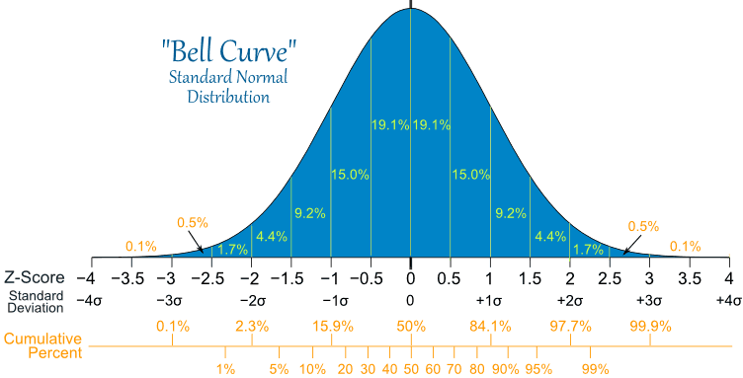
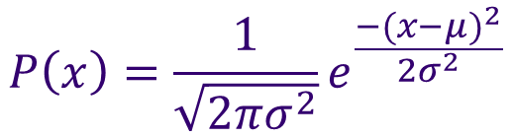
Data Distributions (Continuous)
Normal (Gaussian) distribution
Most common and occurs naturally.
Defined by a mean and variance only. (standard = N(0,1))
Has very nice properties.
Tests for normality are very important.
$$P\left(x\right)=\frac{1}{\sqrt{2πσ^{2}}}e^{\frac{−{(x−μ)}^{2}}{2σ^{2}}}$$

Slide 20
Data Distributions (Continuous)
Student’s T (normal for small samples)
Important for hypothesis testing smaller sample sizes.
Used for:
Testing of mean value when st. dev. is unknown.
Testing difference between two distribution means.
Looks very similar to the normal distribution.

Slide 21
Data Exploration (Descriptive Statistics)
Purpose: To gain a clear understanding of your data.
How large is it?
What columns are of interest?
Missing data?
Outliers?

Slide 22
Numerical Exploration
str(): structure of the data frame
summary(): summary of each of the columns
head() / tail(): top / bottom of data frame
table(): frequency table

Slide 23
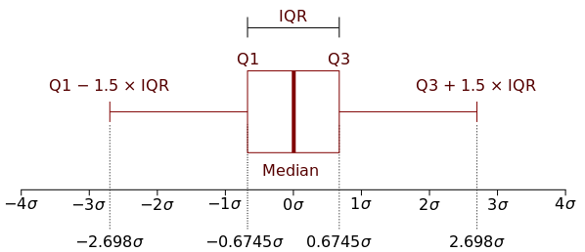
Numerical Exploration
IQR(): inner quartile range (Q3 – Q1)

Slide 24
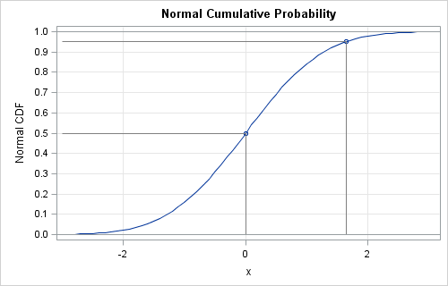
Numerical Exploration
quantile(): quantiles of numerical vectors
Quantiles are inverse values of the CDF (cumulative distribution function).
Standard Normal: (shown in figure)
Quantile(0.5) = 0, means at x=0, 50% of the distribution lies to the left. (This is also the median)
Quantile(0.95) = 1.65

Slide 25
Numerical Exploration
Relationships:
cov(): covariances
Interpretation: Expected value of the differences between x and y and their corresponding mean.
E.g. if x is above it’s mean when y is also above it’s mean, then they will have a high covariance.
Highly interpretable, but not bounded.
$$cov\left(x,y\right)=E\left((x−μ_{x})(y−μ_{y})\right)$$

Slide 26
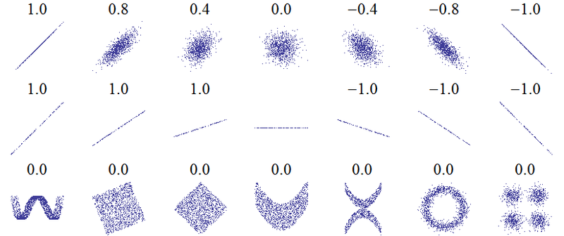
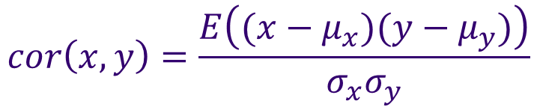
Numerical Exploration
Relationships:
cor(): correlations (pearsons)
Bounded between 0 and 1.
Not as interpretable.
$$cor\left(x,y\right)=\frac{E\left((x−μ_{x})(y−μ_{y})\right)}{σ_{x}σ_{y}}$$

Slide 27
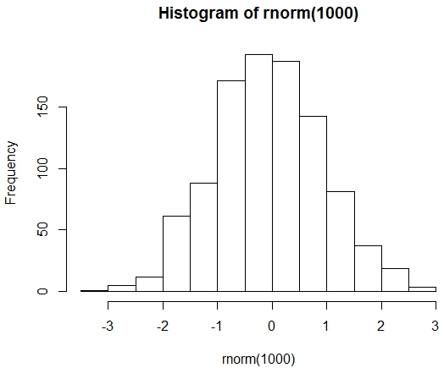
Visual Exploration
Histograms:
Base:
hist()
ggplot2:
+ geom_histogram()

Slide 28
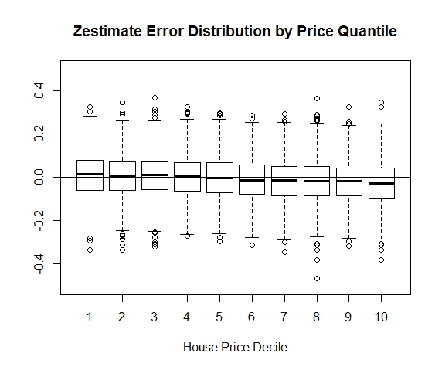
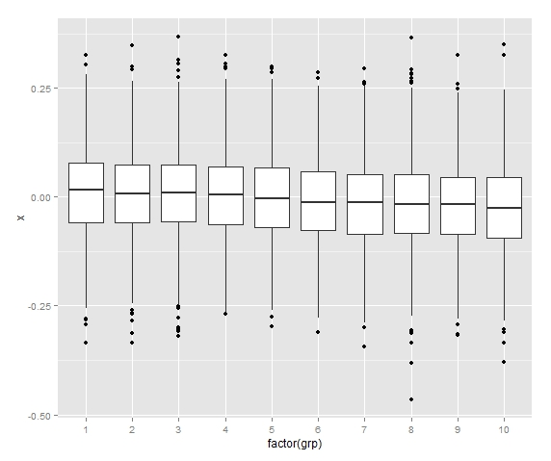
Visual Exploration
Boxplots:
Base:
boxplot()
ggplot2:
+ geom_boxplot()

Slide 29
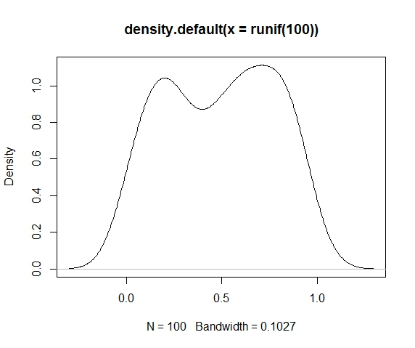
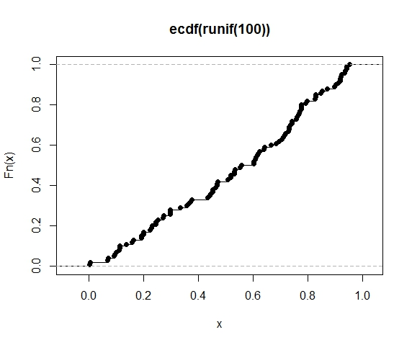
Visual Exploration
Densities/CDFs:
Base:
plot(density())
plot(ecdf())
ggplot2:
+ geom_density()
+ stat_ecdf()

Slide 30
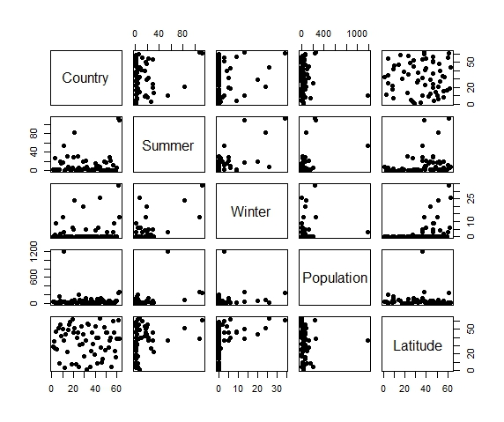
Visual Exploration
Scatterplots
Base:
pairs()
ggplot2:
ggpairs()

Slide 31
Distribution Transformations
The purpose of transforming a variable is to make it easier to distinguish between values.
Most commonly we are looking to transform a distribution to be normal.
Common Transformations
Log-based:
Log(x), log(x+1), log(x-min(x) + 1)
N-th Root based:
X^(1/n)
Any combination you can think of (remembering math rules).
We will cover normality tests in a later class.

Slide 32
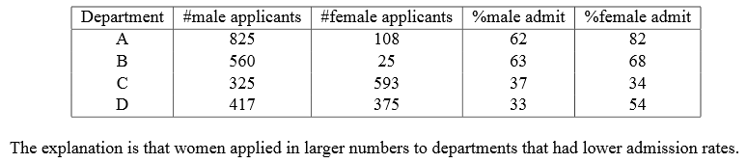
Simpsons Paradox
Slicing up data in different ways can create different results.
http://vudlab.com/simpsons/

Slide 33
Production Level Scripts
Logging
Functionalize everything possible
interactive()
R-example: Weather Scraping R script

Slide 34
Assignment
Go to:
Vote for extra topics (time permitting)
Complete Homework 1:
Explore ‘JitteredHeadCount.csv’, a data set from Caesar’s Entertainment that has falsified/jittered table headcounts.
Write production level script that shows/illustrates 3 key takeaways of your choosing from exploring the data.
You should submit:
ONE R-script.
One word document with 5 key points. (example next page).

Slide 35
Example Takeaway
The aggregate table headcounts on the weekends are X% higher than non-weekends (figure 1). In fact, the game that has the highest difference between average highs and average low days is Gamecode AA with a difference of 5.71 heads/table.

