Slide 1
Data Science UW
Methods for Data Analysis
Probability and More on Distributions
Lecture 2
Nick McClure

Slide 2
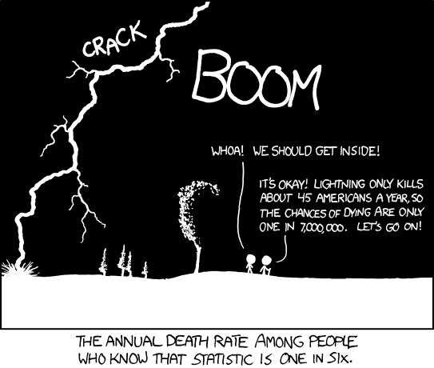

Slide 3
Topics
Review
Counting
Axioms of Probability
Probability Examples
Conditional Probability
More on Distributions

Slide 4
Review
Distributions
Discrete: Bernoulli, Binomial, Poisson
Continuous: Uniform, Normal, Student’s T
Numerical and Visual Exploration of Data
Transformations
Simpson’s Paradox
R Code Examples
R Review
Numerical/Visual Exploration of Distributions
Weather_retrieval.R as a production level script

Slide 5
Counting
This is one of the biggest areas of mathematics, called Combinatorics.
Example:
Subway has 4 different breads, 5 different meats, 4 different toppings. How many sandwich combinations?
How many different 4-beer tasters can I have in a bar with 10 beers on tap?
Solve these using the ‘Multiplication Principle’.
(See board for solutions)

Slide 6
Multiplication Principle
If there are A ways of doing task a, and B ways of doing task b, then there are A*B ways of completing both tasks.
Example:
If I have 5 books, how many ways can I order them on the bookshelf?
= 5 factorial = 5! = 120
5 choices *
4 choices *
3 choices *
2 choices *
1 choice
1st book
2nd book
3rd book
4th book
5th book

Slide 7
Factorials
Factorials
Count # ways to order N things = N!
Factorials get VERY large quickly.
21! Is larger than the biggest long-int in 64 bit.
21! = 5.1E19
Biggest long int (64 bit) = 9.2E18
Fun fact, every 52 card shuffle is highly likely to be the only time that shuffle has ever occurred.

Slide 8

Counting Subgroups
Revisit: 10 beers on tap, need a sample of 4 different beers.
Let’s assume order matters, i.e., Amber-Stout-Porter-Red is different from Red-Porter-Stout-Amber.
Use ‘Permutations’ (pick):
$$10∗9∗8∗7=\frac{10!}{6!}=\frac{10!}{\left(10−4\right)!}=10P4=P(10,4)$$

Slide 9



Counting Subgroups
Now, Let’s assume order doesn’t matter.
Use ‘Combinations’ (choose):
$$10∗9∗8∗7=\frac{10!}{6!}=\frac{10!}{\left(10−4\right)!}=10P4=P(10,4)$$
$$\left(\# of orderings of 4 beers\right)=4!$$
$$=\frac{10!}{4!\left(10−4\right)!}=10C4=C\left(10,4\right)=\left(\begin{matrix}10 \\ 4\end{matrix}\right)$$

Slide 10
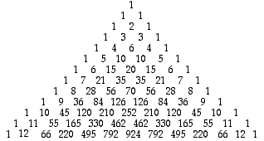

More on Combinations
Combinations appear on the Pascal’s Triangle!
C(N,x) appears on the Nth row, xth number (starting at 0)
$$\left(\begin{matrix}10 \\ 4\end{matrix}\right)$$

Slide 11


Counting Examples
There are 10 Light beers on tap, and 10 Dark beers on tap, how many ways can Rick get a 4-beer sampler that contains exactly 1 light beer? (ordering doesn’t matter)
$$\frac{(\# of ways for light beer)∙(\# of ways for dark beer) }{(\# of ways to order 1L and 3D)}$$
$$\frac{(10)∙\left({10 \atop 3}\right)}{4}=\frac{10∗120}{4}=300$$

Slide 12
Counting Examples
6:5 Blackjack is dealt with a 6 shoe deck (52*6=312 cards). How many ways can someone get dealt two rank 10 cards?
$$\left({6decks∗4ranks∗4suits \atop 2}\right)=\left({96 \atop 2}\right)=\frac{96!}{2!(94!)}=\frac{96∗95}{2}=4560$$

Slide 13
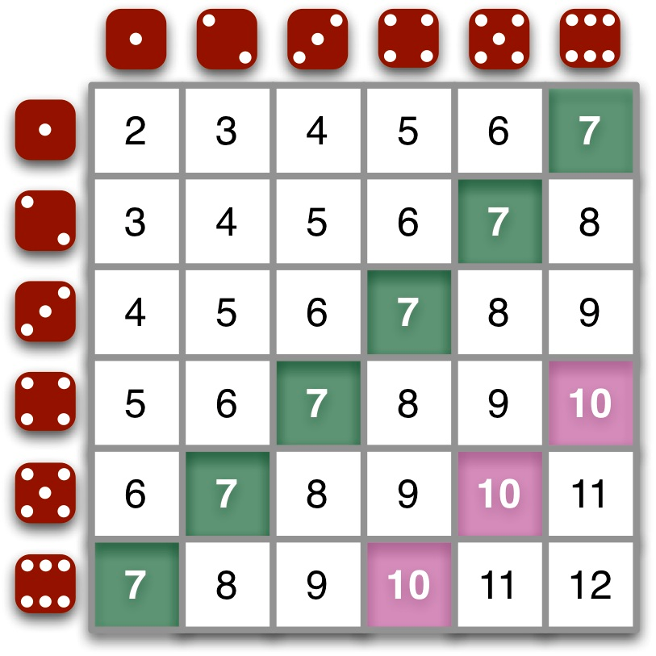
Counting Examples
How many ways can two dice be rolled to get a sum of 10?

Slide 14
Counting in R
expand.grid() – function that creates a data frame from all combinations of vectors supplied.
R-demo

Slide 15
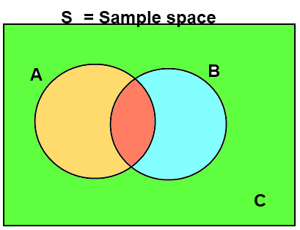

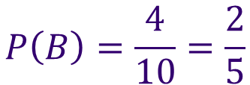
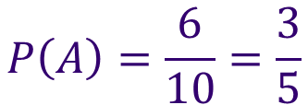
Probability
The Probability of an event, A, is the number of ways A can occur, divided by the number of total possible outcomes in our Sample Space, S.
If is an event, then
$$P\left(A\right)=\frac{N(A)}{N(S)}$$
$$P\left(A\right)=\frac{6}{10}=\frac{3}{5}$$
$$P\left(B\right)=\frac{4}{10}=\frac{2}{5}$$

Slide 16
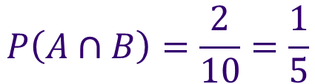
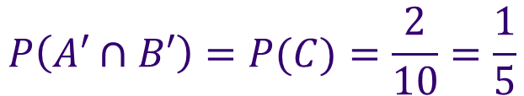
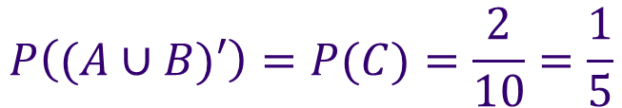
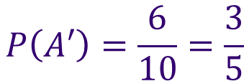
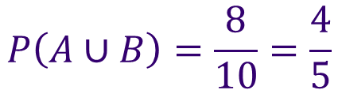
Probability
If is an event, then
Intersection:
Union:
Negation:
$$P\left(A∩B\right)=\frac{2}{10}=\frac{1}{5}$$
$$P\left(A∪B\right)=\frac{8}{10}=\frac{4}{5}$$
$$P\left(A′\right)=\frac{6}{10}=\frac{3}{5}$$
$$P\left((A∪B)′\right)=P(C)=\frac{2}{10}=\frac{1}{5}$$
$$P\left(A′∩B′\right)=P(C)=\frac{2}{10}=\frac{1}{5}$$

Slide 17



Axioms of Probability
Probability is bounded between 0 and 1.
Probability of the Sample Space = 1.
The probability of finite mutually exclusive unions is the sum of their probabilities.
$$0≤P\left(A\right)≤1$$
Note: “Percent” literally means per one hundred
$$P(S)=1$$
$$P\left(A∪B\right)=P\left(A\right)+P(B)$$
If A and B are M.E.

Slide 18
Probability Examples
Probability of rolling a sum of 10?

Slide 19
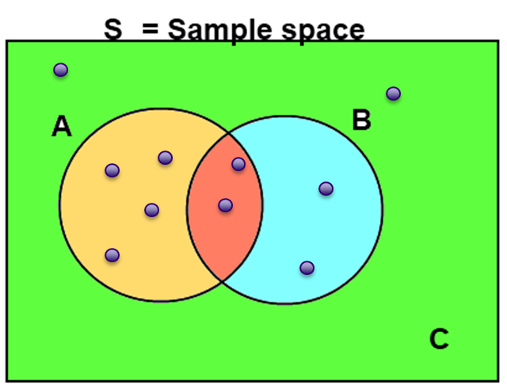


Mutually Exclusive Events
In all cases, the probability of the union of A and B takes the form:
If A and B are mutually exclusive that means that
$$P\left(A∪B\right)=P\left(A\right)+P\left(B\right)−P(A∩B)$$
S = Sample space
$$P\left(A∩B\right)=0$$
A
B
$$P\left(A∪B\right)=P\left(A\right)+P(B)$$

Slide 20
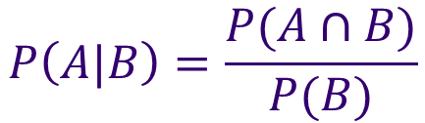

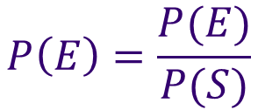
Conditional Probability
The probability of A given B is written:
And is equal to:
$$P\left(A|B\right)$$
$$P\left(A|B\right)=\frac{P(A∩B)}{P(B)}$$
$$P\left(E\right)=\frac{P(E)}{P(S)}$$
, compare to:
S = Sample space
A
B

Slide 21




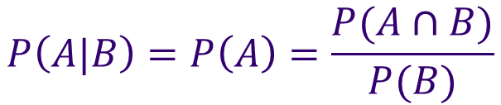


Independent Events
Events A is independent of B if and only if:
A being independent of B does NOT imply B is independent of A.
$$P\left(A|B\right)=P(A)$$
$$P\left(A|B\right)=P(A)$$
$$P\left(B|A\right)=P(B)$$
$$P\left(A|B\right)=P\left(A\right)=\frac{P(A∩B)}{P(B)}$$
$$P\left(B\right)P\left(A\right)=P(A∩B)$$
E.g. The event that my boss takes vacation has an impact on when I take vacation, but when I take vacation has no impact on when my boss takes vacation. (i.e., his vacation is independent of mine, but not vice versa)

Slide 22


Independence vs. Mutually Exclusive
These are not related AT ALL and in fact, are nearly opposite ideas.
If A is M.E. of B then:
If A is independent of B then:
$$P\left(A|B\right)=0$$
B occurring has a HUGE impact on P(A)
$$P\left(A|B\right)=P(A)$$
Example: The probability the sidewalk is wet given it is raining is very high,
But the probability that it is raining given the sidewalk is wet is lower (if I run
my sprinklers often).

Slide 23

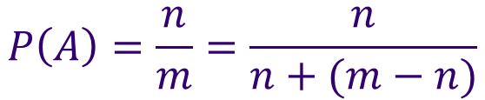
Odds
Odds are expressed as (Count in event favor):(Count not in event favor)
Make sure you reduce the fraction first
Implies the odds are:
$$P\left(A\right)=\frac{n}{m}=\frac{n}{n+(m−n)}$$
Examples:
Count in
favor of A
Count not in
favor of A
If P(A)=5/6, then the odds are
5:1. ‘Five to one’.
If the odds are 3:20, then
P(A)=3/23
A straight up sports bet in
Vegas has odds 1:1 (50%), but
pays 0.95Xbet.
$$n:(m−n)$$

Slide 24
Monty Hall Problem
Famous conditional probability problem that divided statisticians when it came out.
Start with 3 doors. One prize behind unknown door. Pick a door. Host reveals a separate door with no prize. Then contestant can switch. Should they?

Slide 25
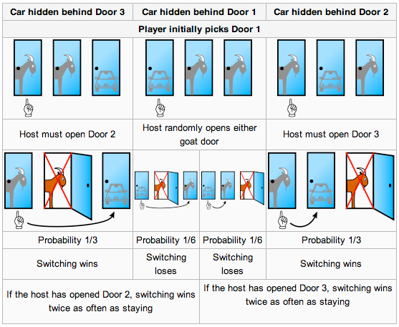
Monty Hall Problem
Start with 3 doors. One prize behind unknown door. Pick a door. Host reveals a separate door with no prize. Then contestant can switch. Should they?

Slide 26
Monty Hall Problem
Start with 3 doors. One prize behind unknown door. Pick a door. Host reveals a separate door with no prize. Then contestant can switch. Should they?

Slide 27
Monty Hall Problem
http://www.stayorswitch.com/

Slide 28
Simulations in R
Simulations are used to verify probabilities.
With these, we can also estimate variation in probabilities.
Use system.time() from base or microbenchmark() from microbenchmark package.
Clean up after yourself:
gc() or invisible(gc())
R demo

Slide 29
Dealing with Missing Data
Reasons for missing data
Recording failure (mechanical/software failures)
Reporting failure (human decisions)
Translation failure (data transferring/parsing errors)
Many shapes and types
Shapes: block, regular, random, sparse
Types:
Missing At Random (MAR): a particular variable has randomly omitted data.
Missing Completely At Random (MCAR) : every piece of data has equal chance of being omitted.
Missing Not At Random (MNAR): The value of data is related to chance of being omitted.
Outliers may also be treated as missing data.

Slide 30
Dealing with Missing Data
Type | Benefits | Disadvantages | Notes
Drop Missing | -Speed | -Data Loss
Mean/Median/Mode Fill | -No Data Loss | -Variance Reduction
X~F(independents) | -More Accurate -No Data Loss | -Slower | -Needs most columns to be filled out -Harder on ind. data
knn | -More Accurate -No Data Loss | -Slower -Dependent on distance function
X~F(y,independents) | -Very accurate -No Data Loss | -Slower -Need y | -Only on training set!

Slide 31
Dealing with Missing Data: Variance and Multiple Imputation
Dealing with imputation, it is important to try and keep the intrinsic variance in the data set.
To achieve this, multiple different predictions are made for each missing data point. (Using previous methods)
These data sets are kept and future hypothesis testing and predictions are made on all imputed sets to gauge the variance in the outcomes.
R package ‘Amelia’ does this and creates a nested list of data frames.
Amelia R demo

Slide 32
Dealing with Missing Data: Using Outside or New Data Sources
Don’t forget to explore outside or new data sources to help fill-in missing data.
With the advent of free public data and bigger data sources, this is gaining popularity as a tool for imputation.
Unstructured text is a major source of data.
Ex:
Caesar’s uses public reviews on websites to mine for customer sentiment about hotel rooms.
Zillow uses text descriptions of properties to fill in missing data about # bedrooms, # bathrooms, sq. footage, and various amenities.
Subject to human stupidity.
Yelp Rating for Circus-Circus: 2/5
Text Description: “My son and I stayed here. The service was great, the room was great, but it turns out my son is deathly afraid of clowns.”

Slide 33
Getting Data
Files
Csv: read.csv
Txt: read.table
Web/HTML
readLines
XML, xpath
http://gastonsanchez.com/work/webdata/getting_web_data_r4_parsing_xml_html.pdf
API
Twitter Example
Get consumer/access keys here:
https://dev.twitter.com/apps

Slide 34
Storing Data
.csv – write.csv()
.txt – write.txt()
.Rdata – save()
Workspaces are very compressed compared to csv
Databases
Sqlite: sqldf, RSQLite packages
Sqlite example
MongoDB: rmongodb package
Postgresql: RPostgreSQL package

Slide 35
Assignment
Complete Homework 2:
Write an R-script to verify the Monty Hall Probabilities with simulations (get probabilities AND variances for switching and not switching).
You should submit:
ONE R-script that outputs the probabilities and variances.
No word document needed, but put a comment at the end of the file addressing your results.
Read Intro to Data Science Chapter 7 and 10.
Read Statistical Thinking for Programmers Ch. 4.

