Slide 1
Data Science UW
Methods for Data Analysis
Time Series, Spatial Stats, and Intro to Bayesian Stats
Lecture 7
Nick McClure

Slide 2
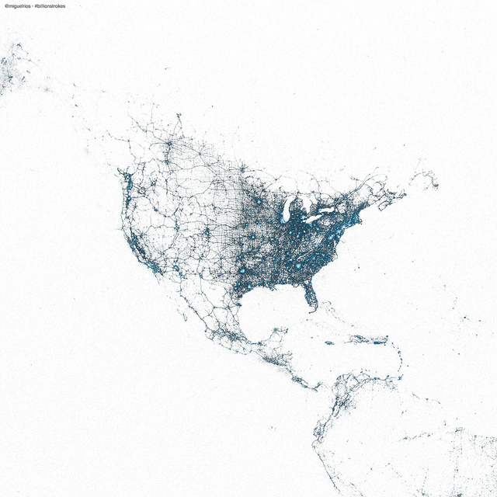
The spatial world according to Twitter

Slide 3
Topics
Review
Time series
Spatial statistics
Introduction to Bayesian Statistics

Slide 4
Review
Decomposition methods
SVD
SVD as linear regression
Variable reduction
Storing data
Ridge Regression
Lasso Regression
Logistic Regression
Binary classification
Intro to time series

Slide 5
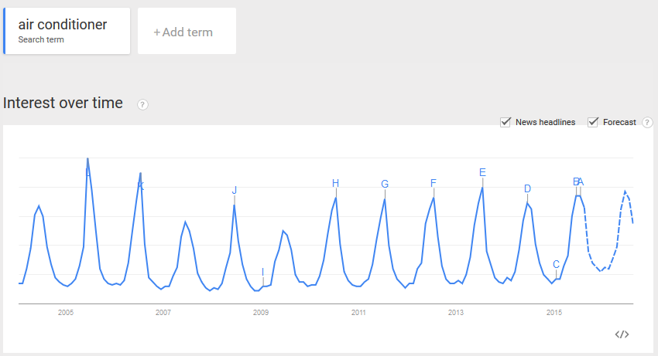
Time series
How do we detect seasonality?

Slide 6
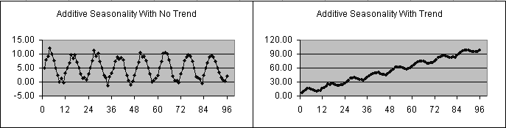
Time series
Seasonality can be with or without trend
If without trend, the series is called stationary

Slide 7

The Fourier Transform
The Fourier transform maps a function (or series of points) to the frequencies that make up the function.
It does this by averaging the normalized points across certain frequencies.
To find the energy at a particular frequency, spin your signal around a circle at that frequency, and average a bunch of points along that path.
$$X_{k}=\frac{1}{N}\sum_{n=0}^{N−1}{x_{n}e^{i2πk\frac{n}{N}}}$$

Slide 8



Exponential Smoothing
Past View moving average in which observations are weighted in terms of recency.
This coefficient sequence is geometric progression, which is a discrete exponential function.
$$s_{0}=x_{0}$$
$$s_{0}=x_{0}$$
$$s_{t}={αx}_{t}+(1−α)s_{t−1}$$
$$s_{1}={αx}_{1}+\left(1−α\right)s_{0}={αx}_{1}+\left(1−α\right)x_{0}$$
$$s_{2}={αx}_{2}+\left(1−α\right)s_{1}={α(x_{2}+(1−α)x}_{1})+{\left(1−α\right)}^{2}x_{0}$$
$$s_{2}={α(x_{3}+(1−α)x}_{2}+{(1−α)}^{2}x_{1})+{\left(1−α\right)}^{3}x_{0}$$
$$coefficients=\left\{1,\left(1−α\right),{\left(1−α\right)}^{2},{\left(1−α\right)}^{3},…\right\}$$

Slide 9





Double Exponential Smoothing
Exponential smoothing does not do well with trends.
To compensate for trends, we just add a term in describing the change between adjacent points.
$$s_{0}=x_{0}$$
$$s_{1}={αx}_{1}+(1−α)s_{0}$$
$$b_{1}=x_{1}−x_{0}$$
$$s_{t}={αx}_{t}+(1−α)(s_{t−1}+b_{t−1})$$
$$b_{t}=β(s_{t}−s_{t−1})+(1−β)b_{t−1}$$

Slide 10
Triple Exponential Smoothing
Triple exponential smoothing takes into account seasonality, or a tendency for the series to repeat itself.
We are still accounting for linear trend as well.
How do we find the length of the cycle?
Auto cross correlation methods, like the Fourier transform.
R-demo

Slide 11
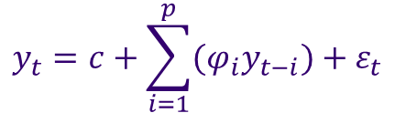
Autoregressive Model (AR)
If a series is stationary and auto-correlated, it should be able to be predicted as some multiple of previous values.
Every new observed point relies on what the previous p-points were:
The above is shown as AR(p)
R-demo
$$y_{t}=c+\sum_{i=1}^{p}{{(φ}_{i}y_{t−i})}+ε_{t}$$

Slide 12
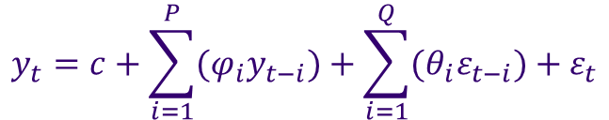
Auto Regressive Moving Average (ARMA)
Auto-Regressive Moving Average (ARMA)
ARMA is denoted by two variables (P,Q)
P = Auto regression order
Q = Order of moving average
R-demo
$$y_{t}=c+\sum_{i=1}^{P}{{(φ}_{i}y_{t−i})}+\sum_{i=1}^{Q}{{(θ}_{i}ε_{t−i})}+ε_{t}$$
AR (P,Q)= AR filter + MA filter + error terms

Slide 13

ARIMA
Auto-Regressive Integrated Moving Average (ARIMA)
ARIMA models are designated by three parameters:
P = Order of Auto regression
D = Degree of Difference for the ‘integrated’ part, this is how the model takes into account the differences needed for finding trend.
Q = Order of Moving Average
*Note ARIMA(0,0,0)=> (random noise)
$$y_{t}=ε_{t}$$

Slide 14


ARIMA(P,D,Q)=AR filter + Integration Filter + MA filter + error terms
(Long term)+ (stochastic trend) +(short term)+ error
AR Models
ARIMA(1,0,0) = 1st order auto regressive
ARIMA(2,0,0) = 2nd order auto regressive
Note that these models look very similar to random walks. This is because as the coefficients approach 1 they are the same.
Consider these models similar to random walks, but not ‘as-dependent’ on the previous values.
$$y_{t}=c+φ_{1}y_{t−1}+ε_{t}$$
$$y_{t}=c+φ_{1}y_{t−1}+φ_{2}y_{t−2}+ε_{t}$$

Slide 15
ARIMA(P,D,Q)=AR filter + Integration Filter + MA filter + error terms
(Long term)+ (stochastic trend) +(short term)+ error
MA Models
ARIMA(0,0,1) = 1st order Moving Average
ARIMA(0,0,2) = 2nd order Moving Average
Note that these models look very similar to random walks. This is because as the coefficients approach 1 they are the same.
Consider these models similar to random walks, but not ‘as-dependent’ on the previous values.
$$y_{t}=c+φ_{1}y_{t−1}+ε_{t}$$
$$y_{t}=c+φ_{1}y_{t−1}+φ_{2}y_{t−2}+ε_{t}$$

Slide 16
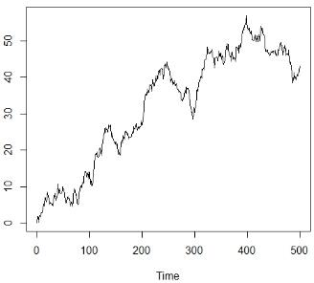
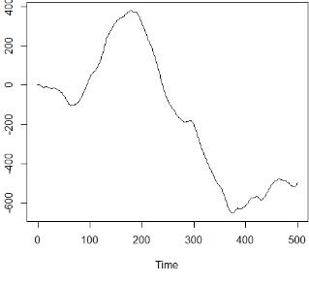



ARIMA(P,D,Q)=AR filter + Integration Filter + MA filter + error terms
(Long term)+ (stochastic trend) +(short term)+ error
Integrated Models (Random Walks)
ARIMA(0,1,0) = Random Walk Model
ARIMA(0,2,0) = 2nd order random walk
$$y_{t}=y_{t−1}+ε_{t}$$
OR
$${∆y}_{t}=ε_{t}$$
$$y_{t}=\left(y_{t}−y_{t−1}\right)−(y_{t−1}−y_{t−2})+ε_{t}$$
1st order 2nd order

Slide 17




ARIMA
ARIMA(P,D,Q)=AR filter + Integration Filter + MA filter + error terms
(Long term)+ (stochastic trend) +(short term)+ error
ARIMA(1,0,0) = 1st order autoregressive
ARIMA(0,0,1) = 1st order moving average
ARIMA(0,1,0) = Random Walk
ARIMA(0,1,1) = Simple exponential smoothing
ARIMA(2,0,1) = 2nd order AR, 1st order MA
ARIMA(1,1,0) = 1st order AR, with differencing
ARIMA(2,1,0) = 2nd order AR, with differencing
$$y_{t}=a_{1}y_{t−1}+a_{2}y_{t−2}+ε_{t}+b_{1}ε_{t−1}$$
$${∆y}_{t}=a_{1}{∆y}_{t−1}+ε_{t}$$
$${∆y}_{t}=y_{t}−y_{t−1}$$
$${∆y}_{t}=a_{1}{∆y}_{t−1}+a_{2}{∆y}_{t−2}+ε_{t}$$
$${∆y}_{t}=y_{t}−y_{t−1}$$

Slide 18

ARIMA + Seasonal
Add in seasonal (cyclic) factors
If Arima models have three factors, PDQ, then seasonal Arima models have 6: the same PDQ, and seasonal PDQ
p = Autoregressive order (non – seasonal)
d = Integrative part (non – seasonal)
q = Moving Average order (non – seasonal)
Seasonal (cyclic) parameters (lagged by a time difference)
P = Autoregressive order (seasonal)
D = Integrative part (seasonal)
Q = Moving Average order (non – seasonal)
$$Arima\left(p,d,q\right)X(P,D,Q)$$

Slide 19
ARIMA + Seasonal
Some examples:
ARIMA(1,0,0) + (0,0,0) = 1st order autoregressive
ARIMA(0,0,1) + (0,0,0) = 1st order moving average
ARIMA(0,1,1) + (0,0,0) = simple exponential smoothing
ARIMA(1,0,0) + (0,0,1) = 1st order autoregressive + seasonal moving average (seasonal smoothing)
ARIMA(0,0,1) + (1,0,1) = 1st order moving average + seasonal moving average and dependence on prior season.
ARIMA(0,1,1) + (0,1,0) = simple exponential smoothing + seasonal integrated differences.
R demo

Slide 20
Time Series Using Linear Models
We can approximate time series using linear models if we are careful.
We can insert factors into our linear model that account for time.
Number of days/weeks/months/years since start.
Day/week/month/season of year
Expected highs and lows of cycle
If our neighboring points are still related we can add in our auto-regressive terms:
Add a ‘time before’ and/or ‘2 times before’ values.
R-demo

Slide 21


Spatial Statistics
Spatial Statistics is a more ‘recent’ area of mathematics.
The first comprehensive spatial statistics book was written in 1991, by Noel Cressie, “Statistics for Spatial Data”.
Spatial data, like time series, is data that is ‘regionalized’. By regionalized we mean that the data is related to each other along multiple dimensions.
Time Series data is related along one dimension (time).
Spatial data is related along one or more dimensions.
General spatial data is usually denoted by:
Here, Y is our response, and s is a position vector which resides in a region, R.
$$Y\left(s\right):s ∈ R$$
$$Y\left(s\right),such that s is in R$$

Slide 22


Spatial Statistics
Types of spatial data:
Continuous Data:
Y is a random variable at each of the infinite continuous locations in R.
E.g.: Temperature, rainfall, …
Lattice Data:
R is fixed, , and on a regular lattice or grid on the plane.
Y(s) is a random variable at these locations.
E.g.: aggregated measurements over an area, pixels on an image, …
Point Process data:
R is fixed, , and is composed of arbitrary points on the plane.
Y(s) is a random variable at these locations.
E.g.: Mining data, most observational studies
$R=\{s_{1},s_{2}$, $s_{3}$,…}
$R=\{s_{1},s_{2}$, $s_{3}$,…}

Slide 23
Spatial Statistics
We can usually format spatial data into any of these types data sets.
Transforming into continuous data can be done via predictions or forecasting (this is called interpolation).
3
2
1
2

Slide 24
Median Polish (or mean polish)
Spatial gridded data sets can be normalized across the axes.
The purpose of this is to remove any linear trends in the data.
The algorithm is as follows:
Take the median of each row and then subtract the median from each point in that row.
Compute the median of the row medians, call this the grand row median. Subtract this grand row median from each of the row medians.
Take the median of each column and then subtract the median from each point in that column.
Compute the median of the column medians, call this the grand column median. Subtract this grand column median from each of the column medians.
Repeat all these steps until there is no change in either of the grand medians.
Note that using the mean for this would result in an algorithm with outlier sensitivity
R demo

Slide 25
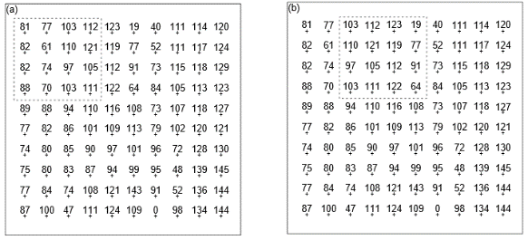
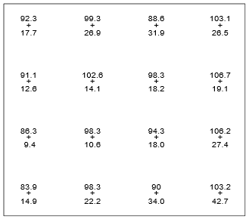
Moving Window Averages
Just like times series, we can create a window and average across it in multiple directions.
E.g. A grid of 10X10 points below was averaged across a sliding window of size 4X4 with overlap 2. This results in a 4X4 matrix.
* Note that this idea is used in convolutional neural networks when dealing with images.

Slide 26
Estimation
Suppose you are sampling the ground for gold content at n locations. You then observe the resulting outcomes as Y.
You might be interested in:
The total or average gold content across the whole region. (Global Estimation)
Predicting the gold content at a specific location. (Point Estimation)
Although the methods are very similar, the point estimation accounts directly for the distances of separation between points.
E.g. if we wanted to predict the gold content at a specific point, reporting the average of the whole region is a poor estimate.

Slide 27
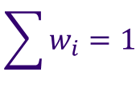
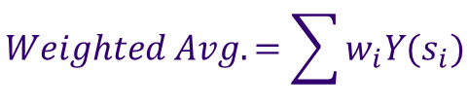
Weighted Averages
For global estimation, you might weight each point in the average by how close it is to other points. A point separated by larger distances should have more weight than points right next to each other (which then just carry the same information).
For point estimation, more weight is given to sites which are closer to the prediction site.
Weighted Average formula:
$$Weighted Avg.=\sum{w_{i}Y(s_{i})}$$
where
$$\sum{w_{i}=1}$$

Slide 28
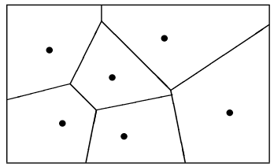
Voronoi Diagrams
Voronoi diagrams, or polygons, split up a plane and points by creating polygons of ‘shortest distance’ to a point. (Also known as Delaunay Triangulation)
You can imagine that we can weight the points by the area of their resulting polygons.
R - demo

Slide 29
Variograms: a way to measure dependence.
How do we measure dependence in spatial data?
It is important to de-trend our data so that we can consider every sub region as similar regions.
This helps us generalize about correlations or dependence between data points.
Consider all points separated by distance (d) in a fixed direction.
D=1 unit diagonally, h=
D=2 unit diagonally, h=
y
y
x
x

Slide 30
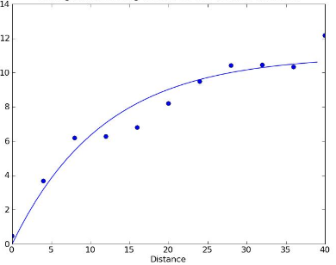
Variograms: a way to measure dependence.
D=1 unit diagonally, h=
D=2 unit diagonally, h=
y
y
x
x
Compute the variance of the differences between the sets as d increases:
Variance

Slide 31
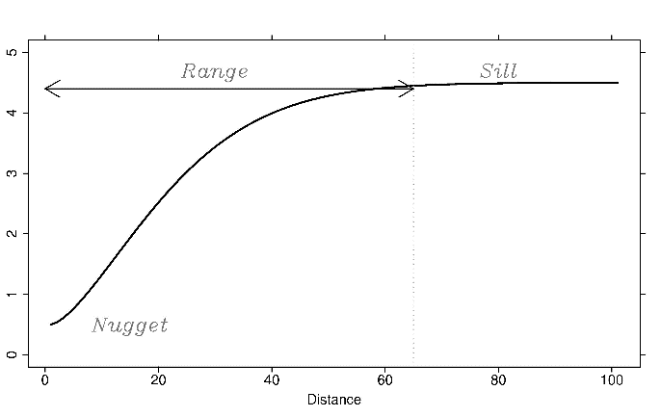
Variograms: a way to measure dependence.
A typical Variogram has very important properties that describe our data:
Note, low variance in the differences implies spatial dependence.

Slide 32
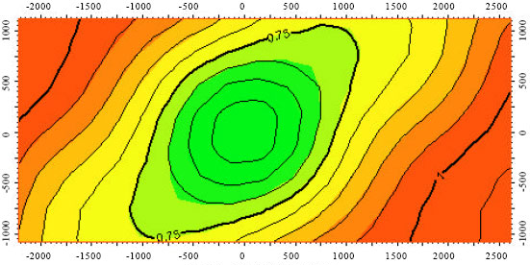
Variograms: a way to measure dependence.
If we plot the ranges for many directions, we end up with a ‘Rose Plot’:
E.g., for the above plot, there is more spatial variance in the Northeast-Southwest direction than there is in the Northwest-Southeast direction.

Slide 33
Kriging: A word with many pronunciations.
Most estimation procedures that we’ve talked about were solely based on the values and locations of points, not the relationship between the points. (how similar/dissimilar the points are)
Kriging estimation attempts to address this issue by incorporating the variogram.
Kriging is a form of interpolation, but weighting by the dependence in the data set (given by the variogram).
R-demo.

Slide 34
Measuring Clustering
Spatial points can be clustered, random, or overly regular.
Human being are notoriously bad at ‘seeing’ clustering or evenness.
We are interested in quantifying how spatial points cluster at different scales.
‘Ripley’s K’ is a common statistic used to quantify clustering.
R-demo

Slide 35
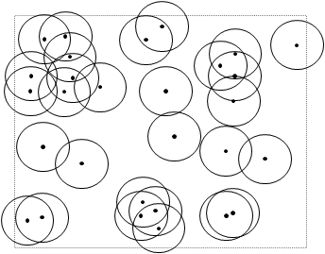
Ripley’s K
Computational algorithm:
Sample random circles at event points
Count how many events occur within circle of radius ‘h’
Repeat this many times.
Compare this distribution to the expected distribution.

Slide 36
Ripley’s K
Edge Effect Problems!
To count circles that overlap with edges, we weight the observations by a ratio of area in the region to the total area of the circle.
R-demo

Slide 37
Introduction to Bayesian Statistics
Most of the statistics we have been doing rely on assumed parameters and limiting distributions. This is called ‘Frequentist Statistics’.
The main difference between Bayesian and Frequentist statistics is that a Bayesian view of the world includes updating/changing our beliefs when we observe data along with taking into account prior beliefs.
Example: If we’ve lost our keys, we either
(1) Search our house from top to bottom.
(2) Search our house starting at the areas we have previously lost our keys before (laundry basket, desk, coat pockets,…), then we move onto more and more less likely places.

Slide 38
Introduction to Bayesian Statistics
Using a specific way to solve some problems does not require you to sign up for a lifetime of using that exact way. In fact, the common belief is that some problems are better handled by Frequentist methods and some with Bayesian methods.

Slide 39
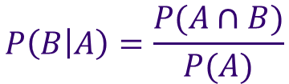
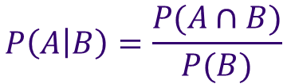
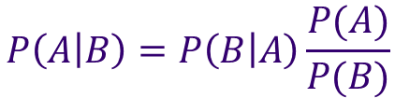


Bayes Law
Remember the rule for conditional probability:
And
Solving for
Or
$$P\left(A | B\right)=\frac{P(A∩B)}{P(B)}$$
$$P\left(B | A\right)=\frac{P(A∩B)}{P(A)}$$
$$P(A∩B)$$
$$P(B)P\left(A | B\right)=P(A)P\left(B | A\right)$$
$$P\left(A | B\right)=P\left(B | A\right)\frac{P(A)}{P(B)}$$

Slide 40
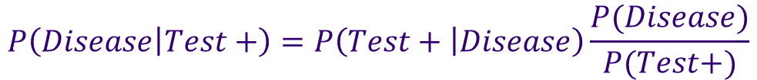

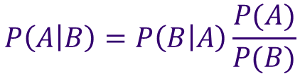
$$P\left(A | B\right)=P\left(B | A\right)\frac{P(A)}{P(B)}$$
Bayes Law
Applications:
Disease Testing: A = Have Disease, B = Tested Positive
Example:
$$P\left(Test+ | Disease\right)≠P\left(Disease | Test+\right)$$
$$P\left(Disease | Test+\right)=P\left(Test+ | Disease\right)\frac{P(Disease)}{P(Test+)}$$
High Probability, usually the reported accuracy of test.
If the disease is rare, the P(disease) will be very small.
$$P\left(Disease | Test+\right)=\left(0.999\right)\frac{0.00001}{0.0001}=0.0999$$

Slide 41
Introduction to Bayesian Statistics
What is the controversy?
Bayesian methods use priors to quantify what we know about parameters.
Frequentists do not quantify anything about the parameters, using p-values and confidence intervals to express the unknowns about parameters.

Slide 42
Assignment
Complete Homework 7:
Perform a linear model on the combined jittered headcount and las vegas weather data set. (See homework start/hint on Moodle).
You want to create time/date features similar to the ones in the Dow Jones Example in class.
Description, dataset and homework hint on Moodle.
You should submit:
A R-script.

