Slide 1
Data Science UW
Methods for Data Analysis
Regex Tutorial
Nick McClure

Slide 2
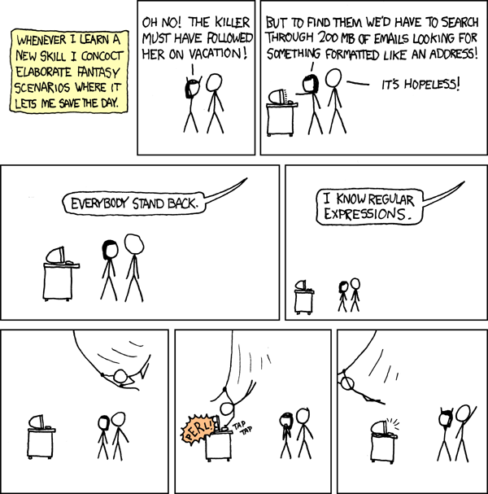

Slide 3
Regular Expressions (Regex)
Regular Expressions: a sequence of characters that define a search pattern for string matching.
Example:
Find all numbers in the string “123 Main St. was built in the 50’s.”
Should return “123” and “50”.
Find all 3 digit numbers:
Should only return “123”.
We want to match the phrases:
“The color is grey”, “The colour is grey”, “The color is gray”, or “The colour is grey”.
‘|’ (bar) = or operator and ‘?’ = optional operator.
Regexes:
“The colou?r is gr(a|e)y”
“The (colour|color) is (gray|grey)”
Both will match.

Slide 4
Regex Literals and Special Characters
Literal matches:
ABCDEF…
abcdef…
1234567890
!,@#%&
A space: ‘ ‘
The above lines will be matched literally.
Special Characters:
|()[]{}\^$.?*+
To match the above characters literally, they must be escaped with a backslash.
‘\$’ will look for a literal dollar sign.
‘\\’ will look for a backslash.

Slide 5
Regex Special Characters
Sometimes we want to search for text and where it is.
^ = start of a line
$ = end of a line
\b = word boundary
\B = not a word boundary
Examples:
‘^Subject’: Find a line that starts with ‘Subject’
‘^$’: Find an empty line.
‘^’: Find any line. Effectively meaningless, all lines have beginnings, even empty lines.
Start and end boundaries:
Mary-Sue can’t believe my B.L.T. is $10.00!

Slide 6
Regex Character Classes
“[]” denotes a character class.
[Math] will match a single character that is either a M, a, t, or h
[a-z] will match any lower case letter a through z
[A-Za-z0-9] will match any upper case, lower case, or number
[^Math] will match any character that is not M, a, t, or h
Note that some characters behave differently inside a character class than outside of it.
‘mat[^h]’ matches matt but not math.
Note: It may or may not match ‘mat’. The search tool you use may remove the end of line character (in case it will not match). And if there is an end of line character, it will match.
Also, the placement of the ‘not’ character in the class matters.
[Ma^th] will match any of the characters M, a, t, h, or ^

Slide 7
Regex Character Classes (Shorthand)
\d = [0-9]
\w = [0-9a-zA-Z_]
\s = [ \t(?:\n|\r\n)] (whitespace)
\D = [^0-9]
\W = [^0-9a-zA-Z_]
\S = [^ \t(?:\n|\r\n)] (not whitespace)

Slide 8
Regex Repetitions and Optional Items
+ Matches the prior object at least once. (one or more).
* matches any number, including none of the prior object.
? Is placed after an optional item.
Matching the month July can be written:
(July|Jul)
July?
Or for the fourth of July:
July? 4(th)?
 | Min Required | Max to Try | Meaning
? | 0 | 1 | One allowed, none required
* | 0 | No Limit | Unlimited allowed, non required
+ | 1 | No Limit | Unlimited allowed, one required

Slide 9
Regex Exact Repitions
We can specify exactly how many repetitions we want with {}
[0-9]{8} Matches an 8-digit number
[0-9]{8,} Matches an 8 or more digit number
[0-9]{2,5} Matches a 2 digit number, 3 digit number, a 4 digit number or a 5 digit number.

Slide 10
Regex Examples
A string within double quotes
“[^”]*”
Dollar Amount
\$[0-9]+(\.[0-9][0-9])?
An HTTP URL
http://[-a-z0-9_.:]+/[-a-z0-9_:@&?=+,./~*%$]*\.(com|html?|edu)
Phone Number
\(\d{3}\)?[\s.-]\d{3}[\s-.]\d{4}

Slide 11
Regex Back Referencing
() is considered a grouping. We can reference these groupings (like we did with the ?).
Escaping a number references the groups in the regular expression.
([A-W])([A-Z])=\1\2 Here, the ‘\1’ references the first group and the \2 references the second group.
This regex will match AZ=AZ and WY=WY, but not AZ=WY.

Slide 12
Regex Look Aheads and Look Behinds
(?=regex1)regex2 is a look ahead. The regex2 only matches in places where regex1 will match ahead.
(?<=regex1)regex2 is a look behind. The regex2 only matches after the regex1 matches.
(?=Tomato)Tom matches the Tom part of Tomato, but not Tomas.
(?<=T)here matches the here part of There, but not just here

Slide 13
Regex POSIX Expressions
[:alnum:] – alpha numeric characters = [A-Za-z0-9]
[:alpha:] – Alphabetic characters = [A-Za-z]
[:blank:] – spaces and tabs
[:digit:] – numbers = [0-9]
[:lower:] – lowercase alphabetic characters = [a-z]
[:upper:] – uppercase alphabetic characters = [A-Z]
[:punct:] - !”#$%&’()*+,.-_/:;\?@[^]`~{|}
[:space:] – space characters = space, tab, newline, vertical tab, form feed, carriage return
https://regex101.com
http://regexpal.com
Regex in R tutorial
A great book with LOTS of detail: “Mastering Regular Expressions” by Jeffrey Friedl. ( O’Reilly Series)

