Slide 1
Data Science UW
Methods for Data Analysis
Intro to Natural Language Processing
Lecture 9
Nick McClure

Slide 2
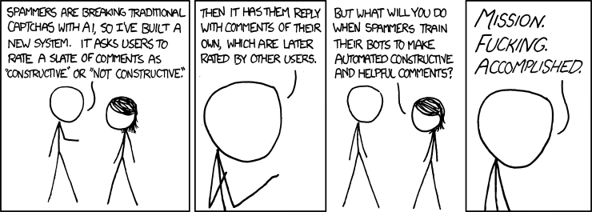

Slide 3
Topics
Review
Natural Language Processing
Text Normalization
Text Distances
Corpus/Dictionaries
Naïve Bayes
Word Frequencies
Latent Dirichlet Allocation

Slide 4
Review
Bayesian Statistics
Bayesian Inference
MCMC distributions
Computational Statistics
Bootstrapping
Generating P-values via simulating the Null Hypothesis
Cross Validation

Slide 5
Why Text?
How much data?
Twitter has more text data recorded than all that has been written in print in the history of mankind. (http://www.internetlivestats.com/twitter-statistics/)
Most of the world’s data is unstructured:
2009 HP Survey: 70%
Gartner: 80%
Teradata: 85%
Why use text?
Structured (numerical/categorical) data very often misses elements critical to modeling.
Un-transcribed notes, comments, logs
Surveys, medical charts

Slide 6




Measuring Text Distance
Hamming Distance
Line up strings, count number of positions that are the different.
Assumes strings are of the same length.
Levenshtein distance
Measures edit distance between two strings (insertion, deletion, substitution only)
$$Hamming\left(beer,bear\right)=1$$
$Hamming\left(101101, 100011\right)=$3
$$Lev\left(beer,bear\right)=1$$
$Lev\left(banana,ban\right)=$3

Slide 7










Measuring Text Differences
Jaccard index
Size of intersection of characters divided by size of union of characters.
Weighted Jaccard Index
For each letter, calculate the minimum times it appears, and the max,
R demo
$$J\left(A,B\right)=1−\frac{\left|A∩B\right|}{\left|A∪B\right|}$$
$$J\left(beer,bear\right)=1−\frac{3}{4}$$
$$J\left(banana,ban\right)=1−\frac{3}{3}$$
$$m_{i}$$
$$M_{i}$$
$$J′\left(A,B\right)=1−\frac{\sum{m_{i}}}{\sum{M_{i}}}$$
$$J\left(beer,bear\right)=1−\frac{m_{a}+m_{b}+m_{e}{+m}_{r}}{M_{a}+M_{b}+M_{e}{+M}_{r}}$$
$$J\left(banana,ban\right)=1−\frac{m_{a}+m_{b}+m_{n}}{M_{a}+M_{b}+M_{n}}$$
$$J\left(beer,bear\right)=1−\frac{0+1+1+1}{1+1+2+1}=1−\frac{3}{5}$$
$$J\left(banana,ban\right)=1−\frac{1+1+1}{3+1+2}$$

Slide 8
Text Normalization (Pre processing)
Strip extra white space:
Remove Unicode text
Lower case
Remove punctuation
Remove numbers
Remove stop words
Stem words (optional)
R-demo
I <3 statistics, it’s my \u1072 fAvoRitE!! 11!!!
I <3 statistics, it’s my \u1072 fAvoRitE!! 11!!!
I <3 statistics, it’s my \u1072 fAvoRitE!! 11!!!
I <3 statistics, it’s my fAvoRitE!! 11!!!
I <3 statistics, it’s my fAvoRitE!! 11!!!
i <3 statistics, it’s my favorite!! 11!!!
i <3 statistics, it’s my favorite!! 11!!!
i 3 statistics its my favorite 11
i 3 statistics its my favorite 11
i statistics its my favorite
i statistics its my favorite
statistics favorite
statistics favorite
statisti favori

Slide 9
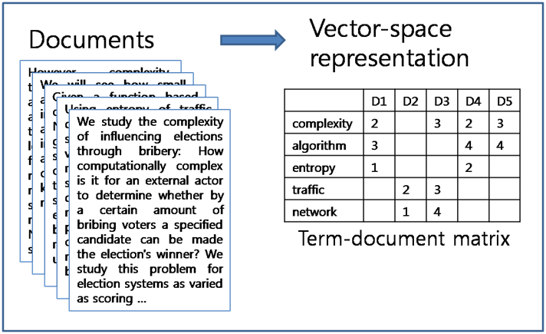
Dictionary Creation
Usually we have a whole bunch of entries, each entry is a sequence of variable length text.
A document is just one entry.
A collection of documents is called a corpus.
We can represent that corpus many ways.
Term document matrix (shown below) or a Document term matrix (transpose).

Slide 10
Naïve Bayes!
Now we have a numeric representation of key words in our documents.
We can use this in our Naïve Bayes algorithm to classify documents.
R-demo

Slide 11
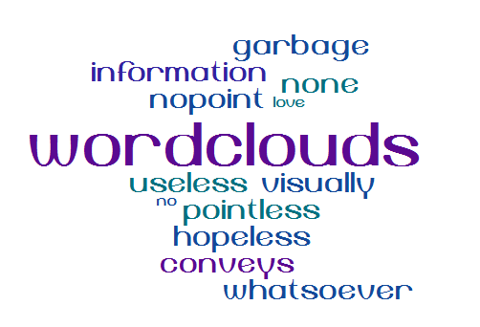
Wordclouds
Completely useless display of information that people love to see.
R demo

Slide 12

Creating Features
Text Frequency: Word frequency or TF
Count how many times a word appears in a single document.
Terms that occur in fewer documents are more descriptive and may contain more information (Rarity matters).
Inverse Document Frequency (IDF)
Inverse of the proportion of documents containing term in the whole collection.
#documents / #documents with word might be too severe.
A word appearing twice instead of once shouldn’t have twice the impact
Maybe we should tie these together:
TF-IDF: Rare terms in whole collection that appear frequently in some documents maybe very important!
Multiply these two
$$IDF=log⁡\left(\frac{\#Documents}{\#Documents with Word}\right)$$

Slide 13
How to Use TF-IDF
$$TF−IDF=log⁡\left(\frac{\#Documents}{\#Documents with Word}\right)×f(Word)$$
Finding important words to describe the document collections or subgroups of collections.
Using the count of important words as a feature in a model.
Using the distribution of a document’s TF-IDF values.
Characterize writing styles
Comparing authors
Determining original authors
Finding plagiarism
R-demo

Slide 14
Latent Dirichlet Allocation
Creates k-subtopics and determines which topics apply to which document (multiple allowed) with a probability.
In other words, each document is considered to be generated by drawing words from a mixture of topics.
Steps:
Initialize the number of topics. Use informed estimate or use trial-and error, choosing the number that results in the most interpretable topics.
Assign every word to a random topic in each document.
Iterate and update topic assignments via:
How common is that word across topics (for all documents)?
How common is that topic in that document.
We are trying to estimate the distribution of topics…
Via MCMC!!!! (prior = Dirichlet distribution)
R-demo

Slide 15
RAKE: Rapid Automatic Keyword Extraction
LDA is computationally hard and to apply this to many documents is quite time and memory consuming.
Tweets come in at up to 500k per minute.
If we can give our algorithm an idea of what to look for:
TF-IDF: Keywords will have higher TF-IDF values.
First occurrence: Keywords will tend to appear in the beginning of the document, so we calculate the % of document before the first occurrence.
Length: Long keywords are not preferred, we know that in English, 3-8 letter words are preferred.
Node Degree: Number of phrases (synonyms, rearrangements, stems) that are related to other candidate phrases.

Slide 16
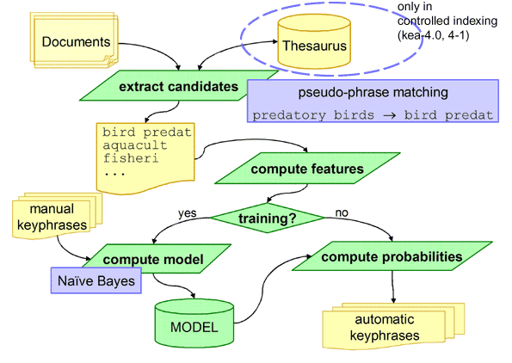
RAKE: Rapid Automatic Keyword Extraction
After candidates are computed, we use a Naïve Bayes model to predict other keywords in the model.
R-demo

Slide 17
Further interesting links
Microsoft Research 2008: Bayesian Inference in Traffic Patterns. http://research.microsoft.com/pubs/101948/TAinfer.pdf
Google Analytics (Multi armed bandit experiments for AB testing): https://support.google.com/analytics/answer/2844870?hl=en
Google Research: Voice recognition: http://static.googleusercontent.com/media/research.google.com/en//pubs/archive/37567.pdf
CNA: Forecasting insurance loss: http://www.casact.org/education/annual/2010/handouts/C4-Zhang.pdf
Swype texting: http://static.googleusercontent.com/media/research.google.com/en//pubs/archive/39190.pdf

Slide 18
Class Overview
Hypothesis Testing
Linear Regression
Ordinary Linear Regression, Multiple Linear Regression, Logistic Regression, Ridge Regression, Lasso Regression, SVD
Graph Algorithms, Spatial Statistics and Time Series
Bayesian Statistics and Computational Statistics
N.L.P.
Parametric/Well Defined
High-Powered
Higher Bias
More-Less
Assumptions
Non-Parametric/Computational
Low-Powered
Higher Variance
Test/Train
Cross Validation
Less Models
Higher Bias
More Models
Higher Variance

Slide 19
Class Overview
Remember this class is an overview of many methods.
Hopefully you will know what and where to lookup subjects that you may need for work, projects, fun dinner party jokes, etc…
This certification class is a great step in the right direction.
It shows employers and colleagues that you are serious about the analytical field and have had formal training.
You are now (and have been) a resource for others.
Last piece of advice:
Don’t ever stop learning. The day we stop learning for/at our jobs is the day we should be looking for a new job.

