Slide 1
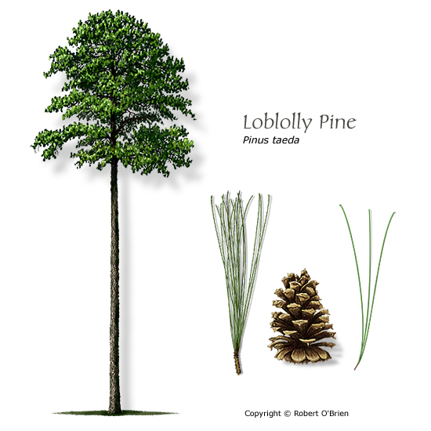
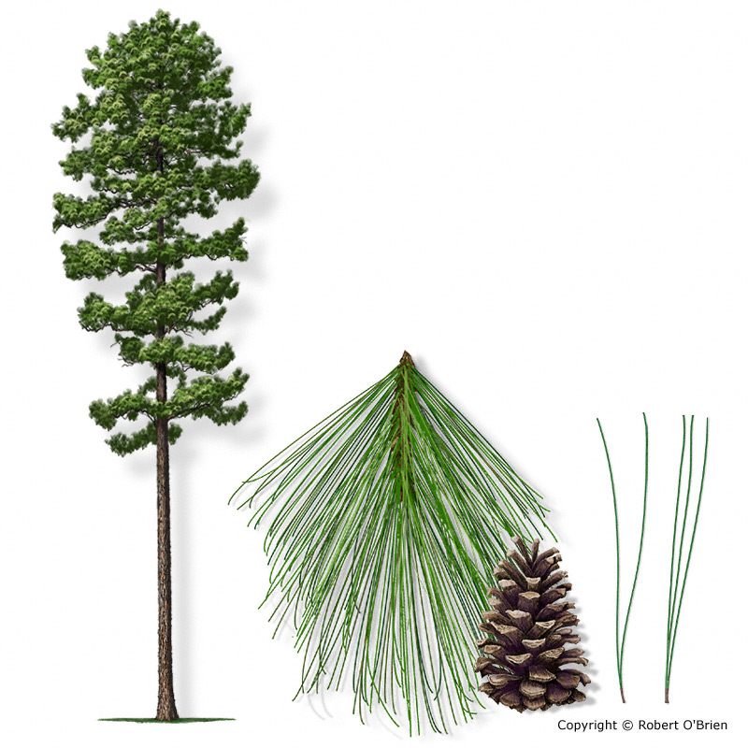
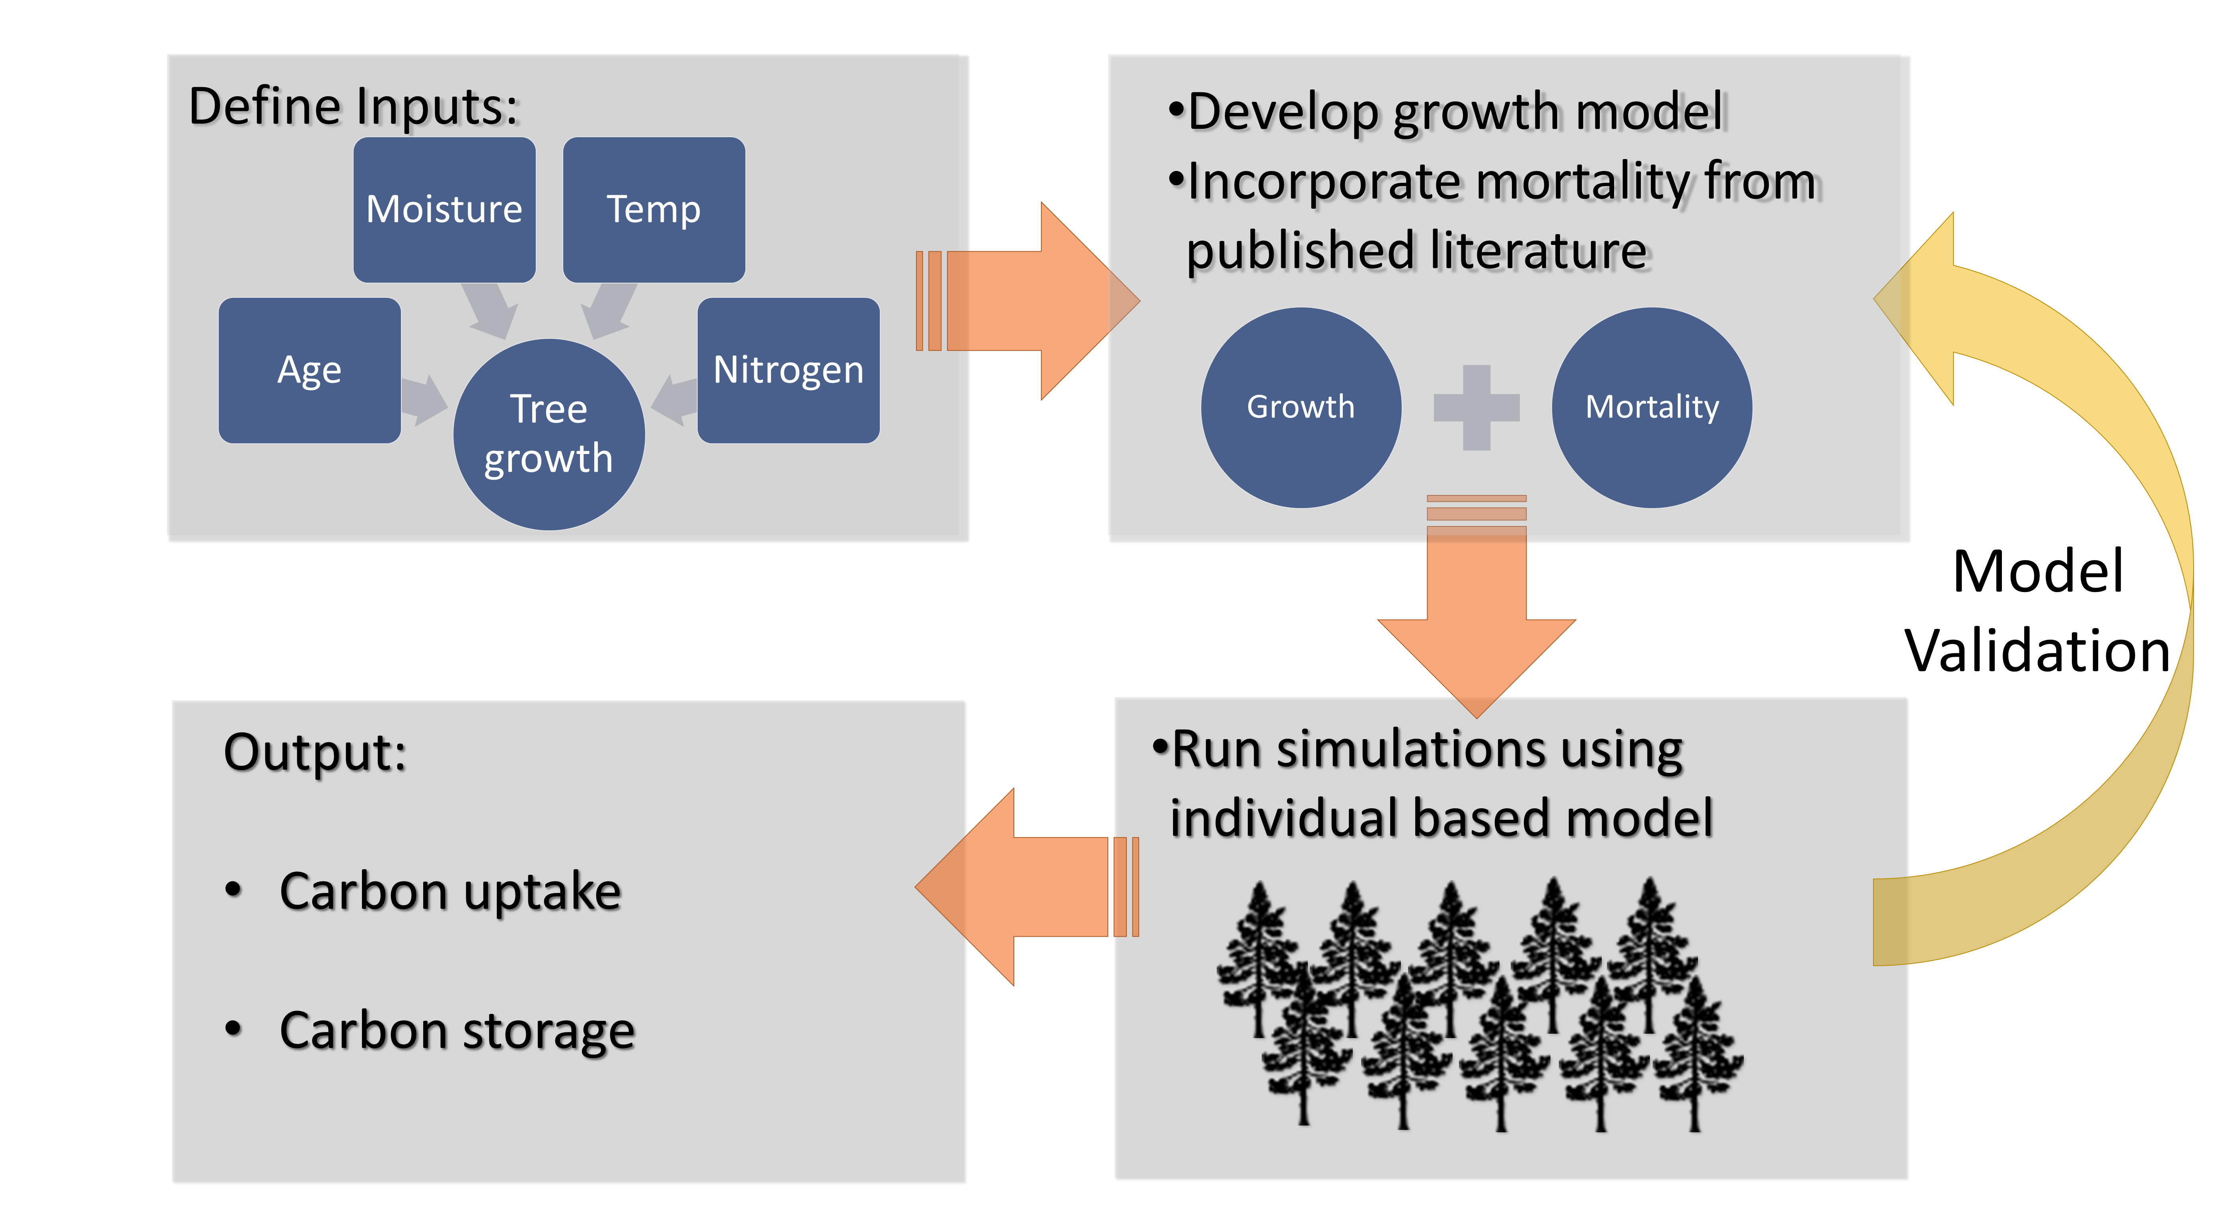
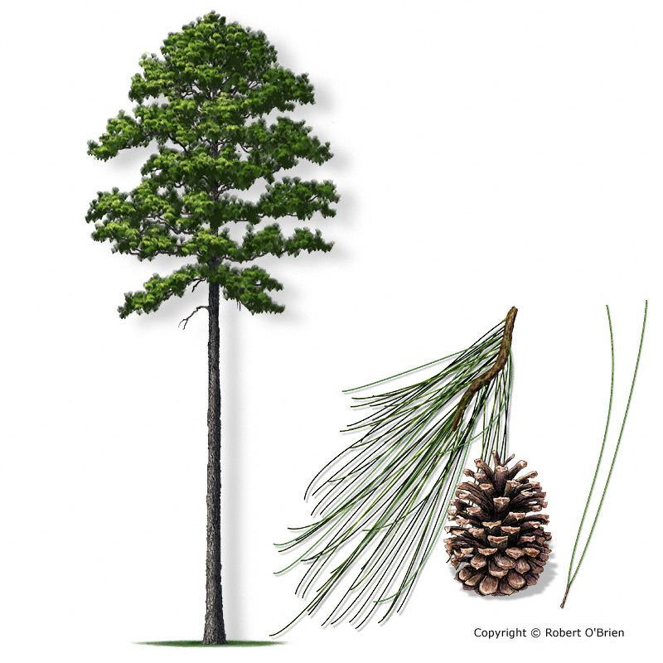
Goal: Evaluate stand-level trade-offs between growth and mortality to assess tree carbon biomass potential for three pine species across environmental gradients in Florida
Loblolly Pine
Pinus taeda
Longleaf Pine
Pinus palustris
Slash Pine
Pinus elliottii

Slide 2
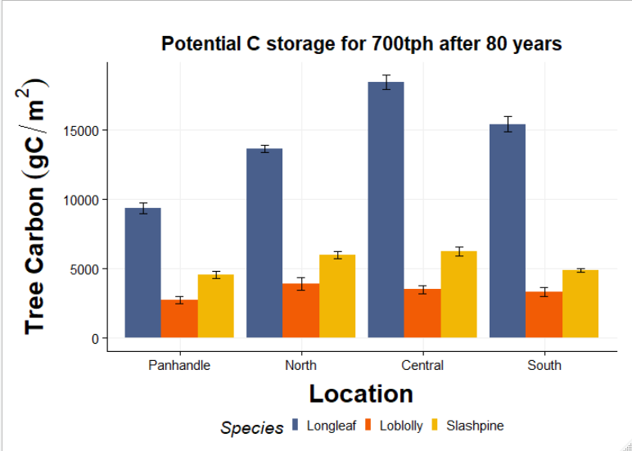
Preliminary Results
Mortality
Carbon Storage
Carbon Loss
Growth
Env variables

Slide 3
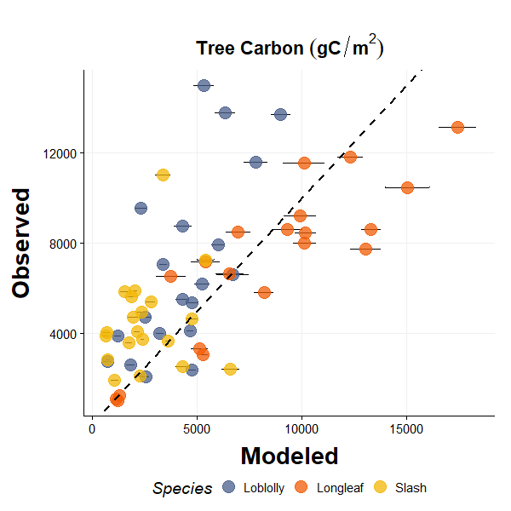
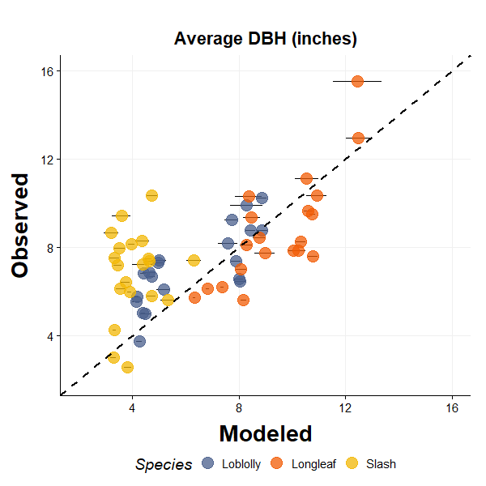
Preliminary Results
Simulations modeling mortality by size class
Mortality using competition index (slash)

