Slide 1
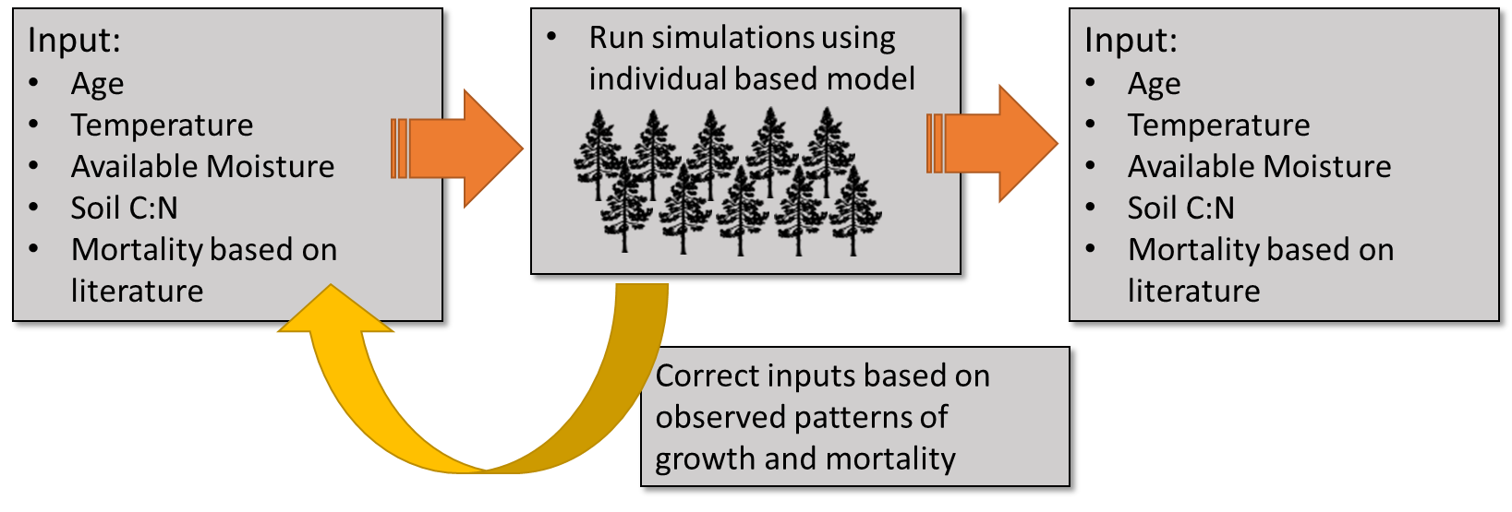

Slide 3

Input:
Age
Temperature
Available Moisture
Soil C:N
Mortality based on literature
Run simulations using individual based model
Output:
Diameter distribution
Temperature
Available Moisture
Soil C:N
Mortality based on literature
Input:
Age
Temperature
Available Moisture
Soil C:N
Mortality based on literature
Correct inputs based on observed patterns of growth and mortality

Slide 4
Define controls of photosynthesis (inputs):
Age
Temperature
Available Moisture
Soil C:N
Run simulations using individual based model
Stand characteristics(output):
Diameter distributions to calculate potential carbon uptake and storage potential for different environmental gradients around Florida
Develop growth model:
Determine relationship between inputs and diameter
Derive growth from change in diameter over time
Incorporate mortality from published literature
Model validation:
Correct relationship between inputs and diameter based on observed patterns of growth and mortality

Slide 5
Define Inputs:
Tree growth
Age
Moisture
Nitrogen
Temp
Develop growth model
Incorporate mortality from published literature
Run simulations using individual based model
Output:
Carbon storage
Carbon uptake
Carbon release
Year 2100
Growth
Mortality
Model Validation

Slide 6
Define Inputs:
Tree growth
Age
Moisture
Nitrogen
Temp
Develop growth model
Incorporate mortality from published literature
Run simulations using individual based model
Output:
Carbon storage
Carbon uptake
Carbon release
Year 2100
Growth
Mortality
Model Validation

Slide 7
Develop growth model
Incorporate mortality from published literature
Define Inputs:
Tree growth
Age
Moisture
Nitrogen
Temp
Growth
Mortality
Output:
Stand-level C uptake
Stand level C storage
Run simulations using individual based model

Slide 8
