Slide 1
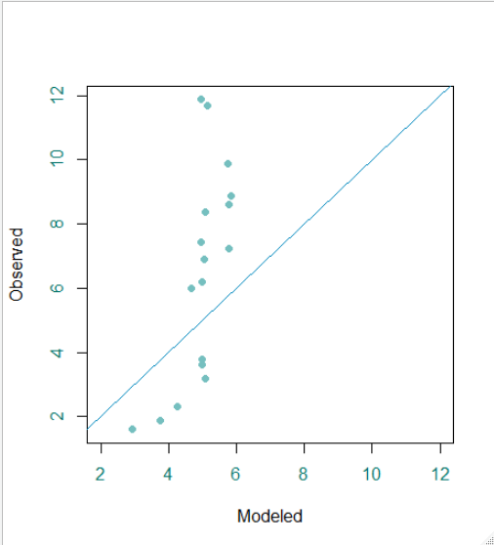
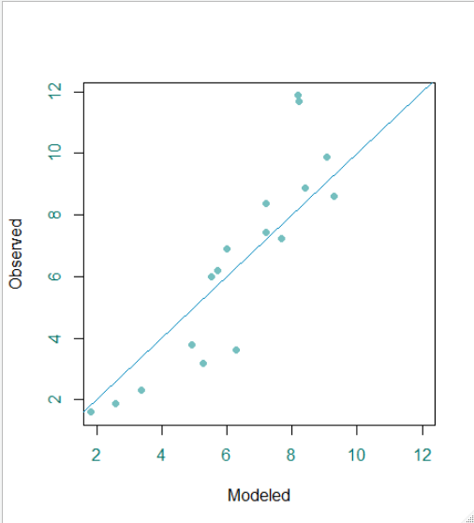
Before and after parameter corrections

Slide 2
Growth rate before and after parameter correction
10(-1.2975+ 0.1872temp - 0.0044temp2 - 0.2243aridity) * 0.3536age^{-0.6464}
10(-2.0202+ 0.1872temp - 0.0044temp2 - 0.2243aridity) * 0.9477age^{-0.0523}

Slide 3
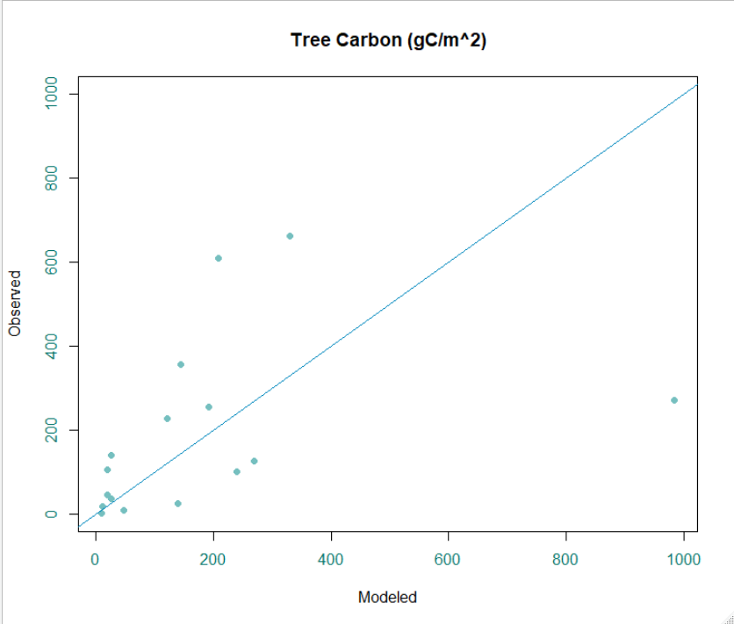
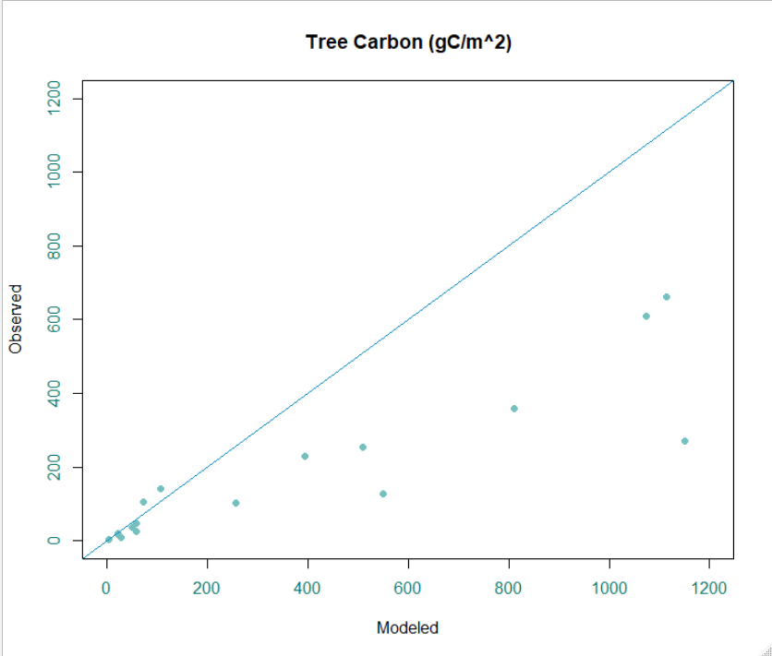
Before and after parameter corrections

Slide 4
Before parameter correction

Slide 5
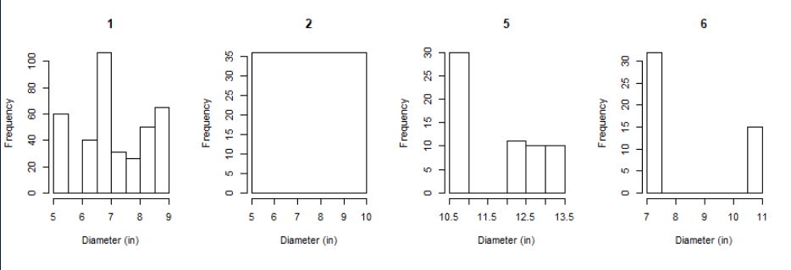


Slide 6
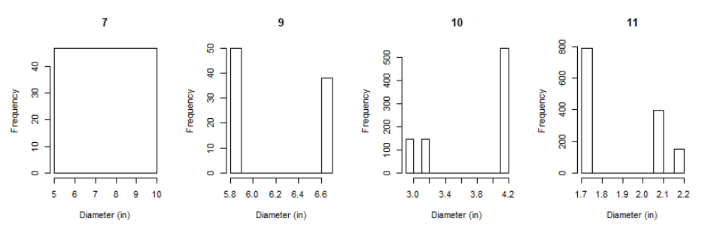


Slide 7



Slide 8



Slide 9
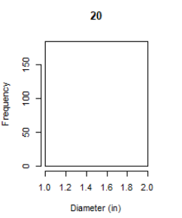
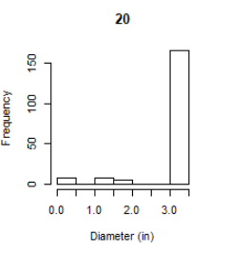

Slide 10
After parameter correction

Slide 11
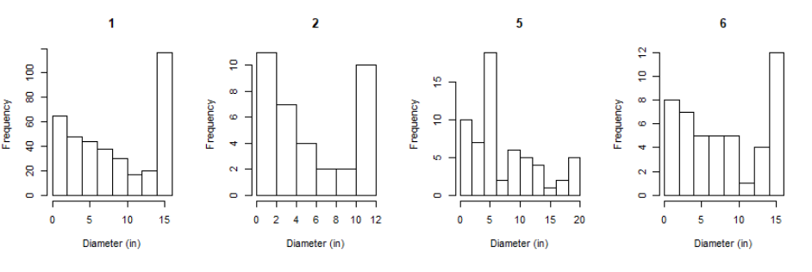

Slide 12


Slide 13


Slide 14
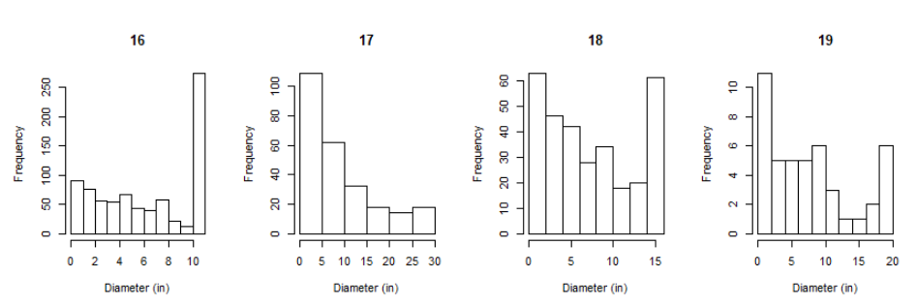

Slide 15
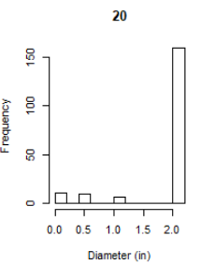

Slide 16
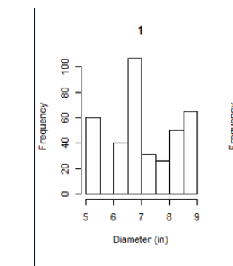
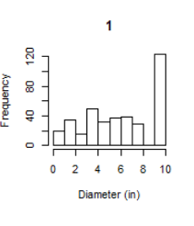

Slide 17
