Slide 1
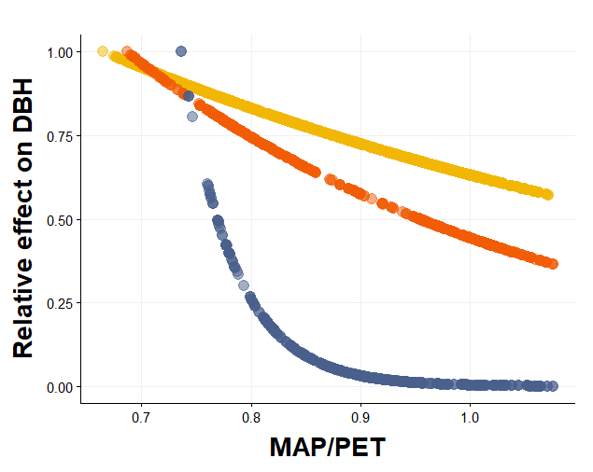
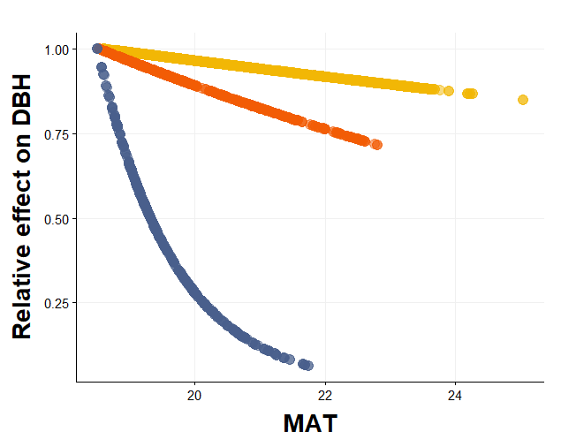
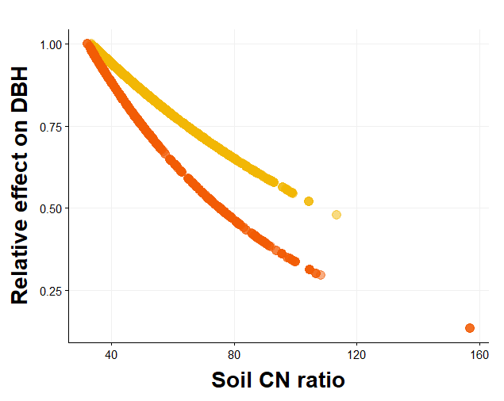
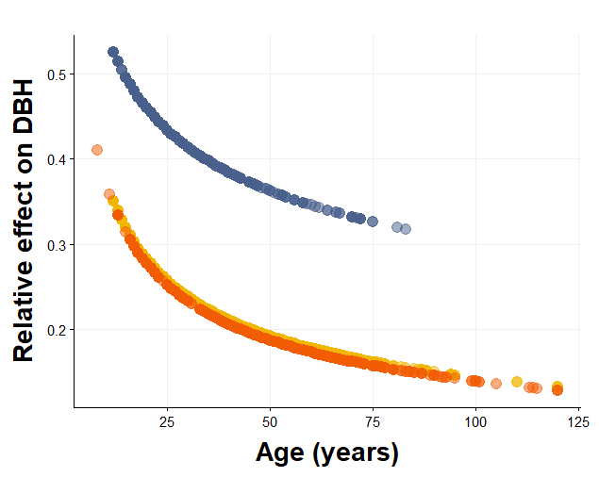

Slide 2
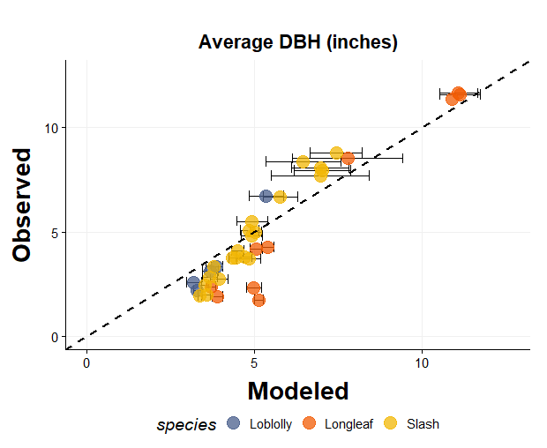
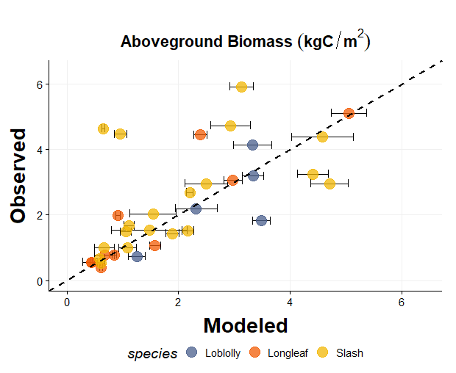
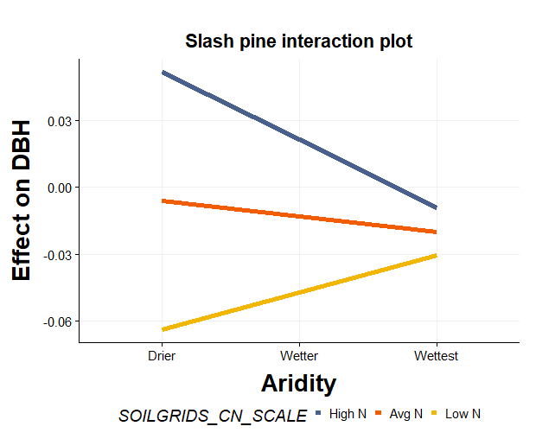

Slide 3
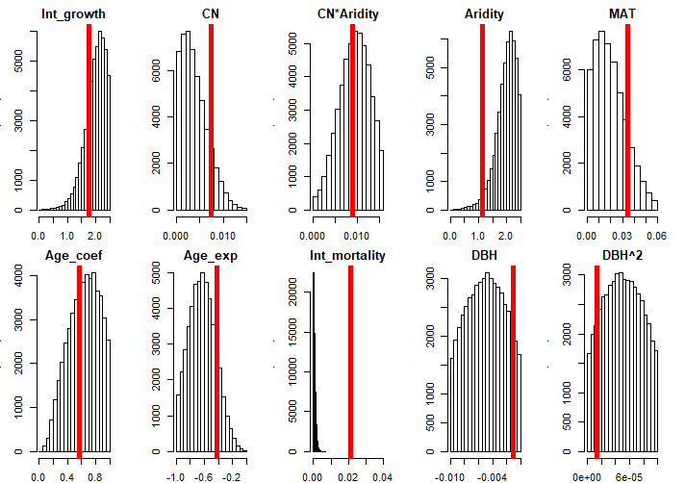
Probability
Parameter Values

Slide 4
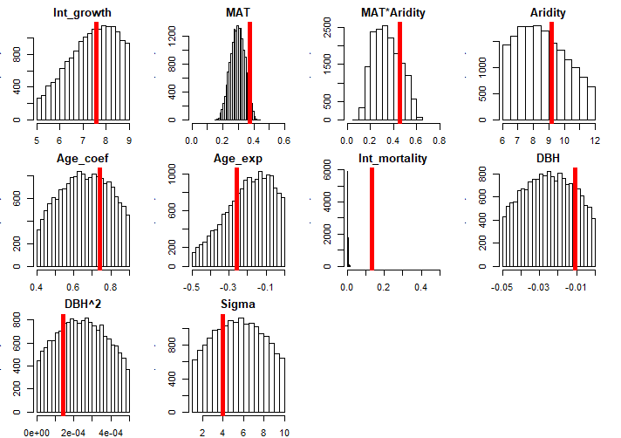
Probability
Parameter Values

Slide 5
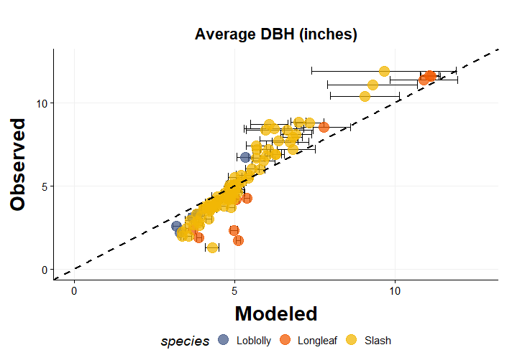
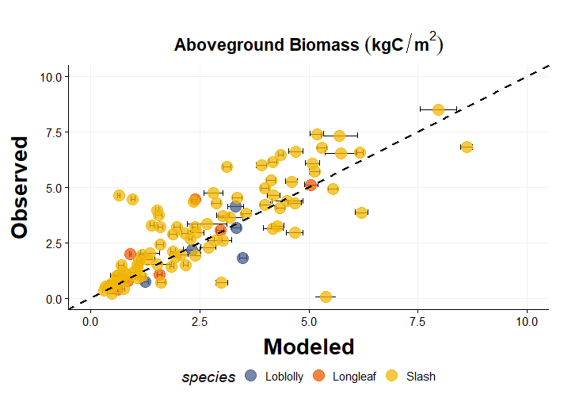
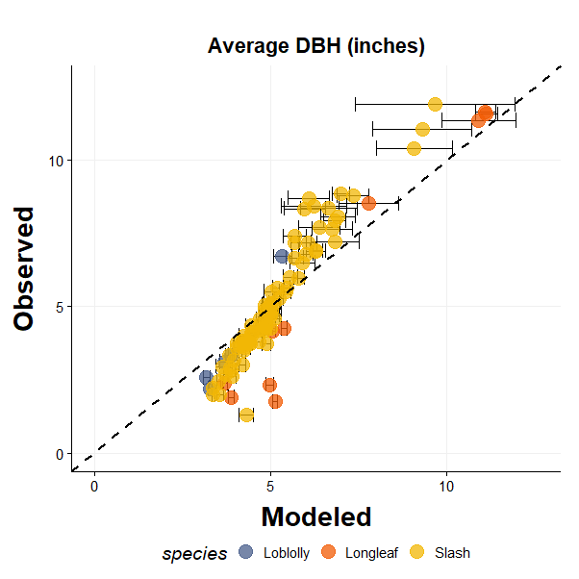
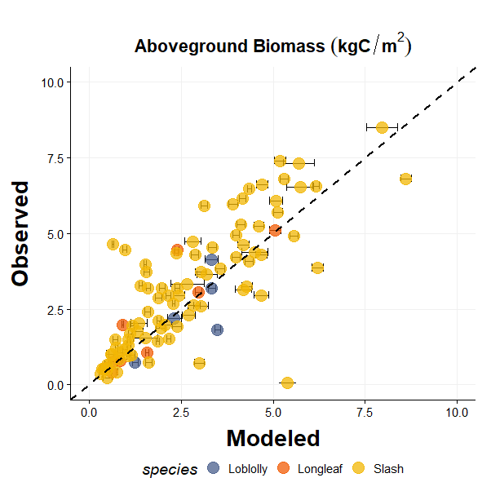

Slide 6
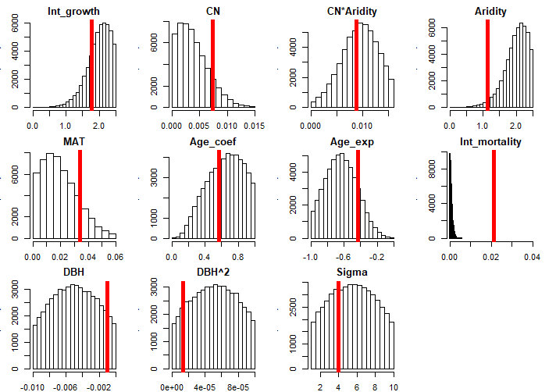
Probability
Parameter Values

Slide 7
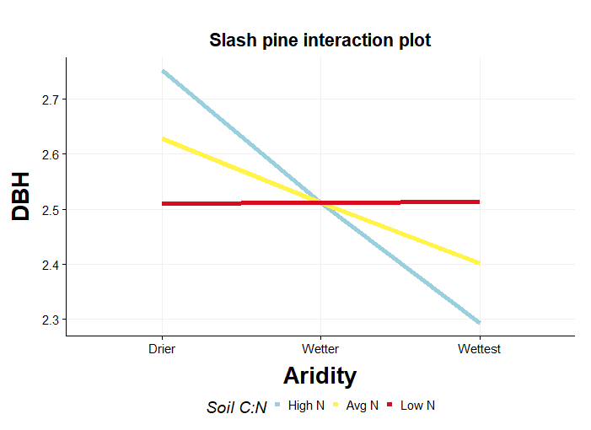
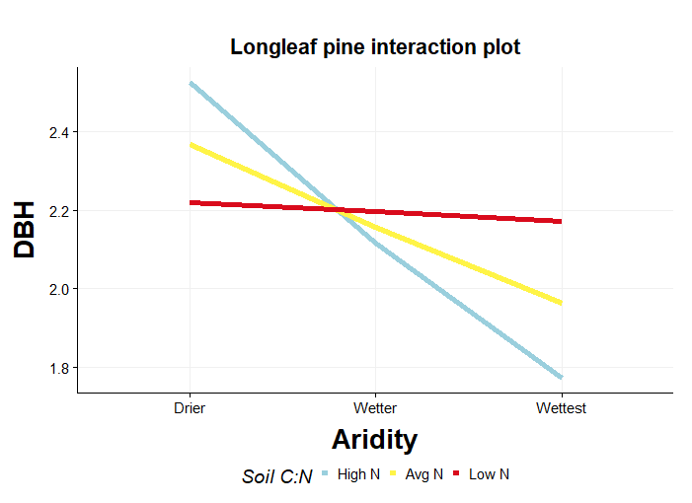
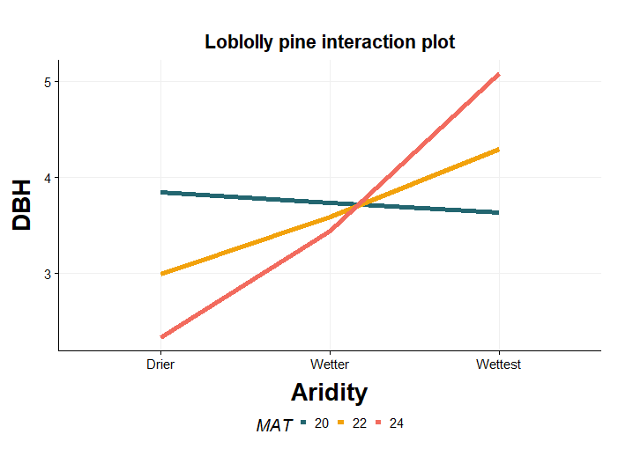

Slide 8
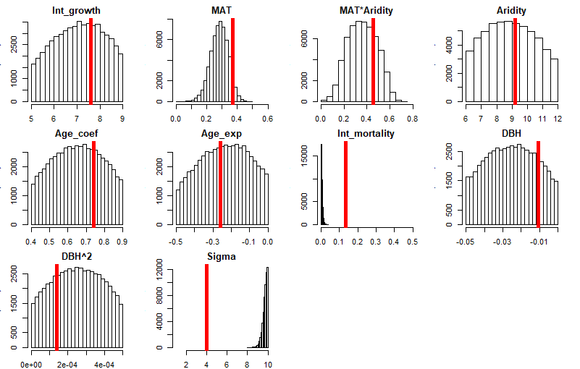
Probability
Parameter Values

Slide 9
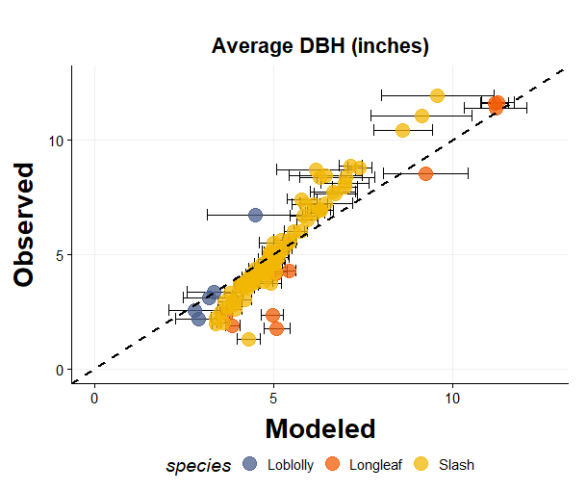
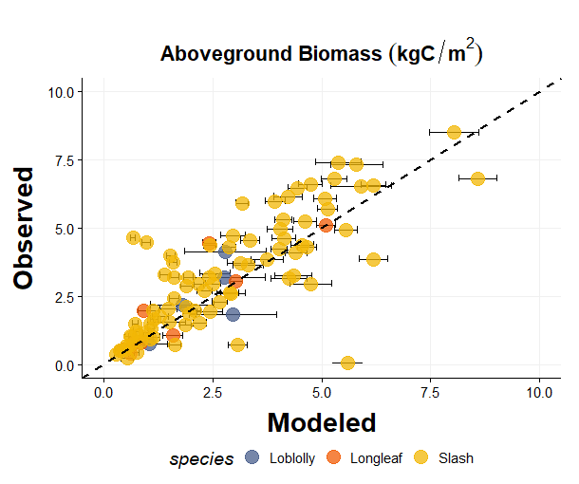

Slide 10
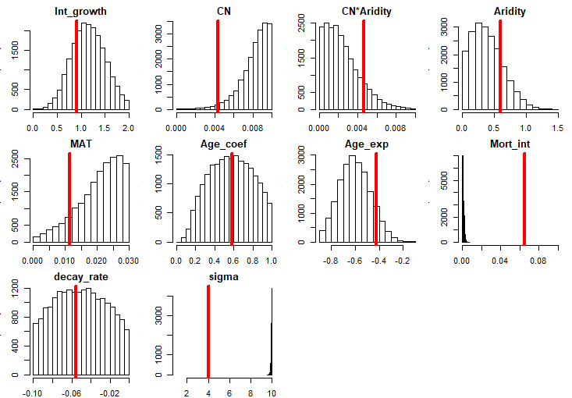
Probability
Parameter Values

Slide 11
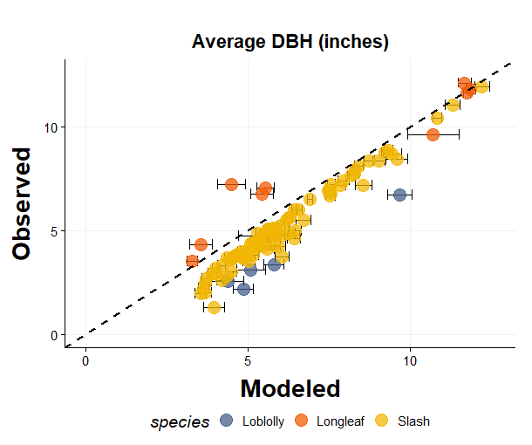
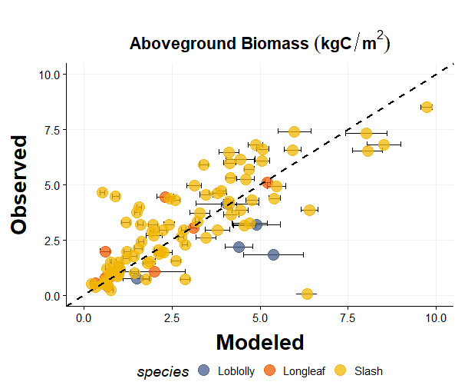

Slide 12
AGB Longleaf Pine before calibration with uncertainty prop: R-squared: 0.8198 AGB Longleaf Pine after calibration with estimating sigma: R-squared: 0.7499 AGB Longleaf Pine before calibration with uncertainty prop: RMSE: 0.137 AGB Longleaf Pine after calibration with estimating sigma: RMSE: 0.172 DBH Longleaf before calibration with uncertainty prop: R-squared: 0.9684 DBH Longleaf Pine after calibration with estimating sigma: R-squared: 0.9162 DBH Longleaf pine before calibration with uncertainty prop: RMSE: 0.298 DBH Longleaf Pine after calibration with estimating sigma: RMSE: 0.281
AGB | R² | RMSE
BEFORE | 0.8198 | 0.749
AFTER est Sigma | 0.7499* | 0.942
AFTER fixed sigma | 0.7463 | 0.871*
DBH | R² | RMSE
BEFORE | 0.9684 | 1.630
AFTER est Sigma | 0.9162* | 1.538
AFTER fixed Sigma | 0.9023 | 1.198*

Slide 13
Loblolly
AGB | R² | RMSE
BEFORE random | 0.4924 | 0.848
Before nonrandom | 0.004 | 1.879
AFTER nonrandom
DBH | R² | RMSE
BEFORE random | 0.9813 | 1.065
Before nonrandom | 0.9658 | 3.805
AFTER nonrandom

