Slide 1
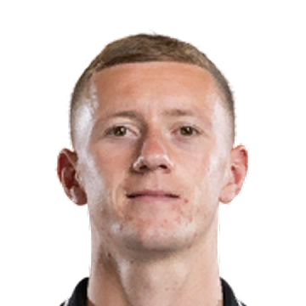
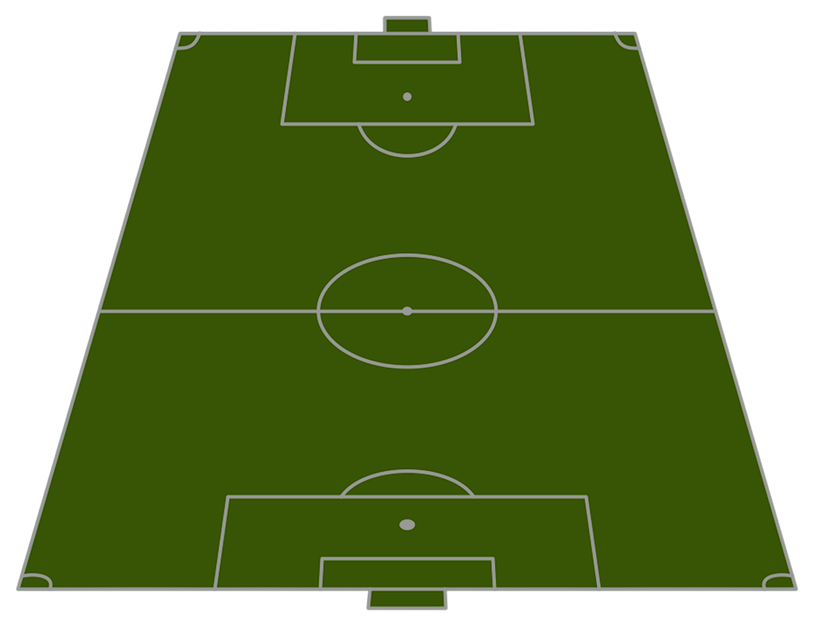
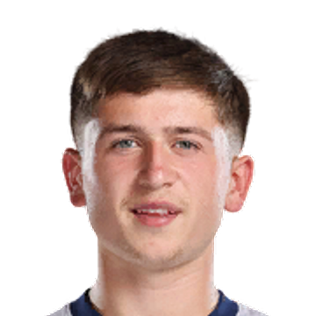
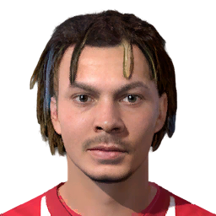
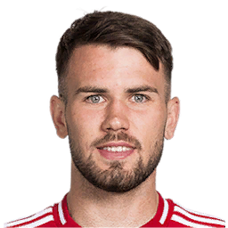
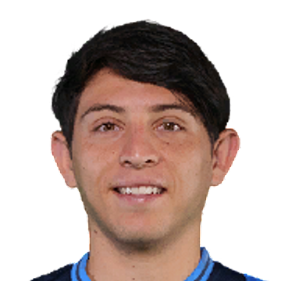
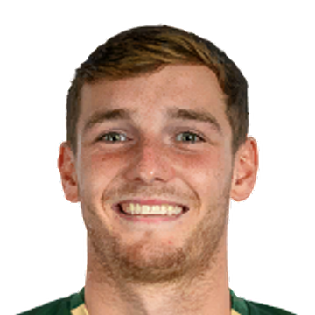
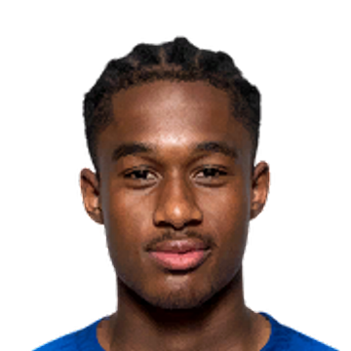
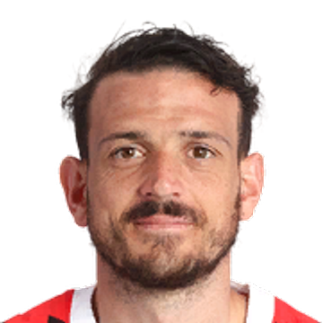
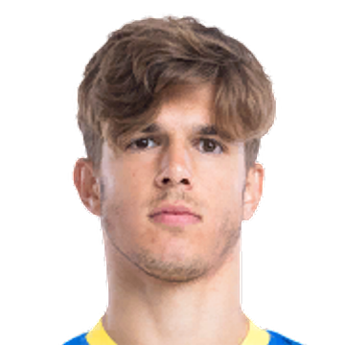
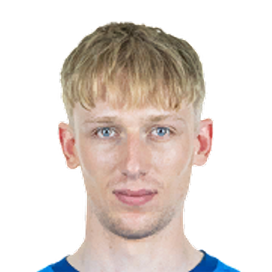
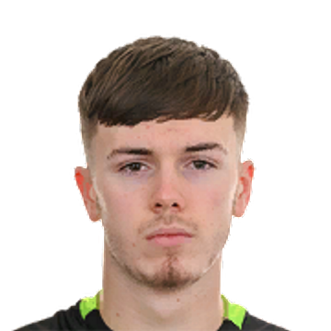
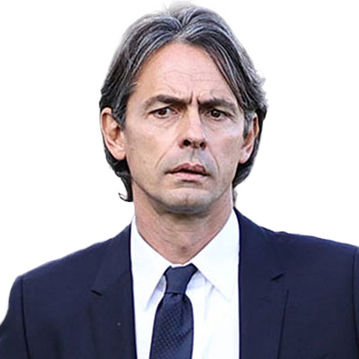
Starting XI
73
Jay Stansfield
Jay Stansfield
71
76
Mikey Moore
Dele Alli [C]
71
Krisztofer Horváth
72
Alexis Gutiérrez
70
Lewis Warrington
63
71
Jayden Meghoma
72
Alessandro Florenzi
Luka Vušković
69
Colin Kleine-Bekel
69
Josh Keeley
Substitutes
Head Coach
Filippo Inzaghi
Ollie O'Neill
Will Lankshear
Dominic Ball
Ethan Galbraith
Brandon Cooper
Ben Davis
Jamie Donley
Omar Beckles
James Wilson
Alfie Dorrington
Luca Lipani
Aaron Nemane
Harry Myers
Guille Rosas
Alfie Bradbury
Peyton Miller
Omari Kellyman [Loan out]
Harrison Armstrong
Jamie Norman

