Slide 1
Course Title
Version: 10.0
Trainer: ________________
Course Code: TGS-2024045797
Website: www.tertiarycourses.com.sg
Email: enquiry@tertiaryinfotech.com
Tel: +65 6100 0613

Slide 2
Digital Attendance
It is mandatory for you to take both AM, PM and Assessment digital attendance for WSQ funded courses.
The trainer or administrator will show you the digital attendance QR code generated from SSG portal.
Please scan the QR code from your mobile phone camera and submit your attendance.

Slide 3
About The Trainer

Slide 4

Let's Know Each Other...

Slide 5
Ground Rules
Set your mobile phone to silent mode
Actively participate in the class. No question is stupid.
Respect each other view
Exit the class silently if you need to step out for phone call, toilet break

Slide 6
Lesson Plan
Day 1
Digital Attendance (AM)
Trainer and Learners Introduction
Learning Outcomes
Course Outline
Topic 1: Introduction to Quantum Computing
Lunch Break
Digital Attendance (PM)
Topic 2: Quantum States and Gates
End of Day 1

Slide 7
Lesson Plan
Day 2
Digital Attendance (AM)
Topic 3: Quantum Algorithms
Lunch Break
Digital Attendance (PM)
Topic 4: Quantum Computing Applications
Course Feedback and TRAQOM Survey
Digital Attendance (Assessment)
Final Assessment
End of Class

Slide 8
Skills Framework
TSC Title: Computational Modelling
TSC Code: ICT-DIT-3001-1.1
Notes:
http://www.tkdocs.com/tutorial/install.html#installwin

Slide 9
Skills Framework TSC
TSC Abilities:
A1: Identify appropriate statistical algorithms and data models to test hypotheses or theories
A2: Use appropriate analytics platforms and analytical tools given specific analytics and reporting requirements
A3: Utilise a range of statistical methods and analytics approaches to data
A4: Conduct statistical modelling of data to derive patterns and/or solutions
A5: Perform coding and configuration of software agents or programs based on a selected model or algorithm
A6: Conduct tests on the actions taken and outcomes to assess
A7: Diagnose unintended outcomes produced by analytical models
A8: Propose changes or updates to the model or algorithms applied
A9: Implement changes to the coding and configuration of software agents or programs
A10: Draw relevant trends and insights from data analysis to support decisions
TSC Knowledge:
K1: Types of algorithms and advanced computational methods
K2: Range and application of various statistical algorithms
K3: Range and application of various types of data models
K4: Usage of analytics platforms and tools
K5: Statistical modelling techniques
K6: Coding languages for programming of algorithms and signals
K7: Potential reasons for unintended outcomes
Notes:
http://www.tkdocs.com/tutorial/install.html#installwin

Slide 10
Learning Outcomes
LO1: Identify and use appropriate quantum computing platforms for testing quantum gates and algorithms
LO2: Utilise and conduct quantum gates and logic to derive solutions
LO3: Perform coding and conduct testing of quantum algorithms
LO4: Diagnose outcomes, propose, and implement changes for quantum computing applications

Slide 11
Course Outline
Topic 1: Introduction to Quantum Computing
(K2, K4, A1, A2)
Key Principles of Quantum Computing
Quantum Computing Platforms
Topic 2: Quantum States and Gates (K3, K5, A3, A4)
Quantum State Vector Representations
Quantum Circuits and Quantum Gates
Topic 3: Quantum Algorithms (K1, K6, A5, A6, A10)
Coding Quantum Algorithms
Testing Quantum Algorithms

Slide 12
Course Outline
Topic 4: Quantum Computing Applications
(K7, A7, A8, A9)
Introduction to Quantum Machine Learning
Introduction to Quantum Error Correction

Slide 13
Final Assessment
Written Assessment (Short Answer Questions)
Practical Performance
Assessment format: Open Book
Open book assessment ONLY includes Slides, Learner Guide or any approved materials.
Appeal process

Slide 14
Briefing for Assessment
Place phones & other materials under the table or on the floor
No photos or recording of assessment scripts
No discussion during assessment
Use black/blue pen for assessment [hard copies]
No usage of liquid paper or correction tape
Assessment scripts will be collected when the time is up

Slide 15
Criteria for Funding
Minimum attendance rate of 75% based on SSG Digital Attendance record.
Complete the assessment and be assessed as ‘Competent’

Slide 16
Access Google Classroom LMS
You can access more resources from Google classroom LMS
https://classroom.google.com/c/NjE1NDA5ODMyMTc4?cjc=2z4ctbb
Alternatively. You can go to https://classroom.google.com and enter the class code on the top right.
Google Class code: 2z4ctbb

Slide 17
Topic 1
Introduction to Quantum Computing

Slide 18
Topic 1

Slide 19
Summary
Q&A

Slide 20
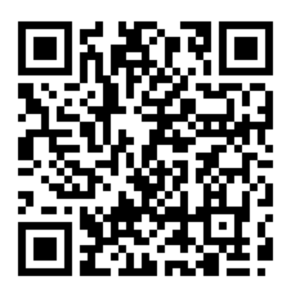
TRAQOM Survey
Access the survey here
Key in your Last four NRIC/FIN characters and the Six-digit course run ID to complete the survey

Slide 21
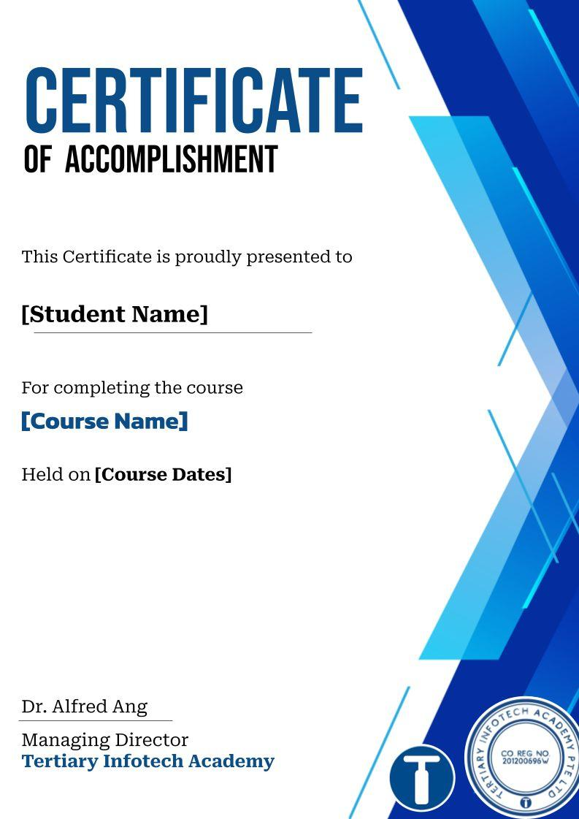

Certificate Delivery
Please provide the following details to facilitate the issuance of your certificate after the class and to ensure the accuracy of the information printed on it.
https://goo.gl/R2eumq

Slide 22
Digital Attendance
It is mandatory for you to take both AM, PM and Assessment digital attendance for WSQ funded courses.
The trainer or administrator will show you the digital attendance QR code generated from SSG portal.
Please scan the QR code from your mobile phone camera and submit your attendance.

Slide 23
Final
Assessment
Notes:
Assessor Guide:
Request the access to
https://colab.research.google.com/drive/1Z3GWKczCULhG6Gd86vvYbykwCqjcUIn9?usp=sharing

Slide 24
Recommended Courses
WSQ - Python Fundamental Course for Beginners
WSQ - Advancing Your Python Coding Skills to the Next Level with Object-Oriented Programming
WSQ - Building Your First Machine Learning Model with Python and Tensorflow
WSQ - Practical Reinforcement Learning for Beginners
WSQ - Practical Image Generation Using GAN, VAE, and Diffusion Models

Slide 25
Support
If you have any enquiries during and after the class, you can contact us below
Email: enquiry@tertiaryinfotech.com
Tel: 61000613
Whatsapp: 61000613

Slide 26
Thank You!

