Slide 1
WORK REDESIGN FOR MANAGING AI AGENTS
01
A
AI agents move fast.
Work design must catch up.
A
A
A
A
HUMAN
OWNER
The competitive advantage is not more agents.
It is better human ownership.
Dr Alfred Ang | Tertiary Infotech Academy Pte Ltd
27 August 2026 | Institute for Adult Learning
A
A
A
REDESIGN > REHEARSE > RELEASE
TERTIARY INFOTECH ACADEMY
Notes:
Timing: 0:00-0:35 Open with the business tension: AI agents are moving into workflows faster than organisations are redesigning roles. The advantage will not come from deploying the most agents. It will come from giving people clearer ownership, stronger judgement and safer ways to work with them.

Slide 2
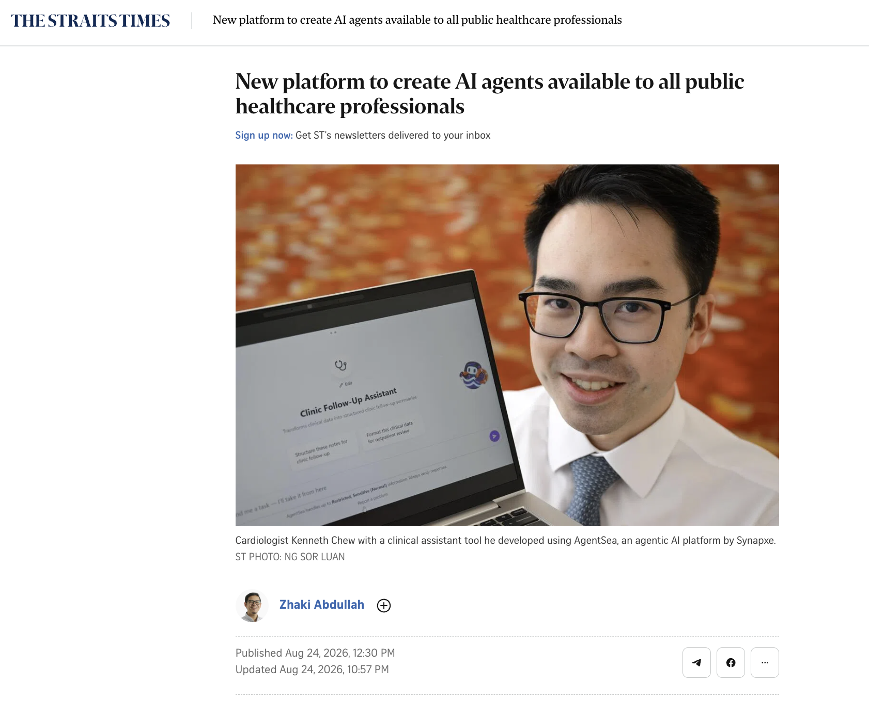
WHY NOW
02
12,000+ agents. One lesson: ownership cannot be automated.
AgentSea shows frontline professionals building and managing agents while humans retain consequential decisions.
12,000+
AI agents created
by Singapore public healthcare professionals since the platform launched in late May 2026
NO CODE REQUIRED
HUMAN REVIEW
MOH: when AI can act, assurance must shift from outputs to actions.
The doctor remains responsible for the clinical decision.
Source: Singapore Ministry of Health, HIMSS26 APAC speech, 24 Aug 2026
TERTIARY INFOTECH ACADEMY
Notes:
Timing: 0:35-1:25 This is not a future prediction. In roughly three months, healthcare professionals created more than 12,000 agents. The official speech is explicit: professionals build, deploy and manage them, and the doctor still owns the clinical decision. That is job redesign in action.

Slide 3
THE STAKES
03
The advantage comes from redesigning work—not merely deploying AI.
WEF projects creation and displacement at the same time. The transition must be deliberately designed.
GLOBAL JOB CHANGE BY 2030
THE EMPLOYER RESPONSE
+170M
86%
expect AI to transform their business
+78M
-92M
77%
plan to upskill workers for AI
41%
also expect workforce reductions from automation
created
displaced
net
THE OPPORTUNITY
22% of today's formal jobs are projected to be disrupted.
Make agent management part of the job.
Sources: WEF Future of Jobs Report 2025; WEF workforce strategies
TERTIARY INFOTECH ACADEMY
Notes:
Timing: 1:25-2:25 WEF does not say every job becomes an agent manager. It says 86 percent of employers expect AI transformation, 77 percent plan to upskill, while 41 percent also anticipate reductions. The opportunity is to add agent direction, checking and governance to existing roles before ambiguity turns into resistance or risk.

Slide 4
OUR OPERATING MODEL
04
Keep a human accountable at every consequential gate.
At Tertiary, agents support website and software workflows—and we help clients apply the same pattern.
LIVE PRACTICE
1
2
3
4
Frame
Orchestrate
Challenge
Decide
Human sets the goal, context and constraints.
Agents research, build, test and monitor.
Human reviews evidence, risks and exceptions.
Named owner approves release and remains accountable.
THE VALUE
Agents increase throughput. Humans protect judgement and accountability.
Source: Tertiary Infotech Academy practitioner experience (websites and software projects)
TERTIARY INFOTECH ACADEMY
Notes:
Timing: 2:25-3:15 This is our operating model. Agents already contribute to websites and software, and we help clients use them in similar workflows. The repeatable pattern is not hands-off automation. It is human framing, agent execution, human challenge and named approval.

Slide 5
THE PROBLEM
05
AI deployment creates adoption debt when roles lag behind.
If identity, decision rights and accountability remain unresolved, resistance compounds.
WHAT WE HEAR
"The agent is wrong."
"This will not work here."
"I do not have time to learn it."
WHAT IS OFTEN UNDERNEATH
JOB
IDENTITY
CONTROL
BLAME
Will I still be needed?
What happens to my expertise?
Can I stop a bad action?
Am I liable for its mistakes?
Resistance is not a people problem. It is a role-design signal.
Source: Tertiary practitioner observations and the Sarah coaching scenario
TERTIARY INFOTECH ACADEMY
Notes:
Timing: 3:15-4:10 The hidden cost is adoption debt when roles lag behind deployment. If we answer fear with a product demo or say "just upskill", we make it worse. The objection may sound technical, but the deeper questions are: am I still valued, what do I own, can I stop the system, and will I be blamed? Treat resistance as design input.

Slide 6
THE SOLUTION
06
The solution is an explicit Human Owner role.
Move routine production to the agent and make human decision rights visible.
BEFORE
AFTER
DOER
HUMAN OWNER
Draft every output
DIRECT
CHALLENGE
DECIDE
Run every check
Set intent and boundaries
Test evidence and assumptions
Approve consequential actions
Handle every routine case
Measure effort by volume
ESCALATE
IMPROVE
Own exceptions and recovery
Refine prompts, tools and rules
Work redesign pattern: human direction, challenge, approval, escalation and continuous improvement
TERTIARY INFOTECH ACADEMY
Notes:
Timing: 4:10-5:10 Our solution is a Human Owner role, not a vague instruction to supervise AI. The person sets intent, challenges evidence, approves consequential actions, handles exceptions and improves the workflow. That is a clear job proposition: higher-value judgement with visible authority.

Slide 7
THE INTERVENTION
07
Turn resistance into a redesign conversation.
Use GROW to surface the fear, identify strengths and co-create a safe experiment.
G
R
O
W
GOAL
REALITY
OPTIONS
WILL
What outcome would be useful?
What concerns you? Which strengths matter?
What could you own, review or decide?
What safe experiment will we try next?
COACHING TURNS RESISTANCE INTO DESIGN INPUT.
Framework: GROW - Goal, Reality, Options and Will
TERTIARY INFOTECH ACADEMY
Notes:
Timing: 5:10-6:10 The intervention is a structured redesign conversation. Validate the emotion, explore reality and strengths, co-create specific decision rights, and finish with a safe experiment. Empathy is how we obtain honest design input from the person closest to the work.

Slide 8

THE PRODUCT
08
Make the hard conversation safe to practise.
The simulator builds coaching confidence across six realistic forms of resistance.
AI AGENT JOB REDESIGN COACH - LIVE SIMULATOR
OPEN LIVE SIMULATOR
Sarah
David
Mei Ling
Marketing
Customer Service
Data Analyst
FEAR / IDENTITY
ANGER / TRUST
ANXIETY / WITHDRAWAL
Arjun
Aisha
Farah
CLICK TO OPEN
Software Developer
Web Operations
HR Executive
OR SCAN
SCEPTICISM / PRIDE
CONTROL / ACCOUNTABILITY
ETHICS / PURPOSE
PICK A PERSON > COACH THE TRANSITION > GET GROW FEEDBACK
Live training simulator - six fictional scenarios; demo mode makes no external API calls
TERTIARY INFOTECH ACADEMY
Notes:
Timing: 6:10-7:20 This is the practical product: six scenarios spanning fear, anger, anxiety, scepticism, accountability and ethical purpose. In Slide Show mode, click the large gold launch button to open the live simulator, or invite the audience to scan the QR code. Demo one exchange and show that the staff member opens up when the manager combines empathy with concrete ownership. No-key mode makes the practice reliable in workshops.

Slide 9
THE WORKED EXAMPLE
09
A coaching conversation can reframe fear as ownership.
Sarah moves from threatened doer to AI-augmented marketing lead.
REALITY
REDESIGNED ROLE
"The agent writes the campaign copy and builds the decks. That is basically my whole job."
AI-Augmented Marketing Lead
DIRECTION
Goals, creative angle and brand voice
CHALLENGE
Audit assumptions, facts and market fit
Fear of redundancy
Loss of identity
No consultation
Anxiety about blame
APPROVAL
Final gate for external content
INSIGHT
Feed live client and market context back
LEARNING
Refine the human-agent workflow
AI lights the way. The human decides the path.
Source: A6 coaching scenario supplied for this presentation; fictional staff and company data
TERTIARY INFOTECH ACADEMY
Notes:
Timing: 7:20-8:35 Sarah begins with the identity question: what do you still need me for? The turning point is not reassurance. It is acknowledging the rushed rollout, drawing out her market strengths and co-creating a more valuable role where she directs, challenges and approves the agent.

Slide 10
THE ASK
10
PILOT ONE ROLE
FOR TWO WEEKS.
Small scope. Named owner. Safe stop rules. Measurable evidence.
PRACTISE NOW
1
2
3
MAP THE WORK
NAME THE OWNER
COACH ONE PERSON
alfredang.github.io/AICoahcing
What should the agent do - and never do?
Who reviews, approves, escalates and stops?
Use GROW and agree a safe two-week experiment.
MEASURE: cycle time | defect count | exception rate | role-confidence score
Simulator and slides: github.com/alfredang/AICoahcing
TERTIARY INFOTECH ACADEMY
Notes:
Timing: 8:35-10:00 Make the ask concrete: pilot one role for two weeks. Map the work, name the accountable human owner, and coach one person through a bounded experiment with stop rules. Measure cycle time, quality, exception handling, ownership clarity and staff confidence. End with the challenge: do not deploy agents into yesterday's jobs.

