Slide 1


From marriage to option pricing:
Optimal transport and its applications
Alfred Galichon
(Sciences Po and MIT)
Big Data Finance 2015
NYU, Courant Institute, March 6, 2015

Slide 2
Agenda
Optimal transport: an overview
Economic applications: Matching markets
Financial applications: Model-free bounds
Notes:
2

Slide 3
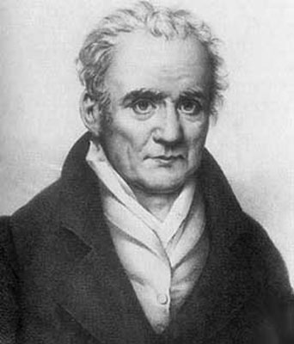
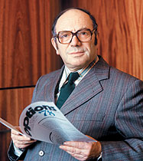
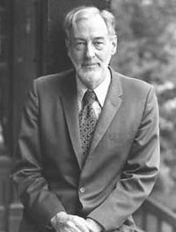
The Monge-Kantorovich problem
Monge (« Sur la théorie des déblais et des remblais » Mém. de l’acad. de Paris, 1781) first formulated the problem with civil engineering motivations: how to move piles of sand in order to fill holes in a cost-effective way.
Kantorovich and Koopmans, working independently in the 1940s, had military and industrial motivations: how to optimally supply military warehouses. Both pioneered Linear Programming techniques to solve the problem, which granted them a joint Nobel prize in Economics in 1975.
More recently, the works of Y. Brenier, R. McCann and C. Villani have made Optimal Transport (OT) become a standard tool in analysis and geometry. The lecture notes by Villani (2003), and his reference monograph (2009) have vastly popularized the topic.
Notes:
3

Slide 4

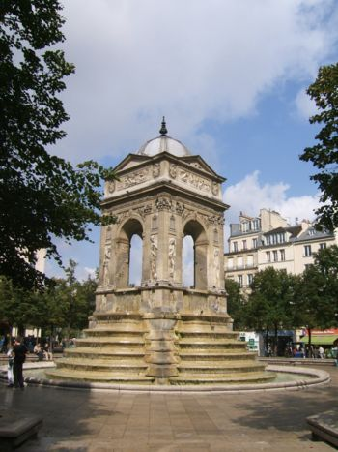
What is Optimal Transport? an example
In the early XVth century, Paris had 17 public fountains and 250.000 inhabitants… that is, a fountain for each 15.000 inhabitant.
Notes:
4

Slide 5
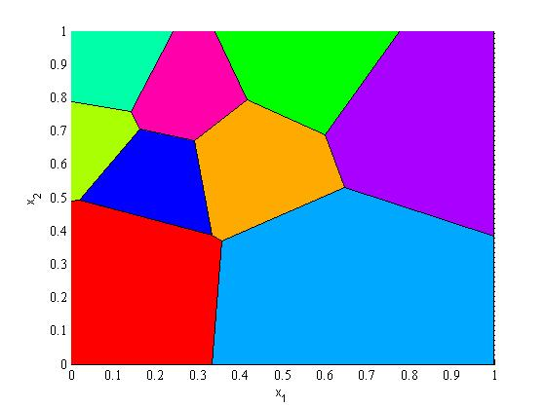
A optimal coordination problem…
Each fountain has a fixed capacity ; inhabitants have a fixed density of population across the city surface; and fountains are more concentrated in some areas than others.
Without a regulation mechanism, each inhabitant chooses the closest fountain.
Thus either a central planner has to assign inhabitants to fountain…
<- The resulting configuration is called a Voronoi diagram.
Notes:
5

Slide 6
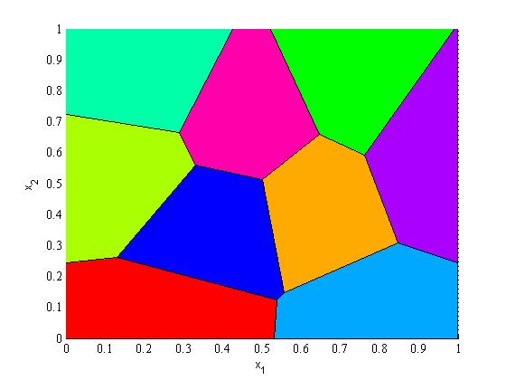
… or a problem of equilibrium price adjustement
…alternatively, differentiated prices should be introduced so that the price of the more demanded fountains rises, the price of the less demanded fountains decreases.
It is a basic result of OT theory that there are prices that clears the market, ie. such that the demand for each fountain exactly equates capacity.
Further, the resulting allocation will be optimal from the central planner’s point of view. This is a Welfare Theorem: the invisible hand at work.
<- The new configuration is called a Power diagram.
Notes:
6

Slide 7
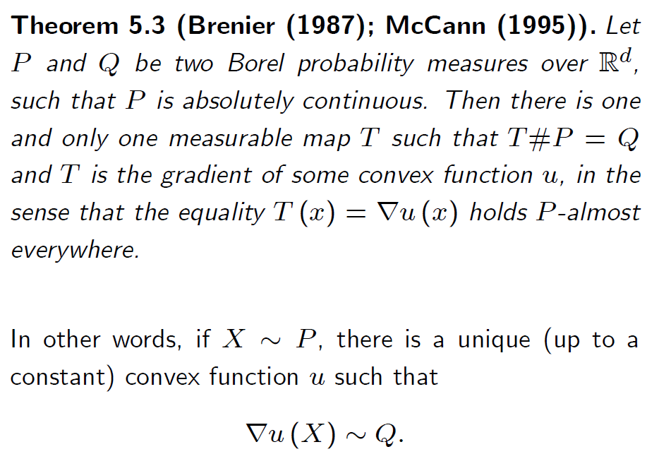
A fundamental result…
The following result is due to McCann (1995), building on earlier work by Brenier (1987). It provides a general representation of any random vector.
Notes:
7

Slide 8
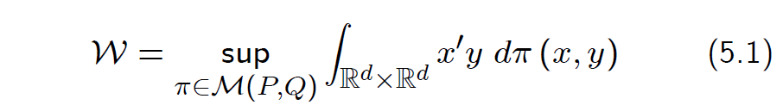

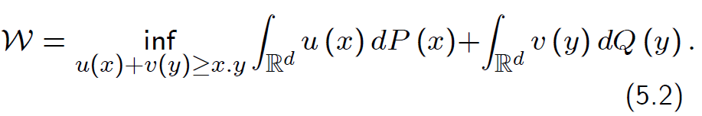
… and a variational intepretation
It turns out that the previous representation result is tightly related to a variational principle, which the Monge-Kantorovich duality:
where M(P,Q) is the set of joint probabilities of (X,Y) with marginals P and Q. This has dual
Notes:
8

Slide 9
2. Matching markets
Optimal transportation has natural application to the analysis of matching markets, for instance:
CEOs and firms
Academic departments
Industrial alliances
School allocation
Marriage
A match is predicted by
The strength of complementarity between two agents
The relative scarcity of these agents’ charactestics
Q: How to estimate complementarities between agents? How to use the findings to design better economic policies?
Ex: legal framework of marriage and divorce; taxation policy; equivalence scales; regulation of competition; etc.
<- our first example today
Notes:
9

Slide 10

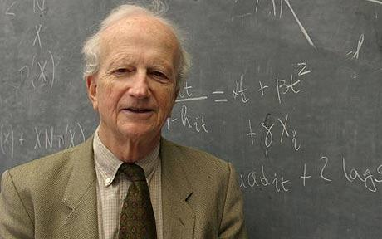
The Economic Approach to Marriage
Gary Becker’s approach to marriage: a competitive matching market at equilibrium where partners bargain to share the joined surplus.
Equilibrium approach: everyone is happy with his/her partner. « Stable marriages ».
Mathematically, an OT problem where the marginal distributions are those of the partners’ characteristics.
Econometrics: an inverse problem: given the observation of how people match, what can be deduced about individual affinities?
Notes:
10

Slide 11
Why models are needed
Q: What are the determinants of attraction?
Endogamy, “assortive mating”: well-known phenomenon in biology and social sciences, observed in many dimensions…
… but it is hard to understand what is going on just by looking at correlation
why does “Barbara marry Barry”: preference for similar names? Or confounding factor?
Notes:
11

Slide 12
Prices
Becker’s theory predicts the existence of « prices » on the marriage market, even though they are not necessarily explicit
Prices are sometimes explicit (dowries)
In our societies, they are mostly implicit… but well known to market participants
Basic economic theory: prices = marginal rates of substitution
According to Chiappori, Oreffice, and Quintana-Domeque (Journal of Political Economy, 2012): “Men may compensate 1.3 additional units of BMI with a 1%-increase in wages, while women may compensate two BMI units with one year of education.”
Notes:
12

Slide 13
Competition
Economic theory (and common sense) predicts that competition favors the short side of the market
Wei and Zhang (2011) note that boys’ parents in China (who are on the « long side » of the market) save more than girl’s parents. They argue that boys’ parents enter in a competitive saving race in order to enhance the odds of their sons on the marriage market. They claim this explains a large part of the rise in the domestic saving behaviour in China since the 1990s.
Notes:
13

Slide 14
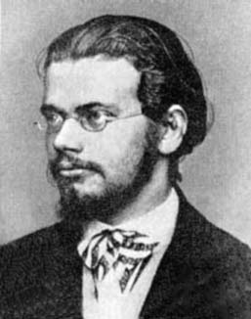
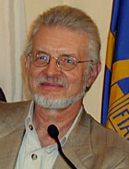
Measurement
Econometric question: what models best describe the data? Approach through revealed preference/discrete choice theory following McFadden, cf. Choo et Siow (2006).
Many characteristics and large number of individuals => computational challenges.
In order to describe unobserved characteristics, G et Salanié (2012) and Dupuy and G (2014) introduce an entropic approach inspired from statistical physics..
In order to quantify the complementarily between various pairs of characteristics, Dupuy and G (2014) introduce the notion of affinity matrix, and estimate affinity between psychological characteristics of partners on the marriage market.
Notes:
14

Slide 15

Love or chance?
Dupuy and G (2014) show that, under these assumptions, the equilibrium matching is solution to
where Φ(x,y)=x’Ay is a quadratic surplus term that is determined by the affinity matrix A, and σ is a temperature parameter that captures the amount of unobserved heterogeneity.
The first term yields assortativeness; the second term yields randomness. Trade-off between them.
Inverse problem: it is possible to estimate the affinity matrix A based on the observation of π, which is the observed matching.
Notes:
15

Slide 16
Affinity
Source: Dupuy & Galichon (2014)
Notes:
16

Slide 17
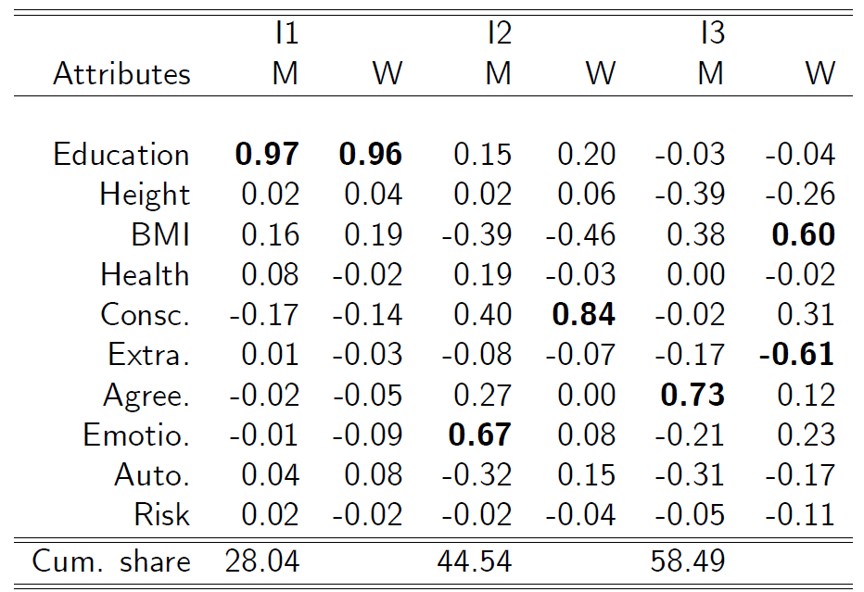
Indices of mutual attractiveness
Source: Dupuy & Galichon (2014)
Notes:
17

Slide 18
Extensions (in progress)
Dupuy, G and Zhao evaluate the welfare impact of a hypothetical softening of internal migration restrictions in China though equilibrium shifts on the labour market and the marriage market.
Dupuy and G study the consequences of the change in taxation on the market for talent (top executives, athletes).
Notes:
18

Slide 19
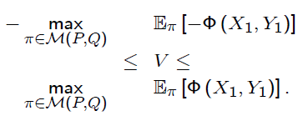
3. Model-free bounds
Optimal transportation is used in G, Henry-Labordere & Touzi (2014) to provide model-free bounds on derivative proces
Assume we want to price an option of maturity T=1 on two underlyings X₁ and Y₁. The payoff of the option at date T=1 is Φ(X₁,Y₁).
e.g. spread options Φ(X,Y)=(X-Y-k)⁺; cheapest to deliver Φ(X,Y)=min(X,Y)
Assume there is a perfectly liquid and complete market of single-name vanilla options on X₁ and Y₁, so that the risk neutral marginal probabilities P of X₁ and Q of Y₁ are known. Let M(P,Q) be the set of probabilities with these marginals.
The arbitrage (“model-free”) bounds on the option price V are
which is a Monge-Kantorovich problem.
Notes:
19

Slide 20
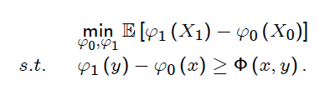
Link with super/sub-replication
Dual of the upper bounds problem (say) is
Financial interpretation: ϕ₁(y)-ϕ₀(x) is a superreplicating portfolio obtained from the vanilla single-name puts and calls. Eϕ₁(Y)-Eϕ₀(X) its price.
Monge-Kantorovich theorem: Price of cheapest superreplicating portfolio=upper bound on price of option.
Notes:
20

Slide 21
Variants and extensions
Many interesting variants. Often, instead of depending on the price of two assets at the same date, the option depends on the price of the same asset at two different forward dates X₀ and X₁. In this case
Target function may depend on the whole path Xt
Martingality constraint may be added for the path of X (gives variational solutions to the Skorohod embedding problem).
G, Henry-Labordere, and Touzi (2014) consider the case when the target function is the expected pathwise maximum and recover the celebrated Azema-Yor solution. Many other solutions can be recovered through OT.
Other fascinating links: reciprocal diffusions, Nelson’s stochastic mechanics.
Notes:
21

Slide 22
Reference
G. Becker, A Treatise on the Family, Harvard, 1991.
A. Dupuy, A. Galichon, “Personality Traits and the Marriage Market”, Journal of Political Economy, 2014.
A. Galichon, Optimal Transport Methods in Economics, MIT lecture notes, available at http://alfredgalichon.com/optimaltransport2015s/ .
A. Galichon, P. Henry-Labordere, N. Touzi, A stochastic control approach to no-arbitrage bounds given marginals, with an application to Lookback options. Annals of Applied Probability, 2014.
C. Villani, Topics in Optimal Transportation, AMS, 2003.
Notes:
22

