Slide 1
Smirk
&
Relationship Between
Implied Volatility And Futures Price
Group 7
CHE Zhiheng
HE Wenqi
Hu Yingdong
Huang Yuqi
Xu Tao
Zeng Qianxin

Slide 2
CONTENTS
01
Dataset
02
Smirk
03
Implied Volatility Spread & Log Return
04
Regression Analysis

Slide 3
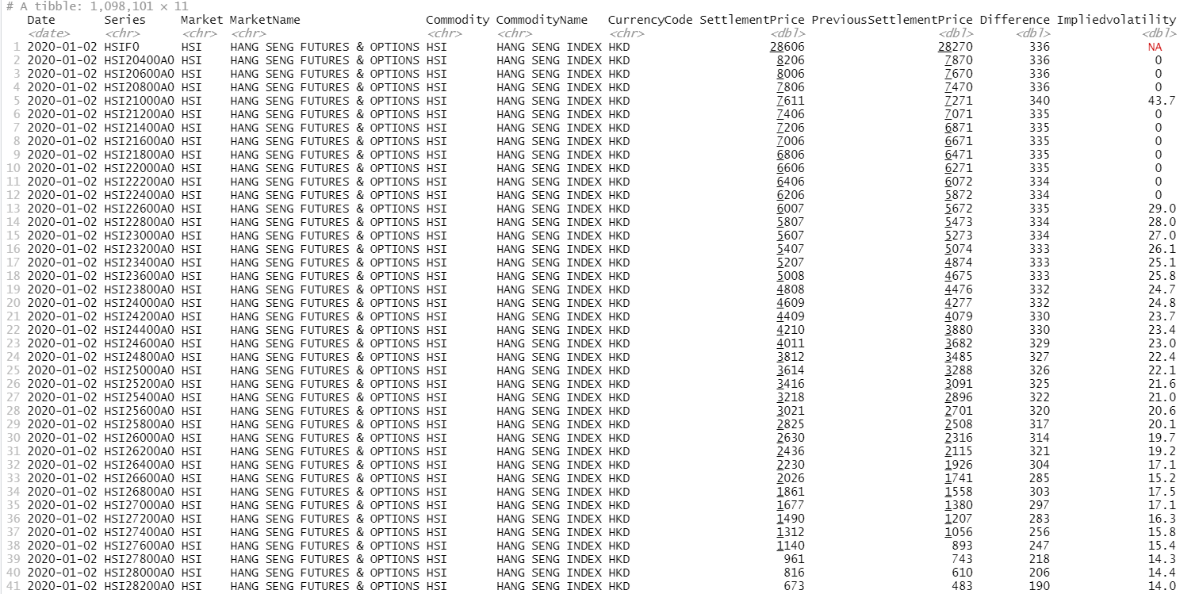
DATASET
Series : HSI20400A0
HSI : HANG SENG INDEX
20400 : Strike Price
Expiration Month Code:
Call Option :
January to December A to L
Put Option :
January to December M to X
0 means The Last Digit of Maturity Year
Currency Code : HKD
Difference :
= Settlement Price – Previous Settlement Price

Slide 4
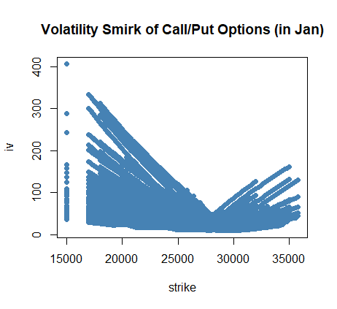
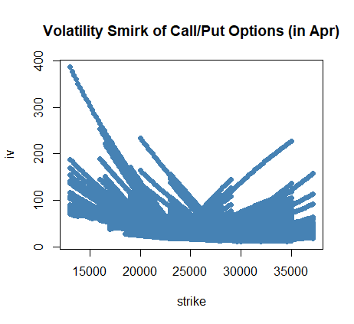
SMIRK
Conclusion 1 :
The Implied Volatility increases with the difference between strike price and the equity index price
Conclusion 2 :
Options that are ITM and OTM by an equal amount should have roughly the same implied volatility.

Slide 5
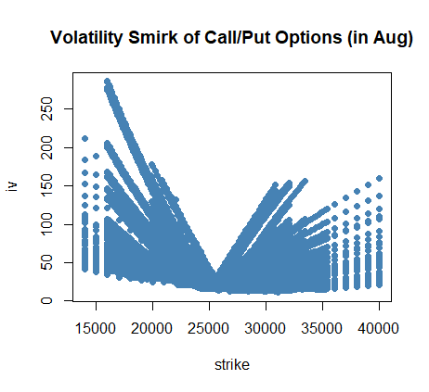
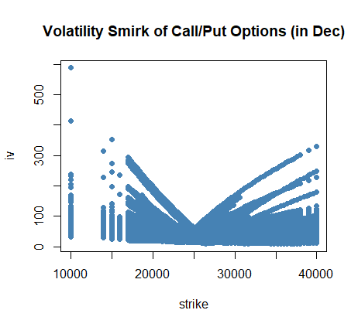
SMIRK
Conclusion 3 :
Compared with the ATM, Demand is greater for options that are ITM or OTM
Demand
Implied Volatility
Time Value
Strike Price

Slide 6
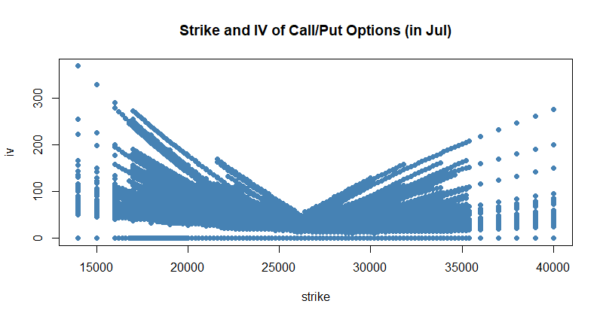

SMIRK
Volatility increases as the option becomes increasingly in the money or out of the money
Out of the money puts
At the money
In the money puts
In the money calls
Out of the money calls
Main Approach is based on the option’s moneyness
We choose 1 ATM call option with its moneyness closest to 1, and 1 OTM put option with its moneyness closest to 0.95.

Slide 7
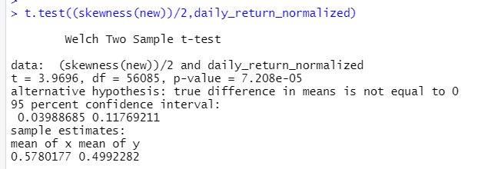
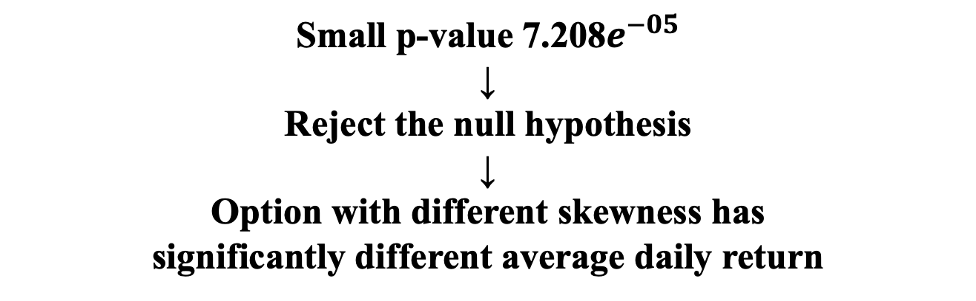
SMIRK Hypothesis Test
Conclusion :
Small p-value 7.208$e^{−05}$
↓
Reject the null hypothesis
↓
Option with different skewness has
significantly different average daily return

Slide 8
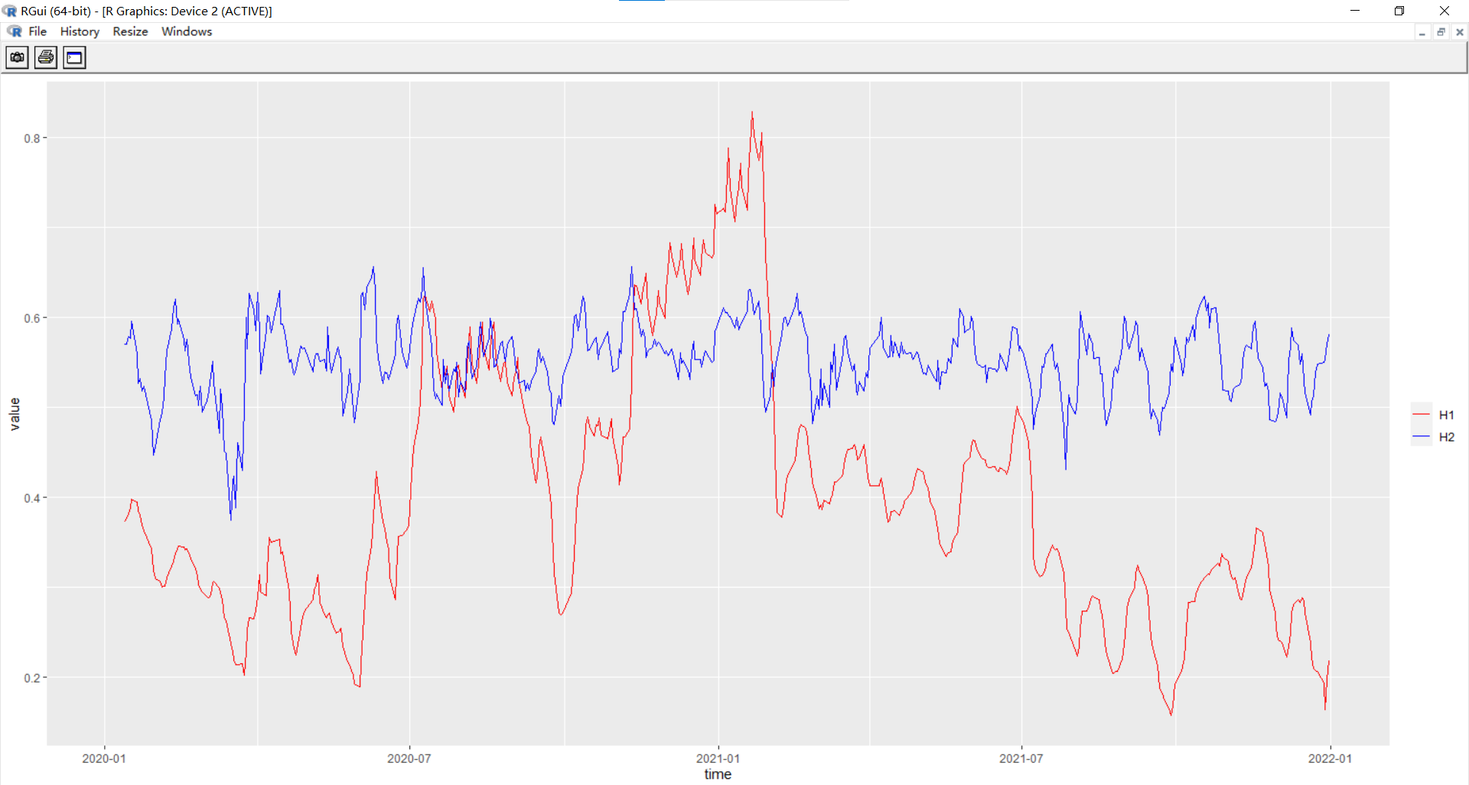
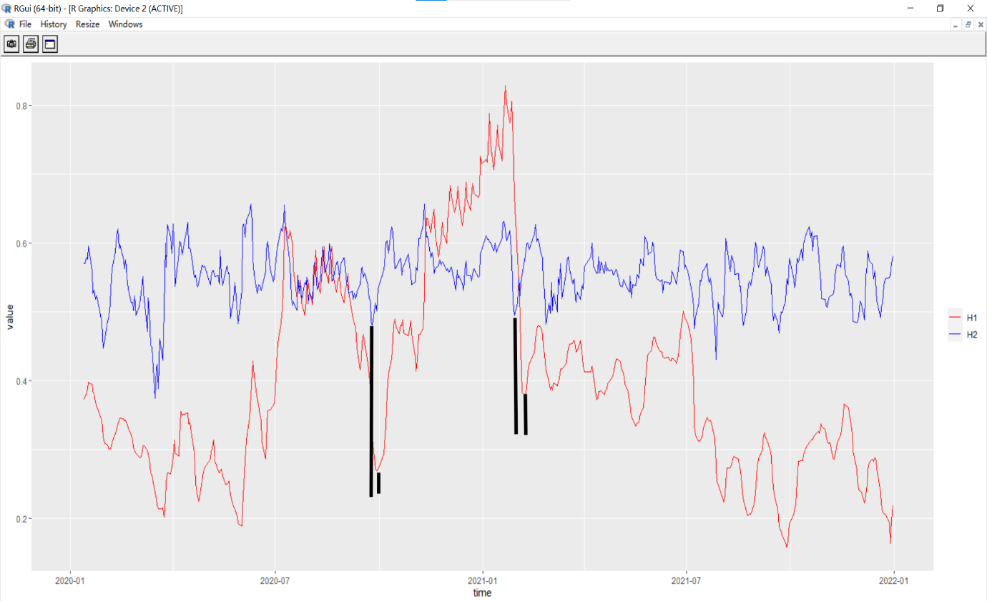
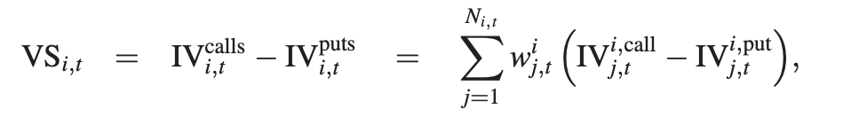
Implied Volatility Spread & Log Return
H1: Log Return of Index
H2: Implied Volatility Spread

Slide 9
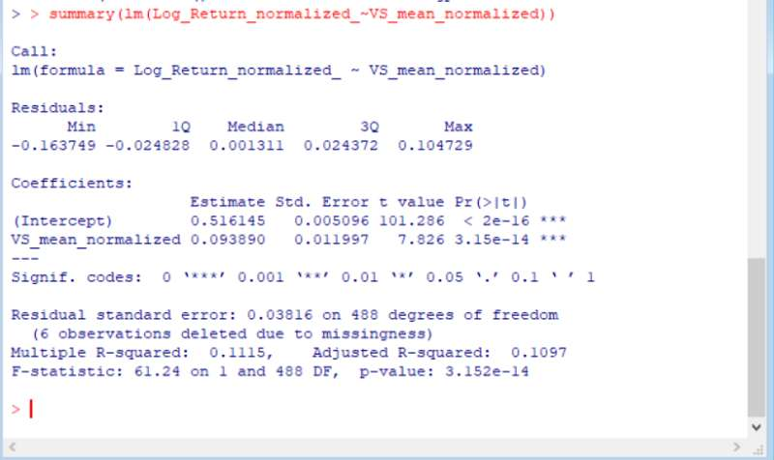
Implied Volatility Spread & Log Return
Conclusion :
The Implied Volatility Spread could forecast the movement of the trend of the index

Slide 10
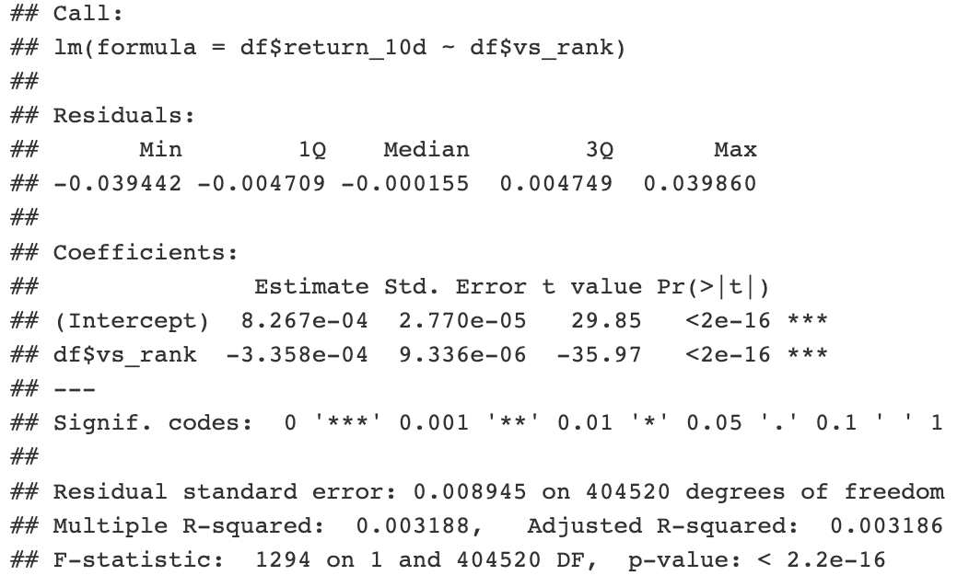
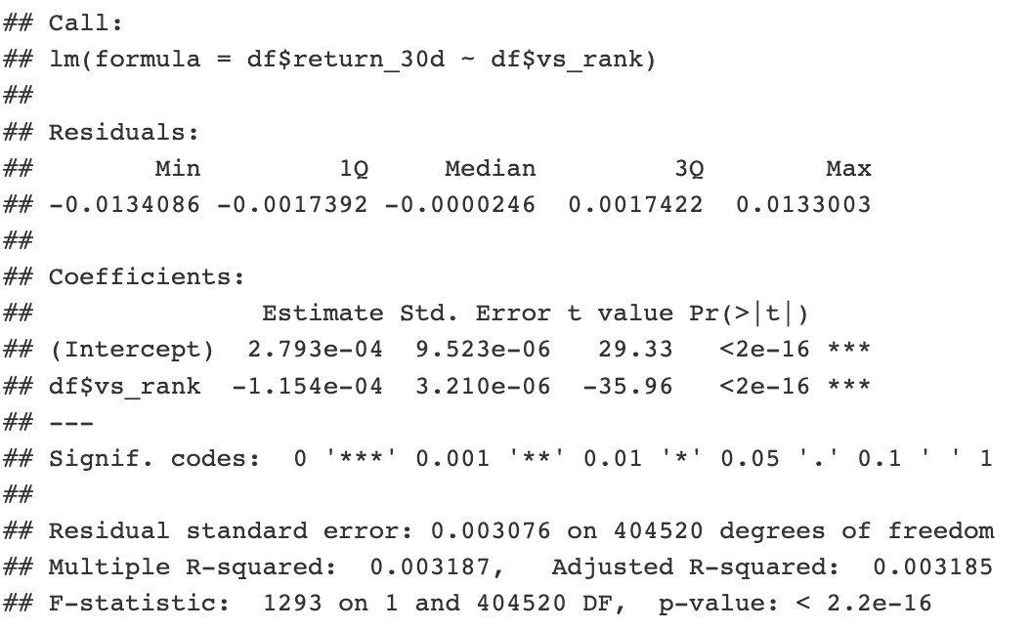
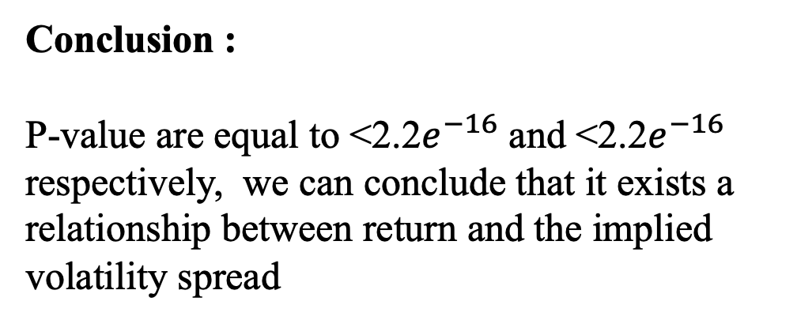
Regression Analysis
Y: 10-day and 30-day daily average return of the Hang Seng Index forecast
X: Implied Volatility Spread
Conclusion :
P-value are equal to <2.2$e^{−16}$ and <2.2$e^{−16}$ respectively, we can conclude that it exists a relationship between return and the implied volatility spread

Slide 11
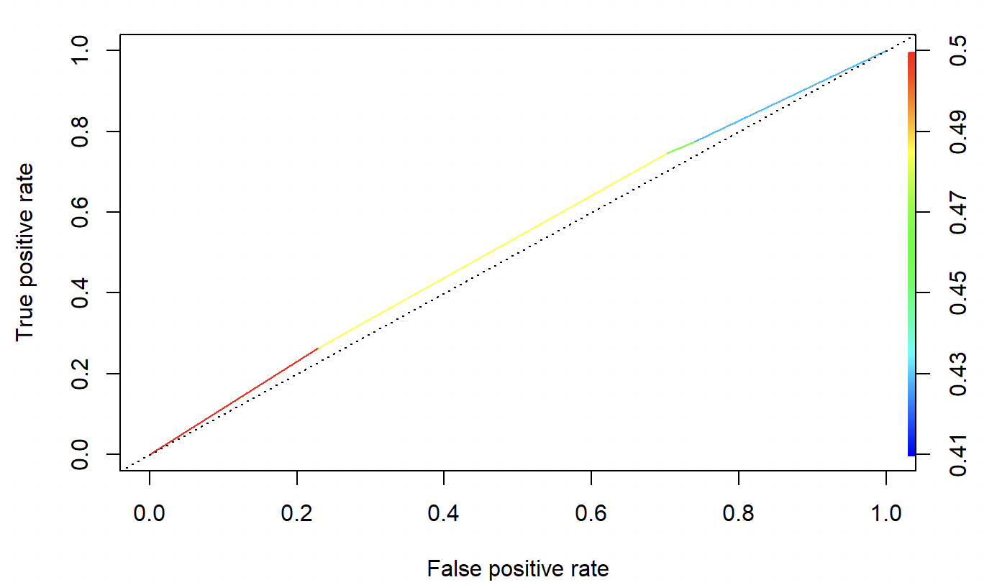
Regression Analysis
Conclusion :
The curve is lying over the 45-degree diagonal of the ROC space, which mean that the model has certain accuracy.

Slide 12
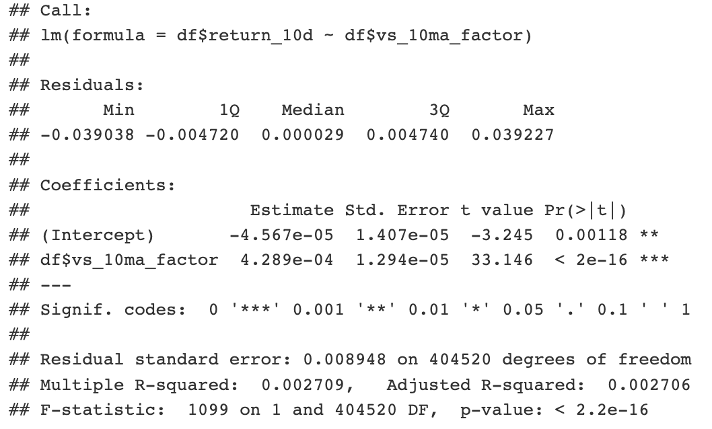
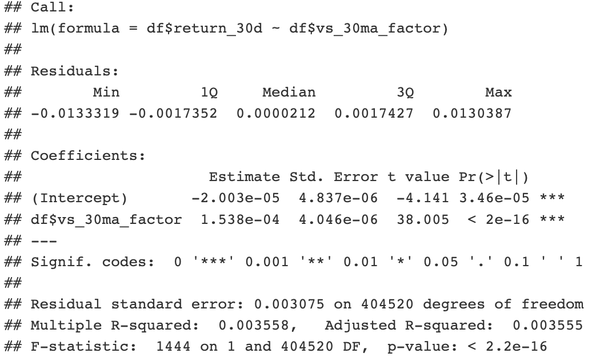
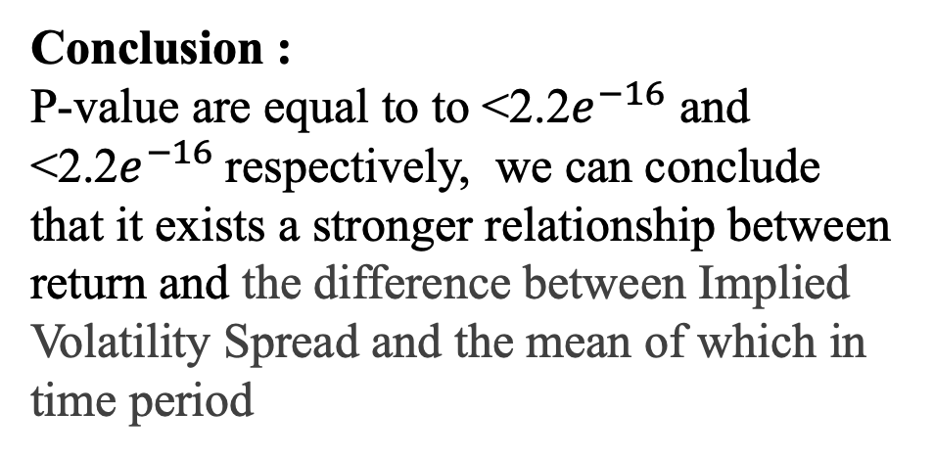
Regression Analysis
Y: 10-day and 30-day daily average return of the Hang Seng Index forecast
X: The difference between Implied Volatility Spread and the mean of which in last 10 and 30 days
Conclusion :
P-value are equal to to <2.2$e^{−16}$ and <2.2$e^{−16}$respectively, we can conclude that it exists a stronger relationship between return and the difference between Implied Volatility Spread and the mean of which in time period

Slide 13
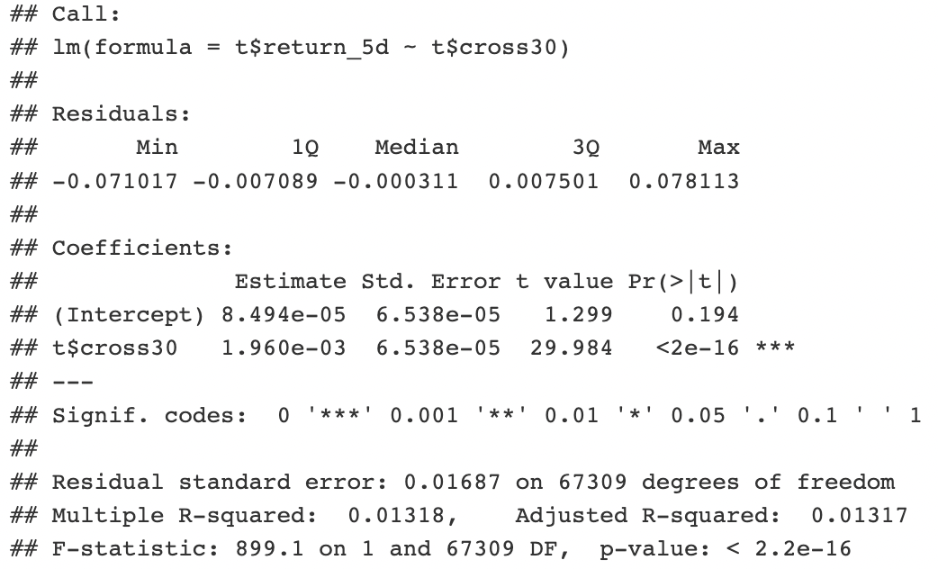
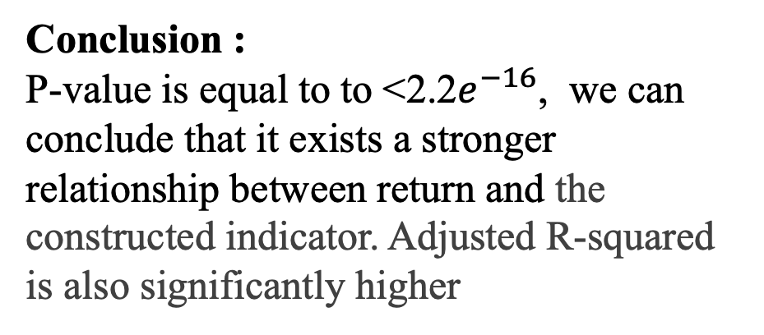
Regression Analysis
Y: 5-day daily average return of the Hang Seng Index forecast
X: If current between Implied Volatility Spread positively or negatively exceed the 80% confidence interval of the mean of which in last 30 days
Conclusion :
P-value is equal to to <2.2$e^{−16}$, we can conclude that it exists a stronger relationship between return and the constructed indicator. Adjusted R-squared is also significantly higher

Slide 14
Limitation
Data Missing : Missing Value
Factor Inadequate : Model needs more factors for Regression
Small Amount of Noise : There is still an individual difference between the groups (Implied Volatility Spread), not every group will react the same way
The Scale of Measurement : The t test we conducted can only indicate the difference between two groups of data. But the scale of the data cannot be compared in the testing.

Slide 15
Q & A

Slide 16
Thank you

