Slide 1
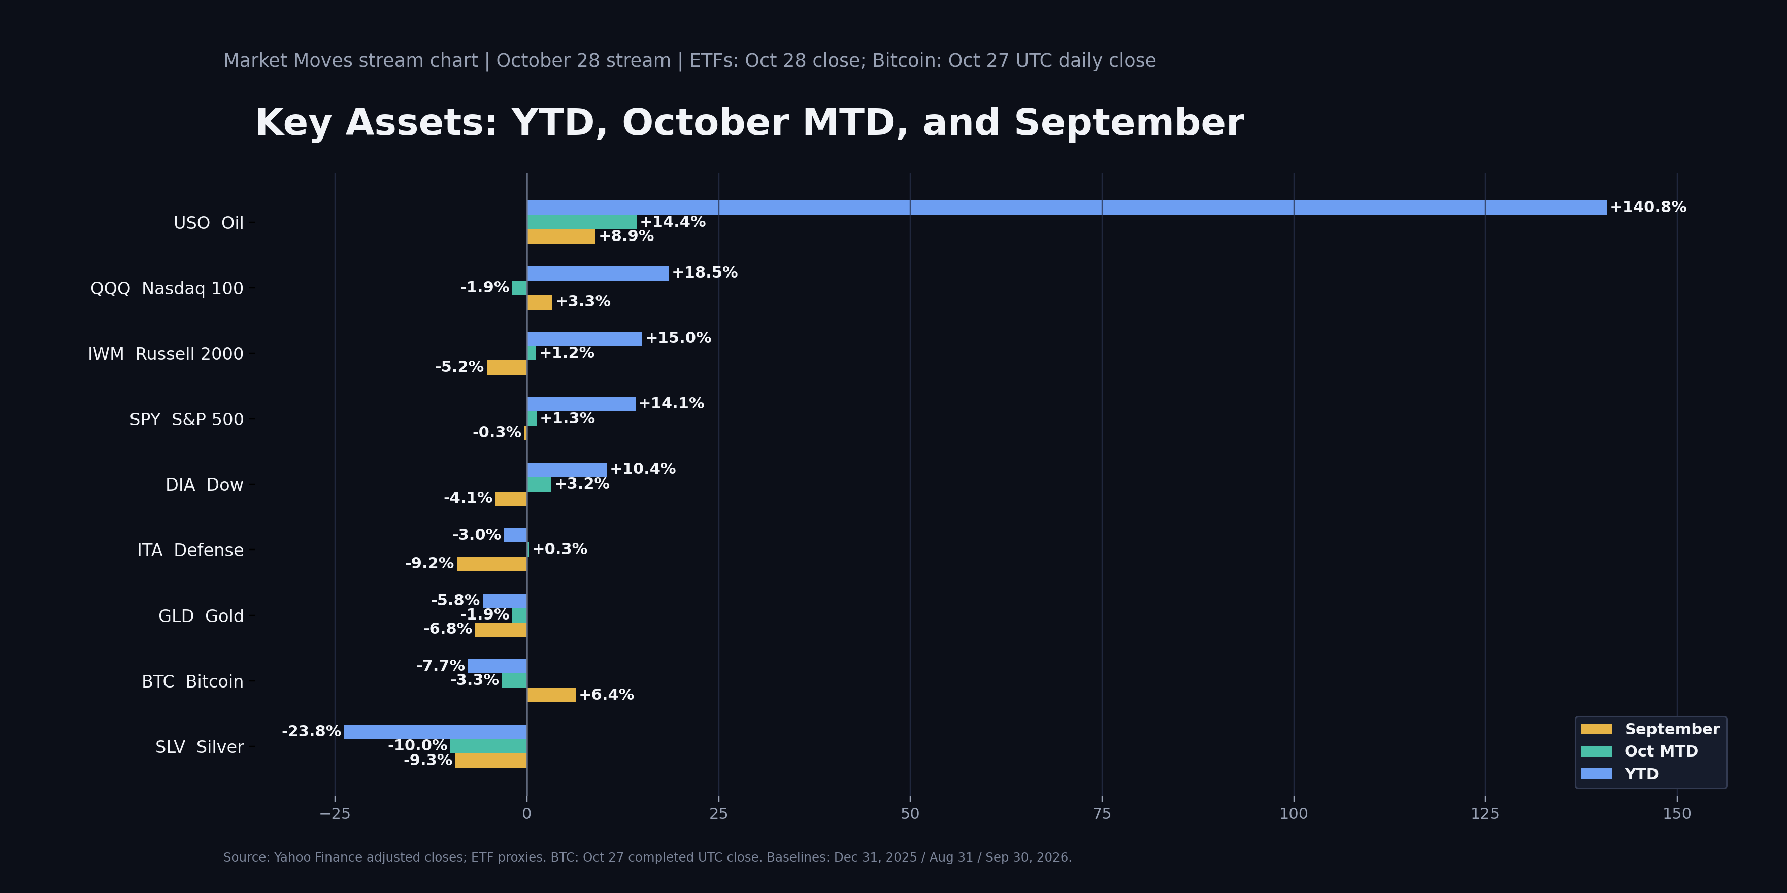
MARKET MOVES
Key Assets Scorecard
Wednesday, October 28 | YTD / October MTD / September | ETFs: Oct 28 close; BTC: Oct 27 UTC close

Slide 2
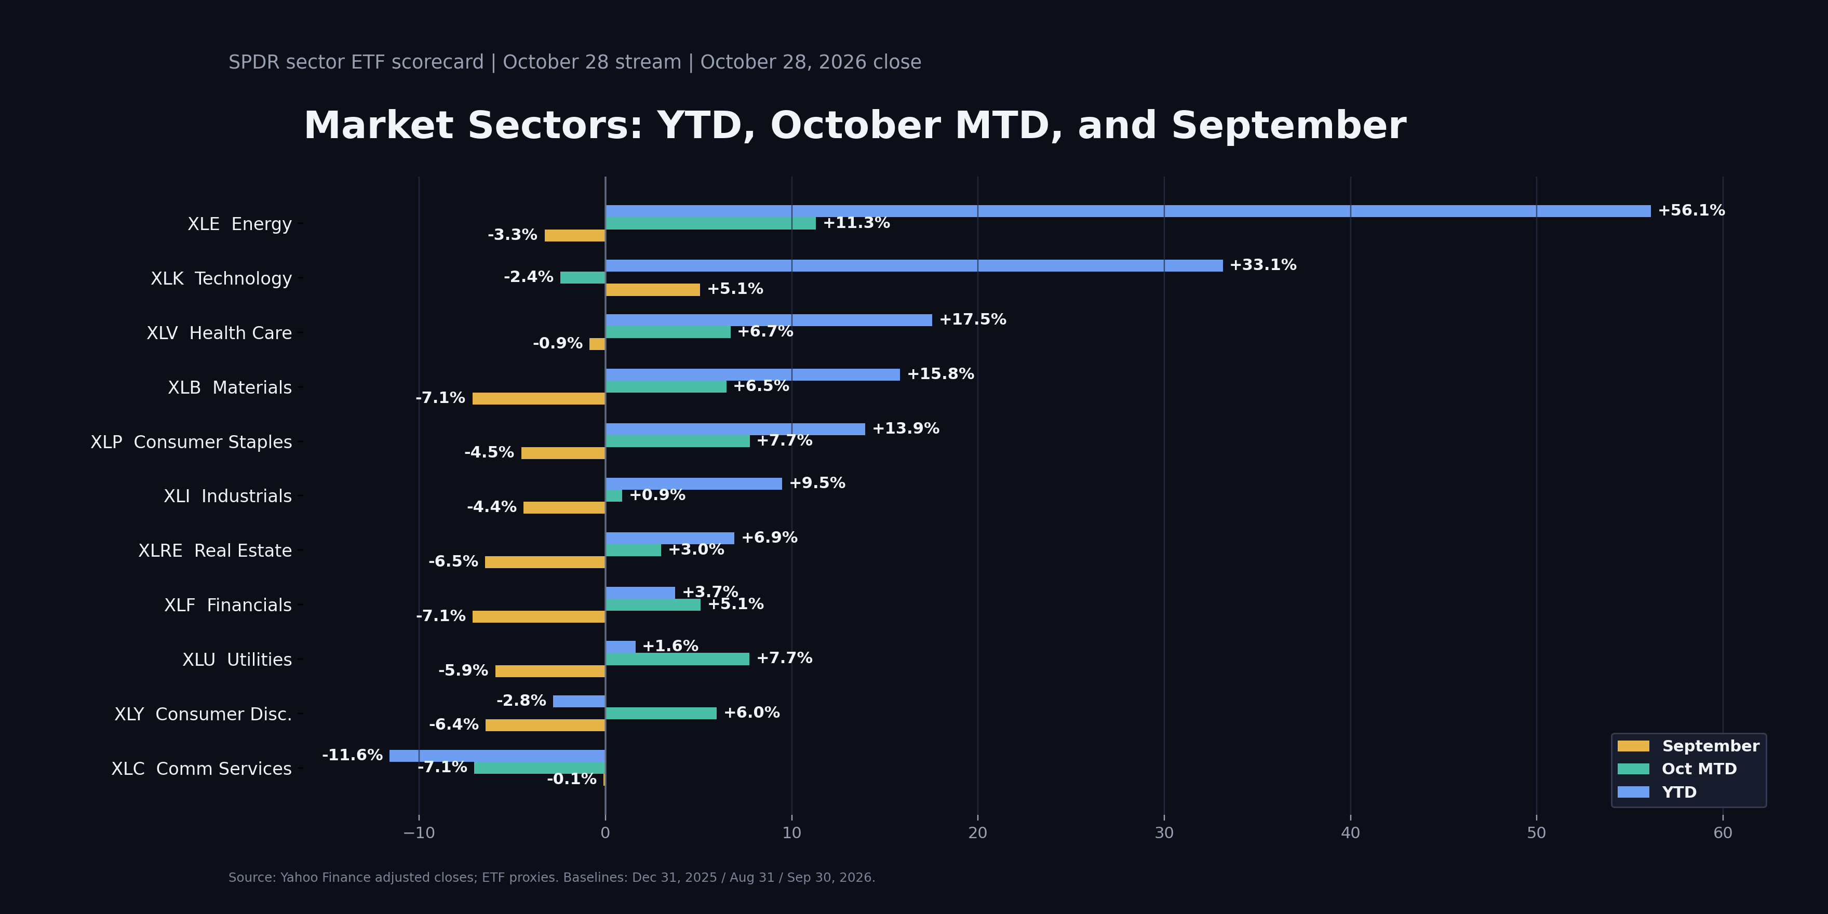
MARKET MOVES
Sector Scorecard
Wednesday, October 28 | SPDR sectors: YTD / October MTD / September | October 28, 2026 close

Slide 3
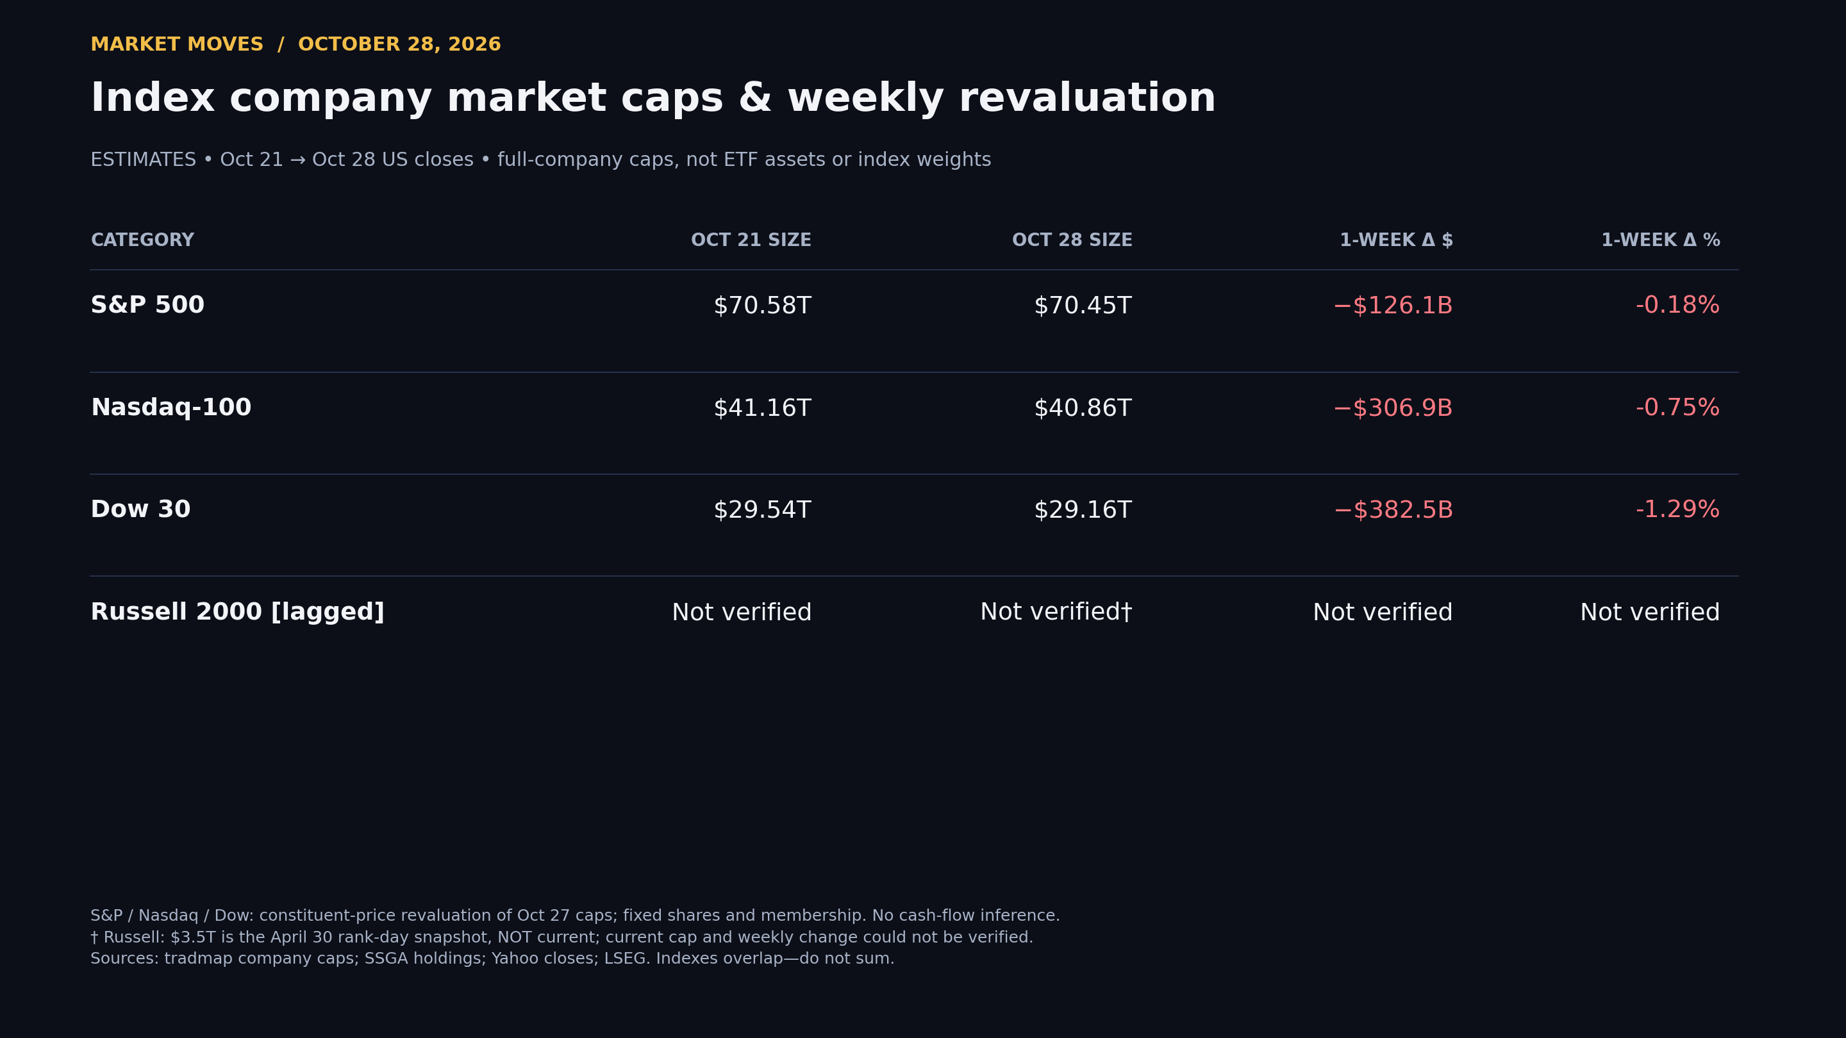

Slide 4
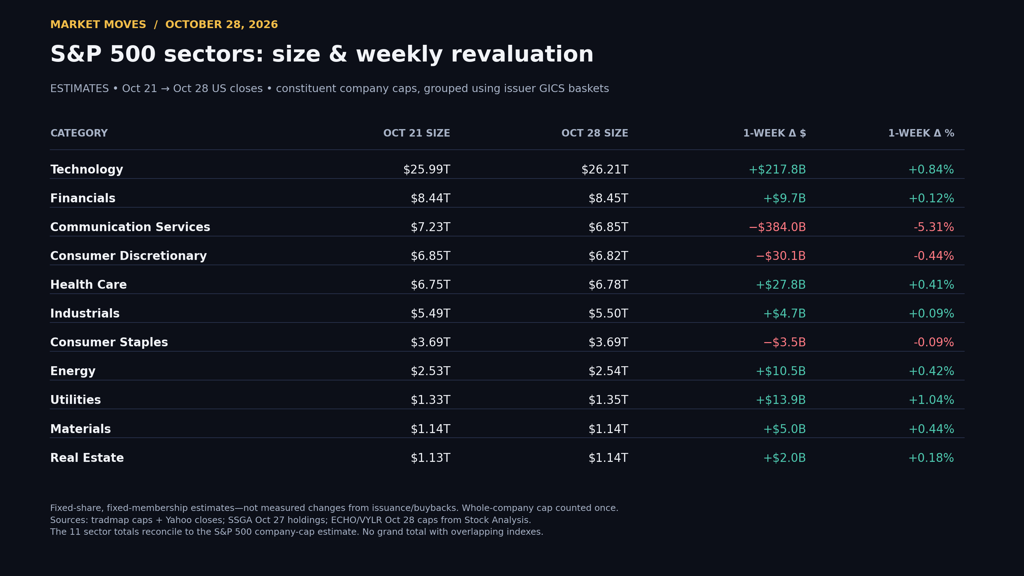

Slide 5
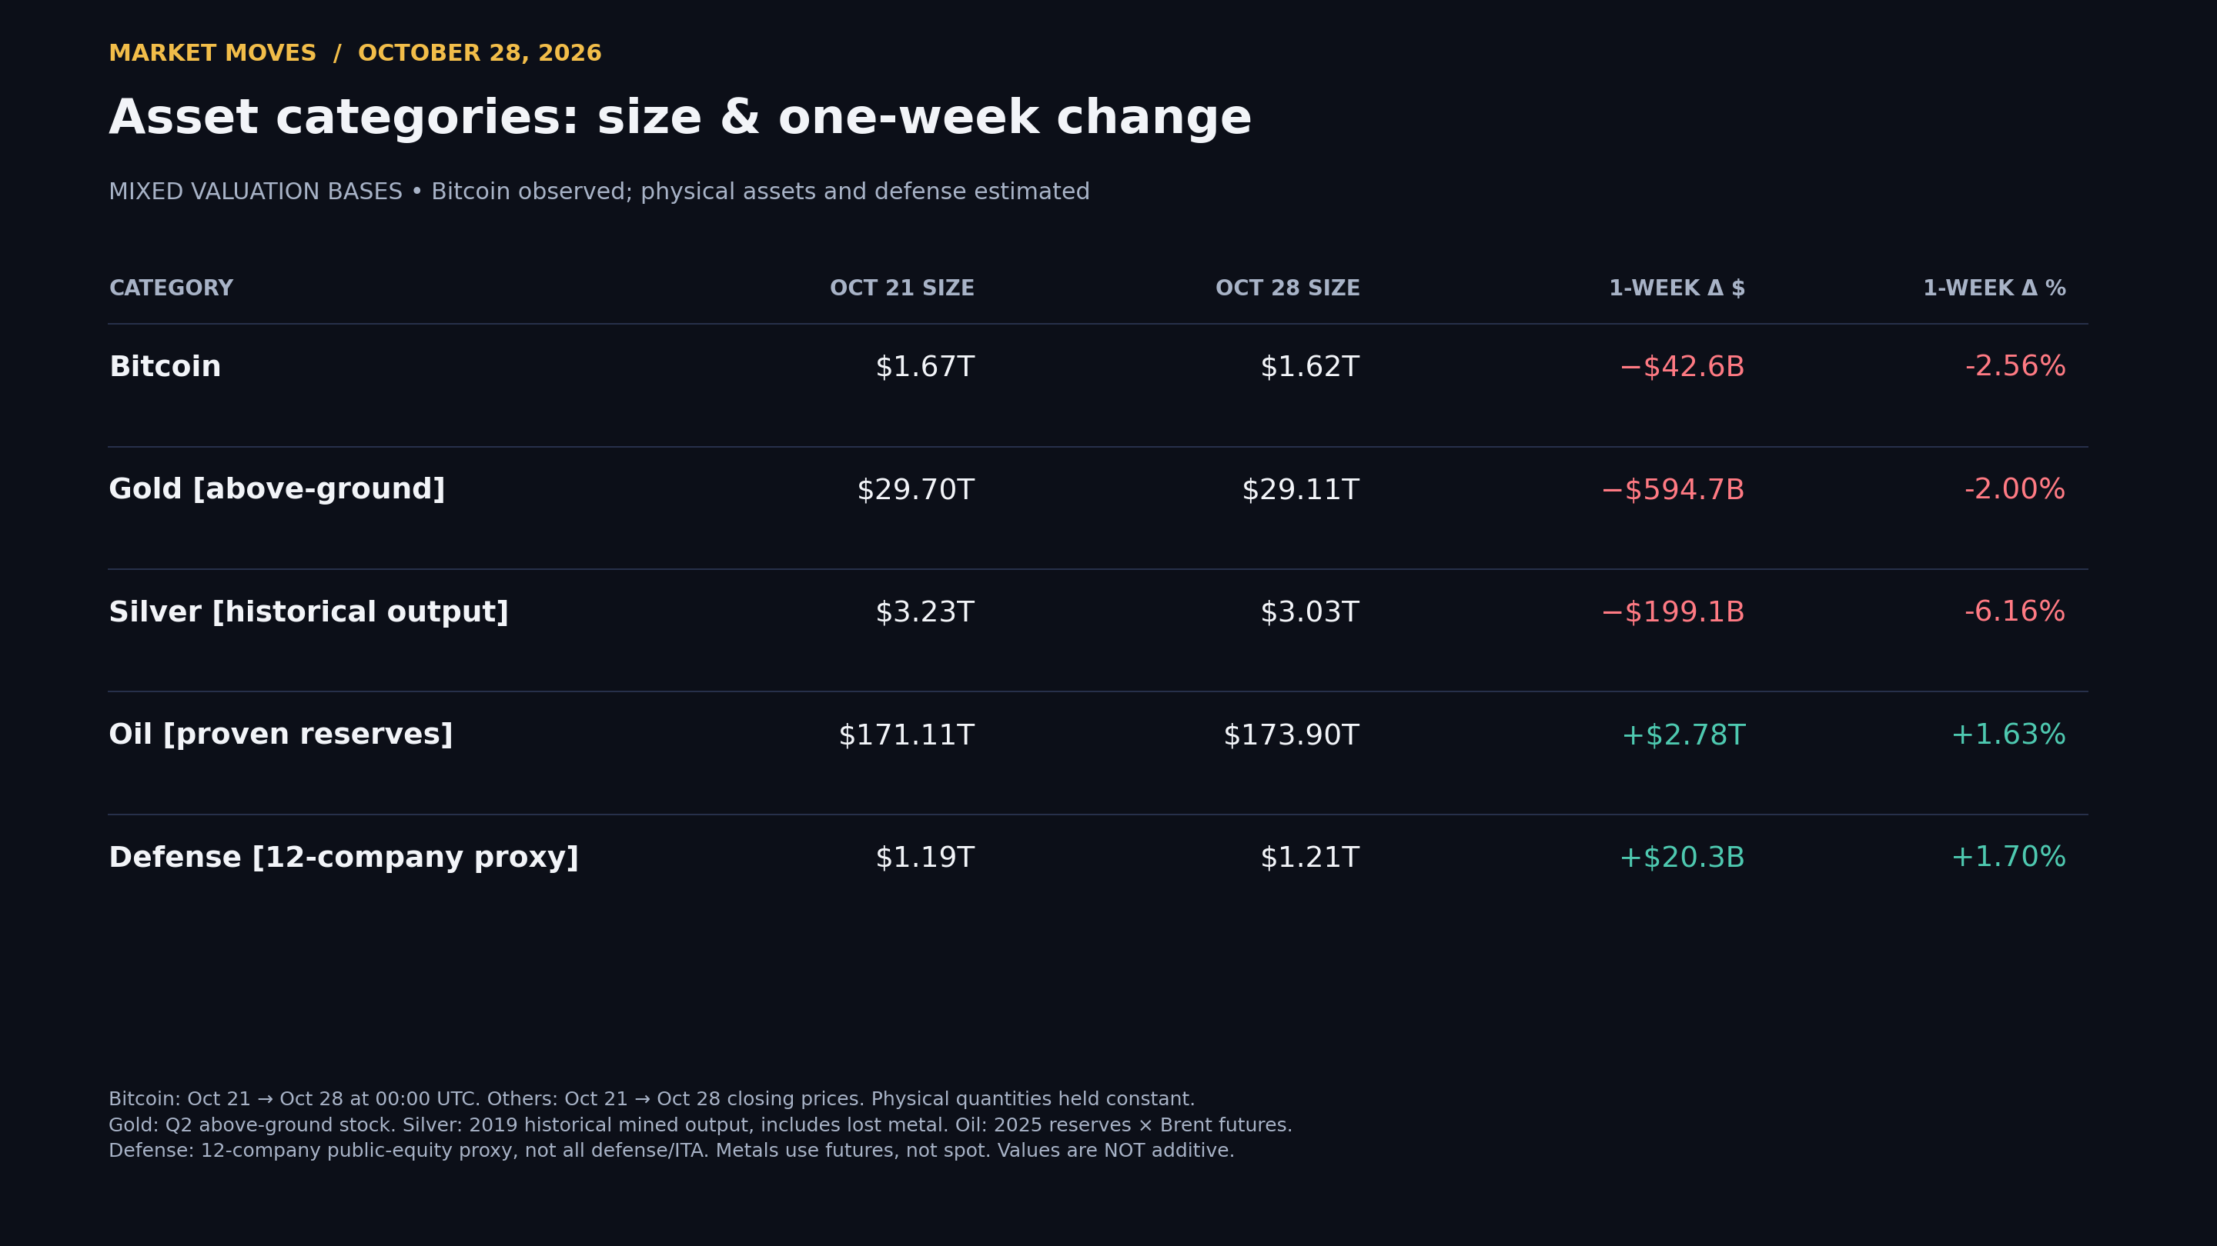

Slide 6
SOXL Wheel — Sandwich | Position setup
Owned: 200 shares × $90 cost basis = $18,000.
Short puts: 2 × $135 strike, Nov. 20, 2026 expiry; potential purchase of 200 more shares for $27,000.
Put credits: $8.45 + $35 per share, one contract each = $4,345 total. Confirmed in Oct. 28 captions at 17:59–18:57 and 1:04:04–1:04:49.
Covered call: 1 × $120 strike, Nov. 20, 2026 expiry, $5.45/share = $545 premium; covers 100 shares.
Remaining 100 shares are uncapped. Standard 100-share contracts; reported educational example, not brokerage-verified fills.

Slide 7
SOXL Wheel — Sandwich | Expiration mechanics
SOXL below $120: both puts assigned; call expires → 400 shares. $45,000 gross stock cost − $4,345 puts − $545 call = $40,110 net cash cost ($100.275/share), before fees/tax.
SOXL between $120 and $135: both puts assigned AND 100 shares called away → 300 shares. These strikes overlap; both sides can be exercised.
SOXL above $135: puts expire; 100 shares called away → 100 shares remain with uncapped upside.
Called lot: ($120 − $90) × 100 + $545 = $3,545 stock gain plus call premium, before fees/tax; not total-position profit.
Exact-strike outcomes/early assignment can differ. SOXL targets 3× DAILY returns; leverage and compounding amplify risk. Premium is not guaranteed profit; substantial downside remains.

