Slide 1
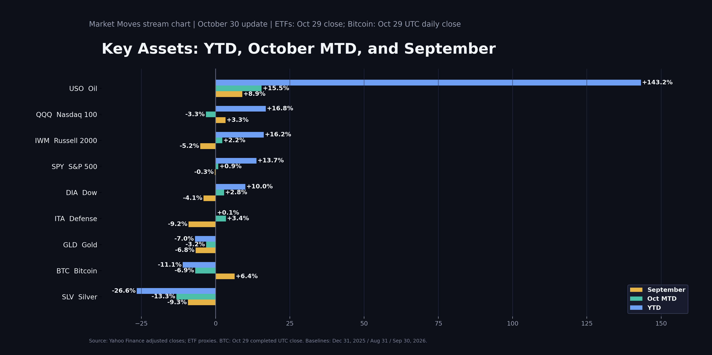
MARKET MOVES
Key Assets Scorecard
Friday, October 30 | YTD / October MTD / September | ETFs: Oct 29 close; BTC: Oct 29 UTC close

Slide 2
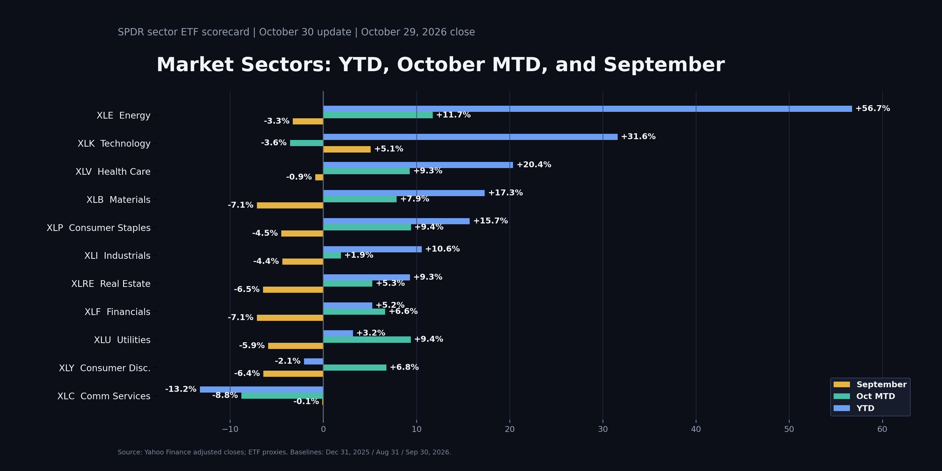
MARKET MOVES
Sector Scorecard
Friday, October 30 | SPDR sectors: YTD / October MTD / September | October 29, 2026 close

