Slide 1
ST. PAUL ACADEMY AND SUMMIT SCHOOL
2026
BOYS VARSITY SOCCER
End-of-Season Banquet
Celebrating our players, our team, and our community
SUNDAY, NOVEMBER 8, 2026

Slide 2
TONIGHT’S PROGRAM
A celebration of the 2026 season
01
Welcome
02
Dinner provided by Shish
03
Player Recognition, Varsity Letters & Coaches’ Comments
04
Season Slideshow & Highlight Reel
05
Coaches’ Reflections
06
End-of-Season Awards
07
Captains & Players: Open Mic
08
2027 Captains Announcement
09
Facilities, Fundraising and Future
SPA / BOYS VARSITY SOCCER / NOVEMBER 8, 2026

Slide 3
OUR PROGRAM
A championship tradition
1986
1987
1991
1994
2022
2023
2024
7
6
3
STATE
CHAMPIONSHIPS
SECTION TITLES
UNDER COACH MAX
IMAC
CHAMPIONSHIPS
Generations connected by a love of the game.
Sources: SPA Athletics championship history; Coach Max’s program totals; Lagos project notes.

Slide 4
THE PROGRAM THROUGH TIME
One program. Different eras.
1986–1994
2010–2012
2021
SINGLE-CLASS SUCCESS
CLASS A SUCCESS
A NEW STATE FORMAT
Four state championships
1986 • 1987
1991 • 1994
Three straight
section titles
2012 state runner-up
Three-class system:
Class A • AA • AAA
The standard carries forward—even as the landscape changes.
Sources: SPA Athletics; Minnesota soccer history; Lagos project chronology; Coach Max.

Slide 5
THE MODERN CHAMPIONSHIP ERA
Three seasons. Three state titles.
2022
2023
2024
CLASS A CHAMPIONS
CLASS A CHAMPIONS
CLASS A CHAMPIONS
2022–2024
A three-peat built across generations of Spartans.
Source: SPA Athletics official championship history and 2024 championship recap.

Slide 6
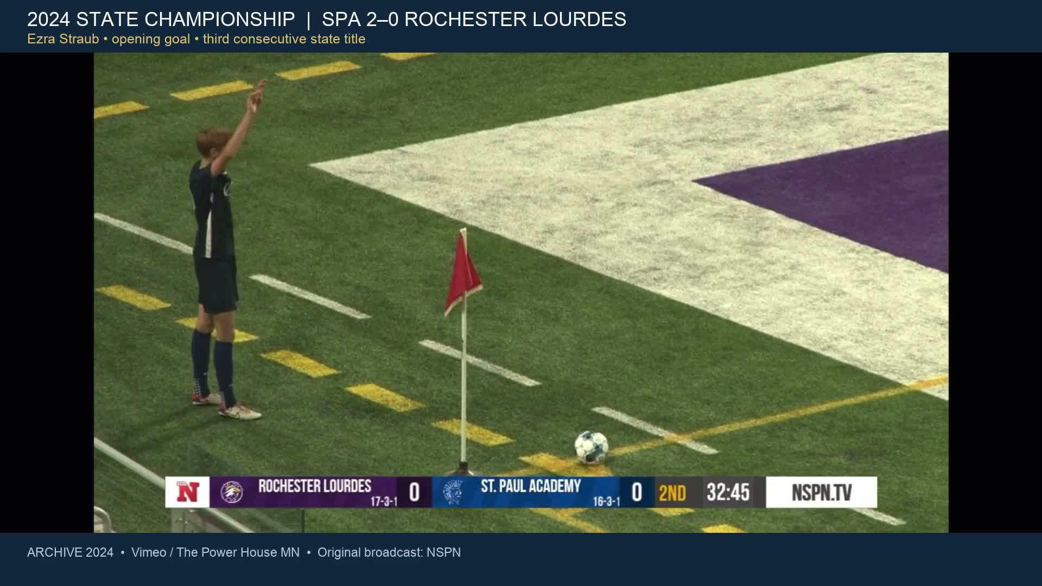

Slide 7
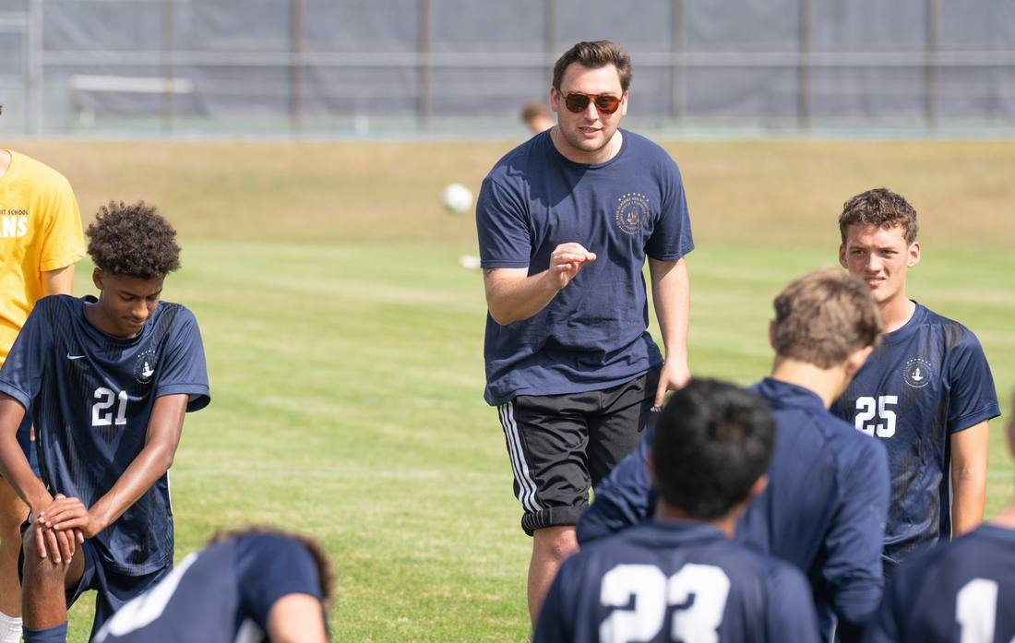
CARRYING THE PROGRAM FORWARD
The 2026 Spartans
28 PLAYERS • 14 SENIORS
Head Coach
Max Lipset
Michael Forsgren • Philip Caputo
Cooper — Goalkeepers
PROGRAM STAFF & SUPPORT
Buzz Lagos • John Jasinski • John Birch
Marco Pavoloni • Corey Mathaler
Student Manager: Isaak Senaratna
Sources: current 28-player roster and coach information supplied by Max. Photo: Geoff George.

Slide 8
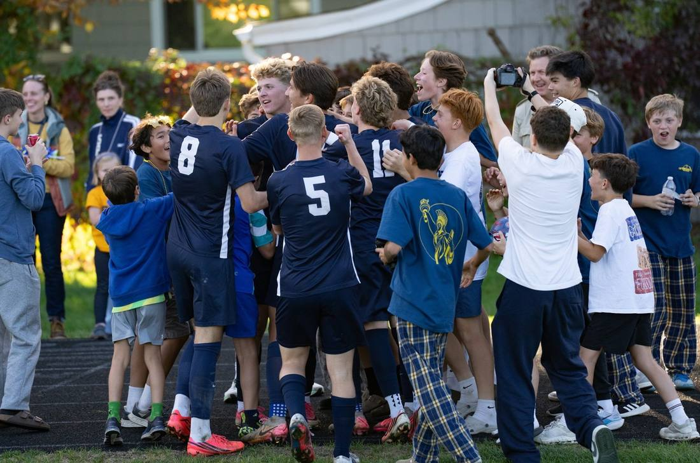
THIS SEASON
2026: a season worth celebrating
13
45
10
WINS
GOALS
TEAM SHUTOUTS
18 matches • 13–5 record
Tonight, we celebrate every player
and the people behind this team.
Source: verified 18-match competitive-season log. Photo: Geoff George.

Slide 9
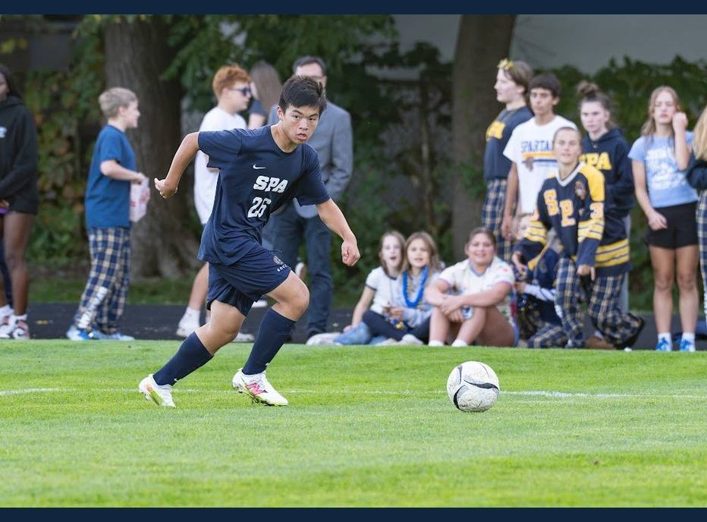
2026 VARSITY LETTER RECOGNITION
Vincent Tran
#8 • Grade 8
Years Varsity: 2026
38
RECORDED MINUTES
4
GAMES WITH MINUTES
Stats: Isaak Senaratna’s recorded match entries. Photos: Geoff George & Nate Waibel.

Slide 10
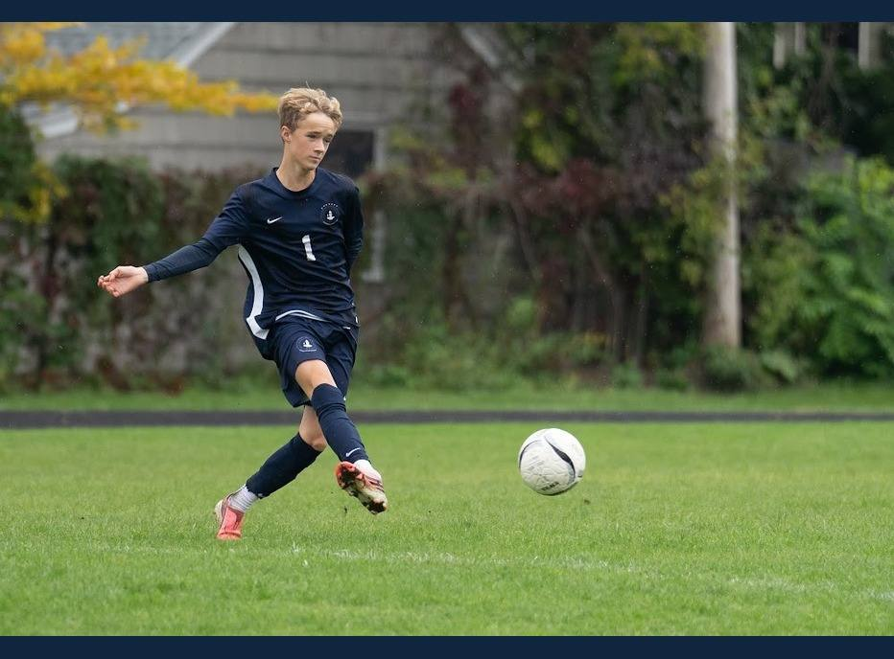
2026 VARSITY LETTER RECOGNITION
William Olson
#1 • Grade 9
Years Varsity: 2026
20
COMPLETED PASSES
4.8
TRACKED MILES
14.1
TOP SPEED (MPH)
Stats: corrected scoring ledger; named-player Veo tracking. Photos: Geoff George & Nate Waibel.

Slide 11
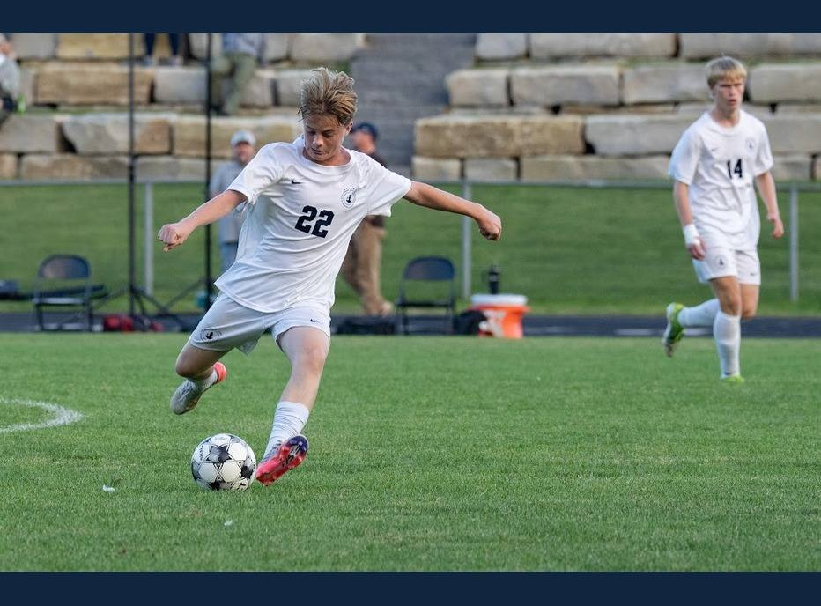
2026 VARSITY LETTER RECOGNITION
Andreas Bauer
#22 • Grade 10
Years Varsity: 2026
1
GOAL
66
COMPLETED PASSES
18.9
TRACKED MILES
Stats: corrected scoring ledger; named-player Veo tracking. Photos: Geoff George & Nate Waibel.

Slide 12
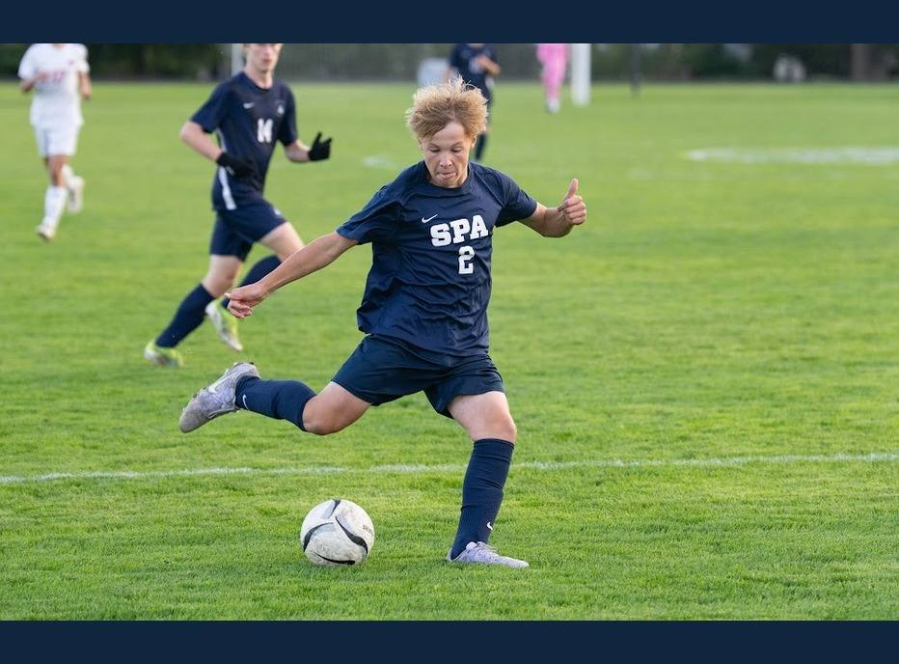
2026 VARSITY LETTER RECOGNITION
Ben Marso
#2 • Grade 10
Years Varsity: 2026
36
RECORDED MINUTES
3
GAMES WITH MINUTES
1
RECORDED GOAL
Stats: Isaak Senaratna’s recorded match entries. Photos: Geoff George & Nate Waibel.

Slide 13
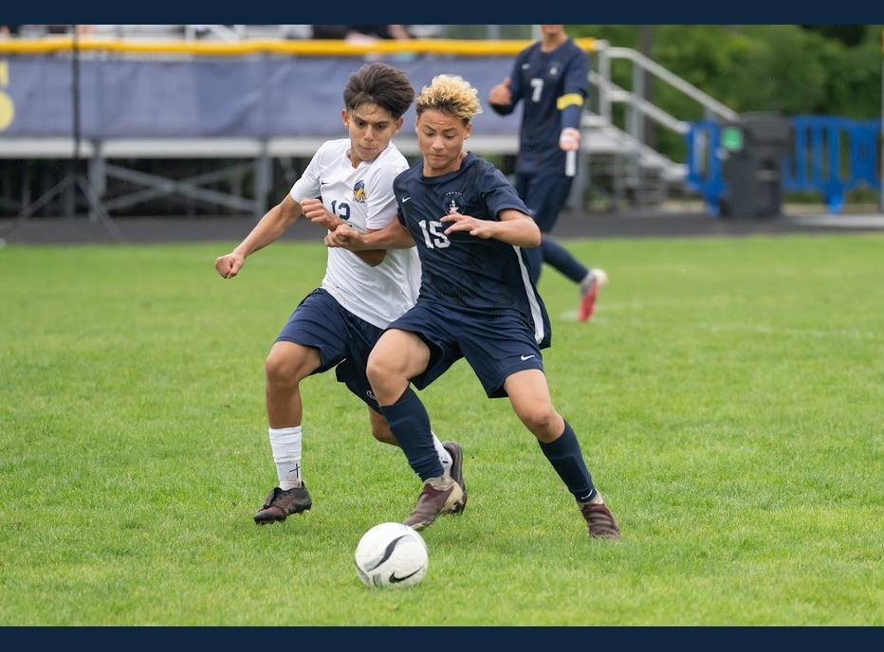
2026 VARSITY LETTER RECOGNITION
Jeray Bass
#15 • Grade 10
Years Varsity: 2026
45
RECORDED MINUTES
4
GAMES WITH MINUTES
1
RECORDED ASSIST
Stats: Isaak Senaratna’s recorded match entries. Photos: Geoff George & Nate Waibel.

Slide 14
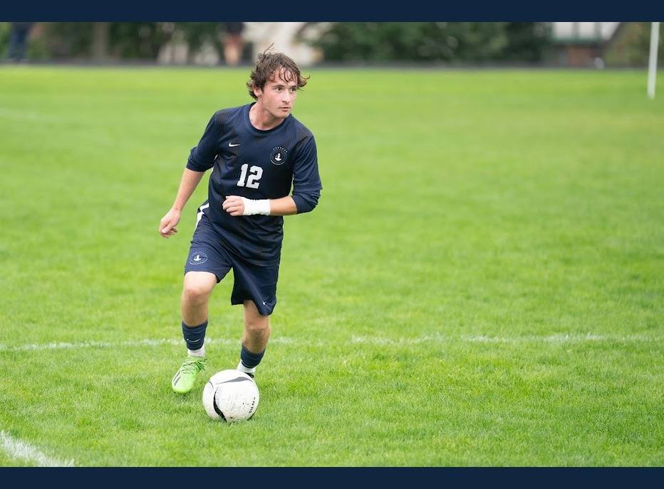
2026 VARSITY LETTER RECOGNITION
Max Vradenburg
#12 • Grade 10 • LB / RB
Years Varsity: 2026, 2025, 2024
2
ASSISTS
217
COMPLETED PASSES
45.8
TRACKED MILES
2024 Minnesota Class A & Section 3A Champion
Stats: corrected scoring ledger; named-player Veo tracking. Photos: Geoff George & Nate Waibel.

Slide 15
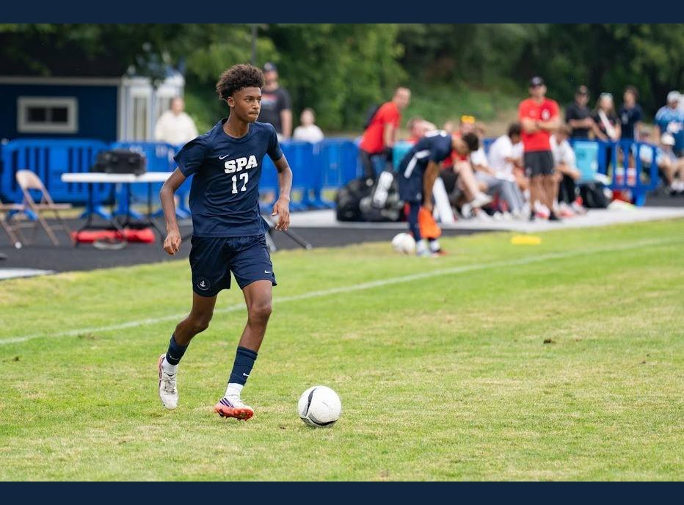
2026 VARSITY LETTER RECOGNITION
Nolan Yeboah
#17 • Grade 10
Years Varsity: 2026
58
RECORDED MINUTES
6
GAMES WITH MINUTES
Stats: Isaak Senaratna’s recorded match entries. Photos: Geoff George & Nate Waibel.

Slide 16
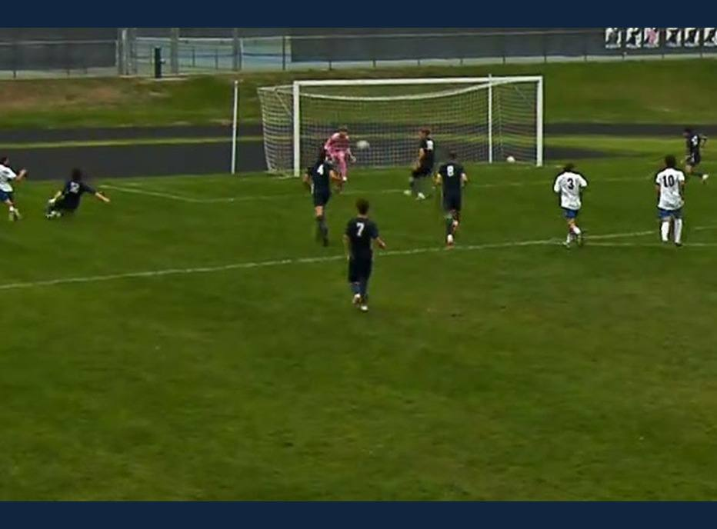
2026 VARSITY LETTER RECOGNITION
Seamus Sullivan
#99 • Grade 10 • GK
Years Varsity: 2026
6
SHUTOUT CONTRIBUTIONS
7
TAGGED SAVES
41
COMPLETED PASSES
80-minute clean sheet vs.
St. Cloud Cathedral
Sources: Isaak’s minutes + match results; Veo saves/passes. Includes shared shutouts. Image: Veo action still.

Slide 17
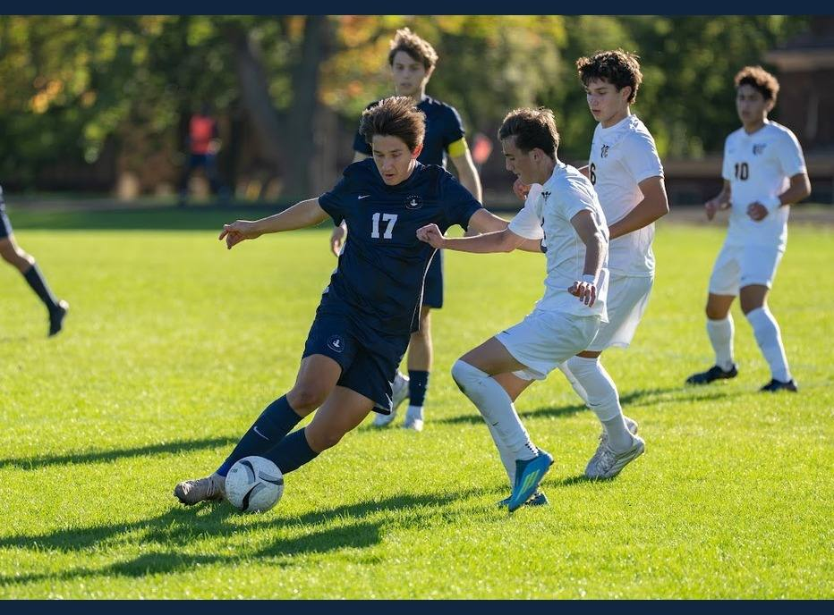
2026 VARSITY LETTER RECOGNITION
Darien Hull
#17 • Grade 11 • LW / ST
Years Varsity: 2026
2
GOALS
8
ASSISTS
10
POINTS (G + A)
Stats: corrected scoring ledger; named-player Veo tracking. Photos: Geoff George & Nate Waibel.

Slide 18
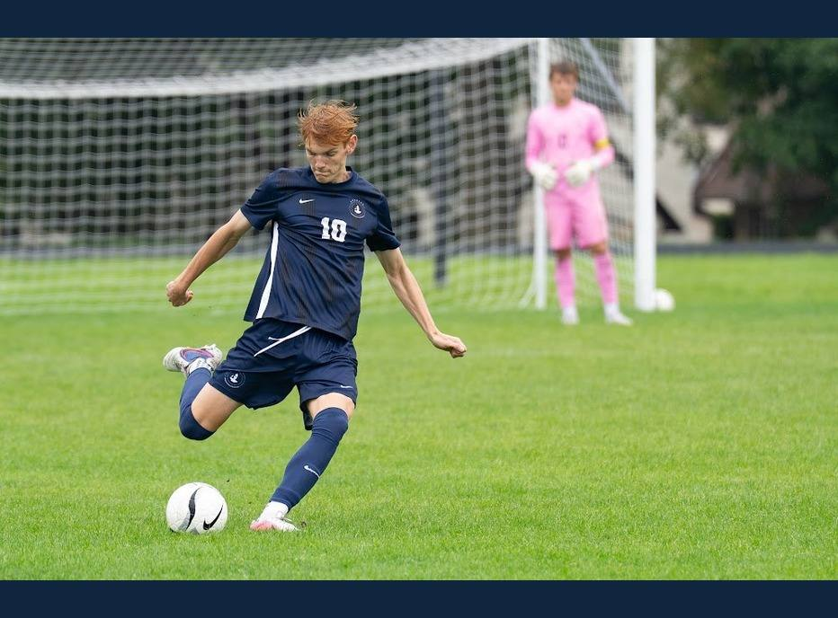
2026 VARSITY LETTER RECOGNITION
Graham Waibel
#10 • Grade 11 • CB
Years Varsity: 2026, 2025, 2024
2
GOALS
3
ASSISTS
5
POINTS (G + A)
2024 Minnesota Class A & Section 3A Champion
Prior awards: 2024 Evan Hindlemeyer Award
Stats: corrected scoring ledger; named-player Veo tracking. Photos: Geoff George & Nate Waibel.

Slide 19
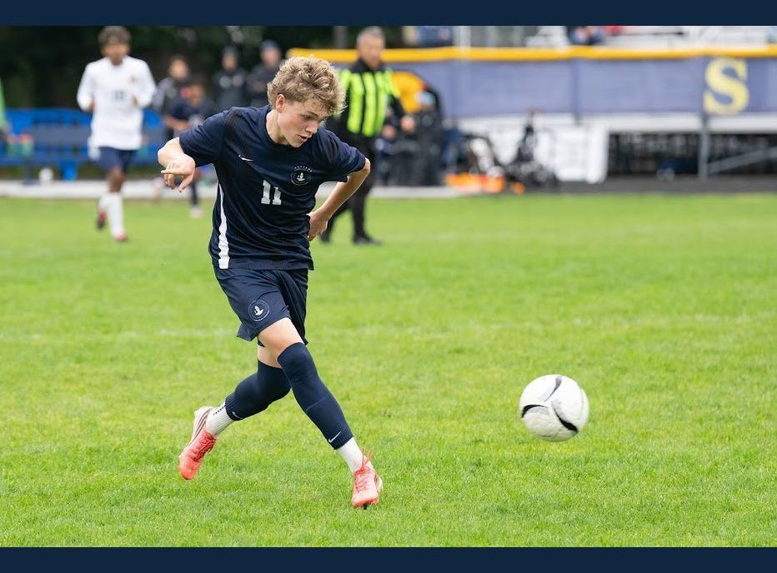
2026 VARSITY LETTER RECOGNITION
Max George
#11 • Grade 11 • CM / DM
Years Varsity: 2026, 2025, 2024
4
GOALS
5
ASSISTS
9
POINTS (G + A)
2024 Minnesota Class A & Section 3A Champion
Prior awards: 2025 Hindlemeyer Award; 2025 All-State
Second Team
Stats: corrected scoring ledger; named-player Veo tracking. Photos: Geoff George & Nate Waibel.

Slide 20
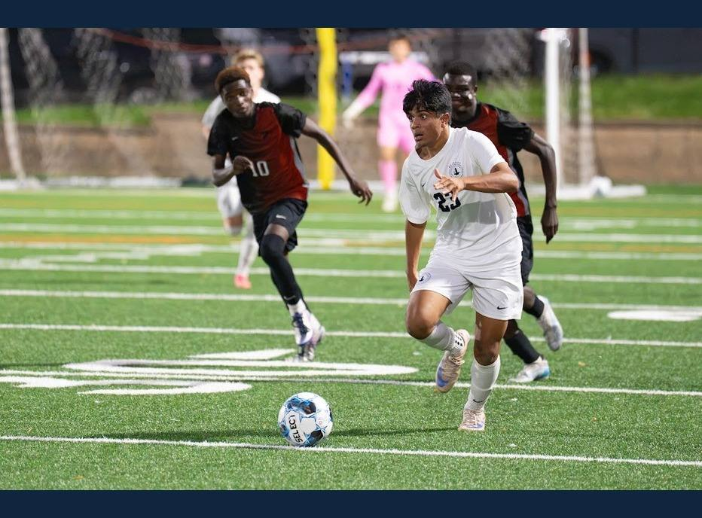
2026 VARSITY LETTER RECOGNITION
Shrey Nemani
#23 • Grade 11 • LB / RB
Years Varsity: 2026, 2025
1
ASSIST
217
COMPLETED PASSES
50.3
TRACKED MILES
Stats: corrected scoring ledger; named-player Veo tracking. Photos: Geoff George & Nate Waibel.

Slide 21
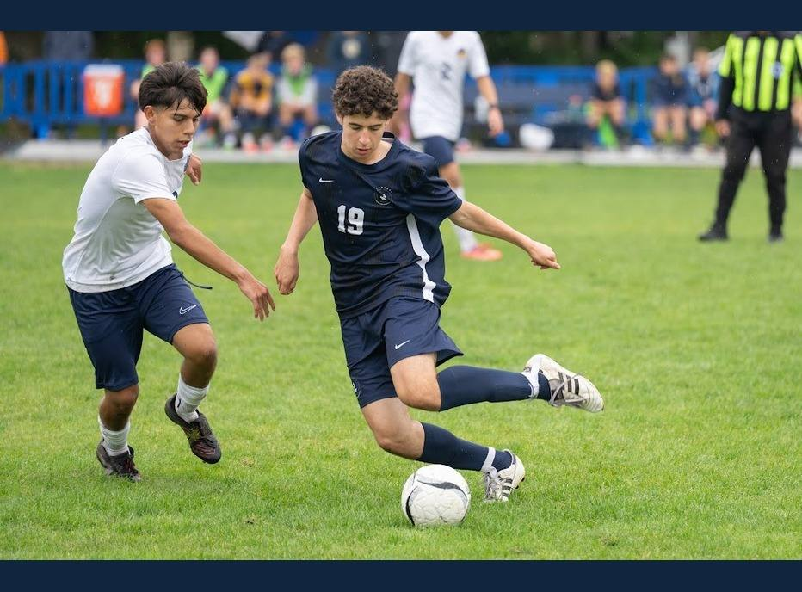
2026 VARSITY LETTER RECOGNITION
Xavi Markowitz Mulet
#19 • Grade 11
Years Varsity: 2026, 2025
1
ASSIST
116
COMPLETED PASSES
36.5
TRACKED MILES
Stats: corrected scoring ledger; named-player Veo tracking. Photos: Geoff George & Nate Waibel.

Slide 22
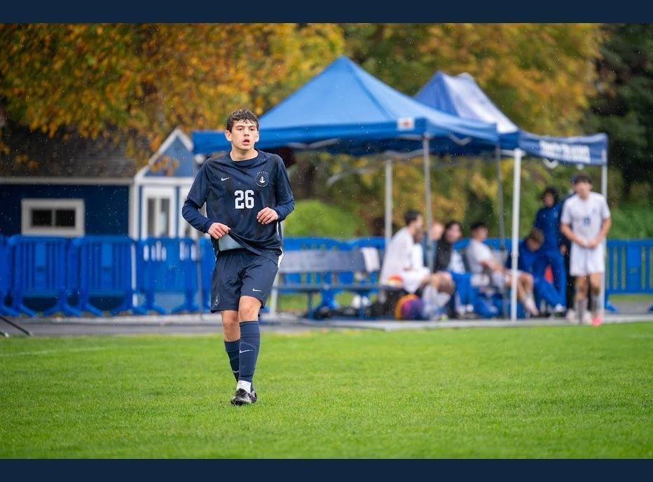
2026 VARSITY LETTER RECOGNITION
Soren Guettler
#26 • Grade 11
Years Varsity: 2026
21
RECORDED MINUTES
2
GAMES WITH MINUTES
Stats: Isaak Senaratna’s recorded match entries. Photos: Geoff George & Nate Waibel.

Slide 23
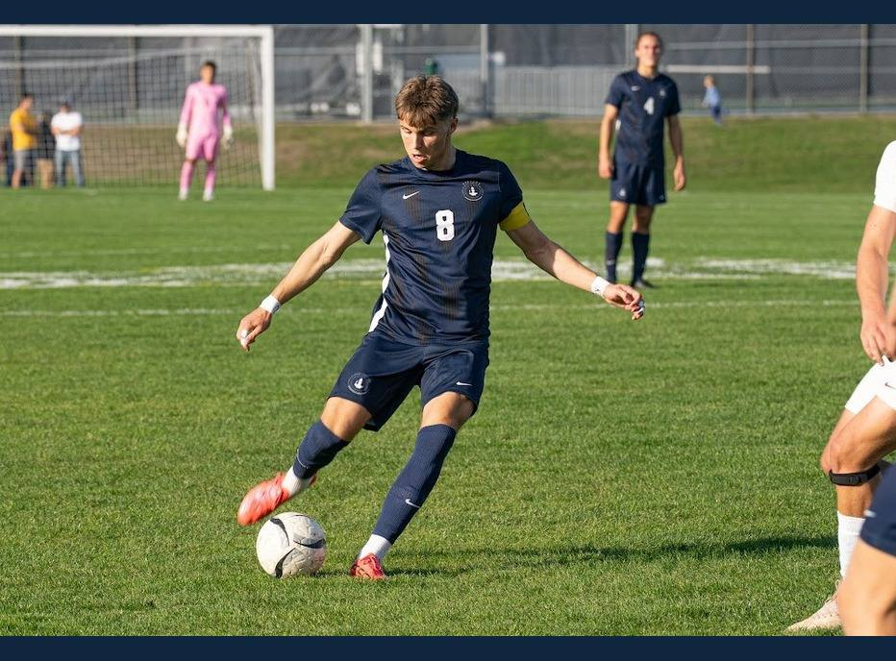
2026 VARSITY LETTER RECOGNITION
Andrew “Kiki” Sullivan
#8 • Grade 12 • CM / DM
Years Varsity: 2026, 2025, 2024, 2023
2
GOALS
5
ASSISTS
7
POINTS (G + A)
2024 Minnesota Class A & Section 3A Champion
Prior awards: 2025 Kaizen (Most Improved)
Stats: corrected scoring ledger; named-player Veo tracking. Photos: Geoff George & Nate Waibel.

Slide 24
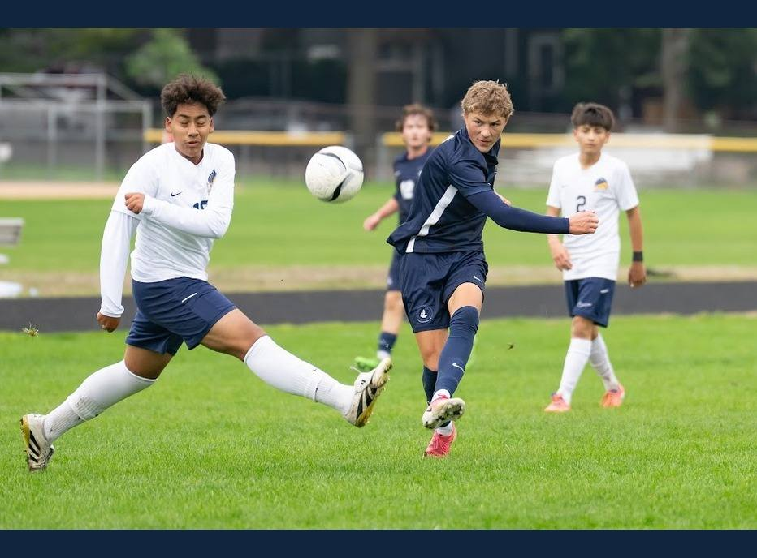
2026 VARSITY LETTER RECOGNITION
Brooks Geiger
#9 • Grade 12
Years Varsity: 2026, 2025, 2024
1
GOAL
106
COMPLETED PASSES
45.7
TRACKED MILES
2024 Minnesota Class A & Section 3A Champion
Stats: corrected scoring ledger; named-player Veo tracking. Photos: Geoff George & Nate Waibel.

Slide 25
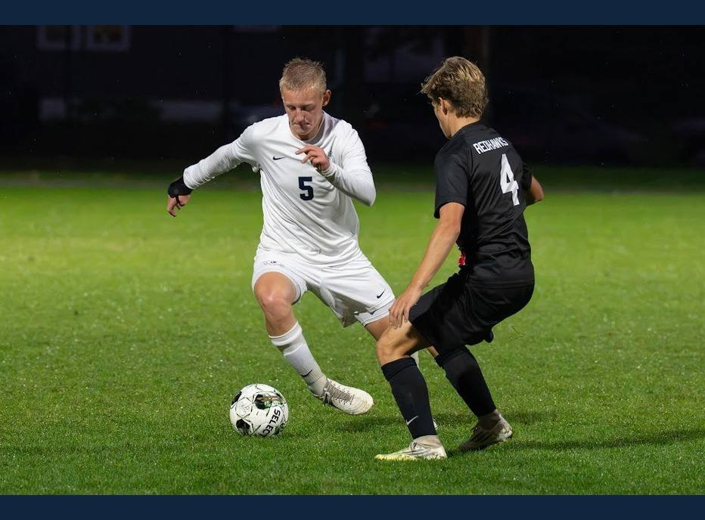
2026 VARSITY LETTER RECOGNITION
Caden Deardurff
#5 • Grade 12 • ST
Years Varsity: 2026, 2024
9
GOALS
6
ASSISTS
15
POINTS (G + A)
2024 Minnesota Class A & Section 3A Champion
Stats: corrected scoring ledger; named-player Veo tracking. Photos: Geoff George & Nate Waibel.

Slide 26
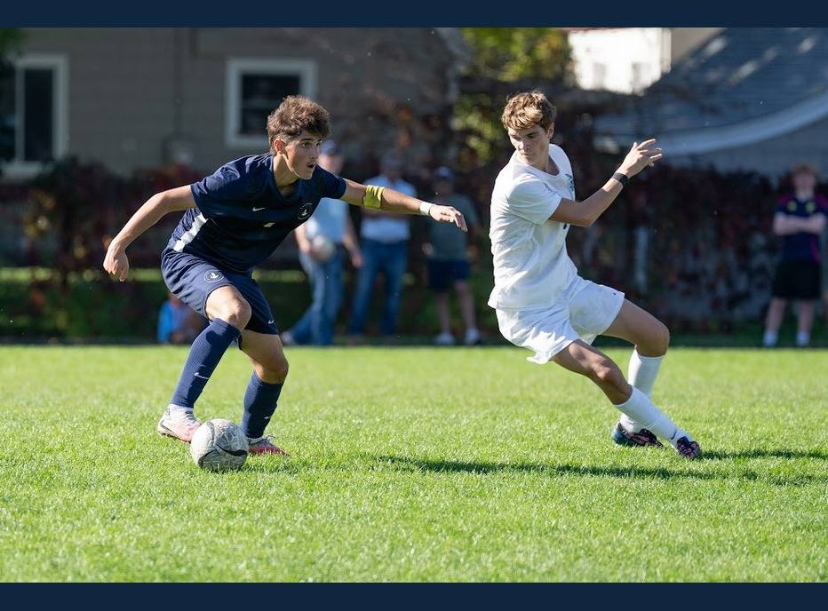
2026 VARSITY LETTER RECOGNITION
Erik Bjorgvinsson
#7 • Grade 12 • CM / ST
Years Varsity: 2026, 2025, 2024, 2023
10
GOALS
3
ASSISTS
13
POINTS (G + A)
2024 Minnesota Class A & Section 3A Champion
Prior awards: 2025 MVP; 2025 All-State Second Team;
2025 All-Conference
Stats: corrected scoring ledger; named-player Veo tracking. Photos: Geoff George & Nate Waibel.

Slide 27
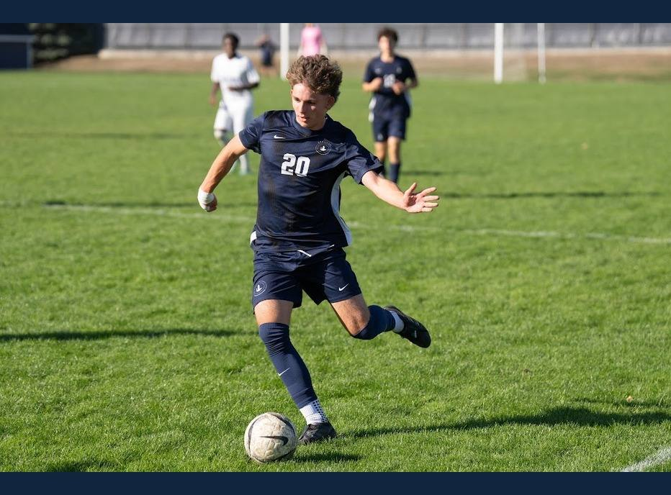
2026 VARSITY LETTER RECOGNITION
Hart Waltz
#20 • Grade 12 • CB
Years Varsity: 2026, 2025
109
COMPLETED PASSES
23.2
TRACKED MILES
19.0
TOP SPEED (MPH)
Stats: corrected scoring ledger; named-player Veo tracking. Photos: Geoff George & Nate Waibel.

Slide 28
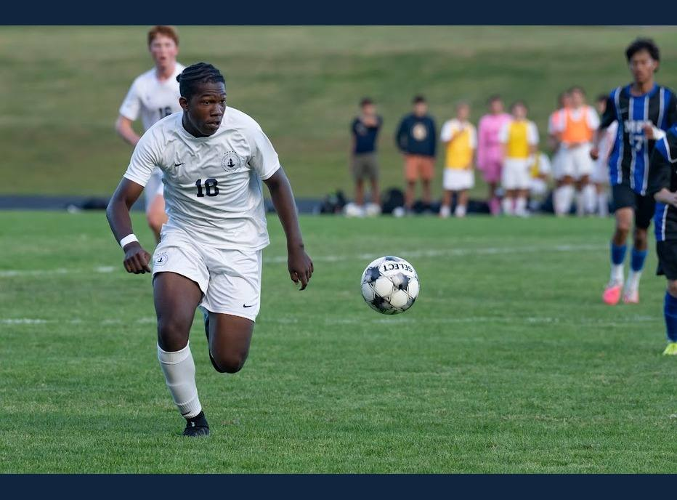
2026 VARSITY LETTER RECOGNITION
Ike Obi-Walker
#18 • Grade 12
Years Varsity: 2026
1
ASSIST
22
COMPLETED PASSES
8.3
TRACKED MILES
Stats: corrected scoring ledger; named-player Veo tracking. Photos: Geoff George & Nate Waibel.

Slide 29
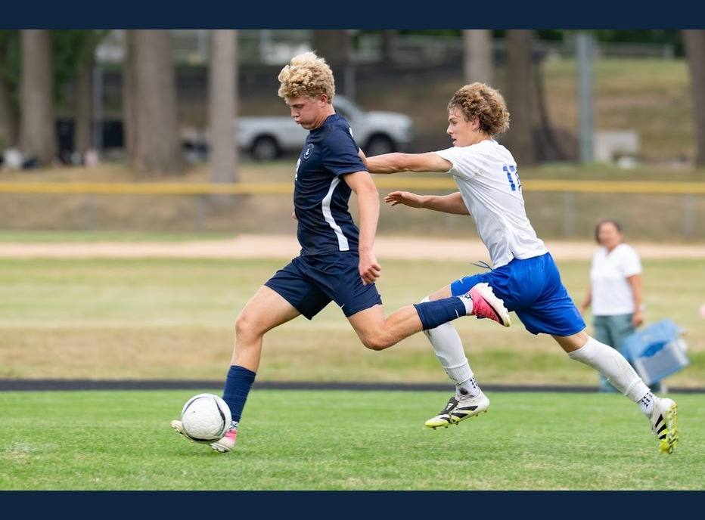
2026 VARSITY LETTER RECOGNITION
John Grimsrud
#13 • Grade 12 • RW / ST
Years Varsity: 2026
12
GOALS
3
ASSISTS
15
POINTS (G + A)
Stats: corrected scoring ledger; named-player Veo tracking. Photos: Geoff George & Nate Waibel.

Slide 30
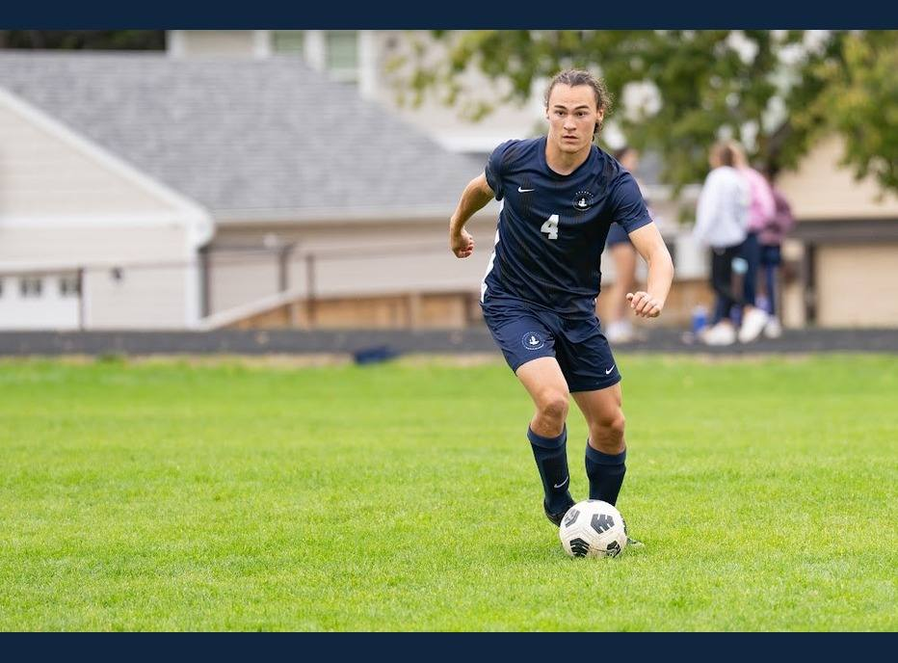
2026 VARSITY LETTER RECOGNITION
Langston Thompson
#4 • Grade 12 • CB
Years Varsity: 2026, 2025, 2024
297
COMPLETED PASSES
59.5
TRACKED MILES
18.9
TOP SPEED (MPH)
2024 Minnesota Class A & Section 3A Champion
Stats: corrected scoring ledger; named-player Veo tracking. Photos: Geoff George & Nate Waibel.

Slide 31
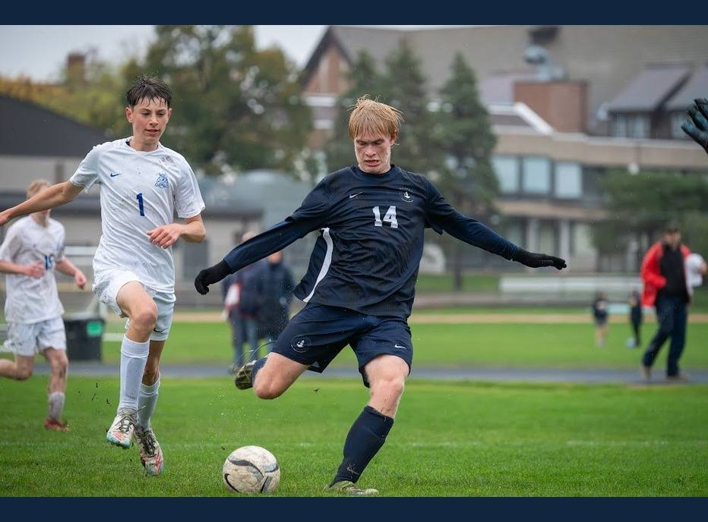
2026 VARSITY LETTER RECOGNITION
Luke Phillips
#15 • Grade 12
Years Varsity: 2026
53
COMPLETED PASSES
11.5
TRACKED MILES
19.9
TOP SPEED (MPH)
Stats: corrected scoring ledger; named-player Veo tracking. Photos: Geoff George & Nate Waibel.

Slide 32
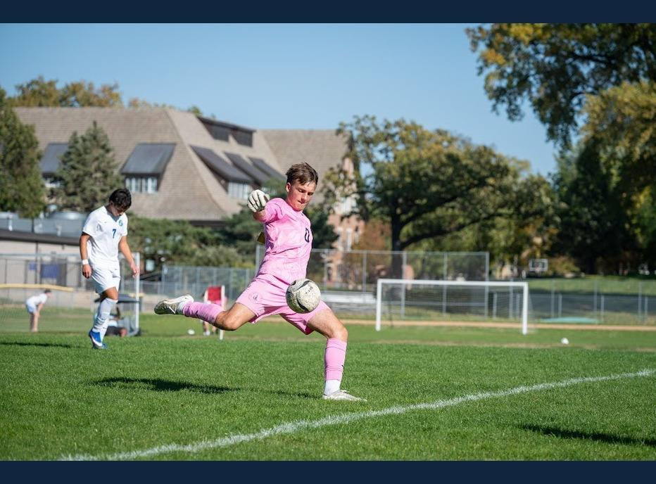
2026 VARSITY LETTER RECOGNITION
Miles Vogenthaler
#0 • Grade 12 • GK
Years Varsity: 2026, 2025, 2024
14
TAGGED SAVES
47
COMPLETED PASSES
2024 Minnesota Class A & Section 3A Champion
Prior awards: 2025 All-State First Team; 2025 IMAC GK of
the Year
Stats: corrected scoring ledger; named-player Veo tracking. Photos: Geoff George & Nate Waibel.

Slide 33
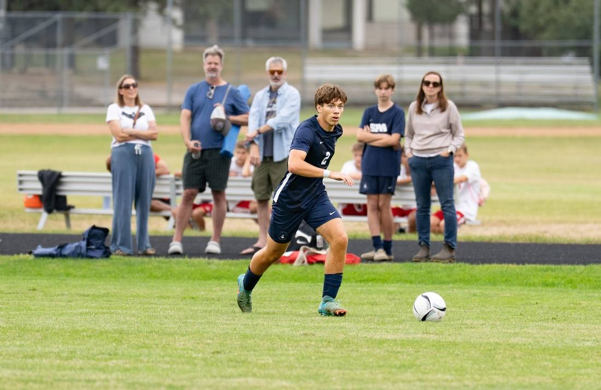
2026 VARSITY LETTER RECOGNITION
Nico Martin
#2 • Grade 12
Years Varsity: 2026, 2025
46
COMPLETED PASSES
10.5
TRACKED MILES
19.6
TOP SPEED (MPH)
Stats: corrected scoring ledger; named-player Veo tracking. Photo: Geoff George.

Slide 34
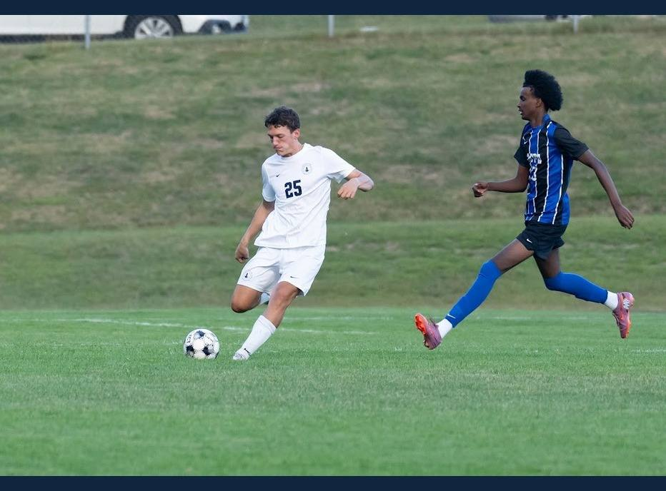
2026 VARSITY LETTER RECOGNITION
Sam Hilton
#25 • Grade 12
Years Varsity: 2026
48
COMPLETED PASSES
9.3
TRACKED MILES
18.7
TOP SPEED (MPH)
Stats: corrected scoring ledger; named-player Veo tracking. Photos: Geoff George & Nate Waibel.

Slide 35
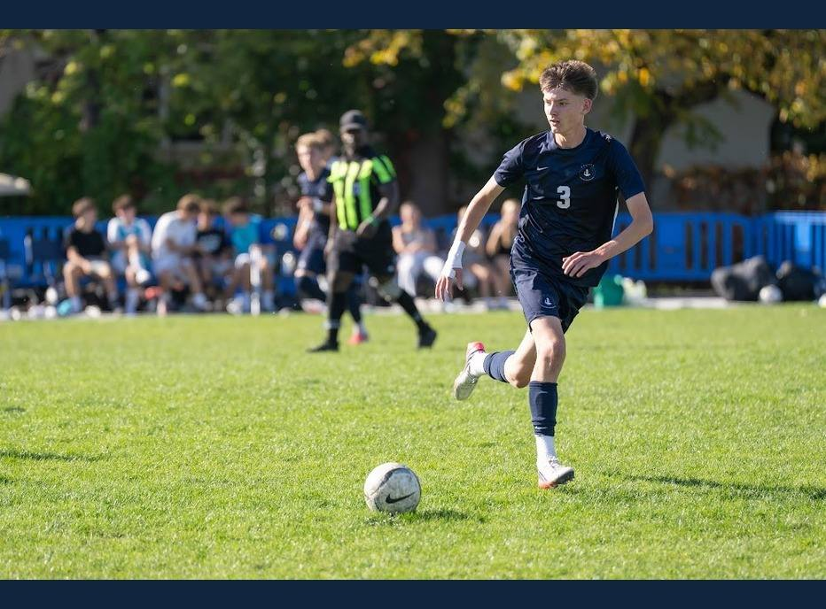
2026 VARSITY LETTER RECOGNITION
Soren Johnson
#3 • Grade 12 • AM
Years Varsity: 2026
1
GOAL
1
ASSIST
2
POINTS (G + A)
Stats: corrected scoring ledger; named-player Veo tracking. Photos: Geoff George & Nate Waibel.

Slide 36
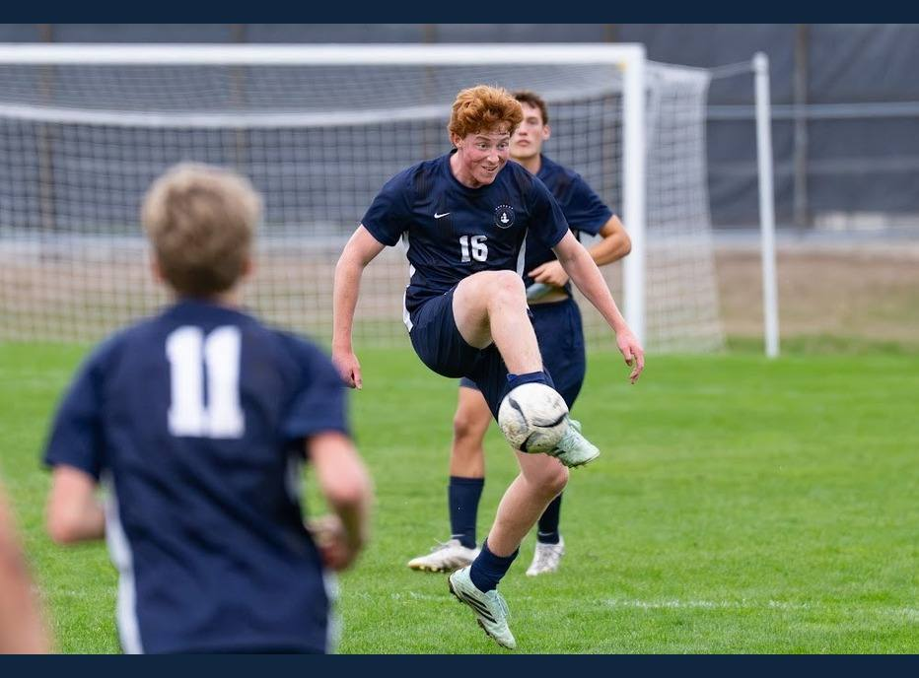
2026 VARSITY LETTER RECOGNITION
William O'Brien
#16 • Grade 12
Years Varsity: 2026
78
COMPLETED PASSES
19.6
TRACKED MILES
17.9
TOP SPEED (MPH)
Stats: corrected scoring ledger; named-player Veo tracking. Photos: Geoff George & Nate Waibel.

Slide 37

STUDENT MANAGER
Isaak Senaratna
Thank you for everything behind the scenes.

Slide 38
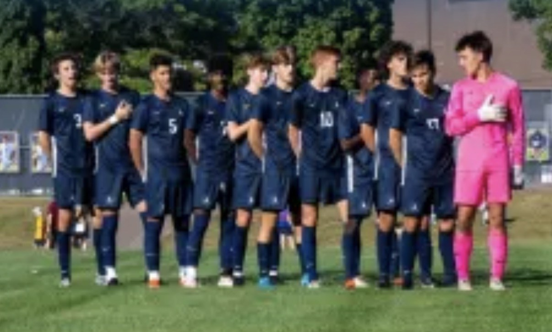
SEASON ALBUM
2026-08-16

Slide 39
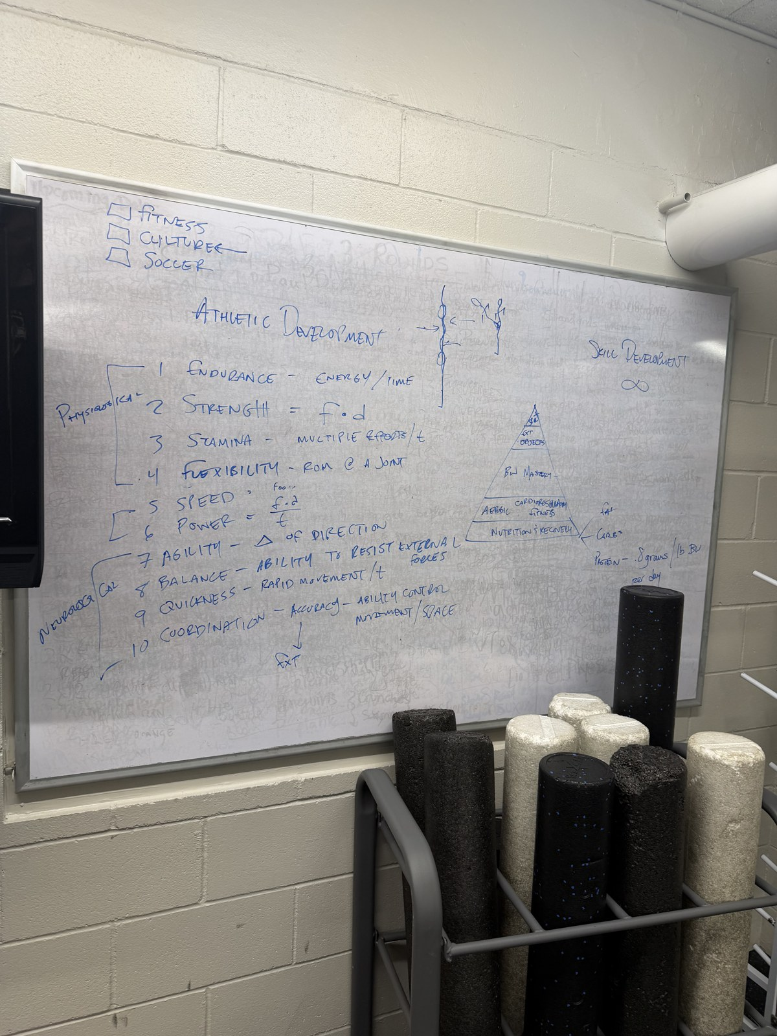
SEASON ALBUM
2026-08-17

Slide 40
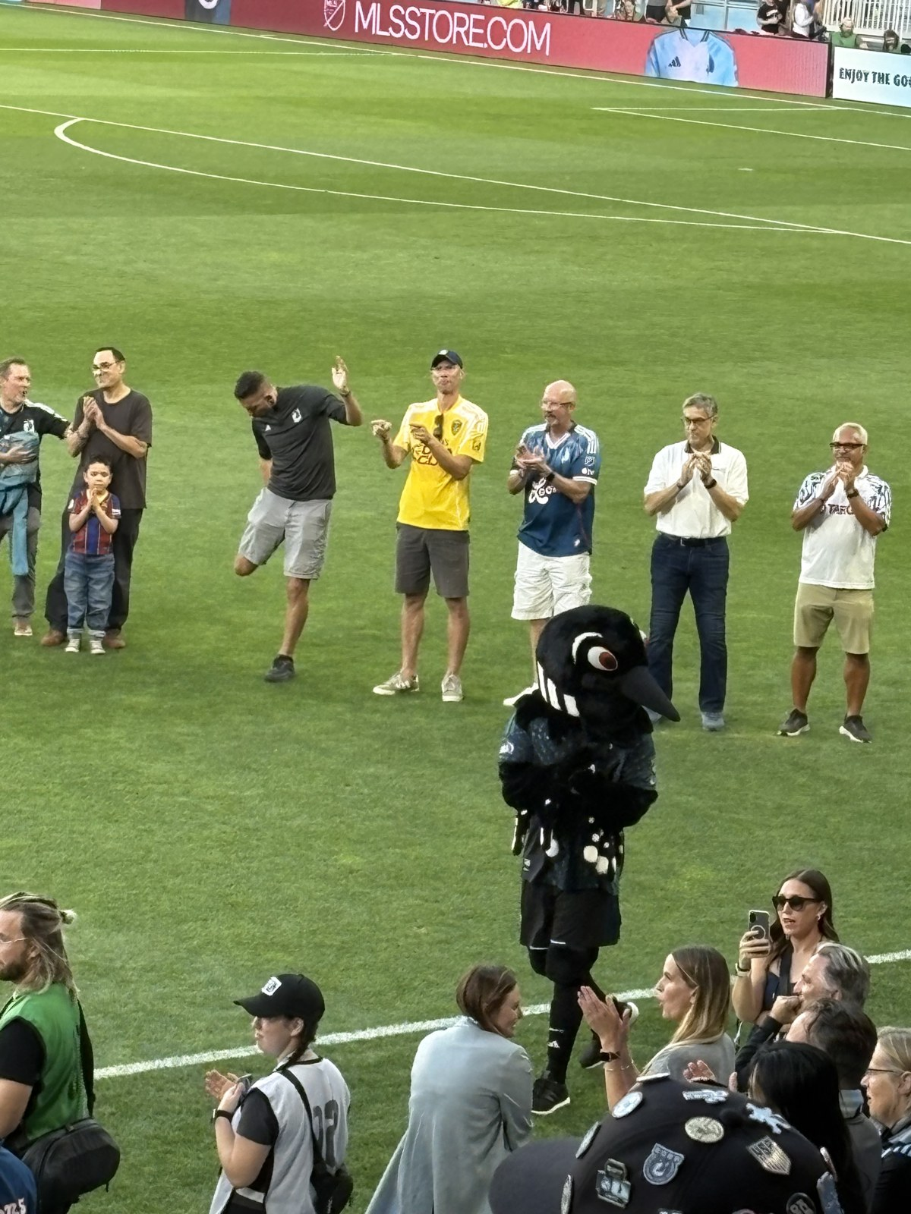
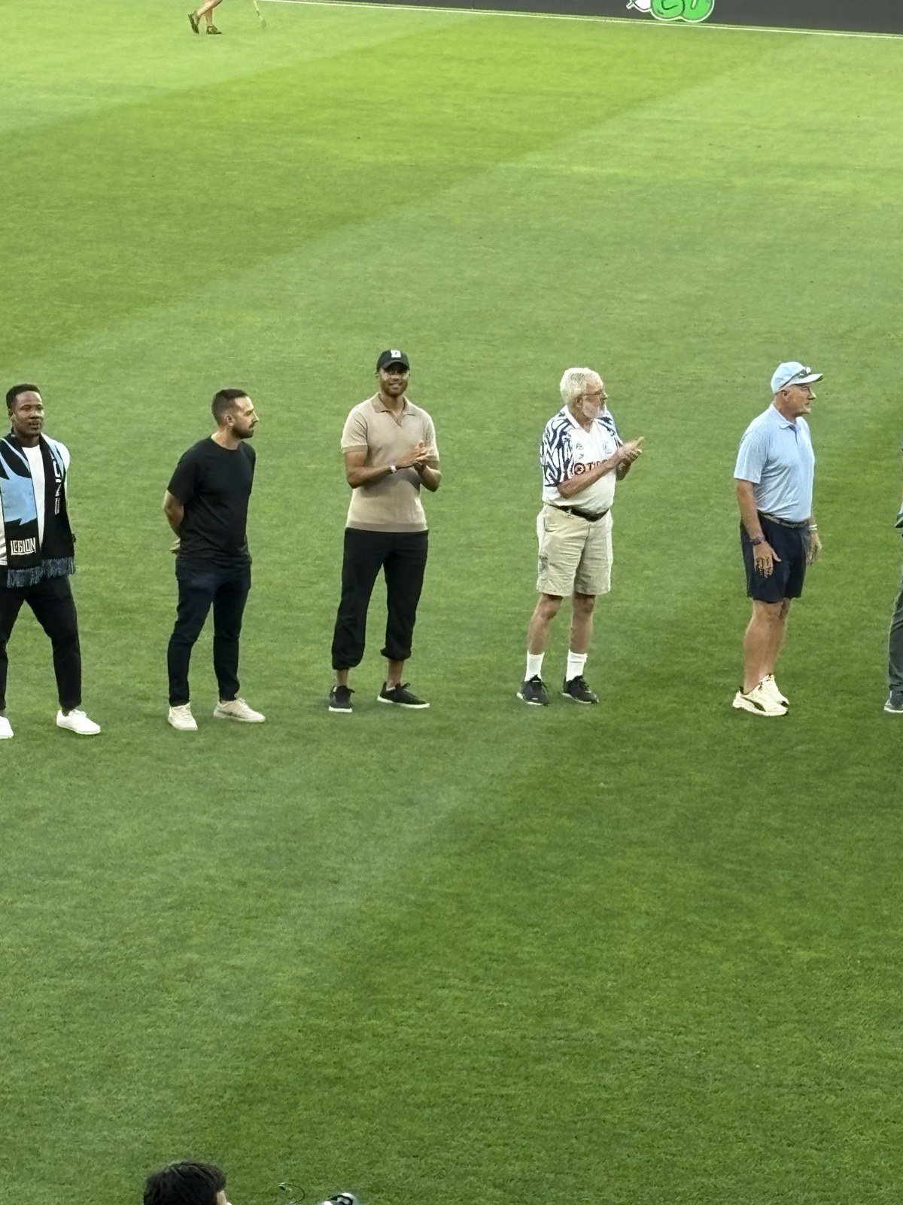
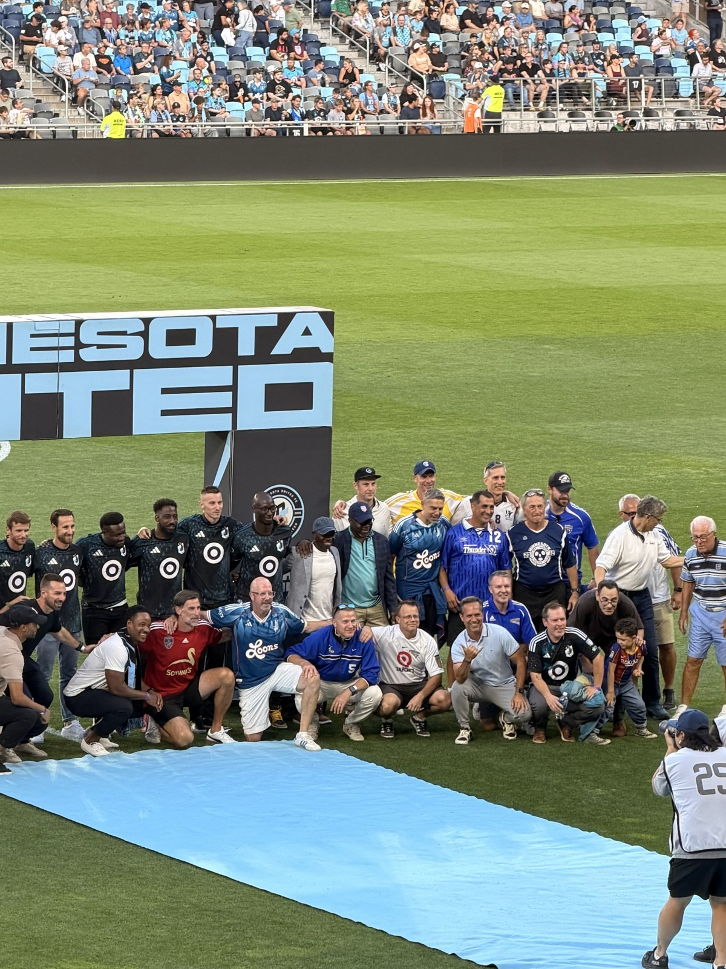
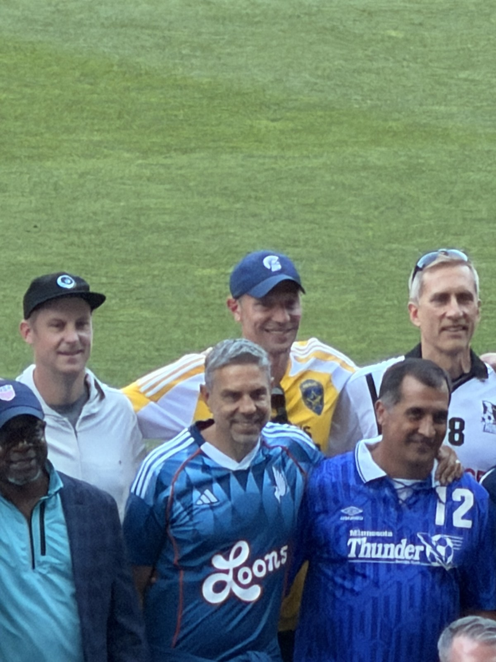
SEASON ALBUM
2026-08-19

Slide 41
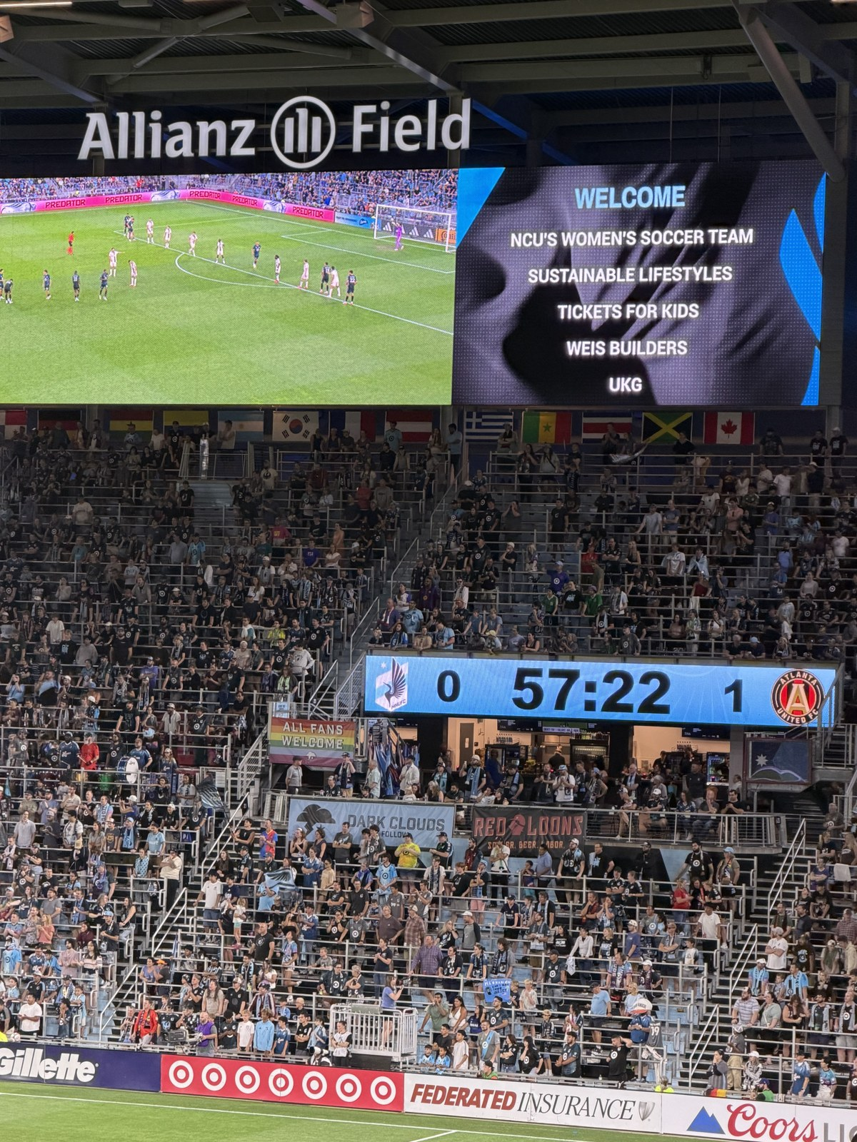
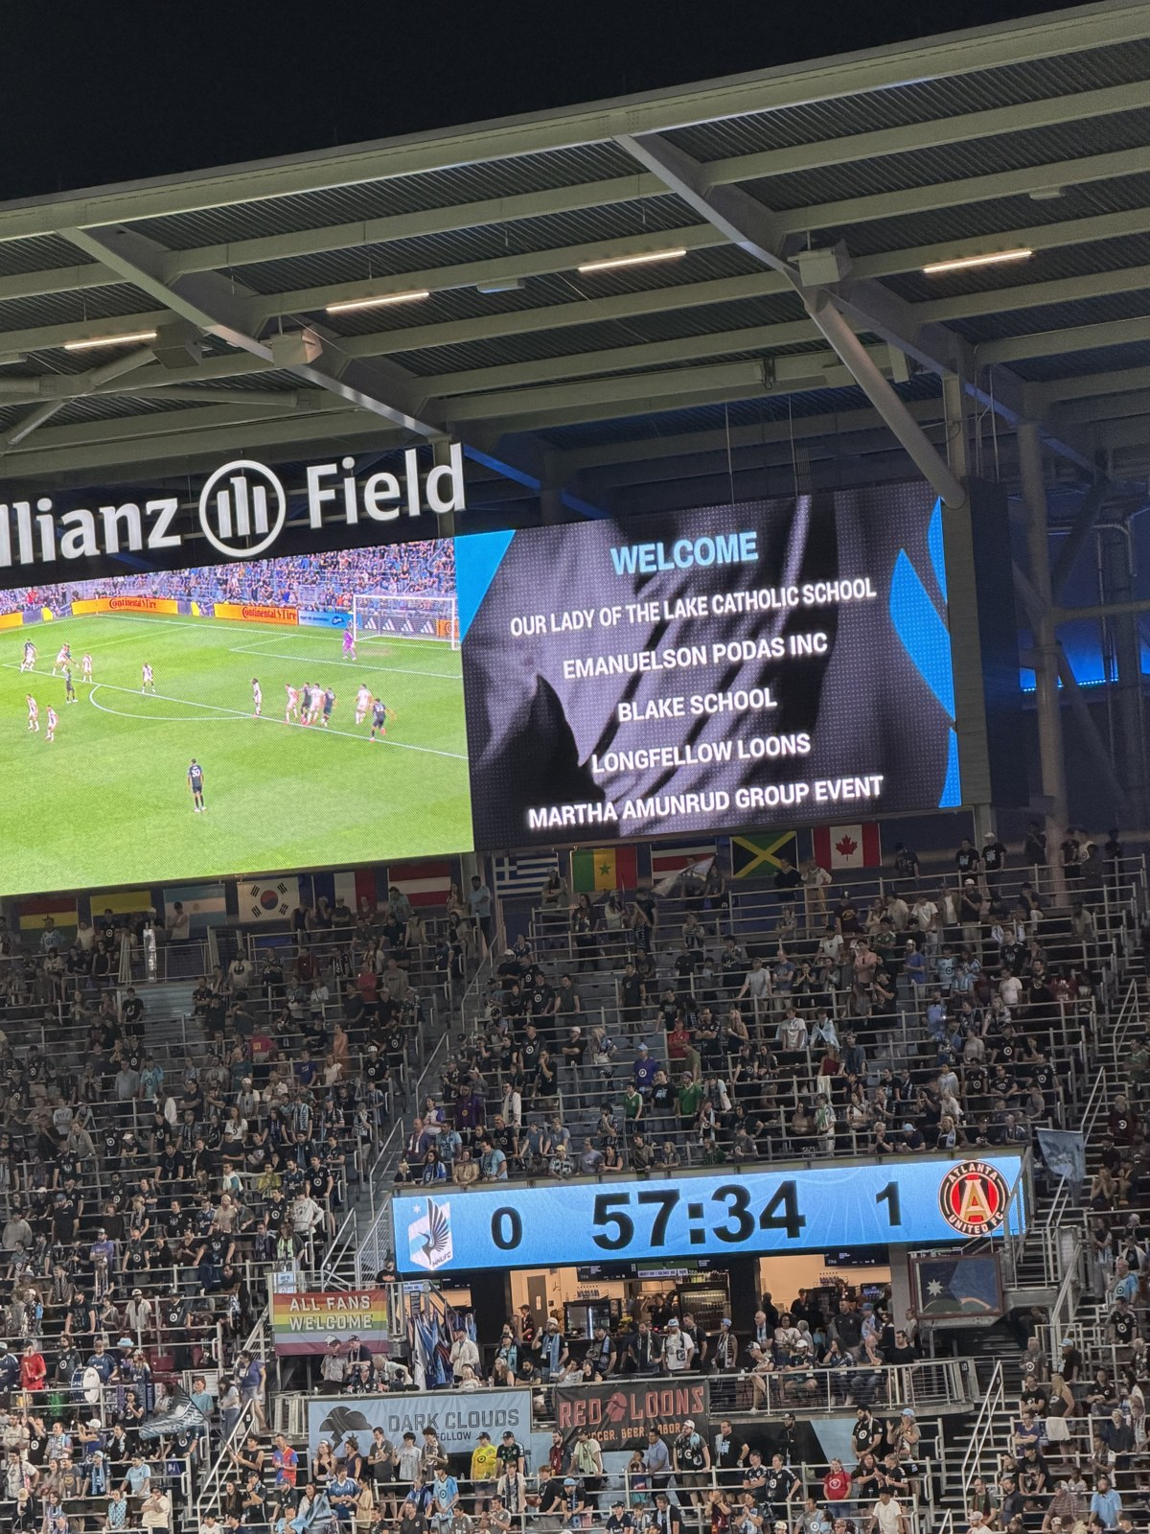
SEASON ALBUM
2026-08-19

Slide 42
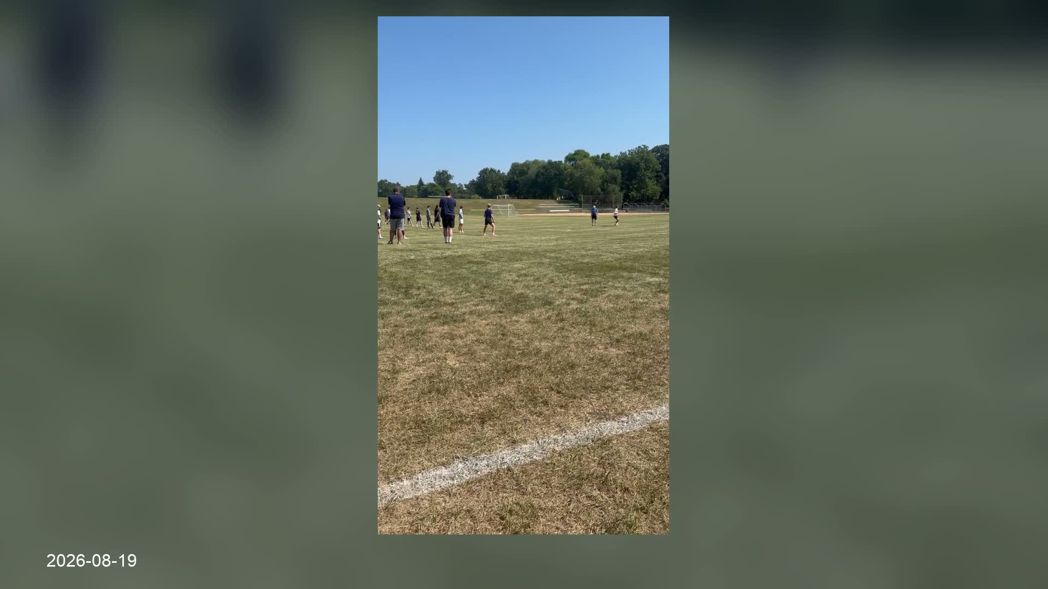

Slide 43
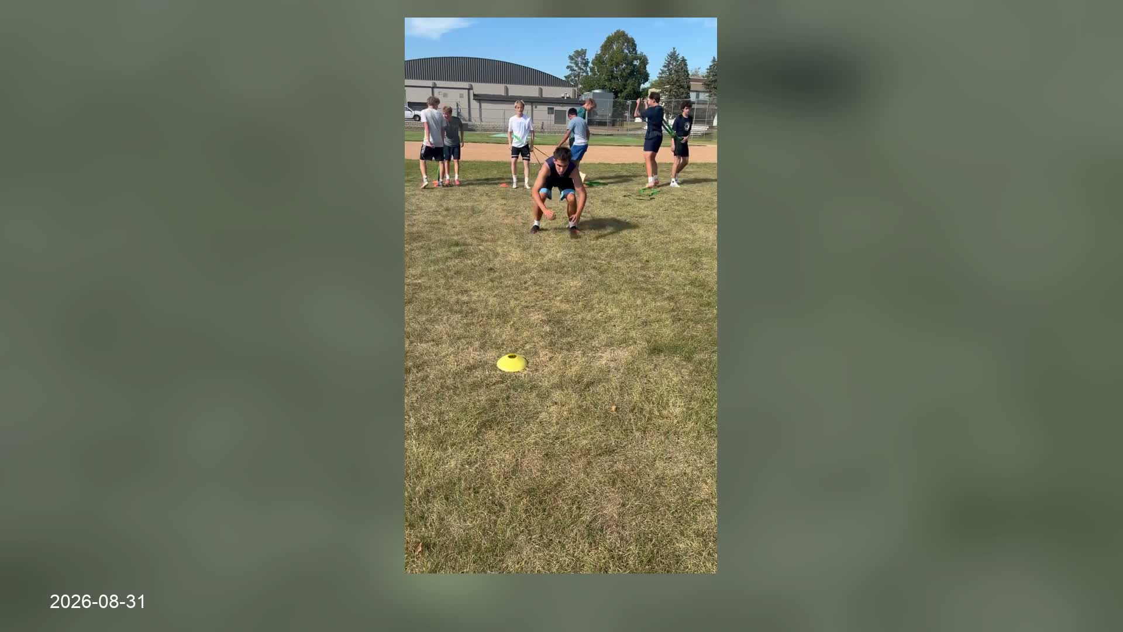

Slide 44
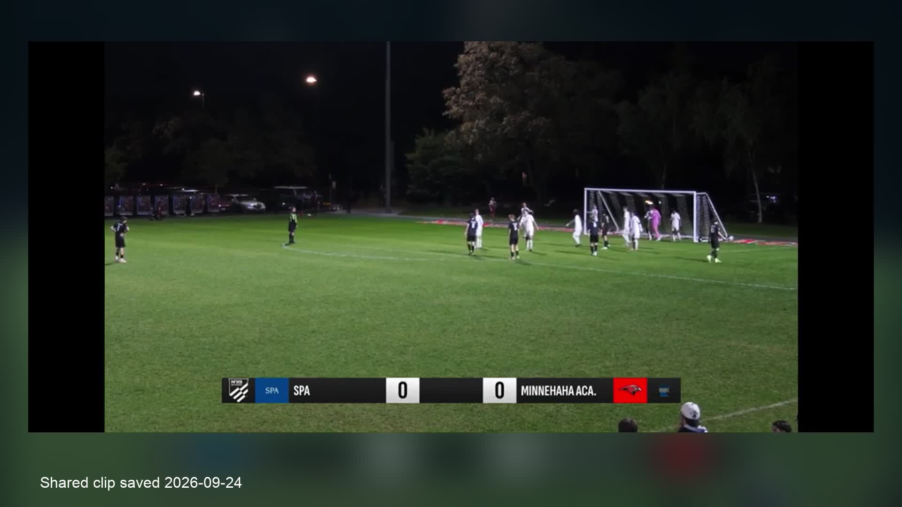

Slide 45
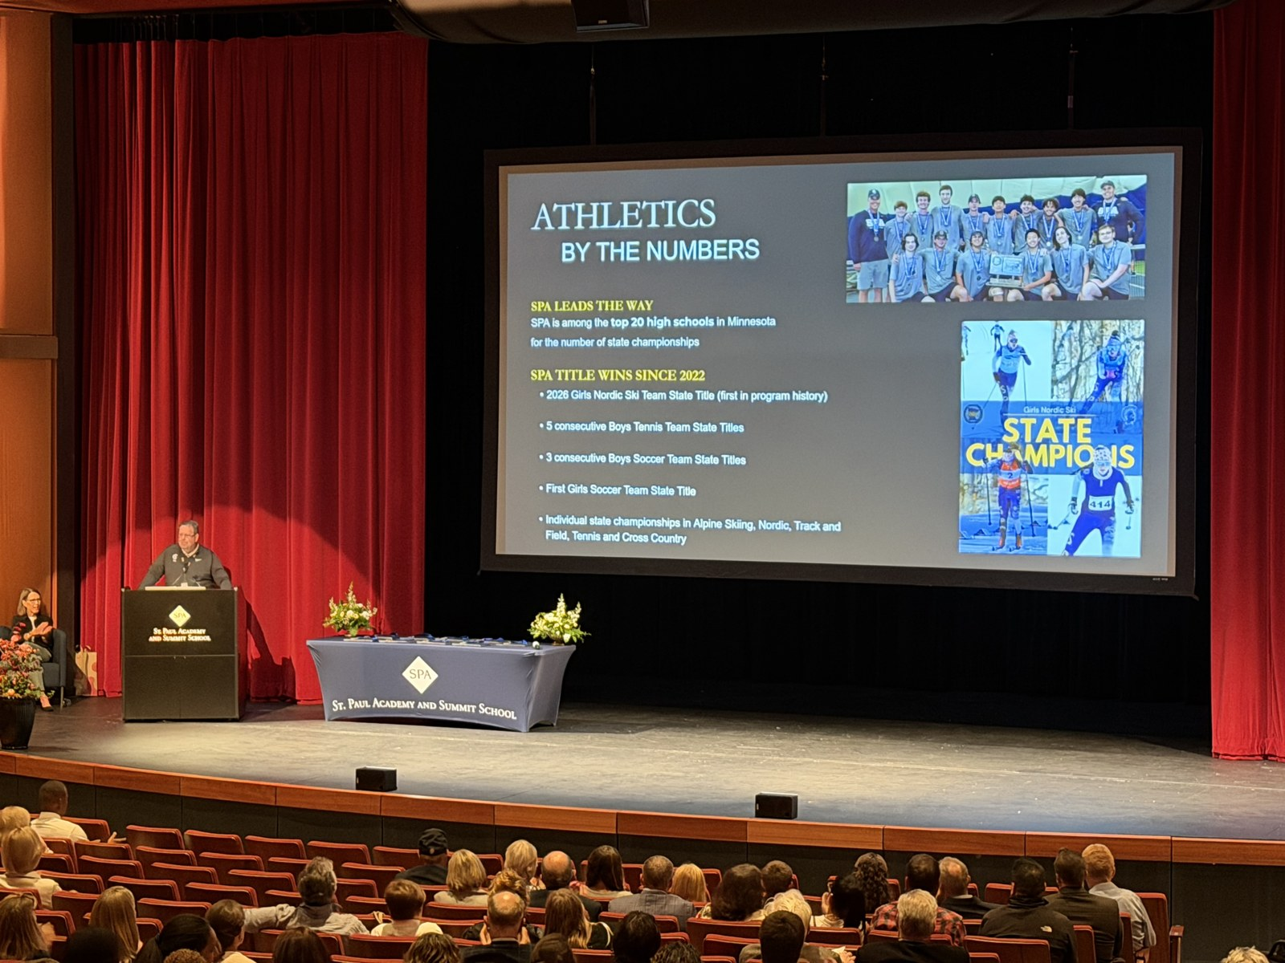
SEASON ALBUM
2026-09-25

Slide 46
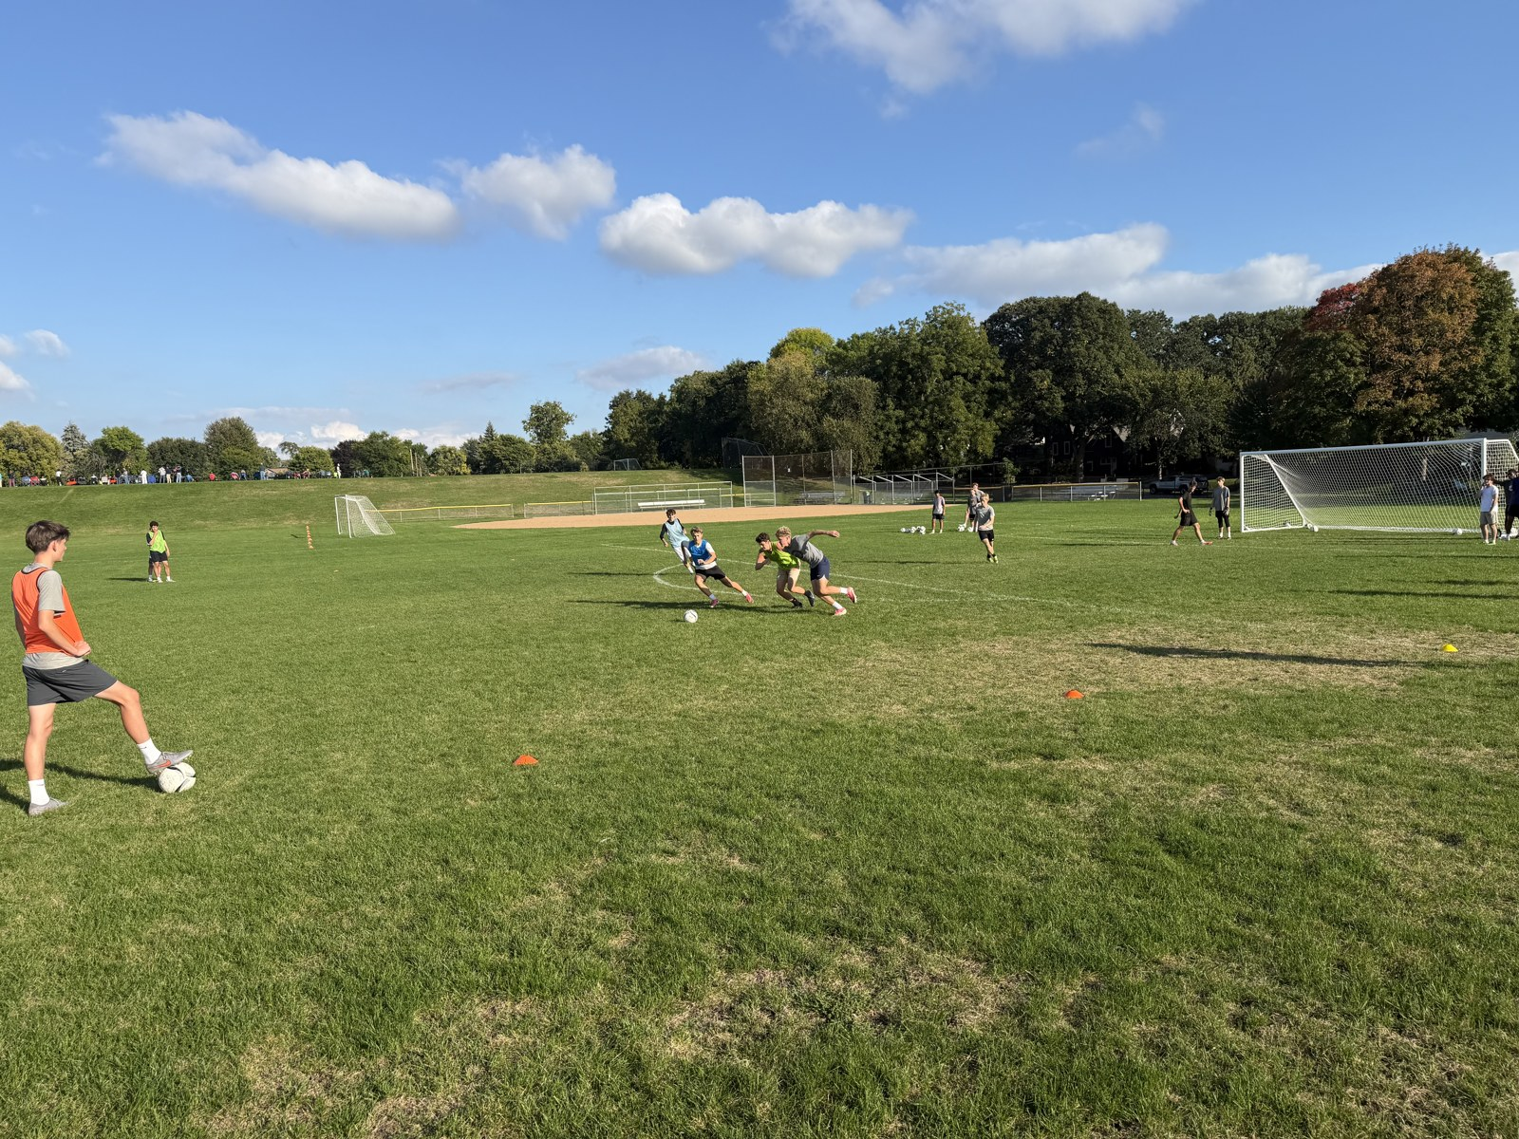
SEASON ALBUM
2026-09-28

Slide 47
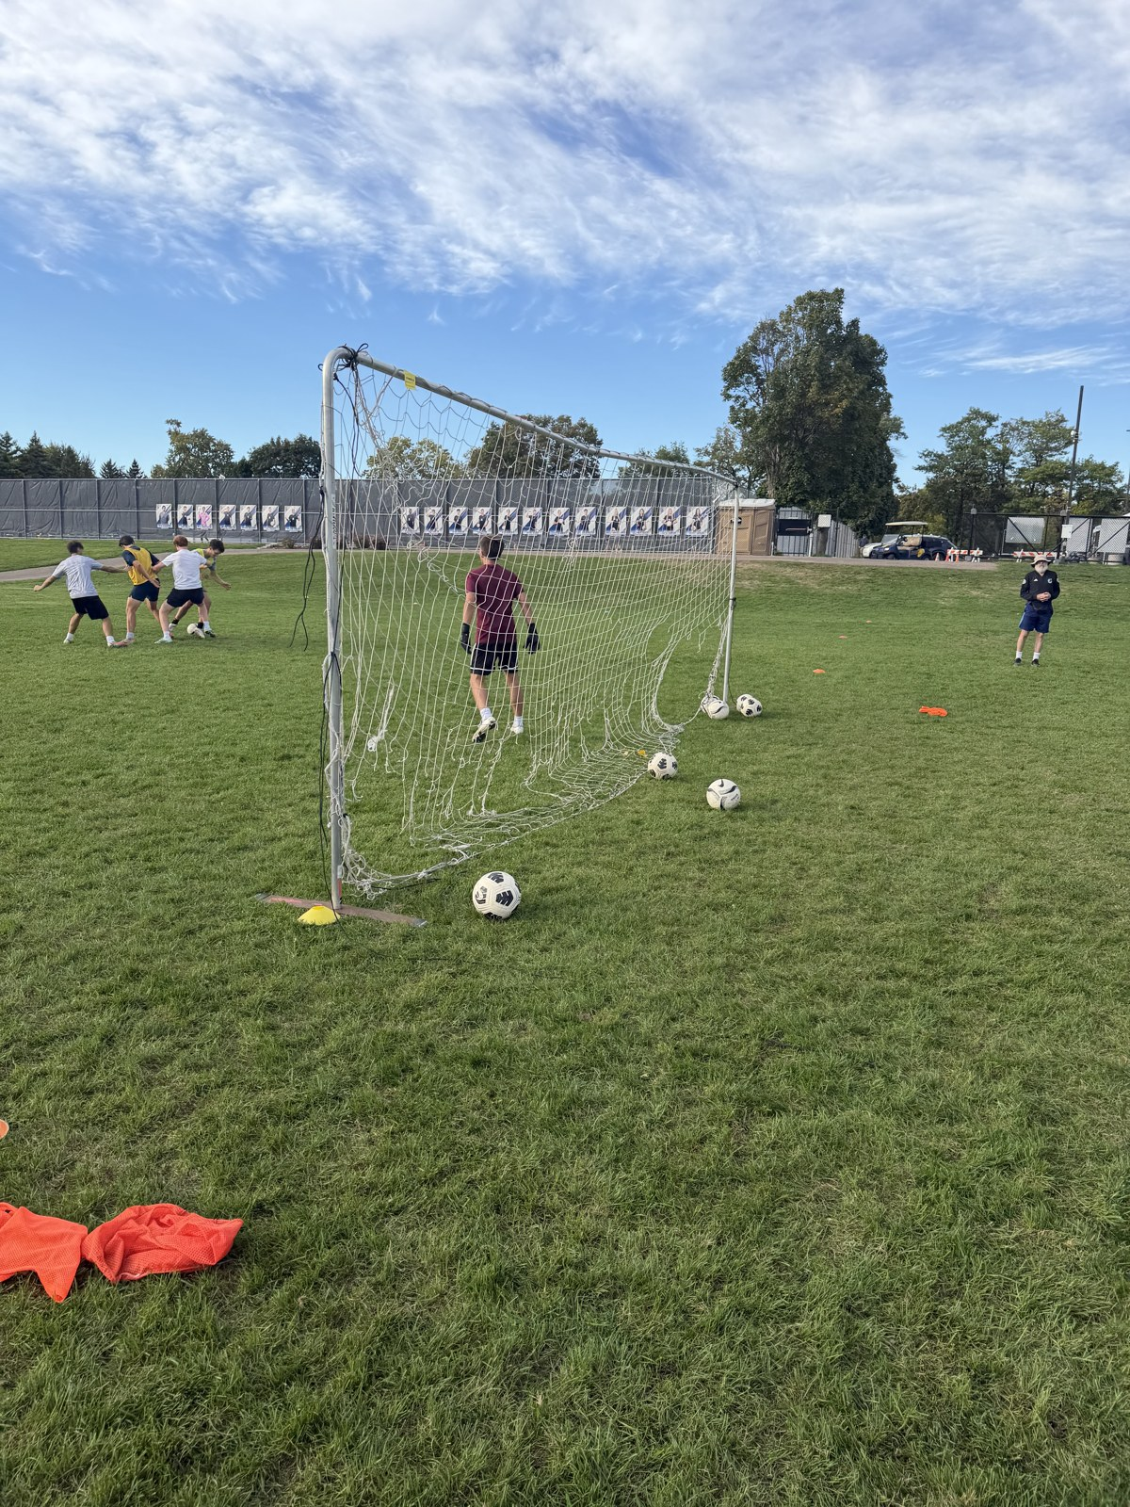
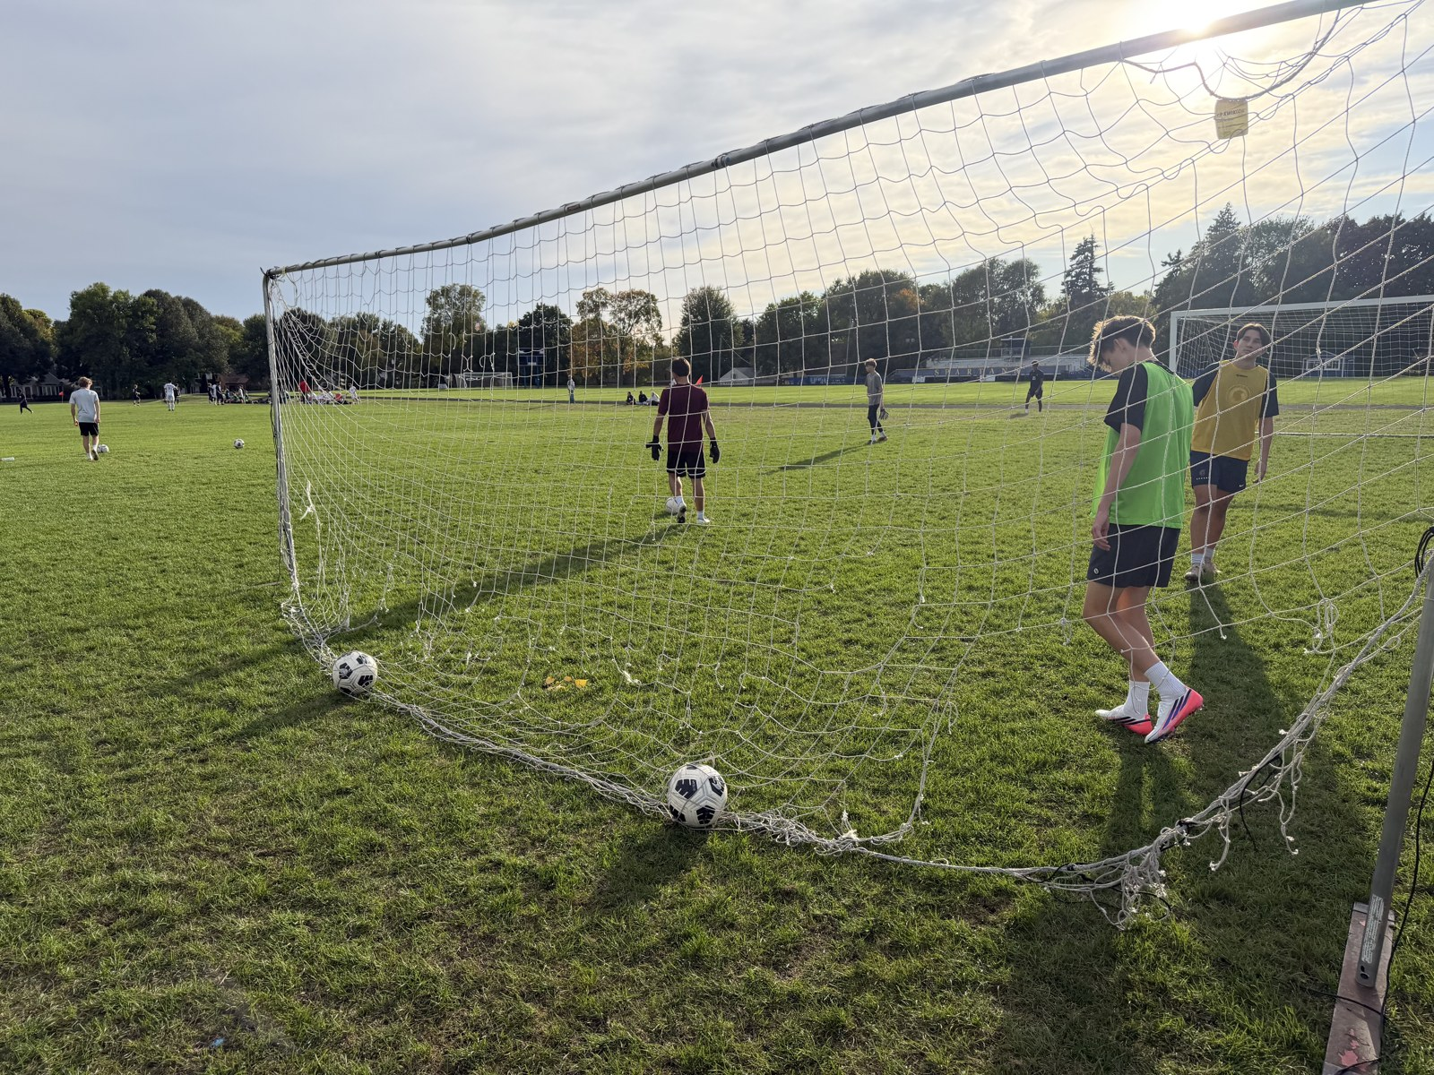
SEASON ALBUM
2026-10-01

Slide 48
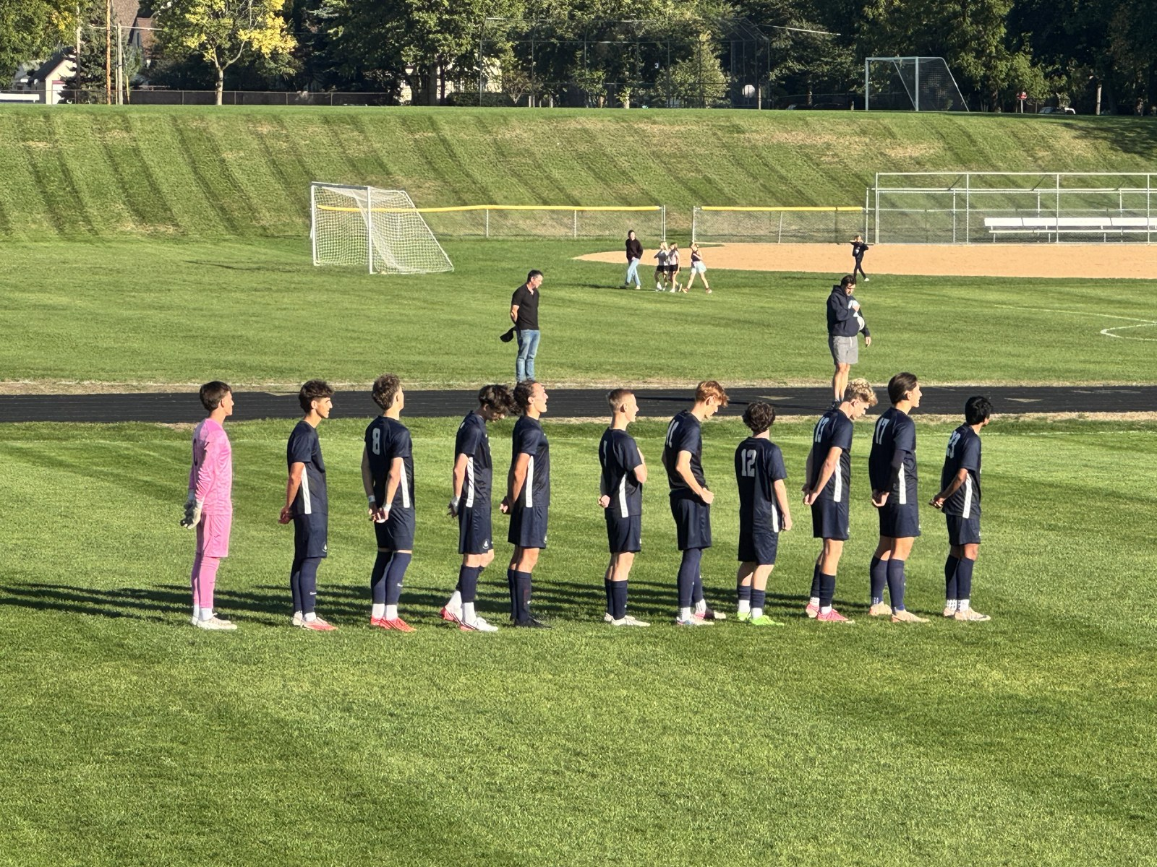
SEASON ALBUM
2026-10-02

Slide 49
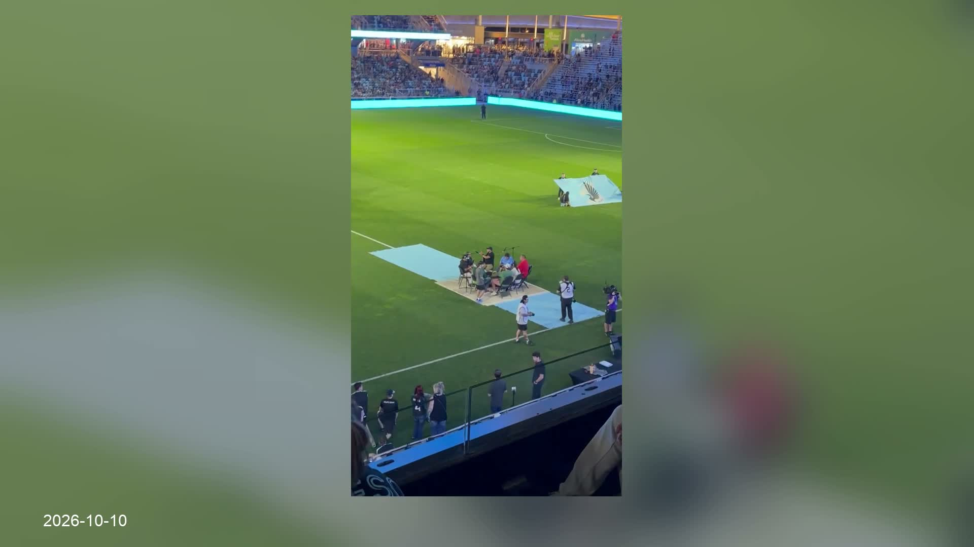

Slide 50
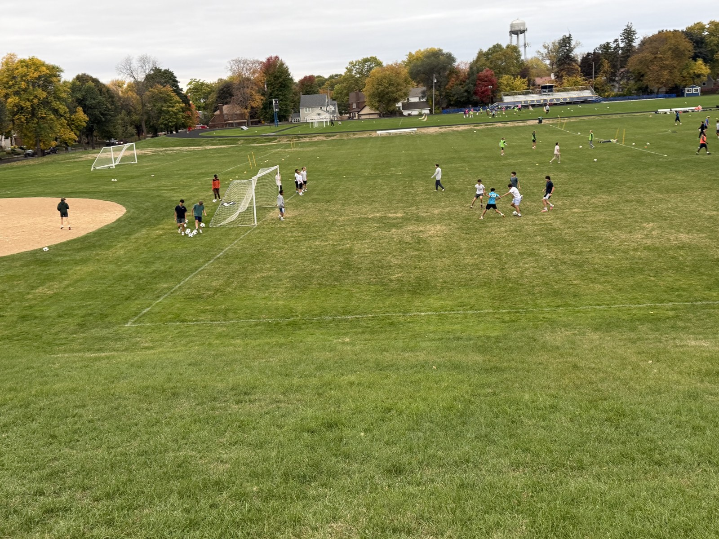
SEASON ALBUM
2026-10-13

Slide 51
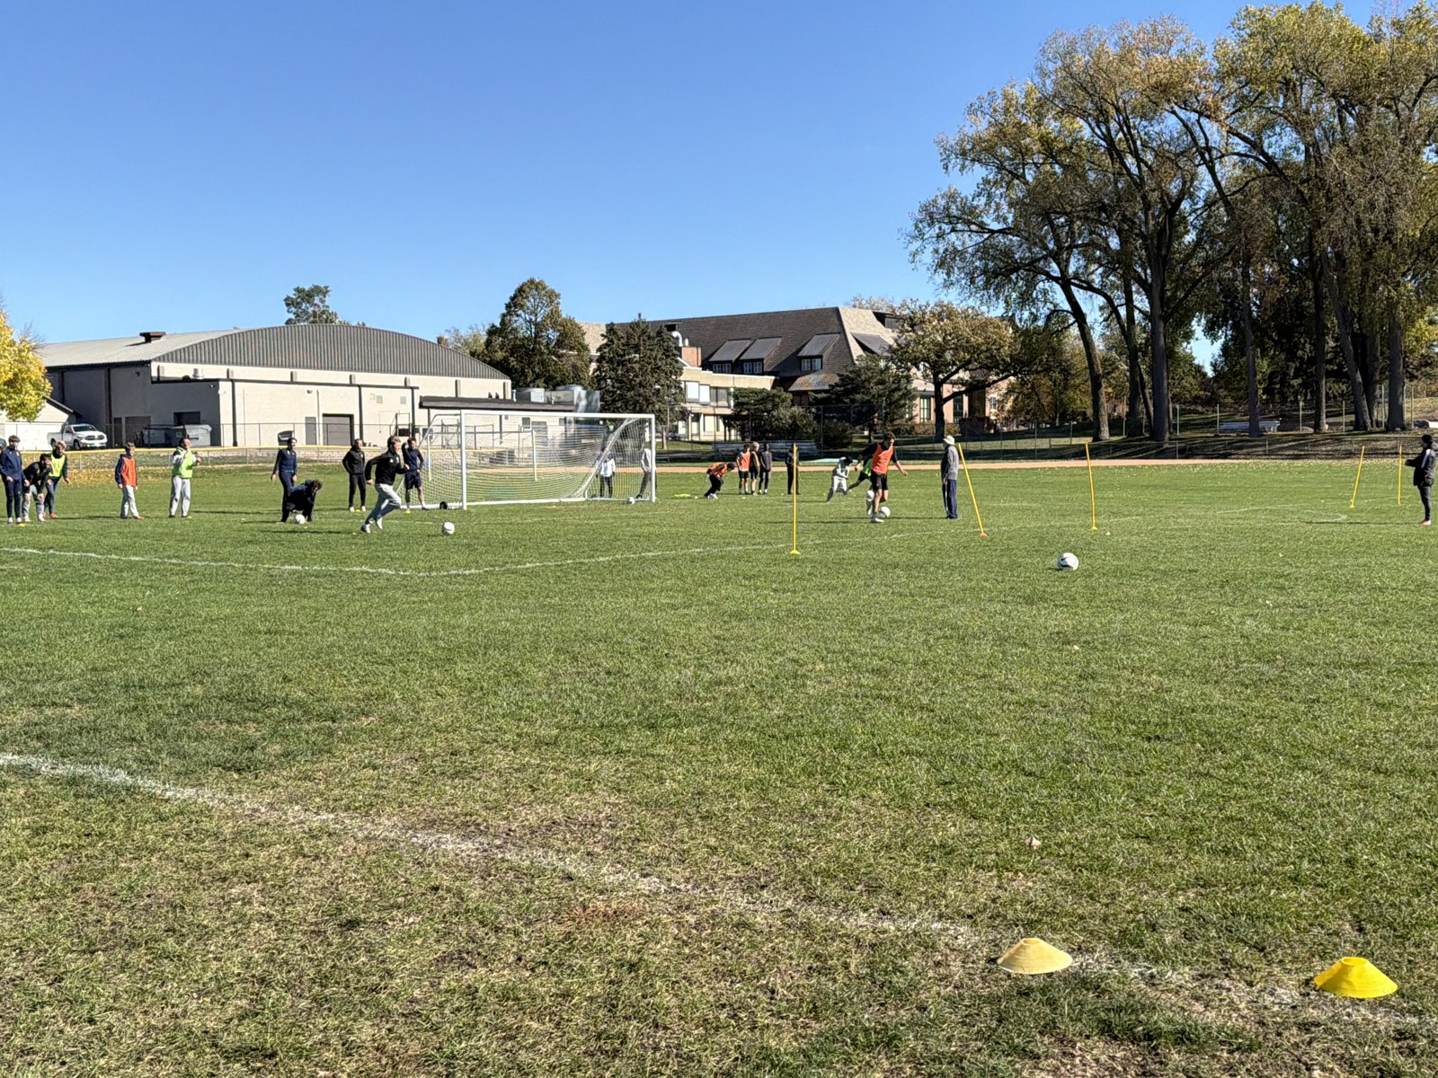

SEASON ALBUM
2026-10-17

Slide 52

SEASON ALBUM
2026-10-19

Slide 53

SEASON ALBUM
2026-10-24

Slide 54


Slide 55


Slide 56
Thank you, Spartans
Players • Families • Coaches • Team manager
Team photo and closing

Slide 57
THANK YOU
Captains’ Parents
Bjorgvinn & Anna
Nick & Sara
Pete & Elizabeth
Thank you for everything you give to this team.

Slide 58

THANK YOU / COACHES
Our Coaches
Buzz Lagos
Michael Forsgren
Philip Caputo
John Jasinski
John Birch
Marco Pavoloni
Corey Mathaler
Photography: Geoff George & Nate Waibel

Slide 59
THANK YOU
Our Photographers
Geoff George
Nate Waibel
Thank you for everything you give to this team.

Slide 60


Slide 61


Slide 62


Slide 63
2026 BVS
All-State 1st Team
Andrew “Kiki” Sullivan
Erik Bjorgvinsson

Slide 64
2026 BVS
All-State 2nd Team
Max George
Miles Vogenthaler

Slide 65
2026 BVS
All Conference
Miles Vogenthaler
Andrew “Kiki” Sullivan
Erik Bjorgvinsson

Slide 66
2026 BVS
All Conference Honorable Mention
Graham Waibel
Max George

Slide 67
2026 BVS
Most Valuable Player
John Grimsrud

Slide 68
2026 BVS
Most Improved Player
The Kaizen Award
Shrey Nemani

Slide 69
2026 BVS
Evan Hindlemeyer Award Winner
Spartan Award
Max Vradenburg

