Slide 1
Machine Learning Intro
Alfredo Fonseca Junior

Slide 2
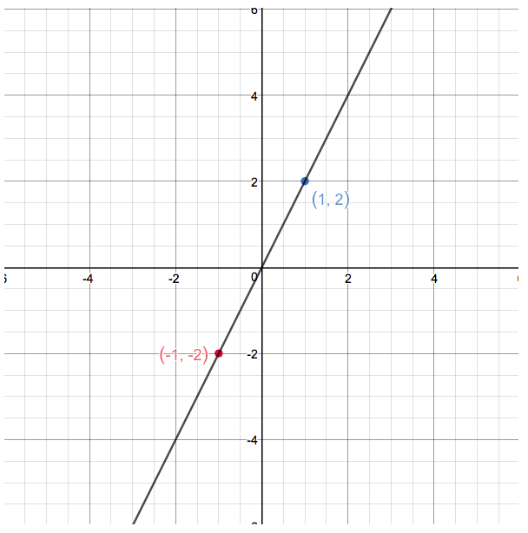
Function (Math)
Functions are entities that assign unique outputs to given inputs
E.g.: Linear function :
f(x) = 2x
Template = ax + b

Slide 3
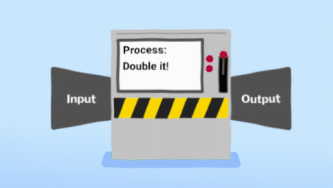
Classic Computation: Input -> Processing -> Output

Slide 4
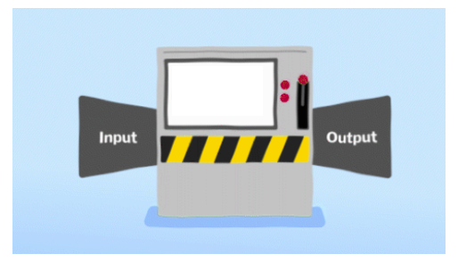

E.g. : one fifth (20%) of taxes to the King
Divide By 5
50 ->
-> 10

Slide 5

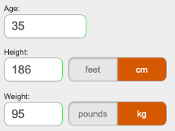
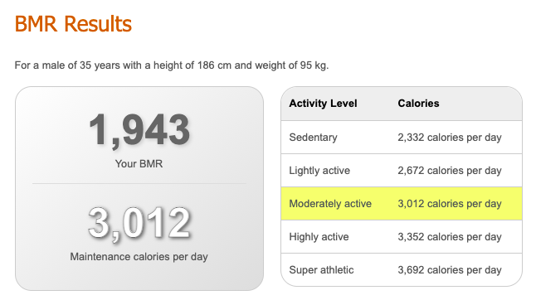
E.g. : BMR or Basal Metabolic Rate, is the number of calories you burn when your body is at rest.

Slide 6
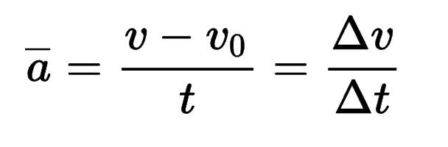
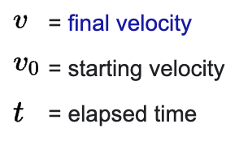

Average Acceleration

Slide 7
House Pricing ??? What’s the function ???
* 3 Rooms
* Dublin 4
* 70 square meters area
* New building
?????
400,000

Slide 8
Machine Learning
Machine learning algorithms build a model based on sample data, known as "training data", in order to make predictions or decisions without being explicitly programmed to do so.
https://en.wikipedia.org/wiki/Machine_learning

Slide 9
House Pricing
training data
ML Model

Slide 10
House Pricing
training data
ML Model
* 2 Rooms
* Dublin 8
* 75 square meters area
* New building
ML Model
Predict Value
300,000

Slide 11
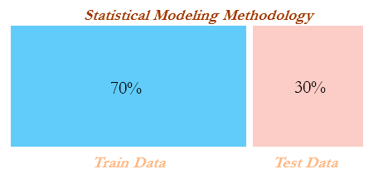

Slide 12
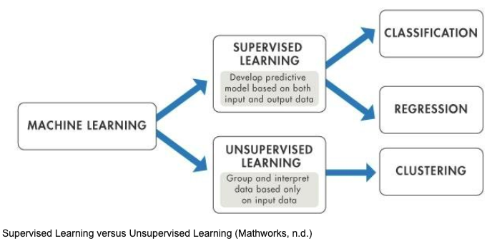

Slide 13
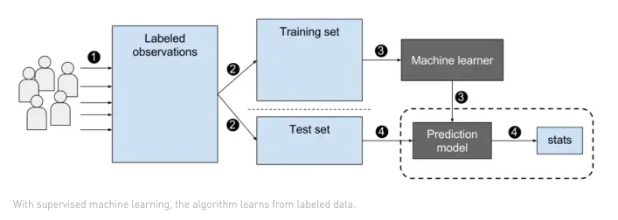
Supervised Learning

Slide 14
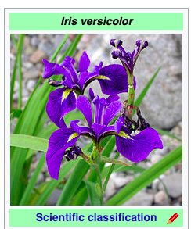
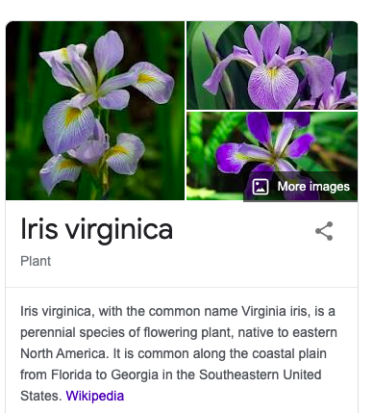
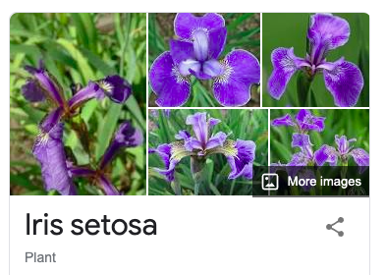
Iris

Slide 15
Flowers Classification
Predict class:
* Iris-Setosa
* Iris-Versicolour
* Iris-Virginica
* sepal length in cm
* sepal width in cm
* petal length in cm
* petal width in cm
ML Model

Slide 16
Flowers Classification
Features : X
Target : y
Predict class:
* Iris-Setosa
* Iris-Versicolour
* Iris-Virginica
* sepal length in cm
* sepal width in cm
* petal length in cm
* petal width in cm
ML Model

Slide 17
Correlations
Correlation is a statistical term describing the degree to which two variables move in coordination with one another.

Slide 18
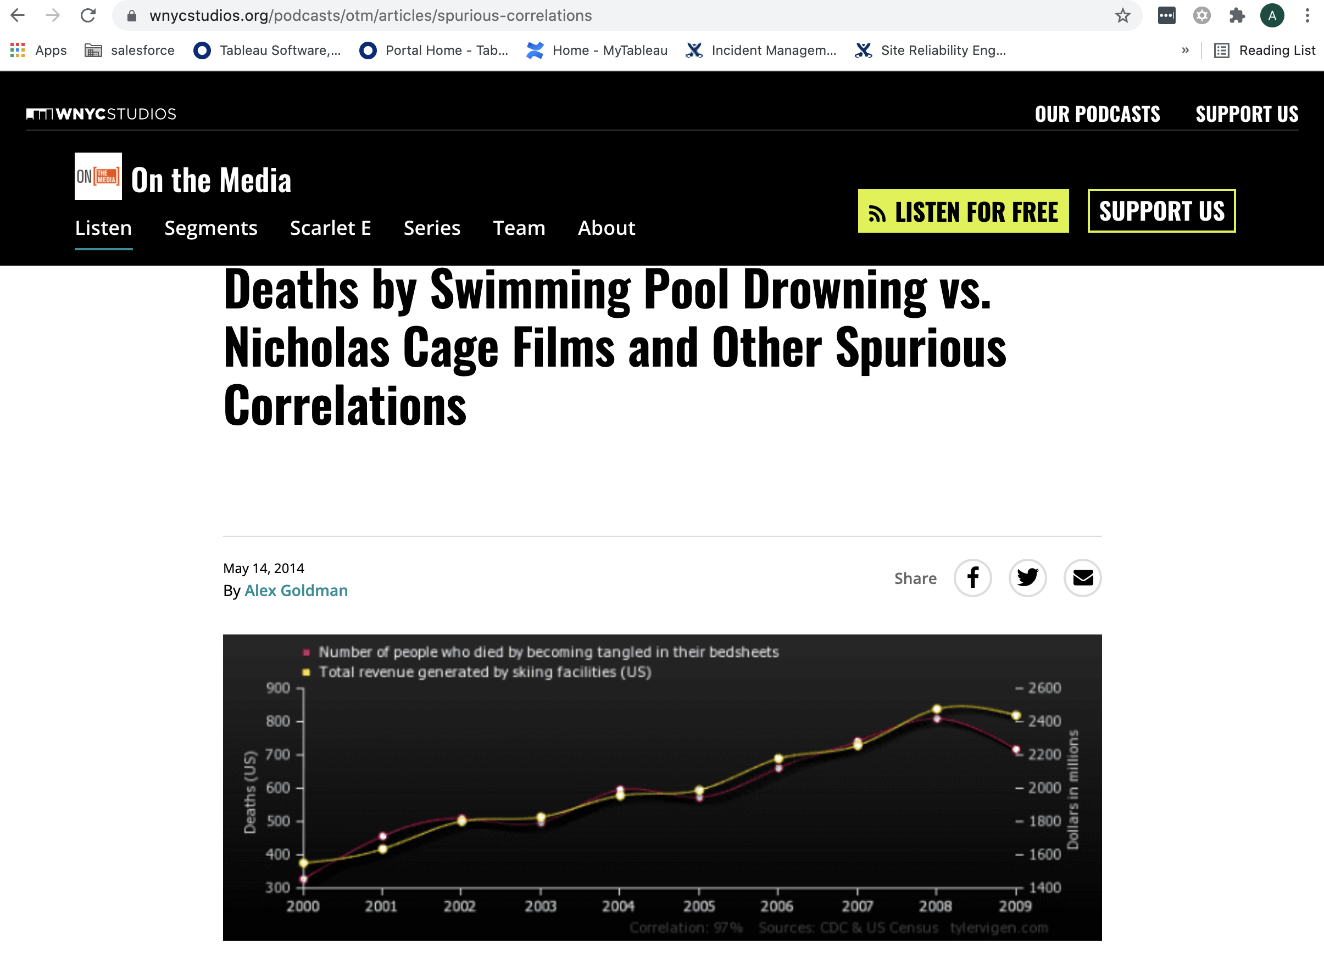
Weird Correlations

Slide 19
Flowers Classification Demo

Slide 20
Unsupervised Learning
”Unsupervised learning is a type of machine learning in which the algorithm is not provided with any pre-assigned labels or scores for the training data. As a result, unsupervised learning algorithms must first self-discover any naturally occurring patterns in that training data set.” Wikipedia

Slide 21
Clustering
"Clustering is a Machine Learning technique that involves the grouping of data points. Given a set of data points, we can use a clustering algorithm to classify each data point into a specific group. In theory, data points that are in the same group should have similar properties and/or features, while data points in different groups should have highly dissimilar properties and/or features. Clustering is a method of unsupervised learning and is a common technique for statistical data analysis used in many fields."
https://towardsdatascience.com/the-5-clustering-algorithms-data-scientists-need-to-know-a36d136ef68
Kmeans
"Kmeans algorithm is an iterative algorithm that tries to partition the dataset into Kpre-defined distinct non-overlapping subgroups (clusters) where each data point belongs to only one group. It tries to make the intra-cluster data points as similar as possible while also keeping the clusters as different (far) as possible. It assigns data points to a cluster such that the sum of the squared distance between the data points and the cluster’s centroid (arithmetic mean of all the data points that belong to that cluster) is at the minimum. The less variation we have within clusters, the more homogeneous (similar) the data points are within the same cluster."
https://towardsdatascience.com/k-means-clustering-algorithm-applications-evaluation-methods-and-drawbacks-aa03e644b48a
Euclidean distance
"In mathematics, the Euclidean distance between two points in Euclidean space is the length of a line segment between the two points."
https://en.wikipedia.org/wiki/Euclidean_distance

Slide 22
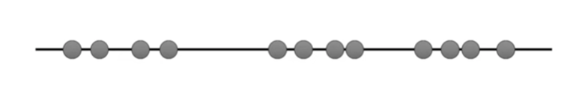
k-means

Slide 23
k-means
we can imagine :

Slide 24
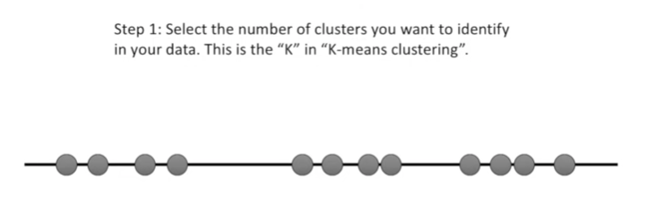
k-means
Source : https://www.youtube.com/watch?v=4b5d3muPQmA

Slide 25
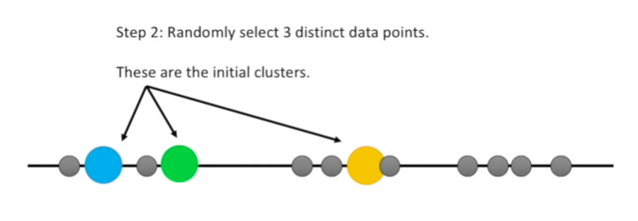
k-means

Slide 26
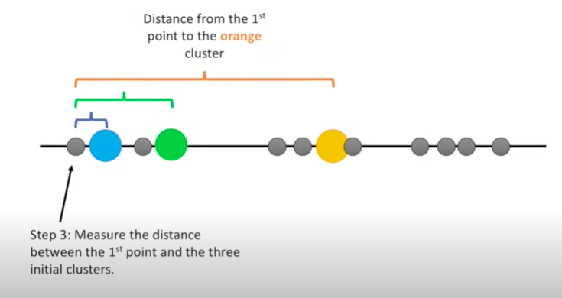
k-means

Slide 27
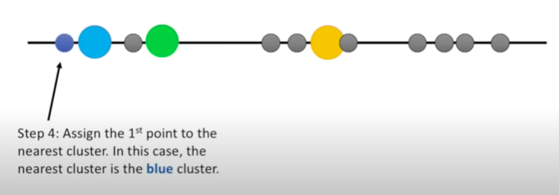
k-means

Slide 28
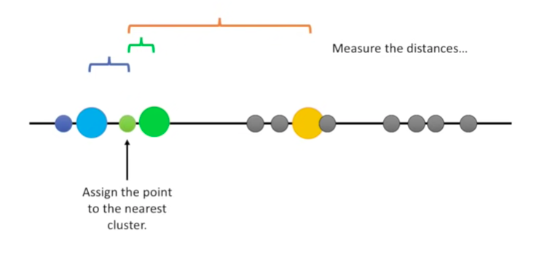
k-means
2nd point:

Slide 29
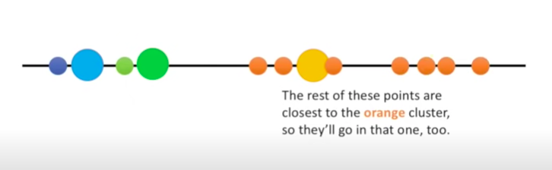
k-means

Slide 30
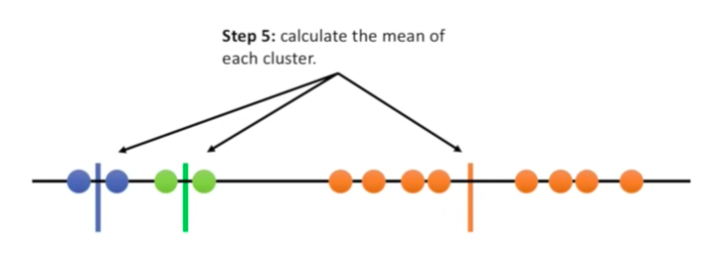
k-means

Slide 31
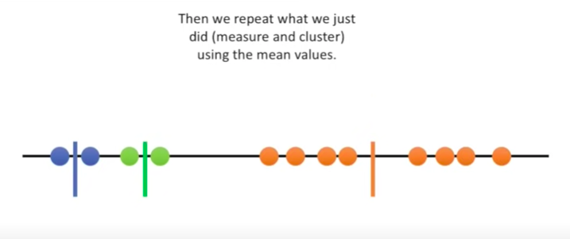
k-means
Point by point, use the means to choose the cluster

Slide 32
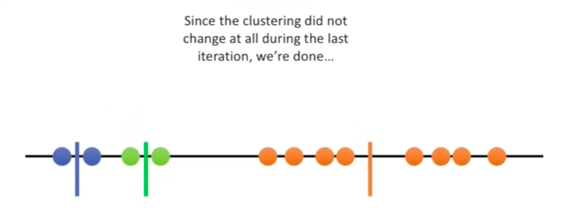
k-means

Slide 33
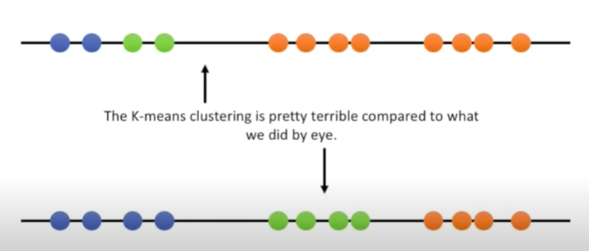
k-means

Slide 34
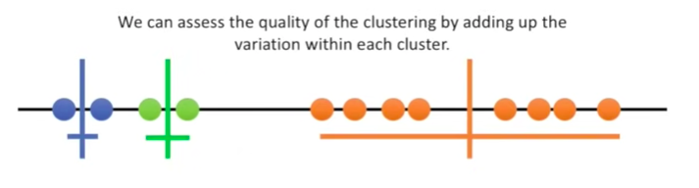
k-means

Slide 35
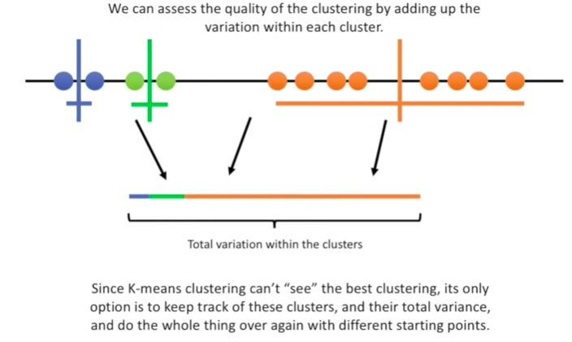

k-means

Slide 36
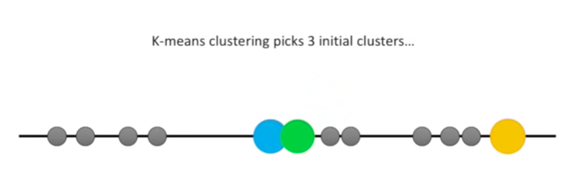
k-means

Slide 37
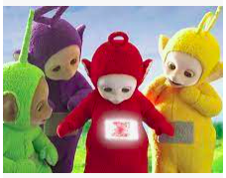
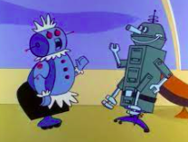
k-means
Again again
Computers are good at things like repetitive tasks and parallel processing

Slide 38
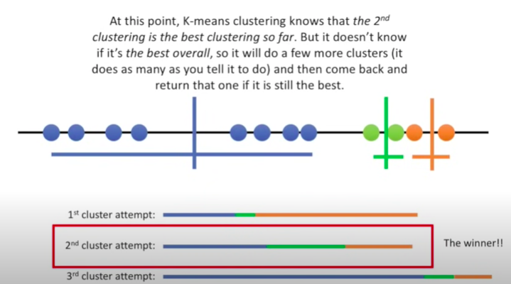
k-means

Slide 39
Pokemon Demo

Slide 40
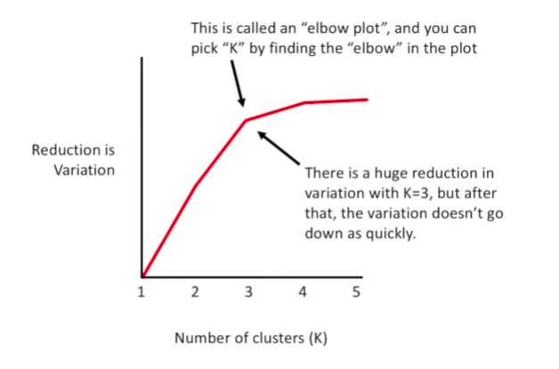
Picking K

Slide 41
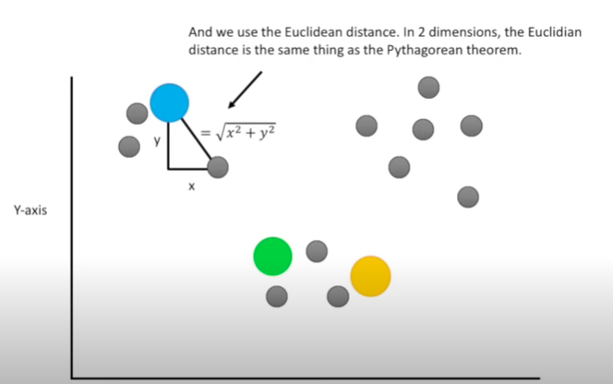
Euclidean distance

Slide 42

Insights about Square
The benefits of squaring include:
Squaring always gives a positive value, so the sum will not be zero.
Squaring emphasizes larger differences—a feature that turns out to be both good and bad (think of the effect outliers have).

Slide 43
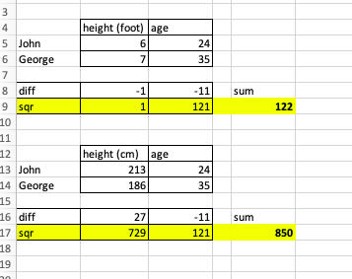
Insights

