Slide 1
Machine Learning Intro
Alfredo Fonseca Junior

Slide 2
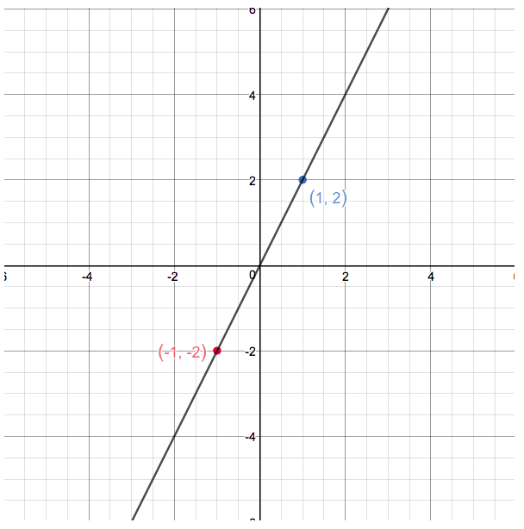
Function (Math)
Functions are entities that assign unique outputs to given inputs
E.g.: Linear function :
f(x) = 2x
Template = ax + b

Slide 3
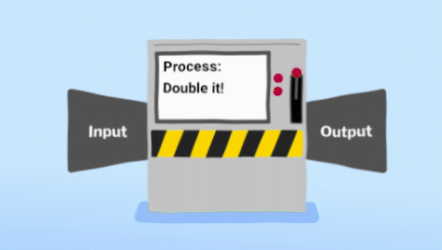
Classic Computation: Input -> Processing -> Output

Slide 4
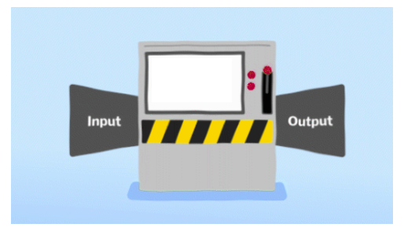

E.g. : one fifth (20%) of taxes to the King
Divide By 5
50 ->
-> 10

Slide 5

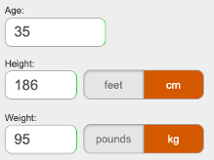
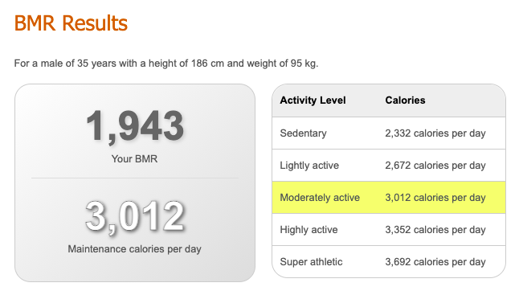
E.g. : BMR or Basal Metabolic Rate, is the number of calories you burn when your body is at rest.

Slide 6
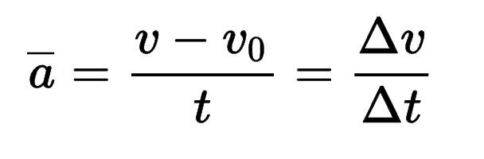
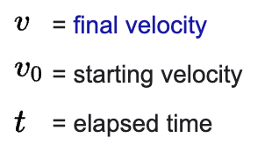

Average Acceleration

Slide 7
House Pricing ??? What’s the function ???
* 3 Rooms
* Dublin 4
* 70 square meters area
* New building
?????
400,000

Slide 8
Machine Learning
Machine learning algorithms build a model based on sample data, known as "training data", in order to make predictions or decisions without being explicitly programmed to do so.
https://en.wikipedia.org/wiki/Machine_learning

Slide 9
House Pricing
training data
ML Model

Slide 10
House Pricing
training data
ML Model
* 2 Rooms
* Dublin 8
* 75 square meters area
* New building
ML Model
Predict Value
300,000

Slide 11
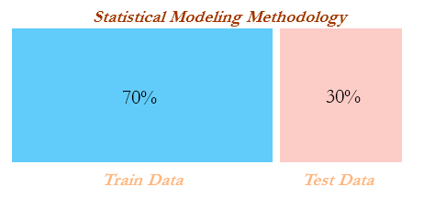

Slide 12
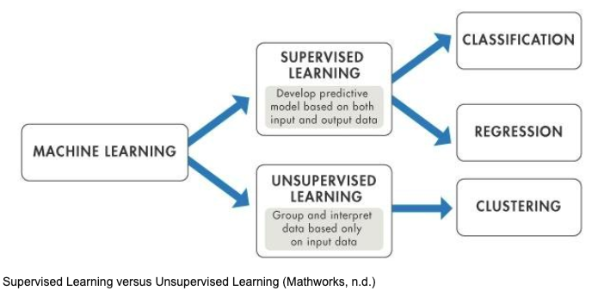

Slide 13
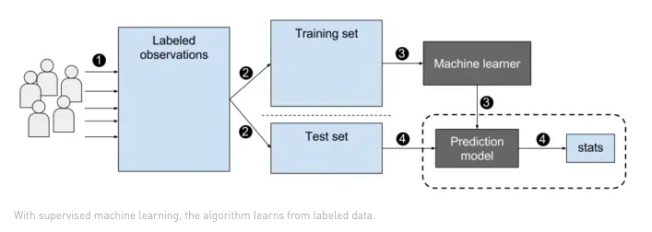
Supervised Learning

Slide 14
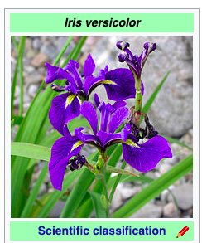
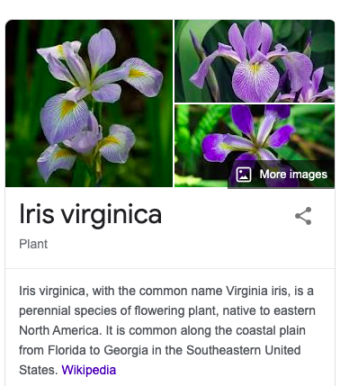
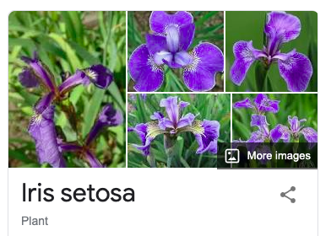
Iris

Slide 15
Flowers Classification
Predict class:
* Iris-Setosa
* Iris-Versicolour
* Iris-Virginica
* sepal length in cm
* sepal width in cm
* petal length in cm
* petal width in cm
ML Model

Slide 16
Flowers Classification
Features : X
Target : y
Predict class:
* Iris-Setosa
* Iris-Versicolour
* Iris-Virginica
* sepal length in cm
* sepal width in cm
* petal length in cm
* petal width in cm
ML Model

Slide 17
Correlations
Correlation is a statistical term describing the degree to which two variables move in coordination with one another.

Slide 18
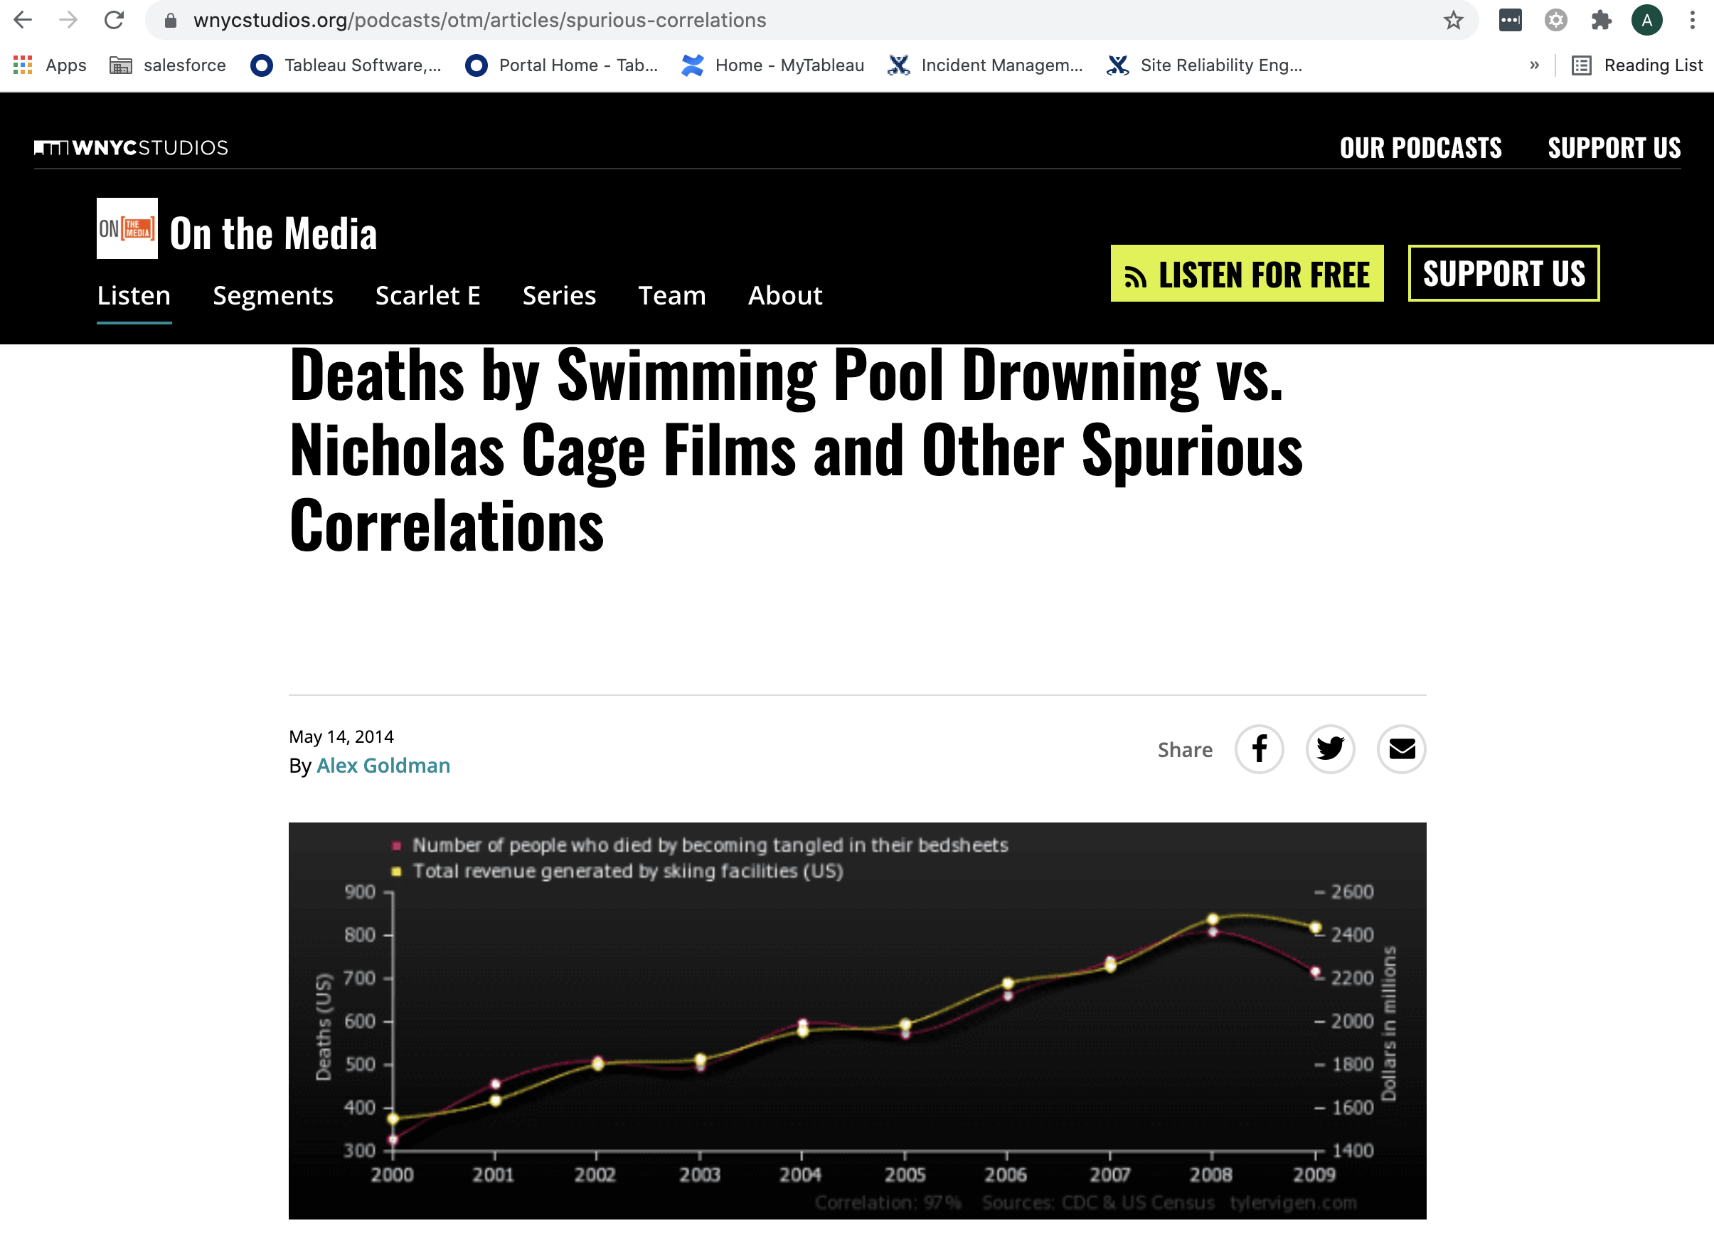
Weird Correlations

Slide 19
Flowers Classification Demo

Slide 20
Unsupervised Learning
”Unsupervised learning is a type of machine learning in which the algorithm is not provided with any pre-assigned labels or scores for the training data. As a result, unsupervised learning algorithms must first self-discover any naturally occurring patterns in that training data set.” Wikipedia

Slide 21
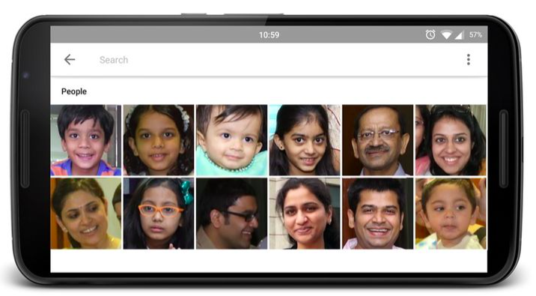
Google Photos
https://photos.google.com/people

Slide 22

Google Photos
https://photos.google.com/people

Slide 23
Pokemon Demo

Slide 24

Square

