Slide 1
Machine Learning Intro
Alfredo Fonseca Junior

Slide 2
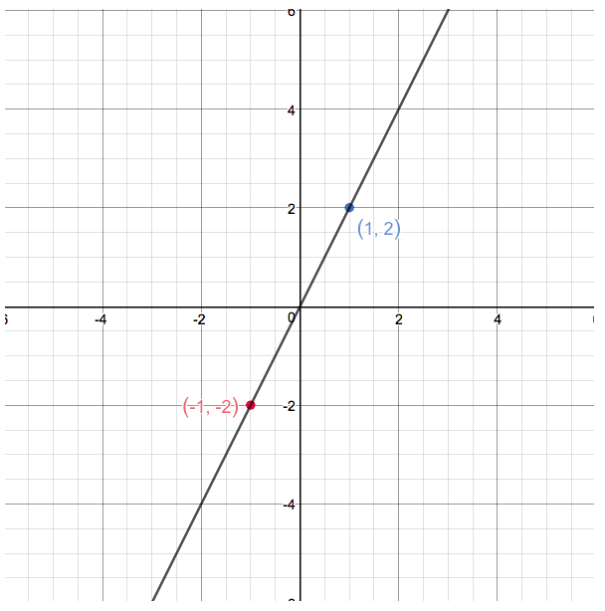
Function (Math)
Functions are entities that assign unique outputs to given inputs
E.g.: Linear function :
f(x) = 2x
Template = ax + b

Slide 3
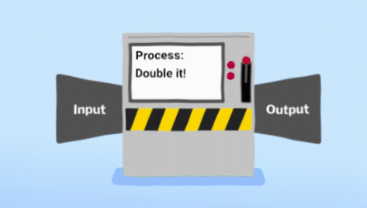
Classic Computation: Input -> Processing -> Output

Slide 4
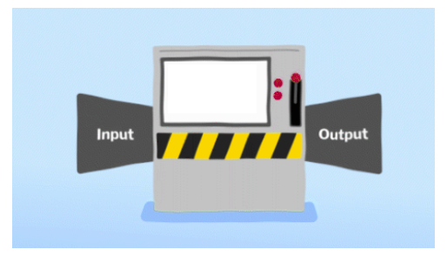

E.g. : one fifth (20%) of taxes to the King
Divide By 5
50 ->
-> 10

Slide 5

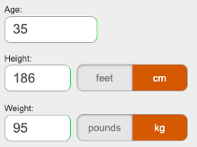
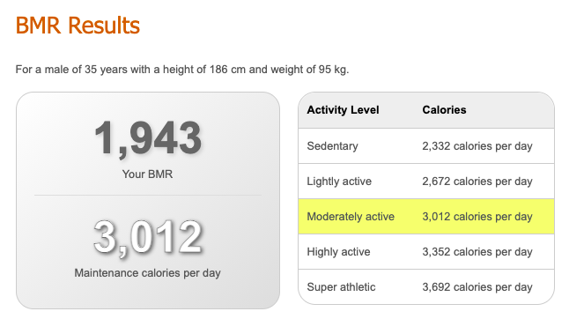
E.g. : BMR or Basal Metabolic Rate, is the number of calories you burn when your body is at rest.

Slide 6
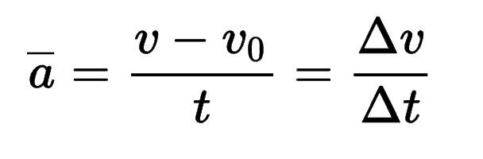
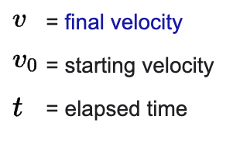

Average Acceleration

Slide 7
House Pricing ??? What’s the function ???
* 3 Rooms
* Dublin 4
* 70 square meters area
* New building
?????
400,000

Slide 8
Machine Learning
Machine learning algorithms build a model based on sample data, known as "training data", in order to make predictions or decisions without being explicitly programmed to do so.
https://en.wikipedia.org/wiki/Machine_learning

Slide 9
House Pricing
training data
ML Model

Slide 10
House Pricing
training data
ML Model
* 2 Rooms
* Dublin 8
* 75 square meters area
* New building
ML Model
Predict Value
300,000

Slide 11
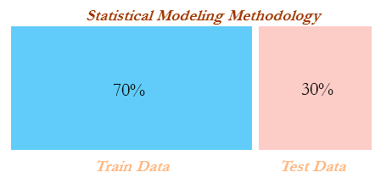

Slide 12
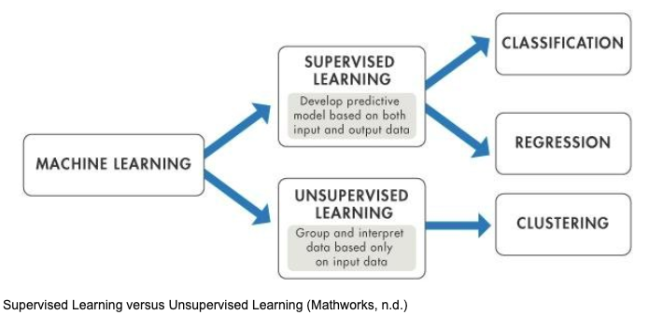

Slide 13
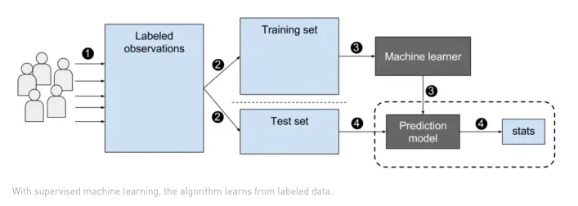
Supervised Learning

Slide 14
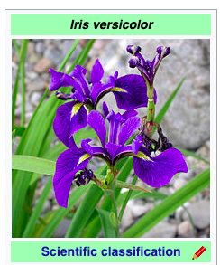
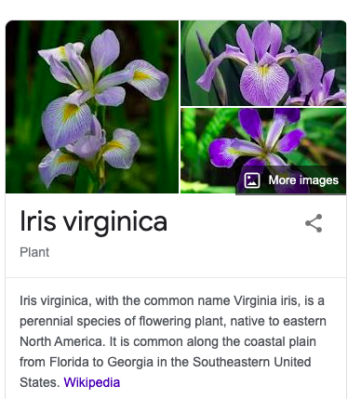
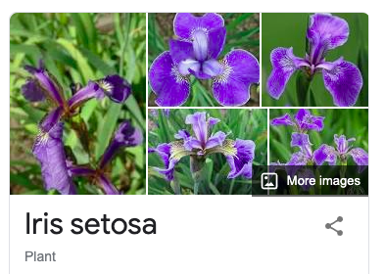
Iris

Slide 15
Flowers Classification
Predict class:
* Iris-Setosa
* Iris-Versicolour
* Iris-Virginica
* sepal length in cm
* sepal width in cm
* petal length in cm
* petal width in cm
ML Model

Slide 16
Flowers Classification
Features : X
Target : y
Predict class:
* Iris-Setosa
* Iris-Versicolour
* Iris-Virginica
* sepal length in cm
* sepal width in cm
* petal length in cm
* petal width in cm
ML Model

Slide 17
Flowers Classification Demo

Slide 18
Unsupervised Learning
”Unsupervised learning is a type of machine learning in which the algorithm is not provided with any pre-assigned labels or scores for the training data. As a result, unsupervised learning algorithms must first self-discover any naturally occurring patterns in that training data set.” Wikipedia

Slide 19
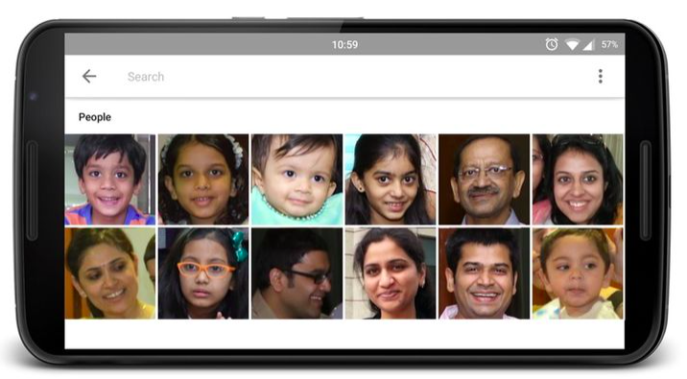
Google Photos
https://photos.google.com/people

Slide 20

Google Photos
https://photos.google.com/people

Slide 21
Pokemon Demo

Slide 22

Square

