Slide 1

Osprey-Hackers: Ember System

Slide 2
Problem
Every 7 minutes 43 seconds, a firefighter is injured
Out of all firefighter injuries 43% are on fire ground operations
Every 63 seconds there is a structure fire
Fire takes an average of nine lives every day

Slide 3
Solution
Ember System
Small ceiling mounted device
Constructed from stainless steel
Detects smoke and temperature variations
Renders map and floorplan
Informs Firefighters on situation
Market to commercial buildings in beginning phases

Slide 4
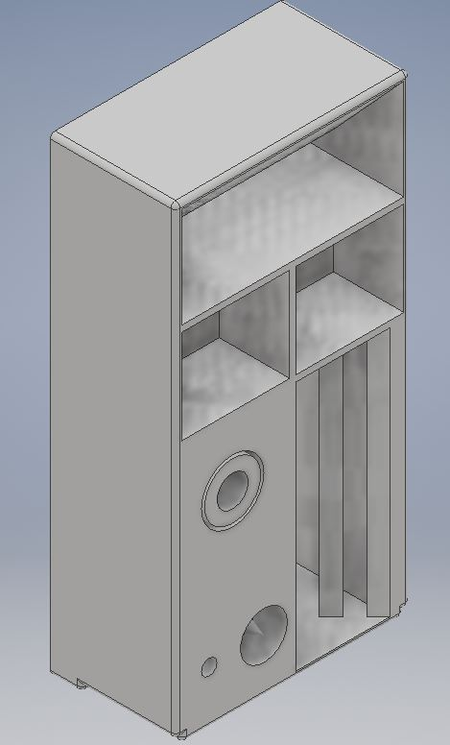
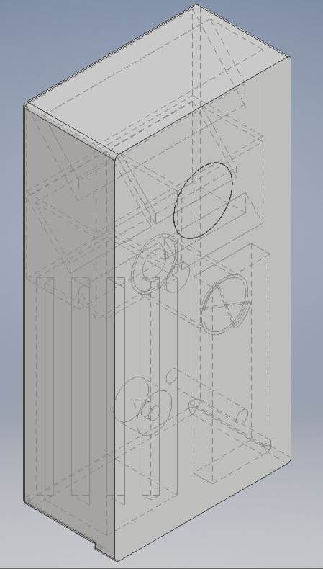

Slide 5
How it Works
Uses various sensors to detect temperature changes, smoke, and carbon monoxide
Ultrasonic sensor renders map of room
With multiple devices in other rooms, renders whole building
Sends information to local hub which relays information to firefighter station and connects to an app on the field manager’s laptop

Slide 6
Database
A database will be constructed of the city’s building’s 3D structure and floorplan profile.
Will be complied through data from Ember device and from building plans filed with the city.
Will be made accessible to the fire department to aid in fire fighting

Slide 7
How the App Works: Phase 1
Database receives information from Ember device
Fire Chief connects to database, accessing all information on building
Fire Chief toggles through information and delegates necessary instructions to firefighters

Slide 8
How the App Works: Phase 2
Firemen receive augmented reality glasses that receive data from app
Firemen can view information on the fire location and projected burn path
Firemen can use that information to make better informed decisions

Slide 9
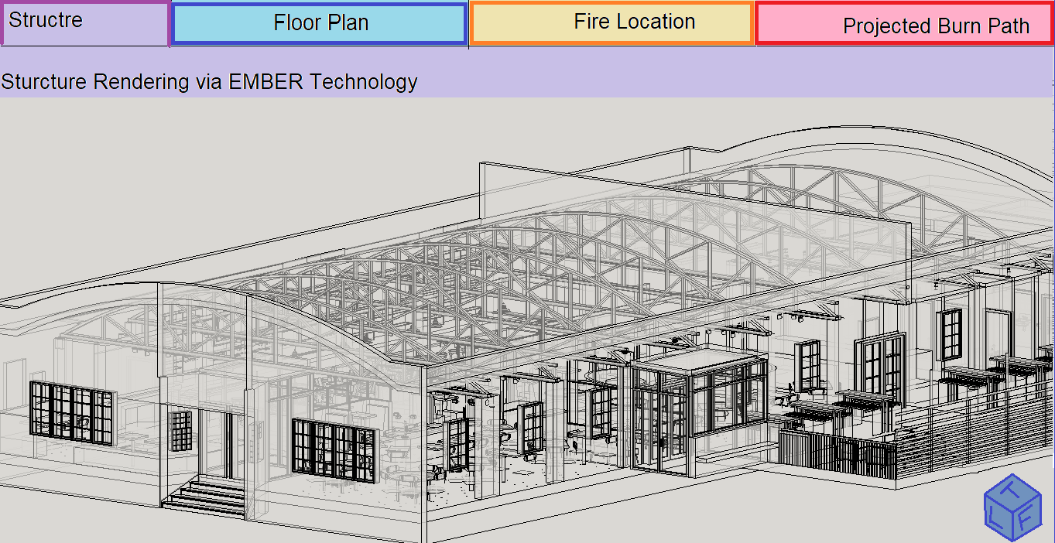
Structure

Slide 10
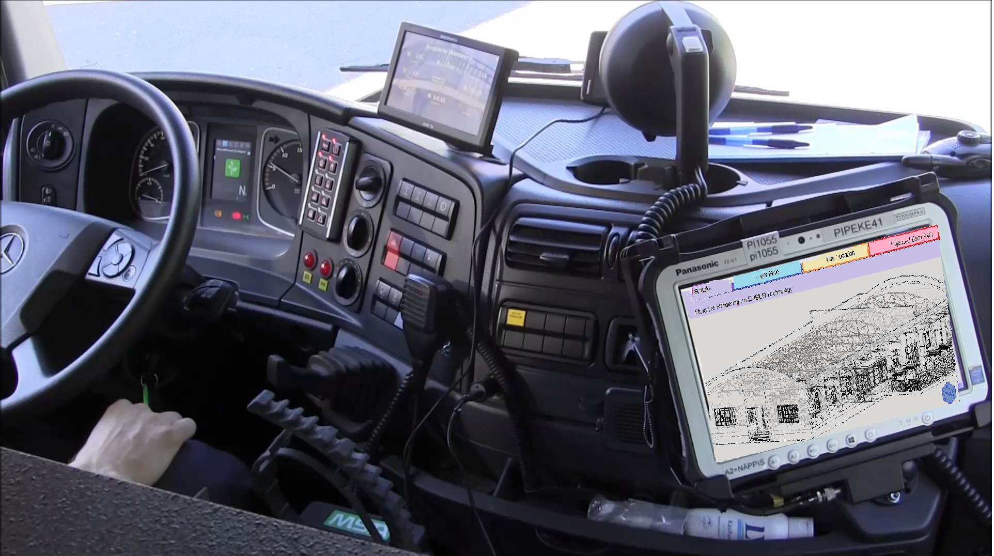

Slide 11
Why Ember is Necessary
Connects building information with firefighter crew in real-time
Gives information to firefighters and managers
Allows firefighters to have maximum preparation

