Slide 2
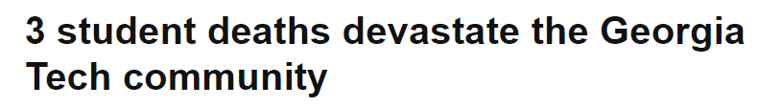

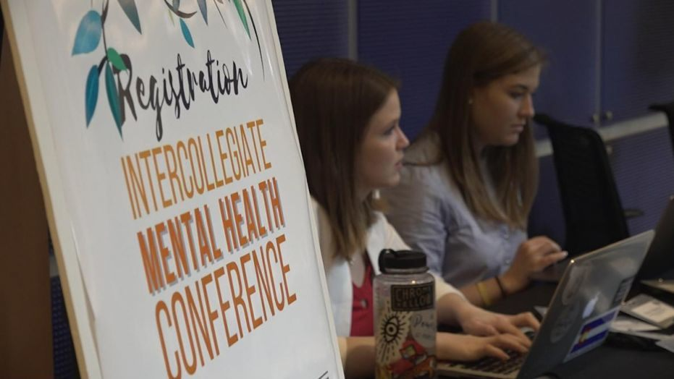

Notes:
Hi everyone.
I’m an Exchange student at Georgia Tech. I guess y’all remember the tragic happenings of last year in my campus: 2 students commited suicide on the same week. It was a big punch for everybody.
Coming from Europe, this event was absolutely striking for me, so I decided to do some research.
***************
Q&A: Afterwards, we were given talks by profesional psychologists about the importance of maintaining close contact with your peers

Slide 3

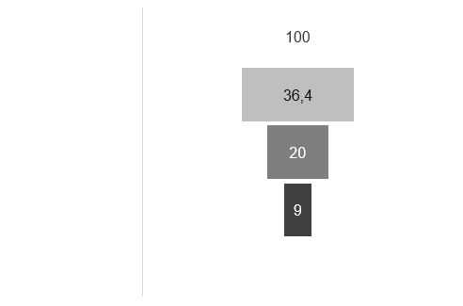
the problem
1,000 student suicides
per year on campus
Total economic burden of depression > 210 B $
College students (%)
Notes:
If we look at the facts, we see that it’s a very common thing for students to contemplate suicide; and that this sort of mental issues have a huge economic burden on society. And yet, 90 % of students ending up killing themselves were not receiving any sort of help.
******************
The total economic burden of major depression is now estimated to be $210.5 billion per year (2015). Only 40 percent of this sum is associated with depression itself.
Students with depression are twice as likely to drop out of college as their healthy peers.
36.4% of college students reported they experienced some level of depression.
Suicide is the second most common cause of death among college students.
1,000 students take their lives each year on college campuses.
More than half of college students have had suicidal thoughts and 10% think about seriously considering attempting suicide.’
80-90% of college students who die by suicide were not receiving help from college counseling centers.
https://blogs.scientificamerican.com/mind-guest-blog/the-growing-economic-burden-of-depression-in-the-u-s/
https://www.bestcolleges.com/resources/top-5-mental-health-problems-facing-college-students/
https://www.safecolleges.com/suicide-second-highest-cause-of-death-among-college-students/
https://www.aau.edu/research-scholarship/featured-research-topics/one-five-college-students-reported-thoughts-suicide

Slide 4
the current approach
On-campus events to promote connectedness
Ready for helping students who seek help
Notes:
Nowadays, this help is mainly based on encouraging people to seek for counseling in public events and having staff ready to assist those who do.

Slide 5
the current approach
On-campus events to promote connectedness
Ready for helping students who seek help
Suicide rates still on the rise
Stigma in seeking help
No new approaches
Notes:
But these measurements do not really engage them into doing so due to fear of stigmatization.
And meanwhile, suicide rates keep going up, and no alternatives approaches are suggested.
**********************
“be ready to respond when a death occurs” = calm people down… DEEDS, NOT WORDS
Seems like they are just waiting for it to happen.
http://www.sprc.org/settings/colleges-universities According to suicide rpevention resource center

Slide 6

the solution
Sancho!
Notes:
Until now… welcome SANCHO! A platform that enables students to receive counseling with no social exposure and from people who they can relate to, and which allows the administrator to learn patterns from the users.
But let’s show you in a more practical way: this, is a demo of the platform.
Let’s imagine we are a troubled student. After logging in, I can establish a conversation with a peer student that Will try to counsel me to recover from my depression. But that person in front is not just another student, it would be a clinical psychology student, or psychiatry student, or nurse in training… Those who will really care about me and furthermore improve their profesional skills in doing so while still in college.
Sancho, apart from providing peer support to those who need it, Will collect data from reports of the helpers and self assessment tests of the users. In the future it would also analyze the conversations themselves and establish trends related to the tone of their voice or their vocabulary.
These data can be very valuable for the university using Sancho, since they could use it for future research and develop new ways of dealing with the issue.
Here’s an example of the admin view of some parameter of the student, which allows individual monitoring of the situation.

Slide 7
the users
23 M students
All US colleges
Selection criteria:
Identifiable users
On-line
Peers
230k students
UNC system
30k students
(beachhead)
UNC Charlotte
Notes:
The market strategy would start at implementing it at UNC Charlotte, and after that pilot, extend the service to the whole UNC system and finally every university in the country.
*********************
Identifiable: well studied group
On-line: used to communicate using digital technologies
Peers: their helpers Will also be students

Slide 8




the roadmap
Target users:
College students
Target users:
Any person at risk
Notes:
But what about all those people in the same situation but not attending college? We do not forget about them. Once the product has been refined in the university system, we aim to target other age groups, where suicide rates also seem to increase rapidly (24 % over the last 15 years overall).
***************
Start in a controlled environment with powerful resources like colleges, then move to provide the same help to the wider population.
We must notice that death by suicide is a serious public health issue that has increased by 24% over the last 15 years in the U.S., with more than 42,000 people dying from suicide each year. Not only students are the sufferers.
https://www.bestcolleges.com/resources/suicide-prevention/
We would include more tailored tools in the platform to provide better analytics and appropriate counseling to profiles different from students.

Slide 9
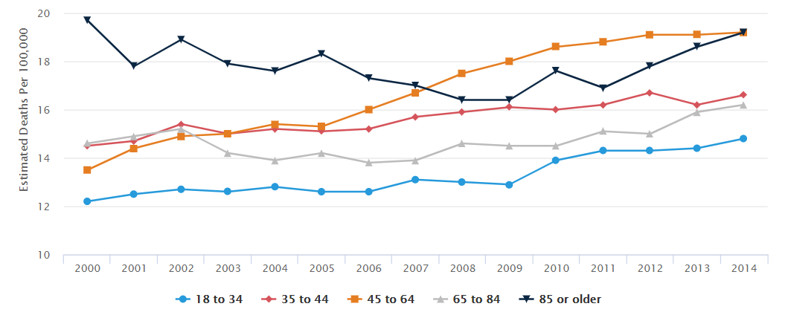
the roadmap

Slide 10


the business model
Sancho
UNIVERSITY
B2B
Suscription model
Notes:
We would sell the communication service and the analytics platform directly to the universities via a subscription model.

Slide 11

the Value
Comfortable access to help with granted anonymity
Early treatment = save lives and money
Classify mental state of user after sign-up via standardized psychological tests
Match with affine partners
Training for future healthcare professionals
Collection of historical data from users can be used by universities to research and improve preventive strategies!!!
Reduced emotional impact of such events on society
Notes:
Now, if we go over the producto, we can list several advantages:
*****************
Do not prescribe drug treatment. But may encourage to attend a doctor to get it. Maybe provide a oficial paper recommending drug treatment from their non profesional standpoint.
Expect early participation in the platform (before drug would be needed), this saving money in drug expenses.
Mental assessment and personality test after sign-up (using standardized tests). Classify level of mental distress.
Match with affine people so that it does not feel so much like clinical help (reduced stigma).
Granted anonimity (avoid stigma) and professionality by helpers.
Should helpers just be already professional psychologists?

Slide 12


Notes:
Because in Georgia Tech, this is how we want students to bee.

