Slide 1
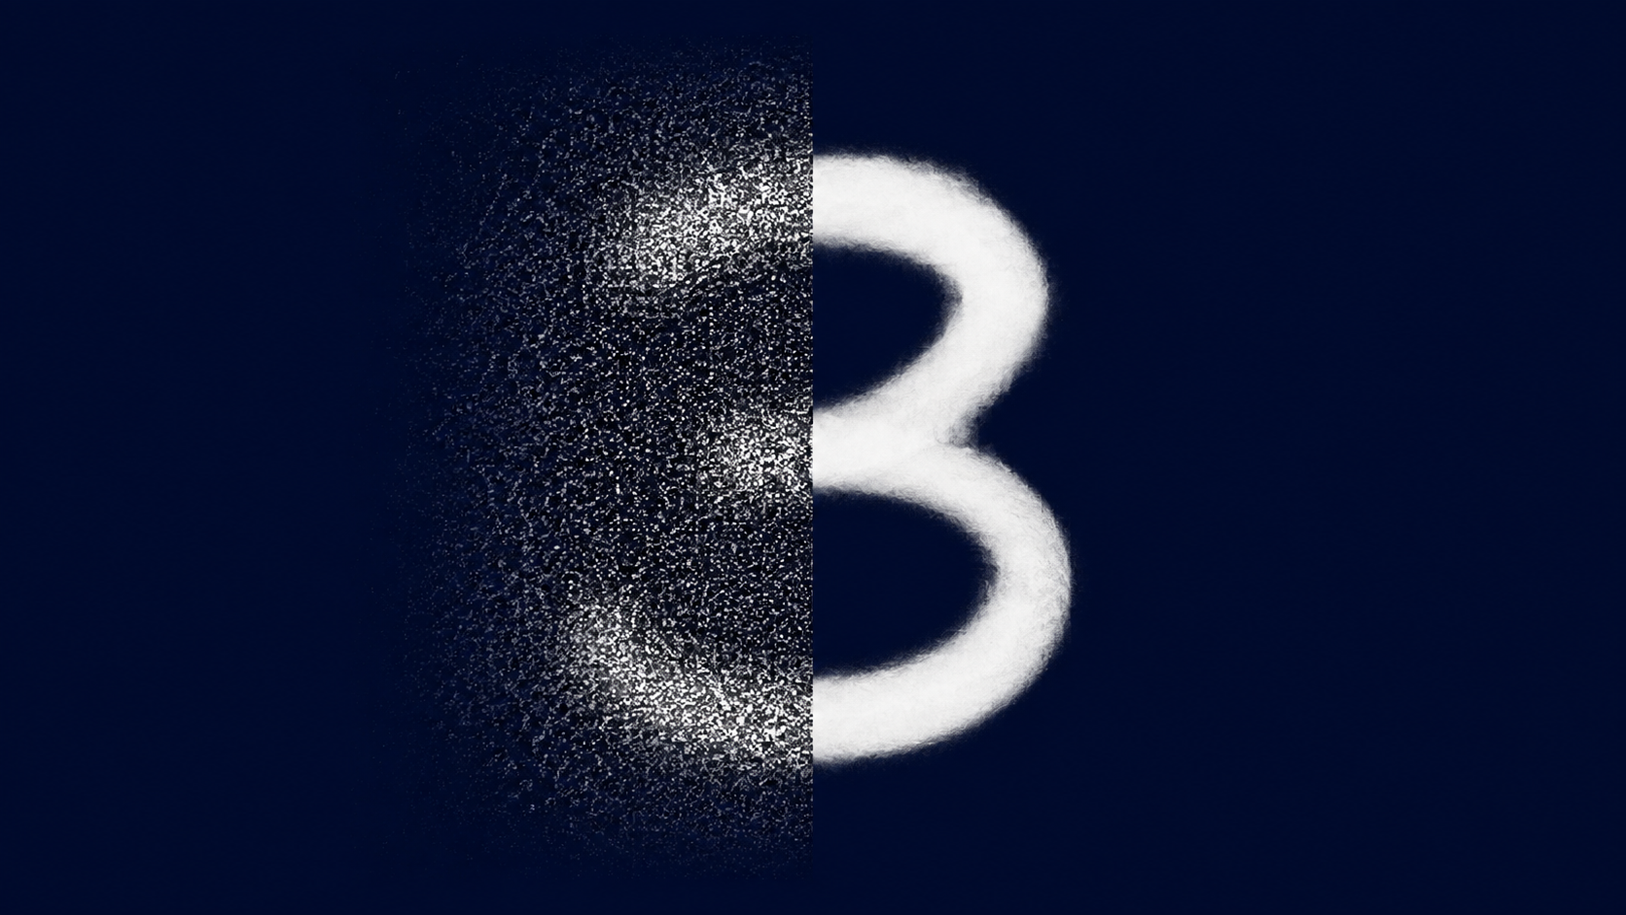
σ = 0.2 · Noisy PSNR = 16.71 dB
SEEING THROUGH
THE NOISE
How SVD Reveals Hidden Structure in Images
A story of mathematics, handwritten digits, and discovery.
What if you could look at a noise-corrupted image and mathematically recover the original digit?
1/10
Notes:
Hook: presentar el problema visual. Preguntar al grupo: ¿qué parte es ruido y qué parte sigue siendo estructura?

Slide 2
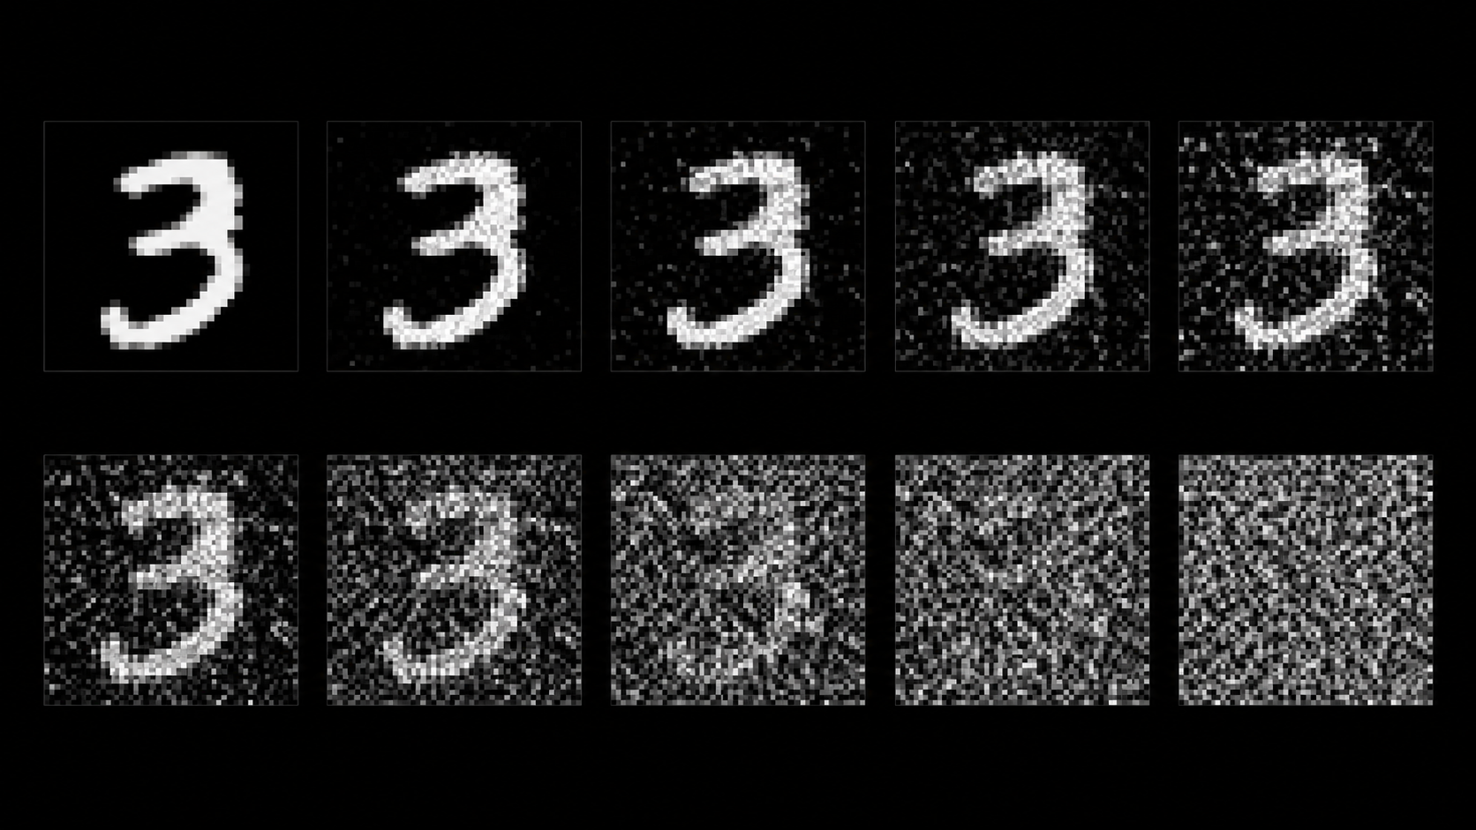
CAN YOU READ THESE DIGITS?
They are all handwritten 3s... but noise makes them almost unreadable.
Notebook data
6,131
28×28=784
digit-3 images
pixels per image
σ = 0.2
16.71 dB
Gaussian noise
Noisy PSNR
Question for students:
Can you identify the number in each image?
2/10
Notes:
El ruido es aleatorio y caótico, pero la estructura que buscamos tiene un patrón. Y SVD puede encontrarlo.

Slide 3
SVD: THE TOOL THAT REVEALS STRUCTURE
It decomposes a matrix into “layers of information.”
X = U · Σ · Vᵀ
X
U
Σ
Vᵀ
6131 × 784
=
6131 × 6131
·
6131 × 784
·
784 × 784
All images
Image patterns
Importance / energy
Pixel patterns
Analogy: imagine an orchestra.
U and V are the musicians; Σ is the volume of each instrument. The loudest instruments are the ones that matter most.
3/10
Notes:
No entrar en álgebra pesada: SVD separa patrones por importancia. Los valores singulares son el ranking de importancia.

Slide 4
WHY DO THE DIMENSIONS MATTER?
The formula is simple; the dimensions tell the story.
Data matrix X
Xₖ = Uₖ · Σₖ · Vₖᵀ
Choose k
6131 rows
= images
keep only the k most important patterns and discard the rest.
Uₖ
Σₖ
Vₖᵀ
784 columns
= pixels
·
·
6131 × k
k × k
k × 784
less data · same structure
[6131×784] = [6131×k] · [k×k] · [k×784]
[6131 × 784]
4/10
Notes:
Al elegir un k más pequeño, reducimos drásticamente la información que guardamos, pero conservamos lo esencial: la estructura del dígito 3.

Slide 5
THE SECRET: SEPARATING SIGNAL FROM NOISE
The digit shape lives in the large singular values. Noise is spread across many small values.
SIGNAL
first components
with the most energy
NOISE
many small,
dispersed components
σ₁ = 593.72 dominates the scale: that is why ranking matters.
5/10
Notes:
Es como una fiesta: las voces principales son los valores grandes; el murmullo de fondo son los valores pequeños. SVD nos ayuda a quedarnos con lo importante.

Slide 6
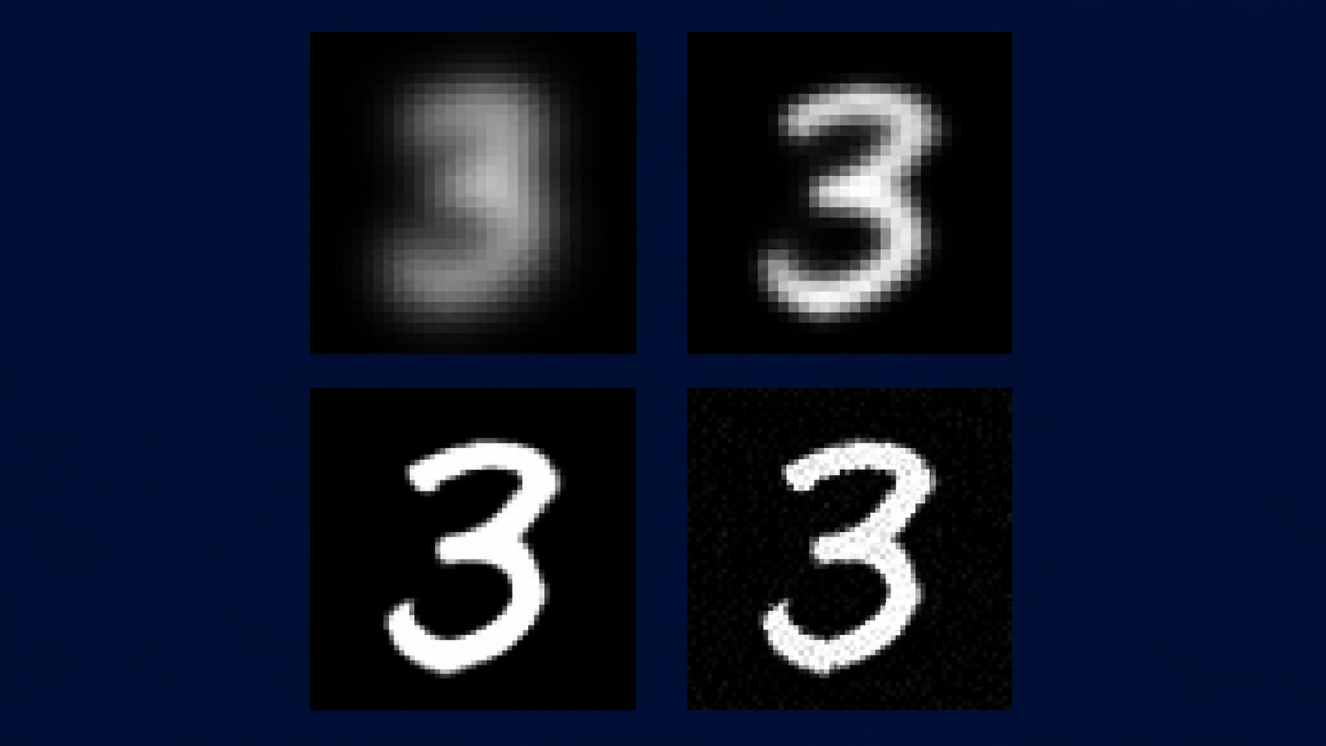
HOW k TRANSFORMS THE IMAGE
4 reconstructions, 4 different outcomes
k = 1
k = 5
PSNR 12.38 dB · Energy 57.2%
Almost unrecognizable
PSNR 14.00 dB · Energy 67.6%
Starting to emerge
Visual takeaway: increasing k helps... until it starts bringing noise back.
k = 20
k = 40
PSNR 16.23 dB · Energy 77.4%
Perfectly readable!
PSNR 17.60 dB · Energy 81.9%
Noise returns
6/10
Notes:
Observa cómo la imagen cobra vida al aumentar k. Pero si subimos demasiado, también empiezan a regresar detalles que son ruido.

Slide 7
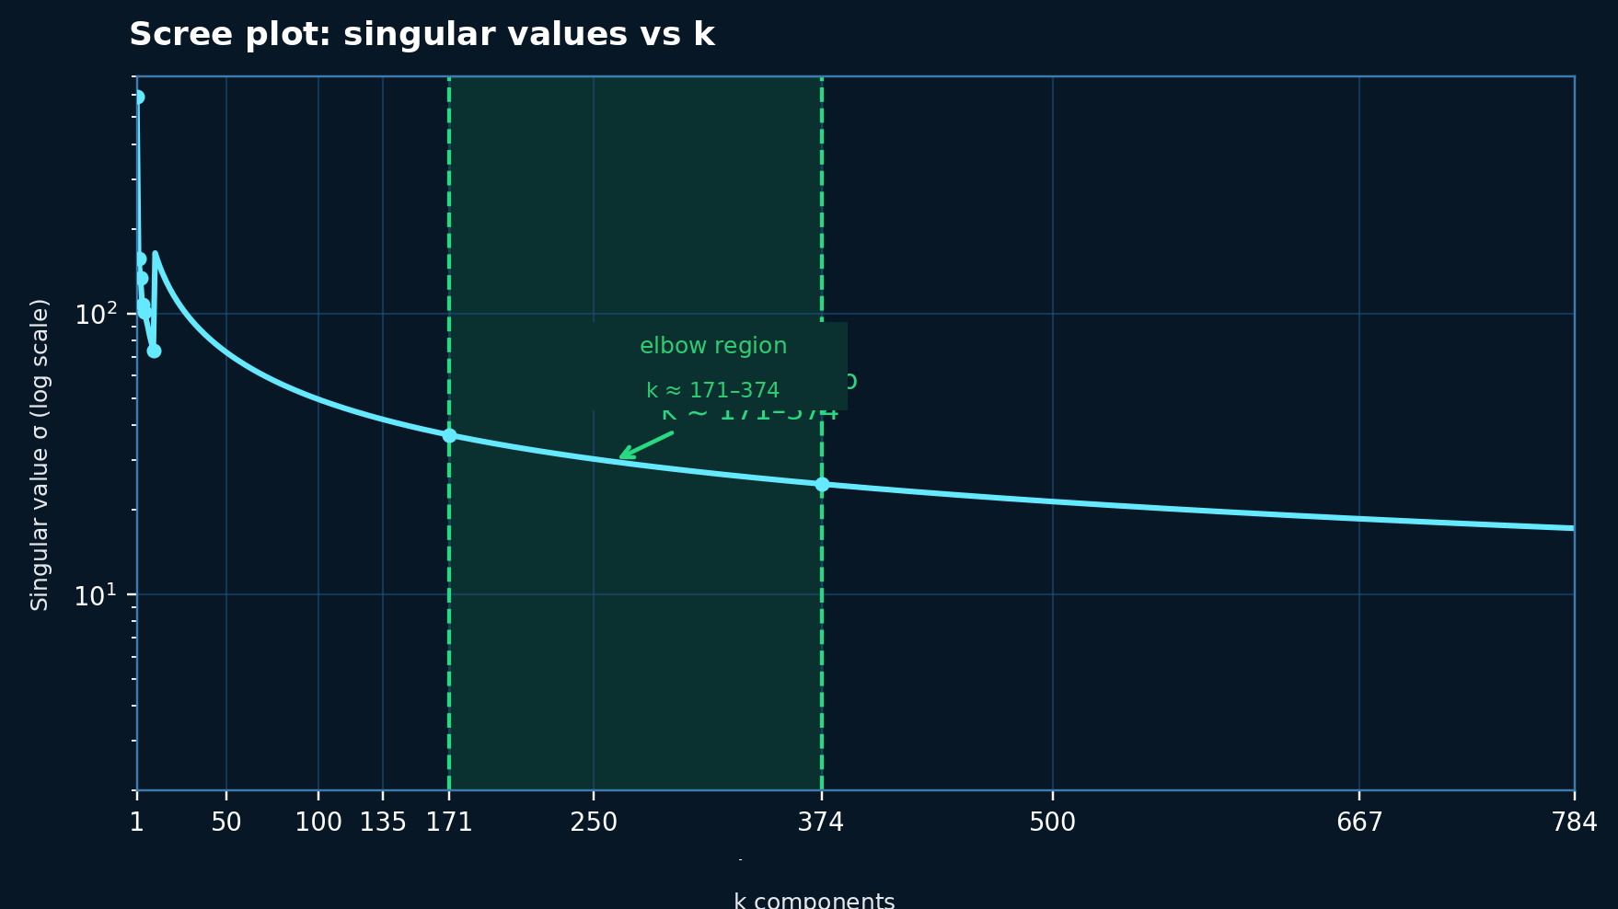
THE ELBOW OF THE SINGULAR VALUES
Method 1: find where the curve stops dropping rapidly.
Reading the scree plot
Values in descending order
We look for the curve’s “elbow”
Suggested region: k ≈ 171–374
k = 171
k = 374
90% energy
95% energy
The elbow marks where values begin to appear less significant.
7/10
Notes:
El codo no siempre da un número exacto. Es una regla visual para detectar el cambio entre información dominante y cola de componentes pequeños.

Slide 8
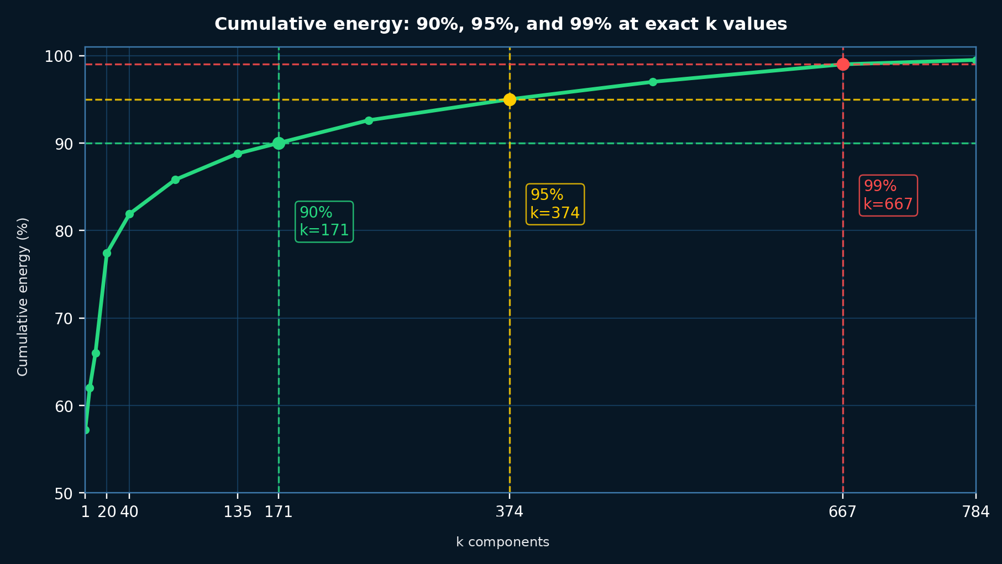
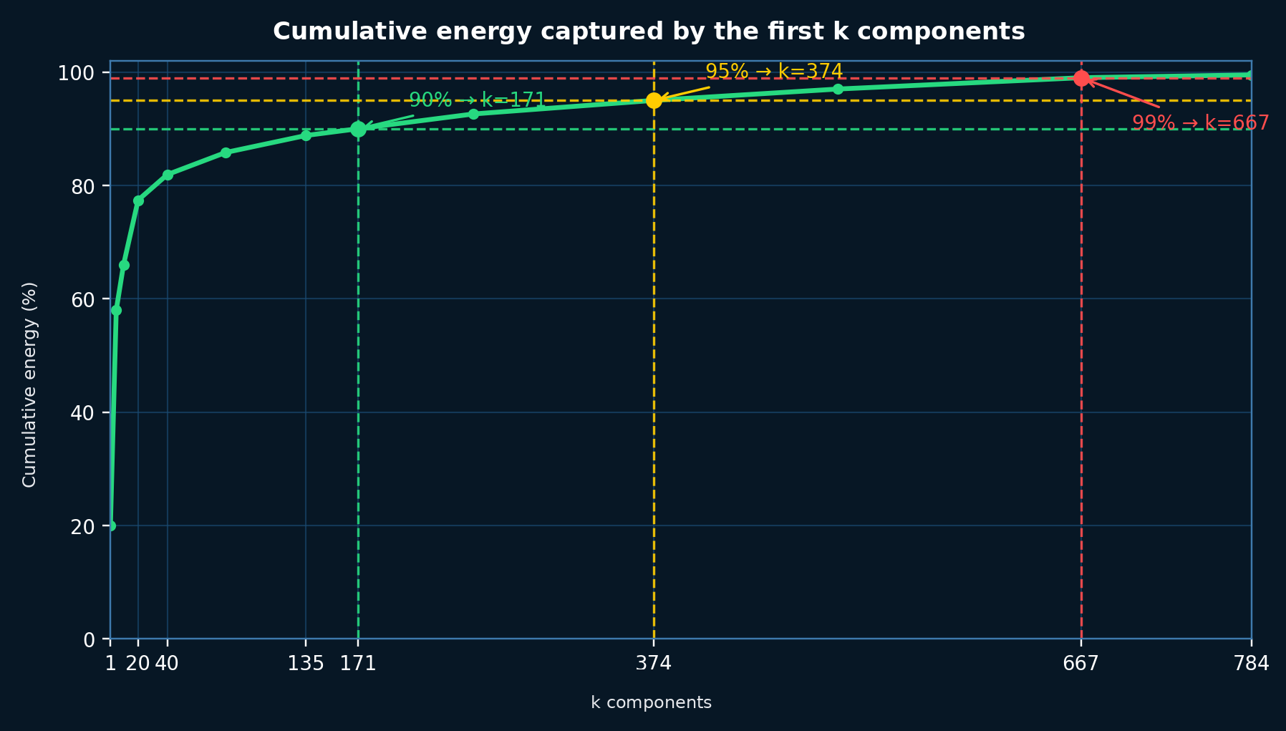
HOW MUCH ENERGY DOES EACH k CAPTURE?
Method 2: cumulative energy.
Results
90% → k=171
energy
95% → k=374
energy
99% → k=667
energy
Key idea: the curve rises quickly at first and then levels off.
8/10
Notes:
La energía acumulada nos dice cuánta información capturan los primeros k componentes. Con 171 componentes ya tenemos el 90% de toda la energía.

Slide 9
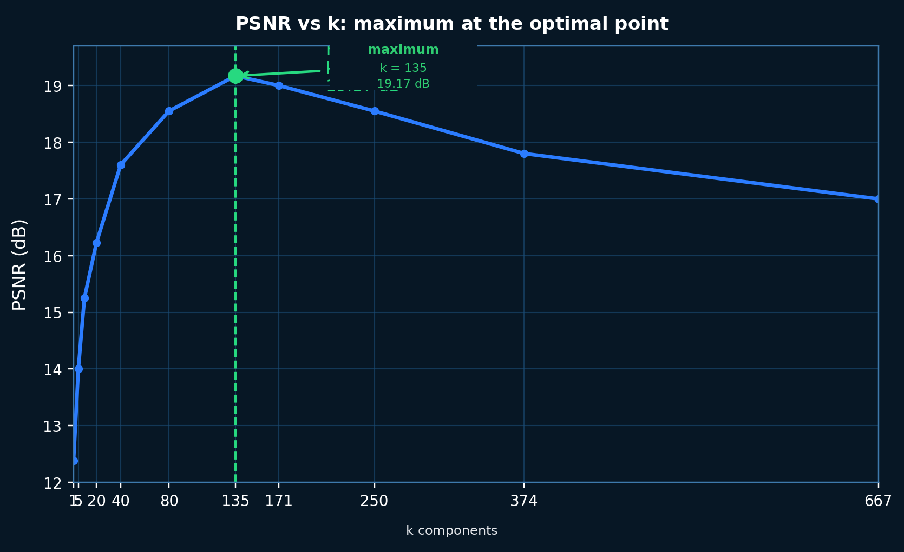
THE PERFECT k: MAXIMUM QUALITY
Method 3: PSNR compares the reconstruction with the clean image.
optimal k = 135
Maximum PSNR = 19.17 dB
Improvement over noise: +2.46 dB
Comparison
95% energy
374
Elbow
171–374
PSNR
135
PSNR gives the most direct answer when we have a clean reference image.
9/10
Notes:
El PSNR nos da una respuesta precisa: cuál k maximiza calidad. Ojo: requiere una referencia limpia, cosa que en problemas reales no siempre existe.

Slide 10
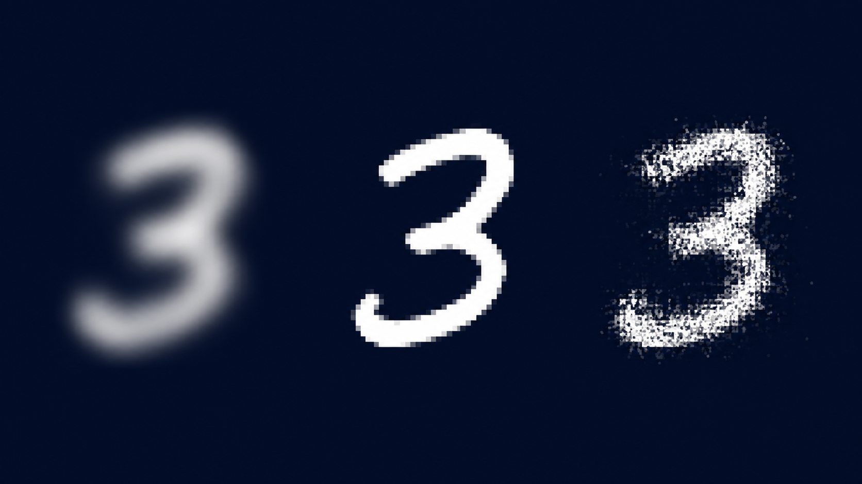
NOT TOO LITTLE, NOT TOO MUCH: JUST THE RIGHT k!
Closing thought
“SVD does more than clean images: it teaches us that behind the chaos, structure is always waiting to be revealed.”
Real-world applications
Neuroimaging: denoise scans
Satellites: enhance imagery
Film: restore movies
Facial recognition
small k
optimal k
large k
loses detail
blurry image
clean image
perfectly readable
noise reintroduced
looks grainy
Experiment: add noise and find your optimal k
10/10
Notes:
Cierre con llamado a la acción: que tomen una imagen, agreguen ruido y prueben distintos valores de k.

