Slide 1
hurobo
From phone video of a human hand to a robot policy in simulation
Real
Sim
1 / 13
Notes:
A phone films my hand; the robot learns from data derived from that video, in simulation.

Slide 2
The question: can human video help?
One 16 GB GPU
QUESTION
1
450M model in bf16, no 3B/7B models.
Can human videos improve a small VLA on a new layout and a new object?
2
Phone only
~15 tripod clips. One camera, no depth sensor, no glove.
3
8 – 16 October 2026
Start of the project to the deadline.
Test case: SmolVLA (450M), bowl onto plate in LIBERO, trained only on data from a phone video of a hand. Simulation only.
4
No physical robot
Success rate in LIBERO is the only metric.
2 / 13
Notes:
The research question. Constraints drive every design choice: one 16 GB GPU, no robot, no depth sensor, about one week.

Slide 3
Pipeline: hand video in, robot demos out
REAL WORLD
1
Record
2
Extract
3
Twin
Tripod phone, ChArUco-calibrated. ArUco markers on table, bowl, plate.
Hand TCP (thumb/index midpoint), grasp from pinch, object poses, in the table frame.
Copy real layout and camera into LIBERO. Real vs. sim side-by-side replay.
SIMULATION (LIBERO)
4
Multiply
5
Train
6
Evaluate
Split demo into object-relative segments, retarget to many sim poses, keep only successes.
Fine-tune SmolVLA from smolvla_base (never saw LIBERO) on generated data only.
lerobot-eval, N = 50, success rate with 95% CI against baselines.
3 / 13
Notes:
Top row happens in the real world, bottom row in simulation. The human video is a motion-capture device; SmolVLA never sees a real pixel.

Slide 4
Four ways to close the real-to-sim gap
1 Teleoperate in sim
2 Scan the objects
3 Scan the whole scene
4 Size-matched objects
IDEA
IDEA
IDEA
IDEA
Control the Panda by tracked hand or keyboard in the simulator.
Bowl and plate from a phone orbit: video, COLMAP, Gaussian splat, collision mesh.
Splat the table; render sim from the real view; composite robot by depth.
Use real objects with the LIBERO bowl and plate dimensions; sim assets are scaled to match.
GAP LEFT
GAP LEFT
GAP LEFT
GAP LEFT
No visual gap.
Objects match; scene stays synthetic.
Smallest visual gap.
Size matches; look does not, but the policy sees no real pixels.
CATCH
CATCH
CATCH
CATCH
Jerky, slow, few demos. Real recording unused.
Scan quality, metric alignment.
Alignment, GPU time. Physics still LIBERO.
Measure objects, print markers.
Debug tool only
Stretch
Stretch
Core path
4 / 13
Notes:
Four parts to the real-to-sim gap: appearance (real vs rendered pixels), embodiment (hand vs gripper), timing and dynamics, object geometry. The four solutions treat them differently. Solution 1 is built as a tool only. 2 and 3 are the splat stretch. 4 is the core path.

Slide 5
Main concept and current state
Core
Motion-only retargeting
WHO CONTRIBUTES WHAT
Video as motion capture: a few object-relative numbers cross to the sim.
Human video
Now: built. 12 of 26 recorded clips cleaned and usable.
Approach direction, grasp timing, lift height, carry path, place offset, release timing.
Main visual
SceneTwin: real layout in sim
Real clip beside the sim replay from the same viewpoint.
Now: built. Recorded episode and sim replay side by side on the next slide.
Simulator
Exact object poses, geometry and appearance. Fixed top-down gripper orientation, yaw from the object.
Stretch
Gaussian-splat objects and scene
Shows visual fidelity, not a trained result.
Now: bowl, plate and scene scanned; bowl and plate shown in LIBERO.
5 / 13
Notes:
The baseline avoids the visual gap rather than closing it. Splats only reduce it for illustration. Current state from README section 7 and D-010/D-011: nothing is trained on our data yet.

Slide 6
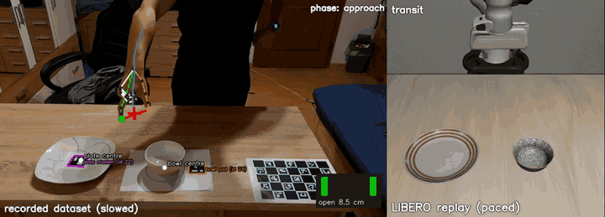
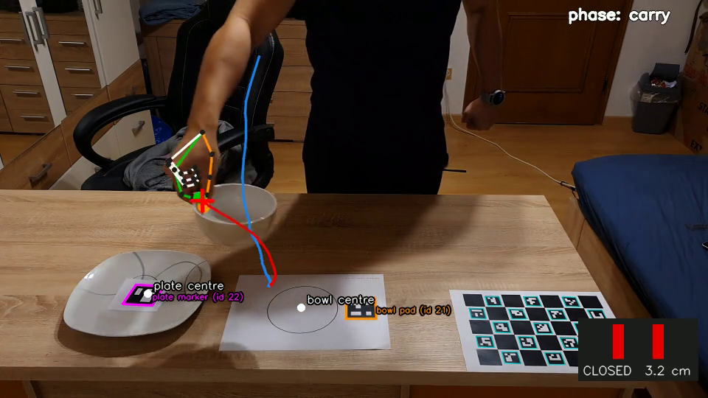
SceneTwin: recorded clip and LIBERO replay
Recorded episode (left, slowed) beside its LIBERO replay (right, paced).
6 / 13

Slide 7
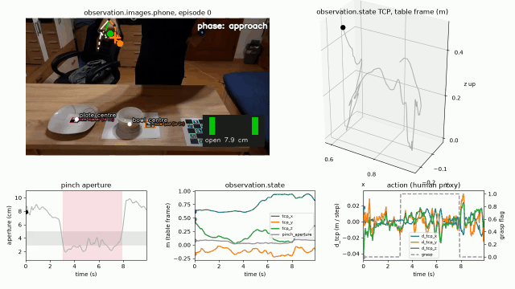
The human demo: hand and markers
Markers
ArUco on the plate (id 22) and the bowl pad (id 21); the ChArUco board is the table frame.
Hand
MediaPipe skeleton. The TCP is the midpoint of thumb and index tip, in metres in the table frame.
Gripper
Pinch aperture with hysteresis gives open or closed (here: closed).
Episode
199 samples at 20 Hz over 9.9 s, stored as a LeRobot episode.
One real clip, cut to a single grasp cycle. 12 of the 26 recorded clips were cleaned and usable.
7 / 13
Notes:
Frame from the overlay video of one real clip (notebook 11), the same overlay as in results/recorded_dataset/episode_0.mp4, which also shows the TCP path and aperture curves. Marker outlines, hand skeleton, projected TCP path and gripper symbol. Nothing here is a policy result.

Slide 8
From 26 clips to 12 usable demos
1
Filter frames
2
Find the cycle
3
Cut
4
Reject
Drop frames with no hand or two hands, a marker pose that reprojects badly (over 15 px), a hand at the image border, or depth outside 0.15 to 3 m.
Keep the first gap-free run (gaps up to 0.4 s bridged) that holds open, closed, open. Pinches under 0.2 s and open gaps under 0.3 s count as noise.
Trim from the start of the run to 2 s after the release, so the hand’s retreat is kept.
Drop clips shorter than 1.5 s, or without the board, bowl and plate marker in the first second.
Result: 12 of the 26 recorded clips are cleaned and usable, each one grasp cycle.
8 / 13

Slide 9
Generating the robot demos
1
Sample layout
2
Pick sources
3
Re-anchor
4
Execute, keep wins
Draw a random bowl and plate position in the size-matched LIBERO scene.
Draw one of the 12 cleaned human demos at random for each rollout.
Approach: the last 20 cm of the hand path, relative to the bowl. Carry: the bowl’s path, relative to the plate, ending over its centre. Both move with the new layout.
Grasp at a fixed 4 cm height, fingers facing the rim; release 4 mm over the plate. Run closed loop in LIBERO and keep only the successes.
First run, 12 clips: 100 successes of 170 attempts (59 %) in about 40 to 50 min, one process. Failures: 37 bowl not lifted, 33 timeouts.
9 / 13

Slide 10
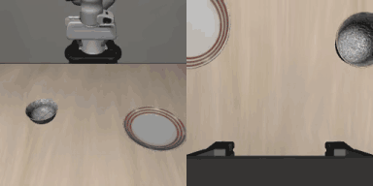
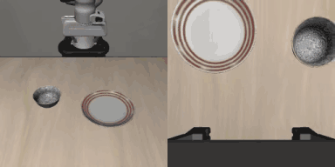
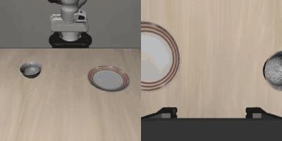
Generated demos: camera 1 and 2
Generated episode 1
Generated episode 2
Generated episode 3
Objects are scaled to real size (bowl x1.23, plate x1.85 of LIBERO’s). Per clip: camera 1 (agent view) left, camera 2 (wrist) right.
10 / 13

Slide 11
Pretrained SmolVLA: layout and size matter
1 Stock
LIBERO's own scene and start positions.
2 Cleared, LIBERO layout
Other objects removed; bowl and plate start where LIBERO puts them.
3 Cleared, new layout
Other objects removed; bowl and plate at random positions.
4 Real size, LIBERO layout
Bowl and plate at measured real sizes (plate 1.86x wider), LIBERO's placement.
5 Real size, new layout
Real sizes at random positions: the target scene of our experiment.
A new layout alone takes the better checkpoint from 6/10 to 0/10; real-size objects give 0 even on LIBERO's layout. Pretrained weights, 10 episodes per cell: 0/10 means 0 to 28% at 95%.
11 / 13
Notes:
Source: examples/09_smolvla_benchmark.ipynb, eval/pretrained_libero_checkpoints, D-011. replan 10, 300 steps, 10 episodes per cell (HuggingFaceVLA in real size, LIBERO layout: 8). Same layout seeds for both checkpoints. No training by us. Cause of the failures is not established; removing the other objects alone already lowers success (stock 10/10 to 6/10).

Slide 12
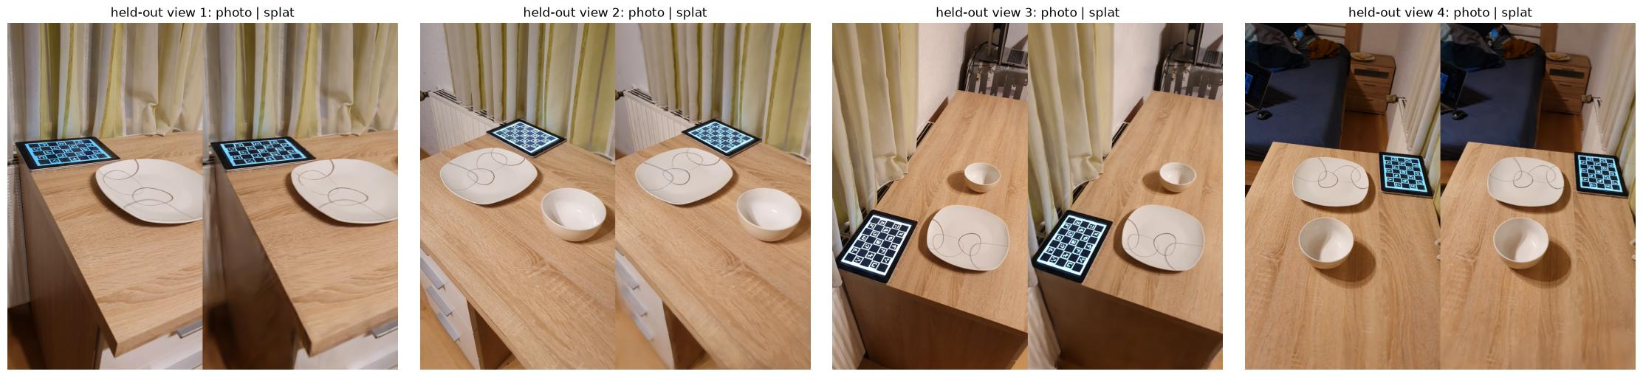
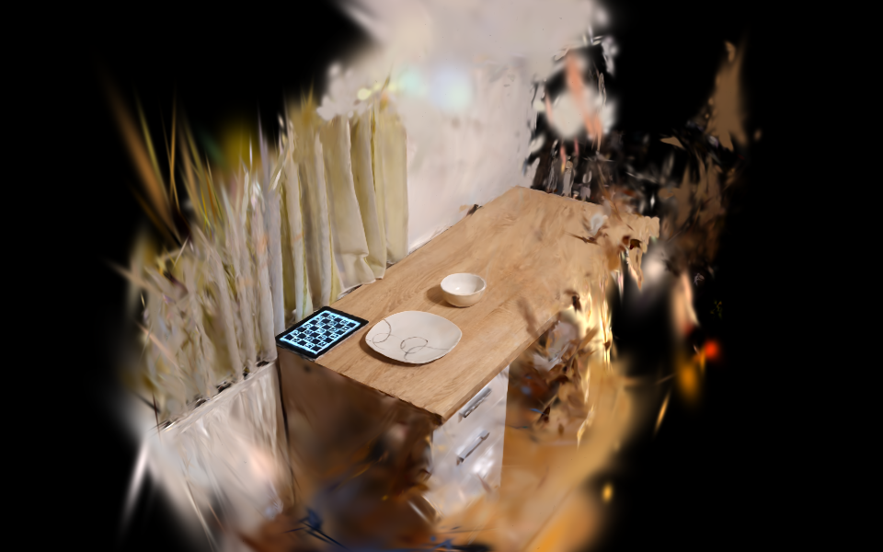
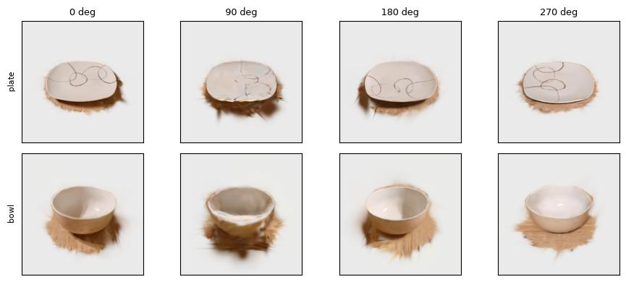
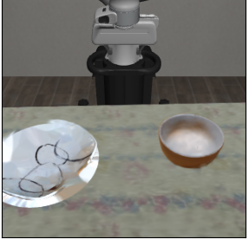
Future work: photoreal real2sim
Whole scene scan: table, background, bowl, plate. Four held-out views, photo left, splat right
Whole scene in 3D (rendered splat)
NEXT
Place the whole-scene splat in LIBERO
Collision meshes for bowl and plate
Composite the mesh robot by depth
Show as visual fidelity, not a trained result
Bowl and plate splats cut out of the scan, four angles.
Scanned bowl and plate inside LIBERO. The table cloth is still LIBERO's.
12 / 13
Notes:
Scene scan: data/splats/table_zoom_02_03_scene.ply, 3D view rendered after cutting to x -0.39..1.66, y -0.79..0.61, z -2.71..1.01 (notebook 09, section 4). Images are from notebook 08 (held-out photo vs splat, bowl and plate renders, composite in LIBERO). The LIBERO image is notebook 01, part 3: scanned bowl and shape-prior-filled plate, scaled to the measurements. This is an illustration of visual fidelity, not a trained or evaluated result.

Slide 13
Limitations and status
Limitations
Built, on stand-in data
Still open
Simulation only, no real robot
Hand vs. gripper, real vs. rendered pixels
One camera, markers required
Fixed top-down grasp, one task family
Perception, SceneTwin, retargeting
Dataset generator and LeRobot export
Scan to splat pipeline (real scene)
Record the 15 to 20 real clips
Real vs. sim side-by-side
Train SmolVLA on our data
Evaluation N = 50
Every number in this deck comes from a run in the repo. Failed runs are included.
13 / 13
Notes:
Cut order if late: splat stretch, robot overlay, multiplier plot. Never cut: the twin side-by-side and the README.

