Slide 1
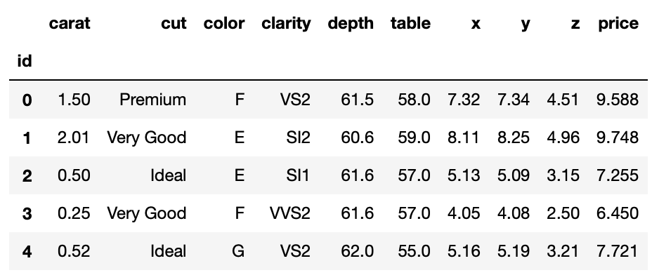
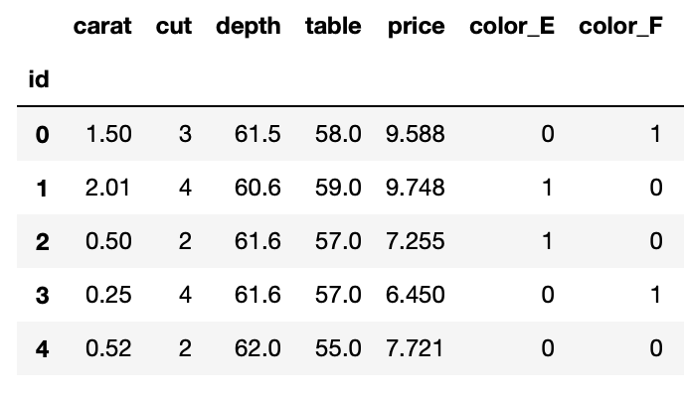
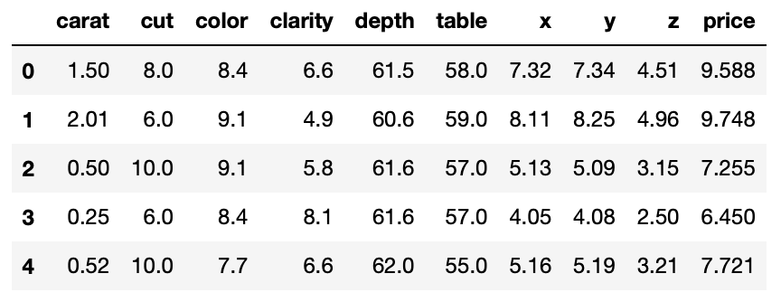
W7 Ironhack – Diamond pricing competition
Cleaning data
1
Original data
Cleaned data – first iteration
Cleaned data – second iteration
Drop columns with high correlation
Filling zeros with KNN Imputer [‘x’, ‘y’, ‘z’]
Convert categorical columns to ordinal
‘Cut’ → label encoder
‘Color’ and ‘Clarity’ → get dummies
Convert categorical columns to ordinal
‘Cut’, ‘Color’ and ‘Clarity’ → get dummies, using data from specialized website for ‘color ‘and ‘clarity’
Modelling
2
Model
Parameters
MSE
Model
Parameters
MSE
RandomFor.
default
0.015
RandomFor.
n_estimators=1000, max_depth=20
0.008
Gradient B.
max_depth=None, max_features='auto'
0.022
RandomFor.
default
0.008
Grid Search
max_depth=4, min_samples_leaf=2, min_samples_split=4, n_estimators=50
0.061
Grid Search
max_depth=5, min_samples_leaf=1, min_samples_split=2, n_estimators=50
0.033
Linear Regr.
(all variables)
StandardScaler
0.115
Linear Regr.
(carats)
StandardScaler
0.157

