Slide 1
Alfred Tso Chun Fai 20012065g
COMP5311 Project: Performance Analysis of TCP and UDP

Slide 2
Introduction
Even wonder why Chrome browser feels so much faster than Firefox when watching Youtube videos ? I do and as a curious student i fired up Wireshark and capture some traffic and what i found is this.

Slide 3
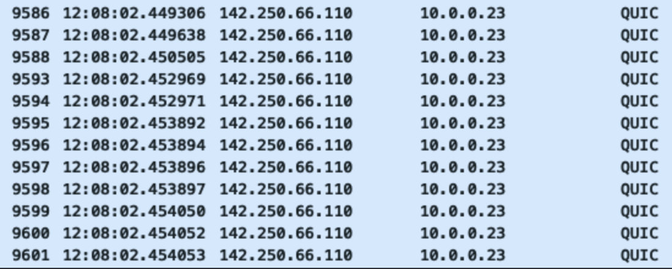
Wireshark Pcap during Youtube browsing

Slide 4
What is QUIC
QUIC is a protocol aiming to improve web application that are currently using TCP ² by establishing a number of multiplexed UDP and some even called it “TCP/2
UDP is unreliable but we are using it to replace TCP … Are we missing something ? We need to study

Slide 5
TCP v UDP: A case study
Background: Related Works
Yuan et al. (2019) ³ compared the performance of TCP and UDP over SDN using average packet delay and packet loss probability. The study found that the TCP outperform UDP over the two metrics by 12-50% and 25-100% respectively. Note that here, we are not conducting our study in SDN.
He et al. (2004) ⁴ studied the effect of, among other things, packet aggregation and ingress buffering on the throughput and delay jitter of TCP and UDP.
Gamess et al. (2008) ⁵ proposed an upper bound model for TCP and UDP throughput in IPv4 and IPv6. The paper presented the model for calculating the maximum theoretical throughput of both protocol to be the ratio of the number of TCP or UDP payload bytes to transmit over the min. number of bytes necessary including IFG, Preamble, SFD, Ethernet DIX encapsulation, IP Header, TCP (or UDP) Header and Paddings, multiple by the bandwidth of the link, assuming full-duplex and no processing time.
Shahrudin et al. (2016) ⁶ compared various transport protocol including TCP and UDP over 4G network using four metrics: Throughput, Packet Loss, End to End Delay and Average Jitter.

Slide 6
Things to consider
Different implementation
Some parameters within protocol (TCP for example) are left up to the implementation (which give rise to TCP/IP Fingerprinting, allowing malicious actor to identify, among other things, OS of the host) meaning that these difference could have subtle effect on the measurement of performance
Network Topology
Topology, bottleneck links in between and other traffic could also affect the results
The Bandwidth of the links involved
link between client and the server. One of the paper mentioned made an assumption that the link would not have any collisions.
Hardware
We have seen that the buffer could have impacted the performance of these protocols and not only the software side of it is relevant, the hardware part also matters and often we could not quite control these lower level details.
Application by which these packets are sent
e.g the interval by which UDP packets are sent, and are there limitation in the language being used as to, for our present purpose, the sending intervals.

Slide 7
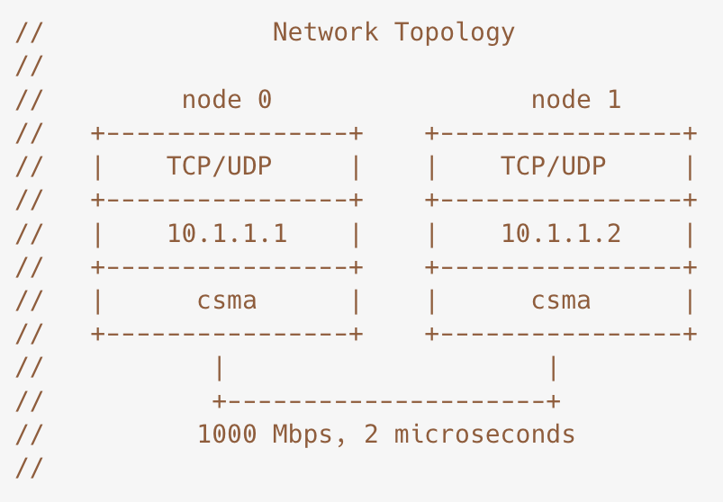
Objectives
Given all these considerations, we will use a
simple network topology with
settings as close to the reality as possible.
the underlying details such as buffer queue size or protocols, we will use the same for both protocol.
As such, we will be comparing TCP and UDP over IPv4 in a wired one-to-one hosts using throughput, average delay and average jitter as our performance indicators
We will send 10, 100 and 10000 , 20000, … , 100000 packets, each of 1472 Bytes in UDP application and the equivalent number of Bytes in a TCP application to observe the flows of both TCP and UDP applications.

Slide 8
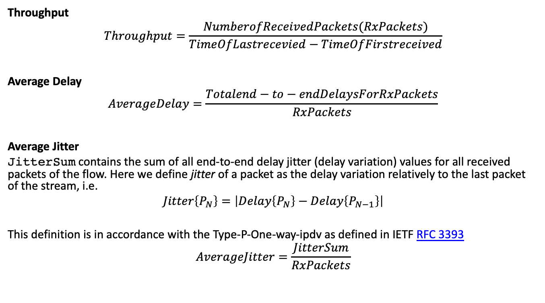
Key Metrics
Throughput
$$Throughput=\frac{NumberofReceivedPackets(RxPackets)}{TimeOfLastrecevied−TimeOfFirstreceived}$$
Average Delay
$$AverageDelay=\frac{Totalend−to−endDelaysForRxPackets}{RxPackets}$$
Average Jitter
JitterSum contains the sum of all end-to-end delay jitter (delay variation) values for all received packets of the flow. Here we define jitter of a packet as the delay variation relatively to the last packet of the stream, i.e.
$$Jitter\left\{P_{N}\right\}=\left|Delay\left\{P_{N}\right\}−Delay\left\{P_{N−1}\right\}\right|$$
This definition is in accordance with the Type-P-One-way-ipdv as defined in IETF RFC 3393
$$AverageJitter=\frac{JitterSum}{RxPackets}$$

Slide 9

Design/Methodology
Simulation or Real Lab?
Simulation might be better :
more control over the considerations we mentioned.
Easier to setup
The biggest downside is how can we be sure that the result is “real” ?
Clear scope and assumption gives us an idea of ”realness”
Tool: NS-3
ns-3 is a open-source, discrete-event network simulator used mainly for research or educational purposes written in C++. The simulator itself has a comprehensive documentation available online.
https://www.nsnam.org/
ns-3: basics
For our present purpose, we only need to understand the main abstractions of ns-3

Slide 10
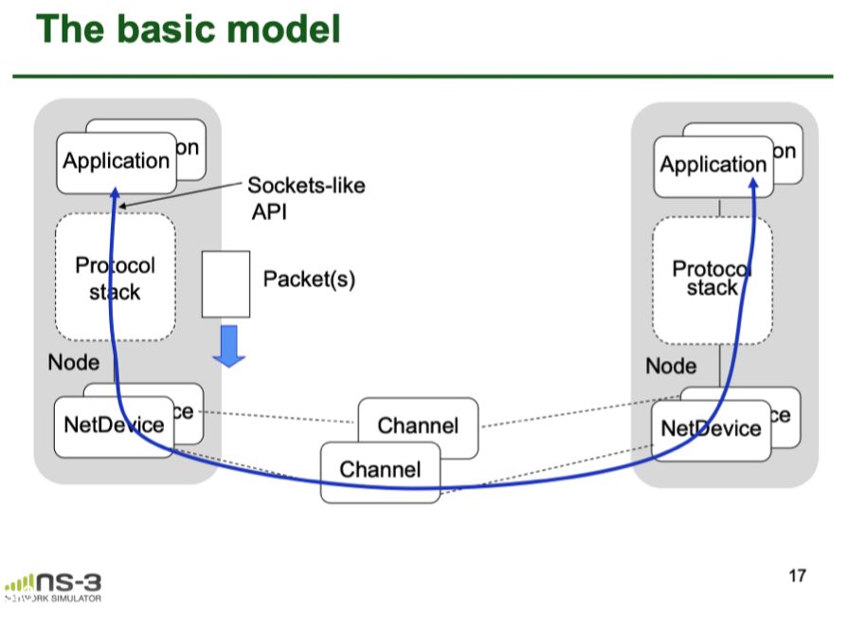
Main abstractions of ns-3

Slide 11
Application
Application
It is like processes in our computer, it uses “sockets” to send data to lower layer. We will install a off-the-shelf BulkSendApplication in ns-3 using TCP socket as TCP app and an UDPClient and an UDPServer for sending UDP packets and a FlowMonitor for both case to monitor the packets.
UDP : Choice of sending interval
We will be sending packets at a interval of 2 microseconds which is the delay of the underlying channel specified below
UDP: Choice of MaxPacketSize
Here it refers to the payload. Since MTU is 1500, naturally we will want to use 1500 Bytes. The IP Header and the UDP Header however require 20 + 8 bytes, so we should use 1472 instead⁷. This is confirmed in simulation; the use of 1500 bytes packet could harm throughput performance.
TCP: BulkSendApplication
We set the MaxBytes to the Total Bytes (PacketCount * PacketSize) send by UDP to compare performance

Slide 12
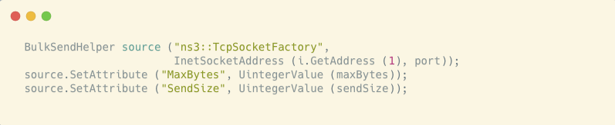
Code for BulkSendApplication

Slide 13
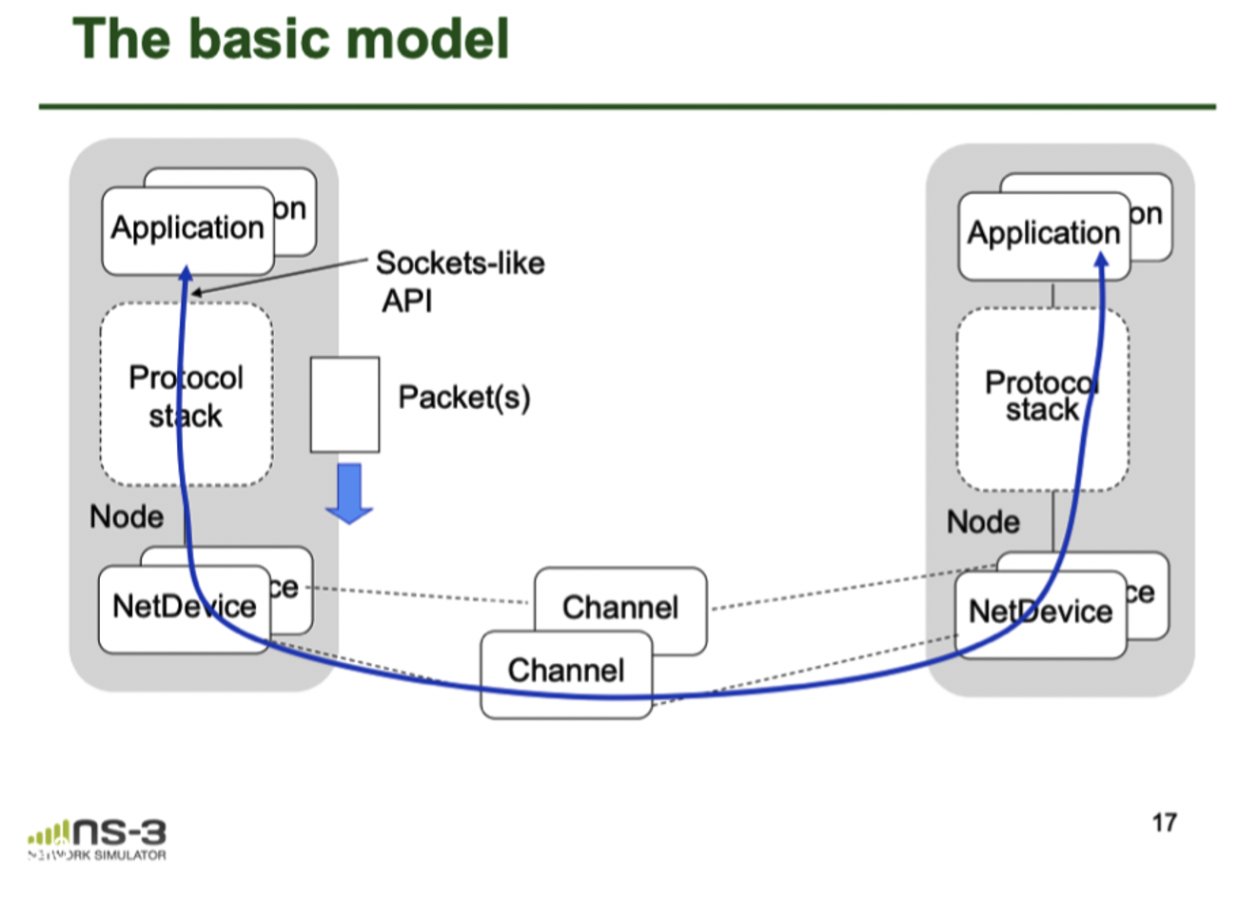
Protocol stack
Also called the InternetStackHelper which usually includes UDP, TCP Sockets, IPv4, and for our present purpose a TrafficControlLayer, which includes a queue and when it is full it would notify the upper layer
NetDevice
This corresponds to both the hardware (Network Interface Cards, NICs) and the software drivers of them and also included a queue for packets, so there are two level of queueing in ns-3

Slide 14
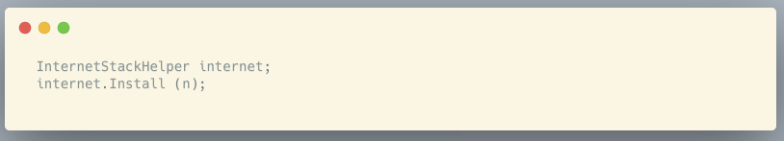
InternetStackHelper

Slide 15
Node
It is the end hosts by which we can install Application, InternetStack and NetDevice to, similar to our computer.
We will be creating 2 Node and connect them with something similar to ethernet cable.

Slide 16
Channel
Provides communication channel to Node and we will be using a CSMA channel (like Ethernet).
Three Attributes of this abstraction:
MTU: 1500 Bytes
DataRate: 1Gbps
Delay: 2 microsecond. The reason for 2 microsecond is for light to travel 600m, as compared to other studies use of 0 delay.

Slide 17
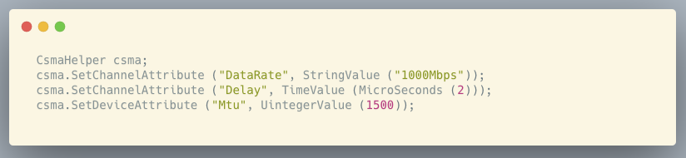
Code for CSMA Channel

Slide 18
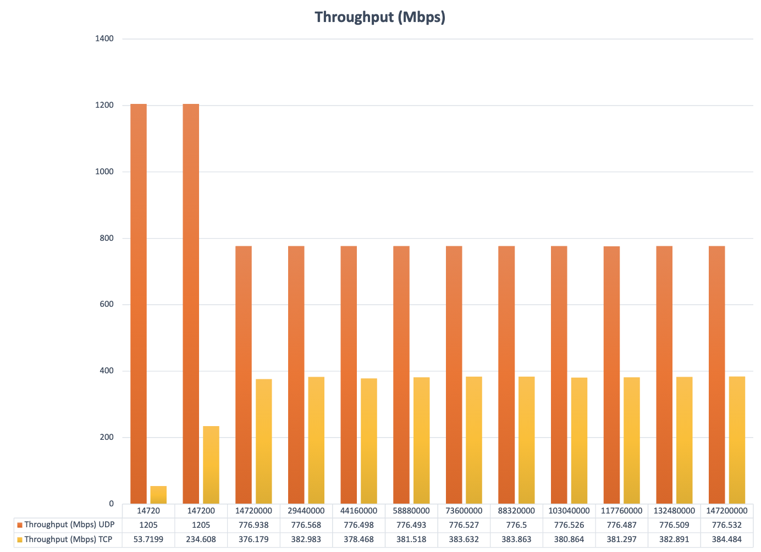
Result
TCP and UDP Throughput (Mbps)

Slide 19
We observed that the throughput for UDP for 14720, 147200 Bytes sent exceeded 1000Mbps (Our bandwidth is 1Gbps). We then looked at the loss of packets

Slide 20
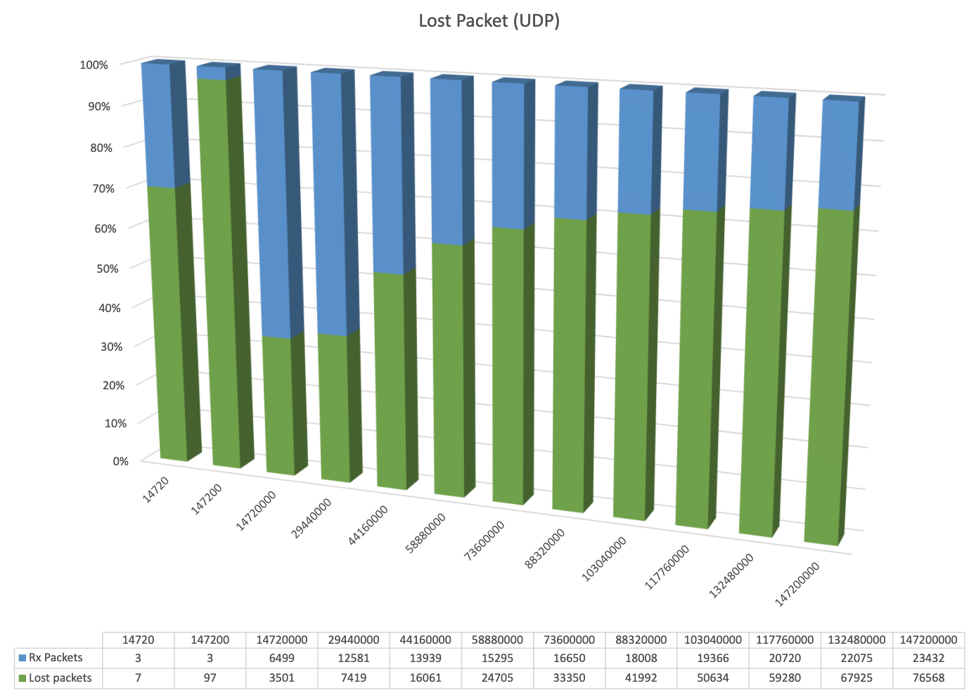
UDP Lost packets

Slide 21
We can see that the in 147200 Bytes 97 out of 100 packets are lost. It is safe to say that we should drop these 2 and further investigate.
We can also see that TCP throughput gradual increased and flatted out at around 400Mbps.

Slide 22
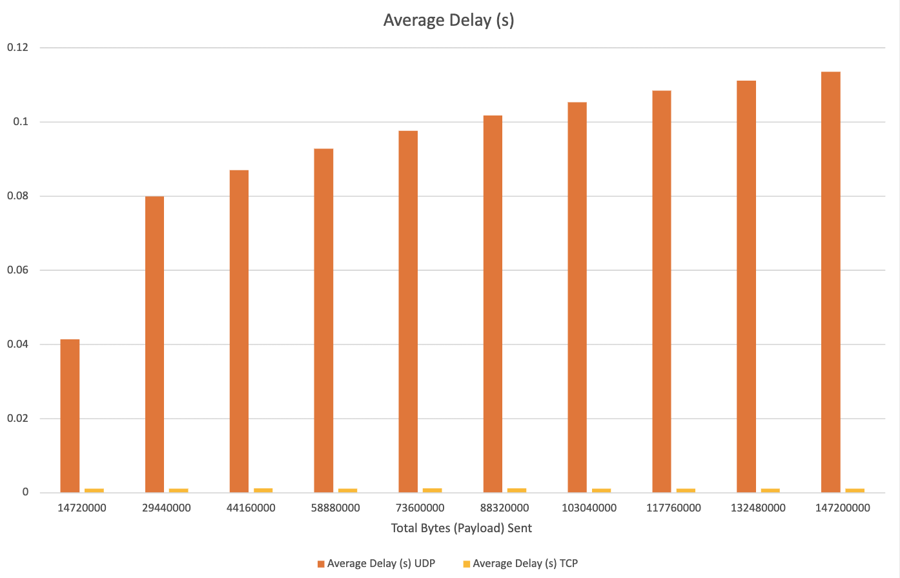
Average Delay of UDP >> TCP’s
Due to the lack of traffic control, UDP packets can be “stuck” in lower layer’s queues. The result might also due to our rapid always-on sending packets causing the congestion.
Further investigation will be need to confirm, such as lowering buffer to see if delay actually increases.

Slide 23
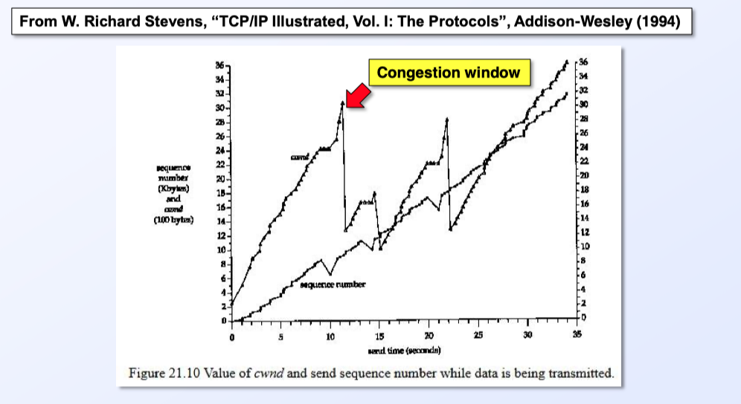
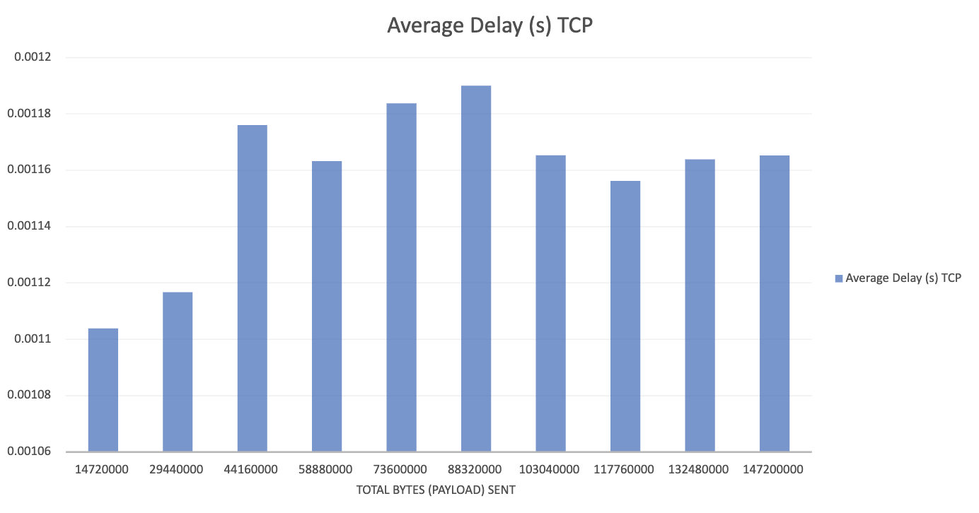
The average delay exhibited dips just after “peaking” and then gradually increase again. This might be due to the cwnd adjusting in congestion avoidance. Further investigation is needed as we need to confirm the algorithm for congestion control actually produces such patterns because there are many choice for it in ns-3 (Veno, Cubic… etc)

Slide 24
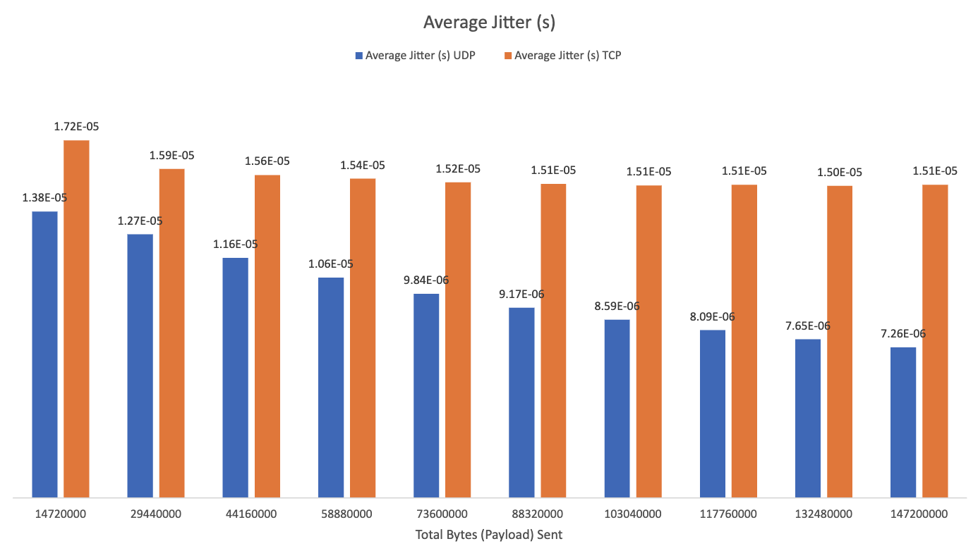
Average Jitter
Average jitter of TCP and UDP

Slide 25
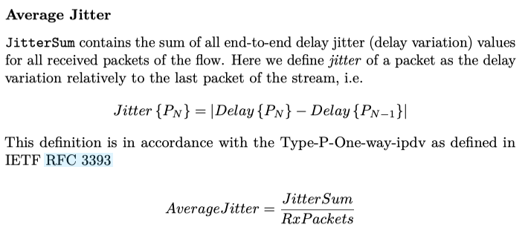
The average jitter is expected to decrease as the system “stables” out and the variation in delay would be less.
TCP jitter larger than UDP’s
The absence of traffic control in UDP means that the packets will be continuously push down the stack and be sent without interference, the variation in delay should only be minimal while packets’ delay of consecutive packets could be large because of the said traffic control.

Slide 26
Discussion
Why not compare packets lost?
The BulkSendApplication made sure the once the lower layer send buffer is filled, it would wait. So the only place we could drop packets is in the channel which we will need to introduce error into.
UDPClient has no such traffic control so we could observe the loss of packets.
So what might be the reason by which QUIC chose UDP based on our study here ?
Might simply be the throughput (greater throughput) and the jitter (less variation of delay). The larger average delay is mainly due to the lack of traffic control which the QUIC aims to move the “congestional control algorithm into the user space … rather than the kernel space”

Slide 27
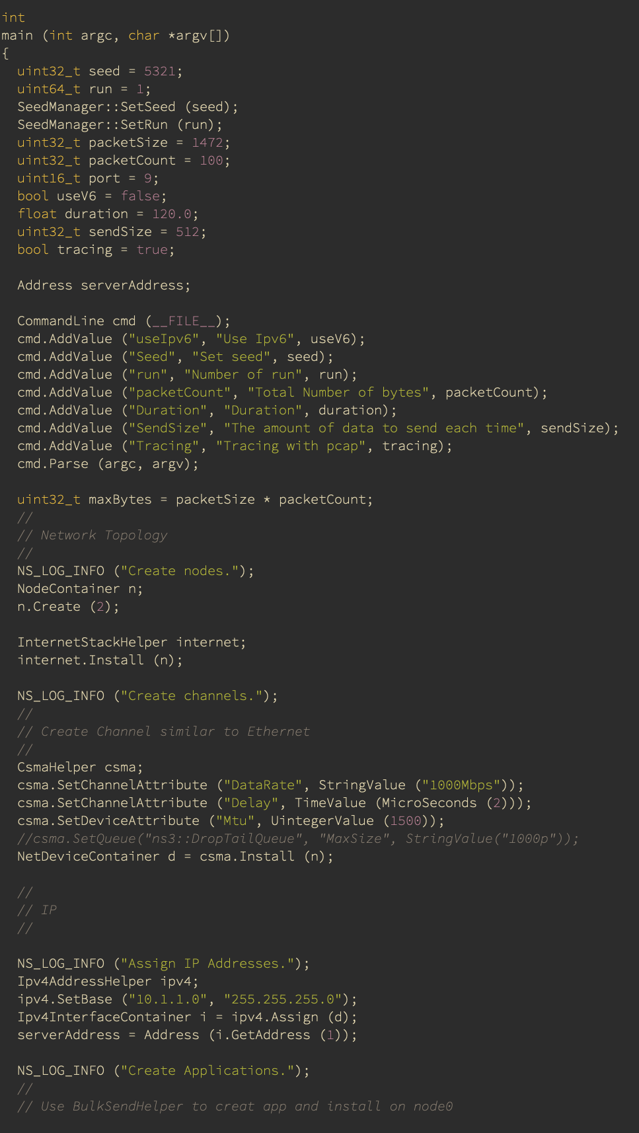
Code
https://github.com/alfredtso/ns-3-project

Slide 28
Reference
ns-3 training resources
HTTP/3 draft

Slide 29
Reference
1. QUIC
2. QUIC GoogleDoc
3. Yuan-Cheng Lai, Ahsan Ali, Md. Shohrab Hossain, Ying-Dar Lin,Performance modeling and analysis of TCP and UDP flows over software defined networks, Journal of Network and Computer Applications, Volume 130, 2019, Pages 76-88, ISSN 1084-8045
4. Jingyi He, S.-H.Gary Chan, TCP and UDP performance for Internet over optical packet-switched networks, Computer Networks, Volume 45, Issue 4, 2004, Pages 505-521, ISSN 1389-1286
5. Eric Gamess, Rina Surós, An upper bound model for TCP and UDP throughput in IPv4 and IPv6, Journal of Network and Computer Applications,Volume 31, Issue 4, 2008, Pages 585-602, ISSN 1084-8045
6. Shahrudin Awang Nor, Raaid Alubady, Wisam Abduladeem Kamil, Simulated performance of TCP, SCTP, DCCP and UDP protocols over 4G network, Procedia Computer Science, Volume 111, 2017, Pages 2-7, ISSN 1877-0509
7. Eric Gamess, Rina Surós, An upper bound model for TCP and UDP throughput in IPv4 and IPv6, Journal of Network and Computer Applications,Volume 31, Issue 4, 2008, Pages 585-602, ISSN 1084-8045

