Slide 1
Final Presentation
-Reneel Sagar Pamarthi
Alfred Zane Rajan Velladurai

Slide 2
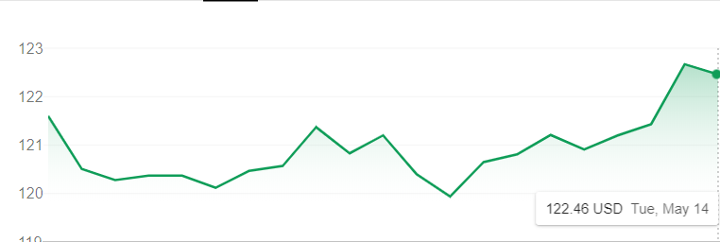
Our data (GLD)
We had trained and analysed our model on GLD data ( commodity market).
Here is its trend over the past month
We used a a look back of 10 (10 days of data for each prediction)

Slide 3
Architecture
Input (10x4)
Dense Layer (100)
LSTM (100)
Dense Layer (100)
Dense Layer (4)
ReLU Activation
MSE
Adam Optimizer
20 Epochs

Slide 4
Dense Layer
A dense layer is a classic fully connected neural network layer : each input node is connected to each output node.
The Dense Layer is given a size of 100 units.
Our activation function is the common ReLU function.
The Rectified Linear Unit (ReLU) function returns 0 if it receives any negative input, but for any positive value x it returns that value x back. So it can be written as f(x)=max(0,x) .

Slide 5
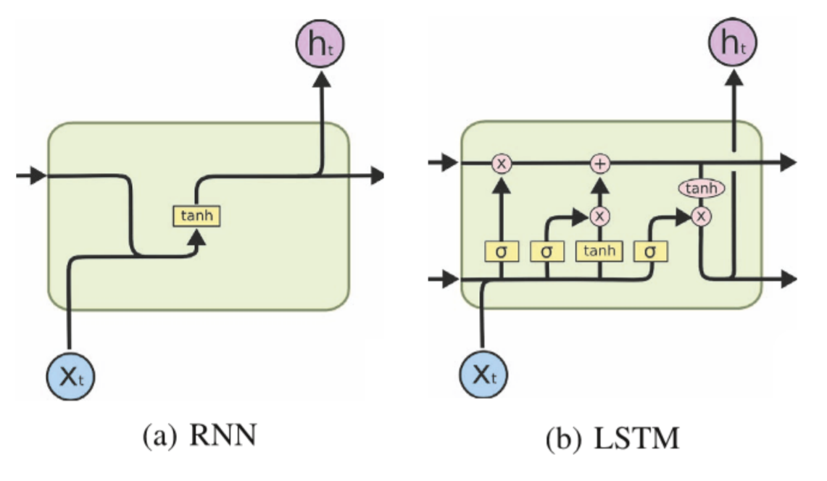
LSTM
LSTM is special type of neuron to deal with the long term dependency problems of RNN.
Our LSTM again has 100
units

Slide 6
Dense Layers
We add a couple other dense layers.
One with 100 units and ReLU activation function as before.
Lastly one with 4 units one for each output prediction.
The output is naturally a 1x4.

Slide 7
Other Hyperparameters
Optimizer – Adam – most common in recent times.
Straightforward to implement.
Computationally efficient.
Little memory requirements.
Invariant to diagonal rescale of the gradients.
Well suited for problems that are large in terms of data and/or parameters.
Appropriate for non-stationary objectives.
Appropriate for problems with very noisy/or sparse gradients.
Hyper-parameters have intuitive interpretation and typically require little tuning.

Slide 8
Other Hyperparameters
The loss function used was MSE (Mean Squared Error).
Epochs – 20
Balanced variance.
Using train data from a particular time period showed steady increase in test error as the date of the test data drew away from the train time period. Showing significant change in market trends

Slide 9
Testing
Predictions:
 | Open | Close | High | Low
5/8 | 121.76718 | 121.29517 | 121.976654 | 121.35081
5/9 | 120.864914 | 120.49896 | 121.1847 | 120.418434
5/10 | 121.322525 | 121.38349 | 122.1955 | 121.28582
5/13 | 121.15658 | 121.216774 | 121.569 | 120.72179
5/14 | 122.75632 | 123.456245 | 124.19715 | 122.170944

Slide 10
Open

Slide 11
Close

Slide 12
High

Slide 13
Low

Slide 14
Model Analysis
Worked better at predicting Opening price than other factors.
Particularly weakest at predicting the highest price point.
Did not take weekend gap into factor.
Market was smoother over this week than expected.

Slide 15
THANK YOU

