Slide 1
ML models implementation and local deployment
Iris Dataset

Slide 2
Content Index
Iris Dataset – Classification problem
EDA - Features distribution
Dimensionality Reduction - TSNE and PCA
Unsupervised Learning - KMeans
Supervised Learning - Logistic Regression, Support Vector Machine, Random Forest, Gradient Boosting
Supervised Learning - Neural Network
Model experiments saving - MLFlow
Application implementation - Python API
Deployment - Docker Container
Load Balancer - Kubernetes

Slide 3
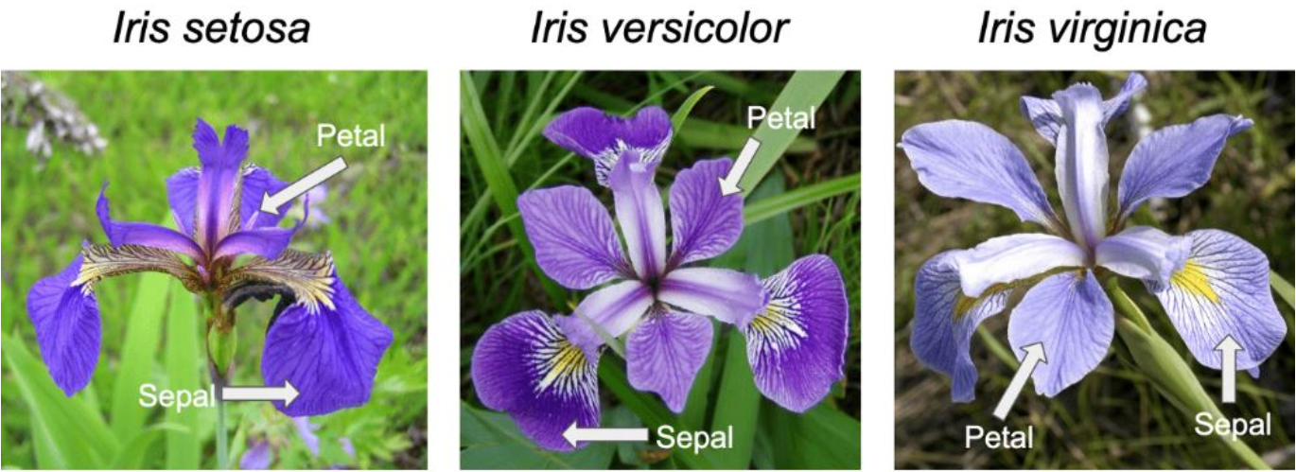
Iris Dataset – Classification problem
The iris dataset contains three classes of flowers:
Versicolor, Setosa, Virginica
and each class contains 4 features:
'Sepal length', 'Sepal width', 'Petal length', 'Petal width‘
The aim of the iris flower classification is to predict flowers based on their specific features

Slide 4
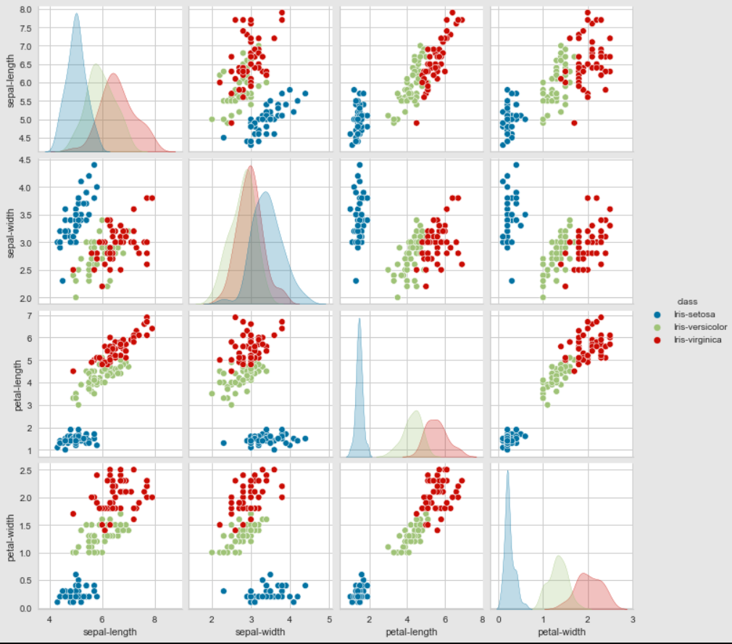
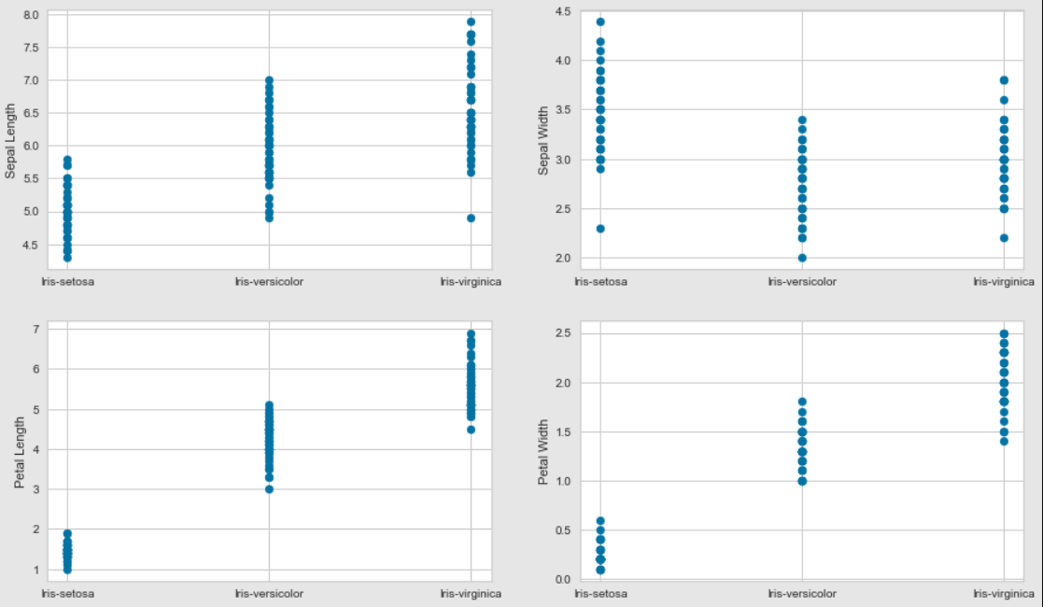
EDA - Features distribution
distribution of single features and relationships between features pairs
Class distribution per feature

Slide 5
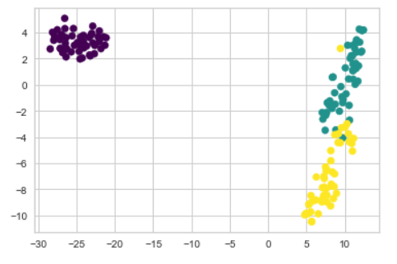
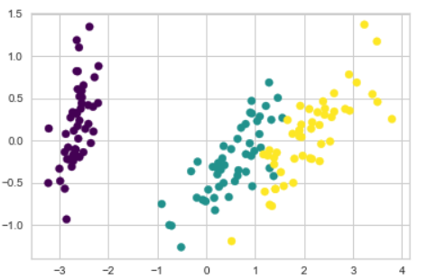
Dimensionality Reduction - TSNE and PCA
TSNE (learning_rate=100)
PCA (n_components=2)

Slide 6
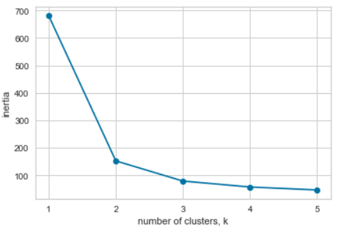
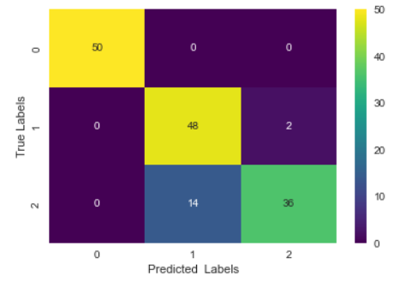
Unsupervised Learning - KMeans
Clusters number Selection – Elbow Method
Confusion Matrix over all samples

Slide 7
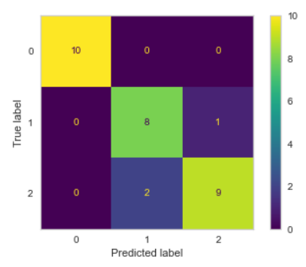
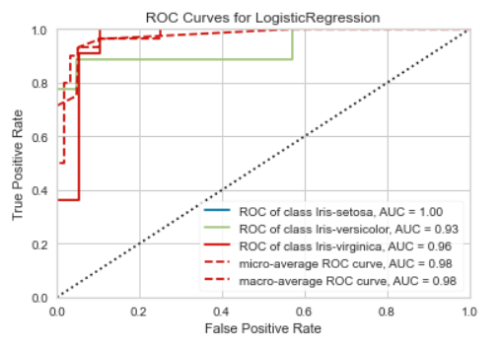
Supervised Learning - Logistic Regression, Support Vector Machine, Random Forest, Gradient Boosting
ROC AUC curve (TPR vs FPR)
Confusion Matrix over test samples

Slide 8
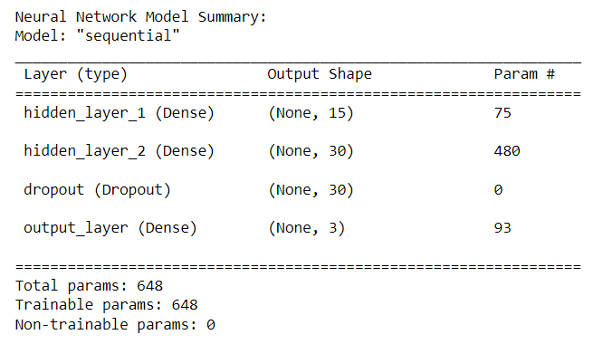
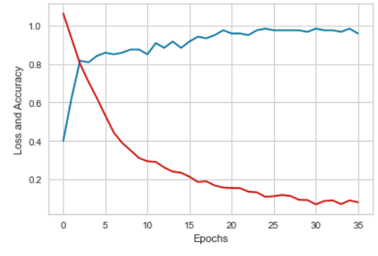
Supervised Learning - Neural Network
Loss and Accuracy VS Epochs

Slide 9
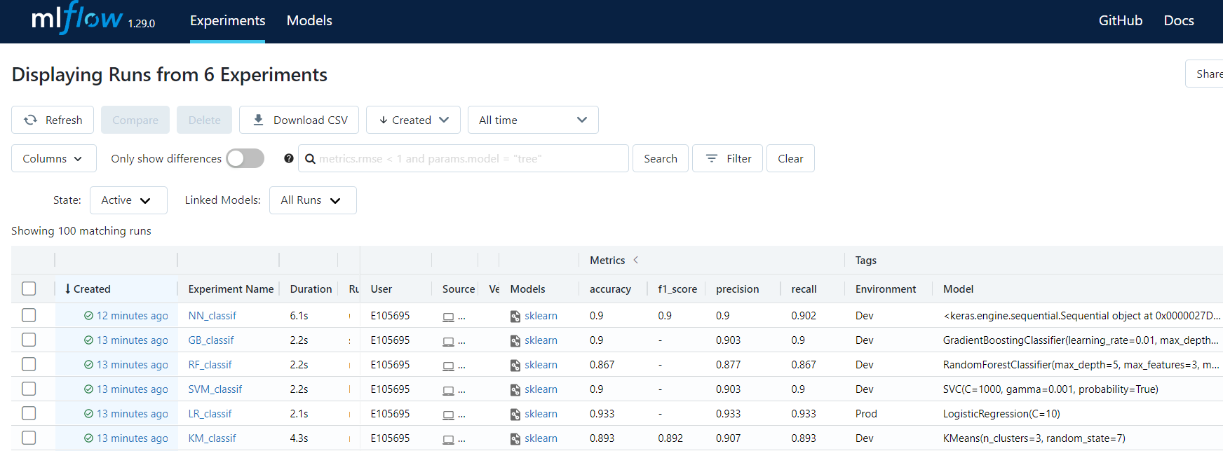
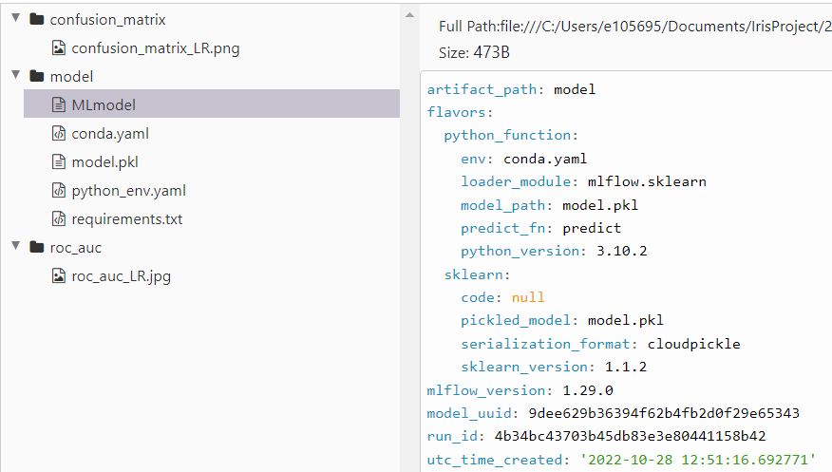
Model experiment saving - MLFlow
New Experiment saved for each model execution in the Jupyter Notebook
Environment (Dev or Prod) selected according to metrics score
Model, Confusion matrix and ROC AUC saved as artifacts

Slide 10
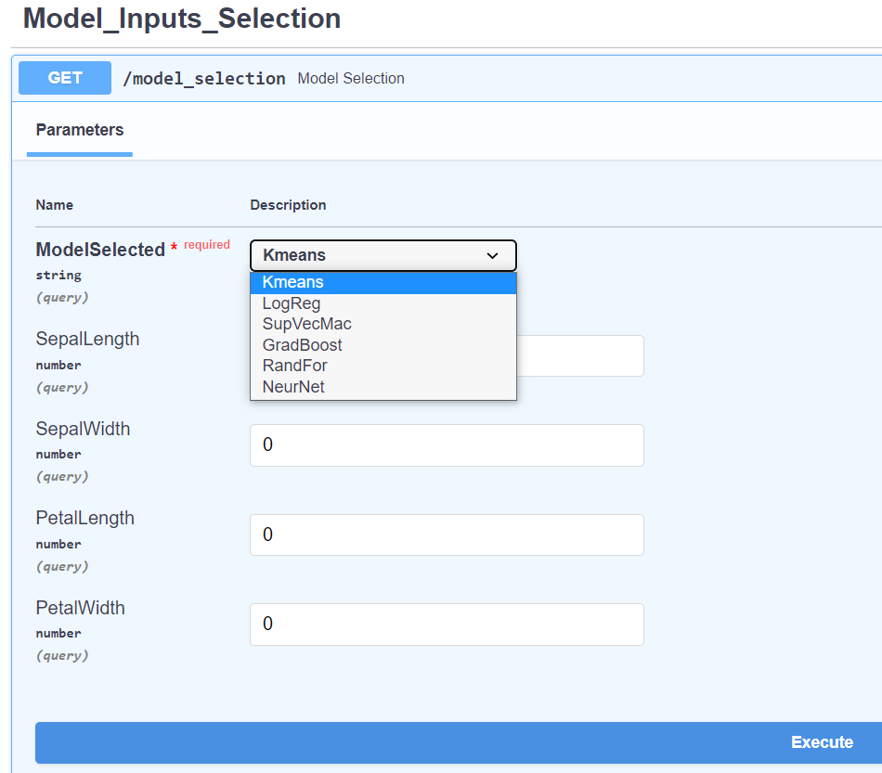
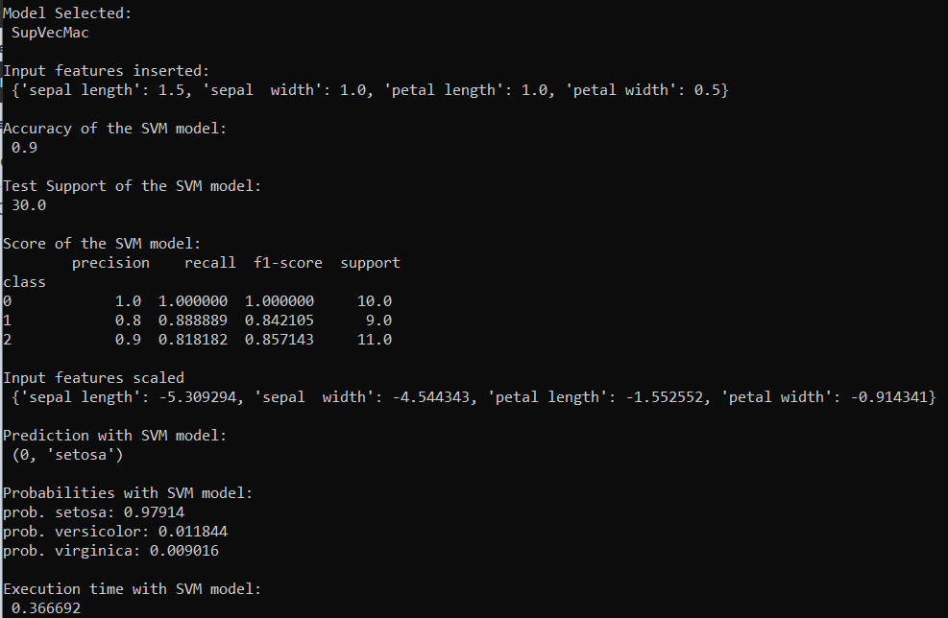
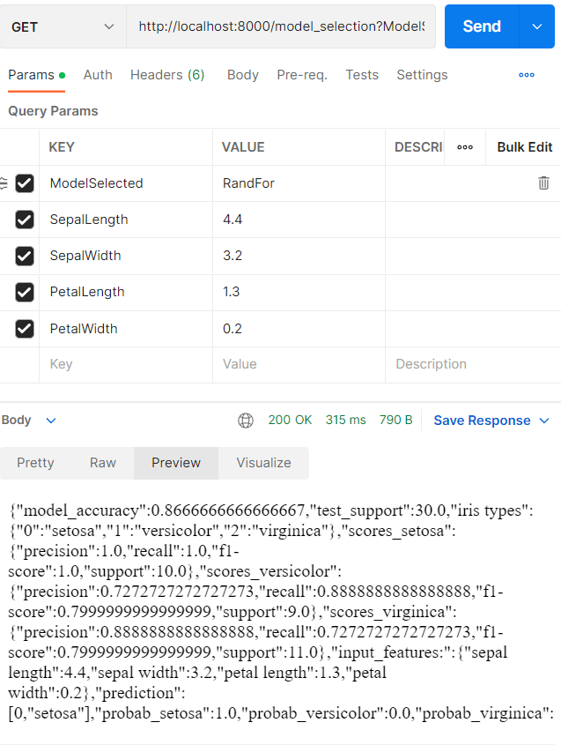
Application implementation - Python API
API UI, Printed response and returned response body (e.g. retrieved from the Postman)

Slide 11
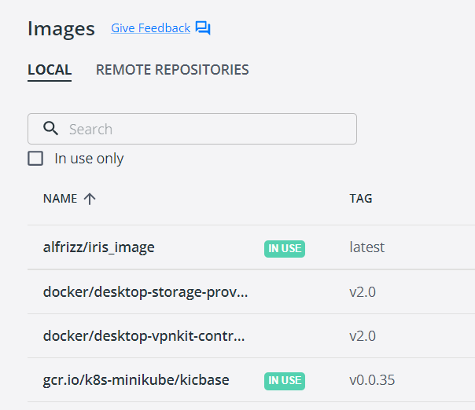
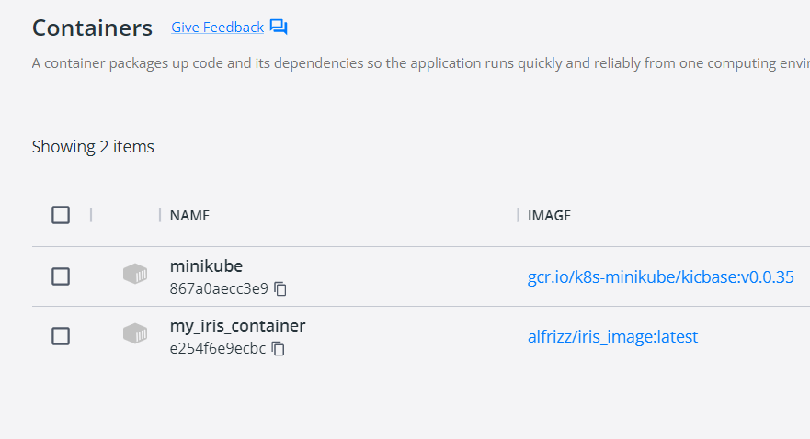
Deployment – Images and Containers
Images and Containers created for Docker and Kubernetes

Slide 12
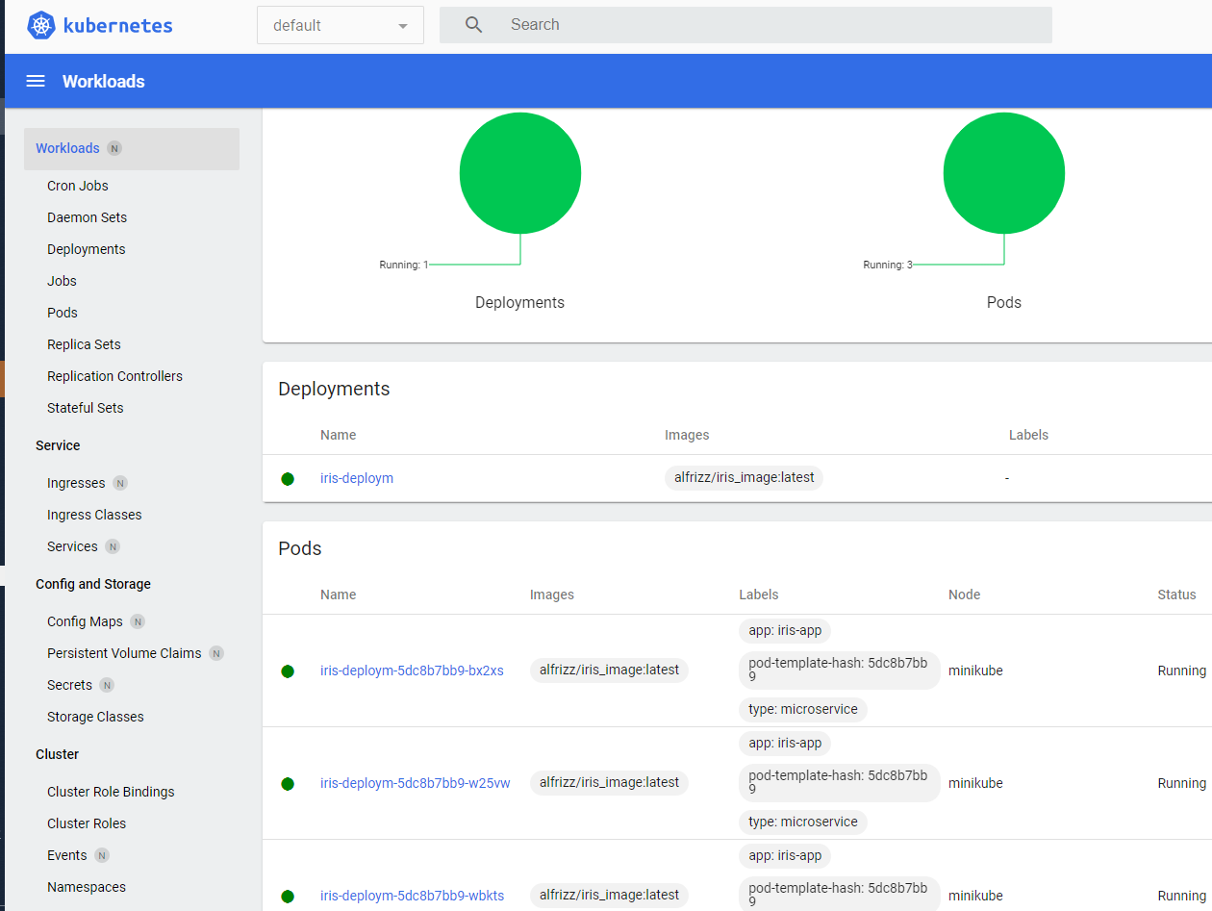
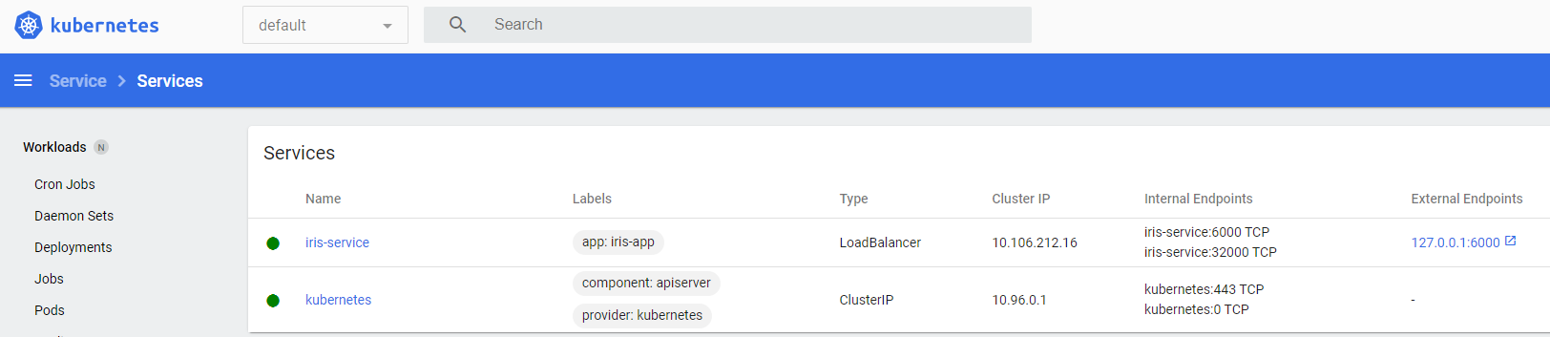
Load Balancer - Kubernetes
Deployment
of 3 replicas
of the application
into 3 pods
and creation
of a Load Balancer service
to distribute the workload into the pods

