Slide 1
Waiting Line Problems (Queues)
A central problem in many service settings is the management of waiting time
Reducing waiting time costs money, but raises customer satisfaction and throughput
When people waiting are employees, it is easy to value their time
When people waiting are customers, it is more difficult to value their time
Lost sales is one value (often a low estimate)

Slide 2
Queuing Systems
Components
Definitions
Examples
Assumptions, etc.
Models
Little’s Law (Again!)
Queue Template

Slide 3
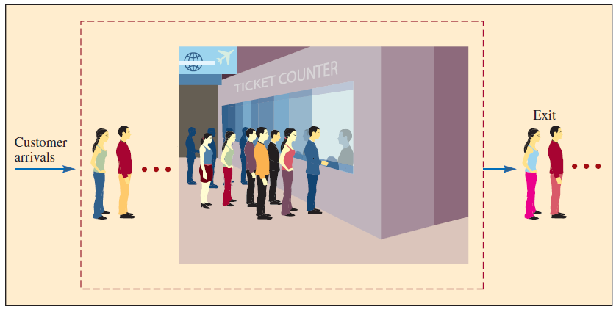
Queuing System Components
Service System

Slide 4
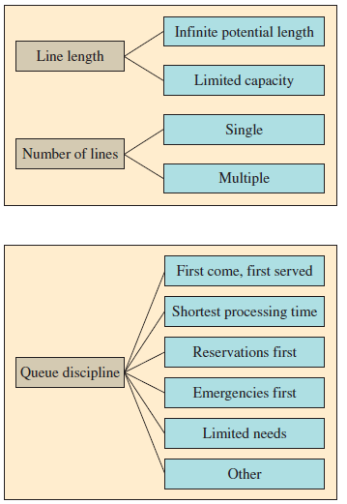
Queuing System Factors
Length
Number of lines
Queue discipline – priority rule or set of rules that determine the order of service for customers who are waiting in line

Slide 5
Queuing System Analysis
The source population – who are your customers?
Population size – finite or infinite?
Customer arrival rates
Exponential
Poisson
Constant
Customer arrival characteristics
Arrival patterns (steady or seasonal)
Size or arrival rates (individuals or groups)
Degree of patience (will they wait?)
Service rate distribution
Exponential

Slide 6
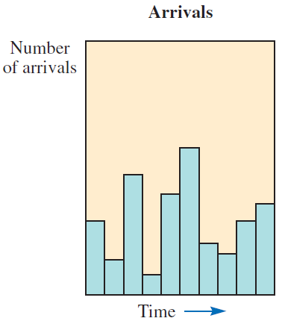
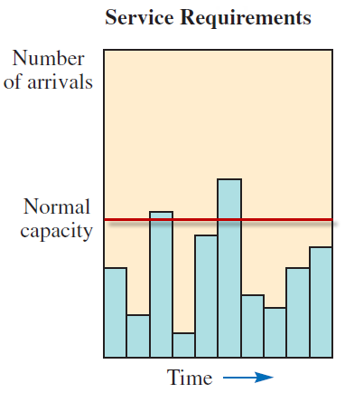
Arrival and Service Profiles
Arrivals often vary greatly over a time period
Service capacity is usually fixed

Slide 7
Practical View of Waiting Lines
Waiting Line Factors
The number of arrivals over the hours that the service system is open
Customers demand varying amounts of service, often exceeding normal capacity
We can control arrivals
We can affect service time by using faster or slower servers
Short lines
Specific hours for specific customers
Specials

Slide 8
Managing Queues
Segment the customers
Train your servers to be friendly
Inform your customers of what to expect
Try to divert the customer’s attention when waiting
Encourage customers to come during slack periods

Slide 9
Queuing System Factors
Length of queue – how much waiting room space is available?
Number of lines – how many servers are working?
Queue discipline – how do new arrivals enter the line? How do you decide which customer to serve next?
Service time distribution – what is the service rate and how much does it vary?
Line structure – what does the process look like?
Single channel, single phase
Single channel, multiphase
Multichannel, single phase
Multichannel, multiphase
Mixed

Slide 10
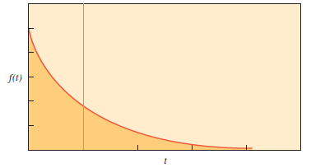
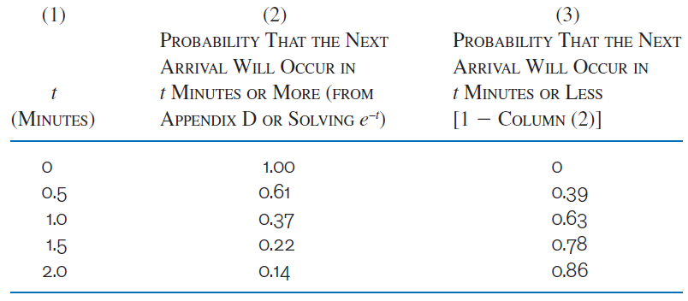


Arrival Distributions - Exponential
Describes the probability that the next arrival will happen within a specified period of time
$$f\left(t\right)= λe^{−λt}$$
$$F\left(t\right)= e^{−λt}$$

Slide 11
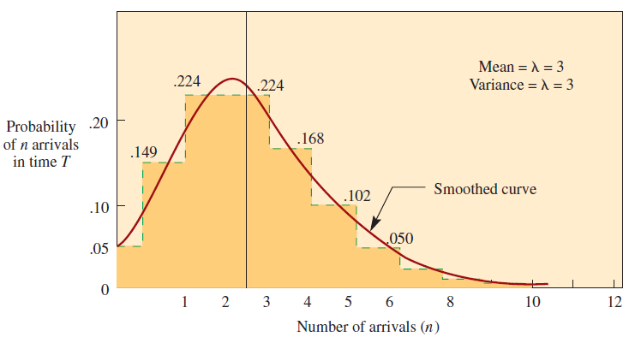
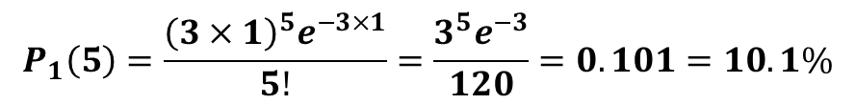
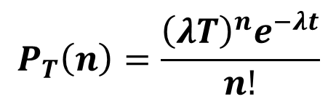
Arrival Distributions - Poisson
Describes the number of arrivals (n) in some time period (T)
With a mean arrival rate of three per minute (λ), what is the probability of exactly one arrival in the next minute?
$$P_{1}\left(5\right)=\frac{{\left(3×1\right)}^{5}e^{−3×1}}{5!}=\frac{3^{5}e^{−3}}{120}=0.101=10.1\%$$
$$P_{T}\left(n\right)=\frac{{\left(λT\right)}^{n}e^{−λt}}{n!}$$

Slide 12
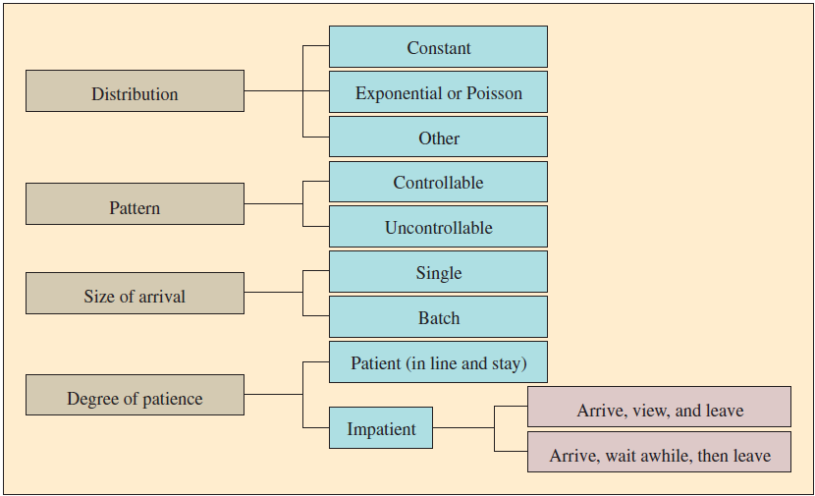
Customer Arrival Factors
No jockeying
Balking
Reneging

Slide 13
Service Time Distribution
Constant
Service is automated and not customized to individual customers (automatic car wash)
Variable
Service is provided by humans
Can be customized to individual customers
Described using exponential distribution

Slide 14
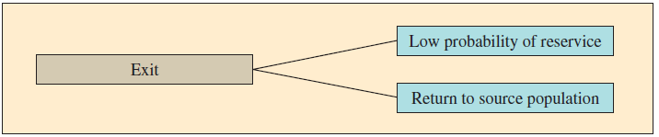
Exiting the Queuing System
Customers who have been served have two possible futures
Low probability of reservice (appendectomy patients rarely return for a repeat operation)
High probability of reservice (a machine that is prone to breakdowns may require new service immediately after leaving the service center)

Slide 15
Different Queues
Single-Server, Single-Phase
Examples:
Drive Thru (1 line)
Bank (with 1 teller open)
Customers Arrive
Customers Leave
Waiting Line
Server

Slide 16
Different Queues
Single-Server, Multiple-Phase
Examples:
2-Phase Drive Thru
Airport (Airline Counter, Security, Boarding)
Waiting Line
Server
Waiting Line
Server
Waiting Line
Server

Slide 17
Different Queues
3 Single-Server, Single-Phase
Examples: Grocery Store, Wal-Mart
Customers Arrive
Customers Leave
Waiting Line
Server
Customers Arrive
Customers Leave
Waiting Line
Server
Customers Arrive
Customers Leave
Waiting Line
Server

Slide 18
Different Queues
Multiple-Server, Single-Phase
Examples:
Bank (with 3 tellers)
Customers Arrive
Customers Leave
Waiting Line
Servers

Slide 19
Different Queues
Multiple-Server, Multiple-Phase
Example:
DMV
Waiting Line
Servers
Waiting Line
Servers
Waiting Line
Servers

Slide 20
Queuing System
Inputs:
Arrival Rate = λ
Service Rate = μ
# of Servers = s
Cost
Service
Waiting
Outputs:
Total Cost
Wait Time
System
Queue
Length of Line
System
Queue
Utilization = ρ
ρ = λ/(sμ)
Assumptions:
First In, First Out (FIFO)
Stable and independent arrival and service rates
Distribution
Poisson (rates)
Exponential (interarrival times)
Infinite population and queue length
No balking, reneging, nor jockeying
Trade Off: Service Cost versus Waiting Cost

Slide 21
Arrival and Service Rates
Arrival rate (λ) – average number of arrivals in a given interval of time
Service rate (μ) – average number of customers that can be served by a single server in a given interval of time
Units: (unit/time); for example (customers/hour)
Note:
Average time between arrivals = 1/λ
Average service time = 1/μ

Slide 22
Utilization
Utilization = ρ
ρ = λ/(sμ)
Think about it …
Need λ < sμ (arrival rate to be slower than service rate); otherwise,
Utilization is over 100%
Queue would become infinitely long (i.e., blows up)

Slide 23
Queuing Models/Notation
Kendall Notation:
A / B / s
Inter-Arrival Distribution / Service Distribution / # of servers
Inter-Arrival times are exponentially distributed
(exponential is displayed as “M” honoring Markov)
Service times are exponential, general, or constant
(M = exponential, G = general, D = Constant)
Number of Servers: s = integer

Slide 24
Queuing Models
M / M / 1 (arrival & service rates = Poisson, server=1)
M / M / s (arrival & service = Poisson, servers >= 1)
M / G / 1 (arrivals=Poisson, service=general, s=1)
M / D / 1 (arrivals=Poisson, service=constant, s=1)
Little’s Law
Avg # in system = Arrival rate * Avg wait in system
L = λ * W
True for all queuing models!
» Examples…

Slide 25
Email Response Rate
Joe receives 50 emails each day to which he must generate a response. Over the last semester, the average size of his email Inbox was 150 emails.
On average, how long does it take Joe to respond to an email?
λ = 50 emails / day
L = 150 emails
W = L / λ = 3 days!

Slide 26
Main Gate
Suppose that during the course of each day, on average cars wait in line for 1 minute at the base’s main gate. Assuming that cars arrive to the gate at a stable rate of 60 cars per hour each day.
On average, how long is the line of cars waiting at the gate?
λ = 60 cars / h
W = 1 min
L = λ * W = 1 car!
= 1/60 h Units have to be consistent!!!

Slide 27
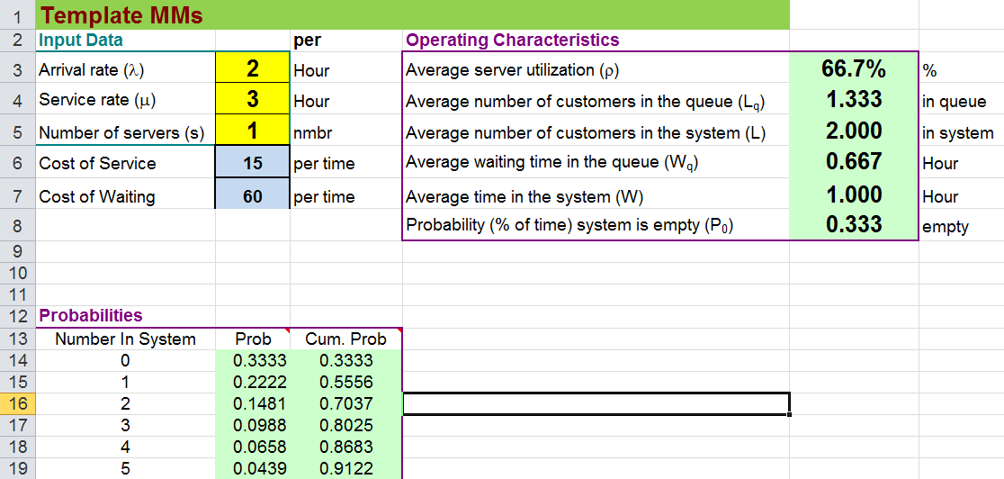
The “Queue Template” Note, this template only works for up to 30 servers. And must be an M/M/s queuing system.

Slide 28
Computer Simulation of Waiting Lines
Some waiting line problems are very complex
Equations assume that waiting lines are independent
Some problems have conditions do not meet the requirements of the equations
When one service is the input to the next, we can no longer use the simple formulas
Servers with different capabilities, multiple customer types
Finite populations, specific arrival/service distributions

Slide 29
Additional Models
Additional slides with some various model formulas, etc. if you are interested.

Slide 30
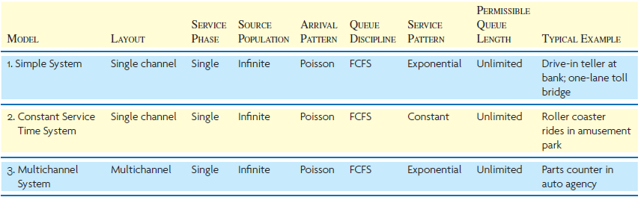
Waiting Line Models

Slide 31
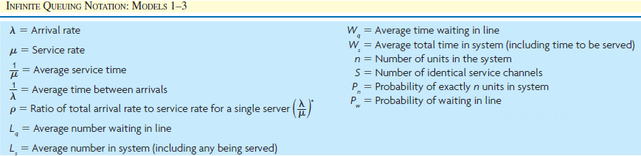
Waiting Line Model Notation

Slide 32
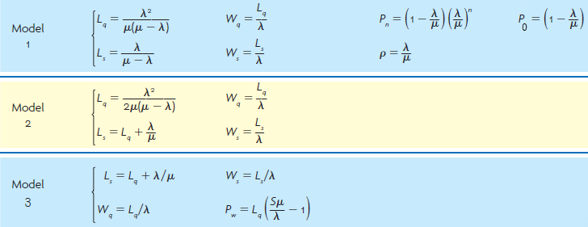
Waiting Line Model Equations

