Slide 1

Notes:
1
1

Slide 2
Simulation
Simulate (verb):
To duplicate the features of a real system. The idea is to imitate a real-world situation with a mathematical model that does not affect operations.
Monte Carlo Simulation:
Randomly generate values for the variables (via random sampling) and repeat (replicate) the simulation as necessary.
Notes:
2
2

Slide 3
Simulation: Advantages & Disadvantages
Advantages
Can be used to analyze large and complex real-world scenarios
Does not interfere with real-world system
Time compression is possible
Inclusion of “real-world” complications (e.g., by using different distributions)
Can be cheaper (long term) [or safer]
Disadvantages
Expensive to setup/maintain a good simulation
Does not generate “optimal” solution
Managers/analysts must generate all conditions and constraints
Each simulation is unique (new scenario)
Notes:
3
3

Slide 4
Excel: Data Tables
Used to vary a variable (or two variables) within a table
From Excel Worksheet
Data Ribbon
What-if Analysis
Data Table
Other Examples: http://www.excel-easy.com/examples/data-tables.html
Notes:
4
4

Slide 5
Simulation Steps
Define Objective(s) [e.g., max profit, min cost] {Green}
Identify Parameters [e.g., $ per pip, cost to play] {Blue}
Identify Decision Variables [e.g., bankroll] {Yellow}
Create Mathematical Model Using Randomness
(e.g., a Monte Carlo simulation)
Run the Model (Check Results)
Replicate
Summarize Results (Select Best Course of Action)
Note: Colors and examples (e.g.) correspond to Excel Dice Game.
P.S. A pip is a dot (symbol) on a die (or domino, playing card)
Notes:
5
5

Slide 6
Distributions
Use Excel to generate different distributions
Use Random Number Generator
The Excel Function “=RAND()” produces random numbers between 0 and 1 (16 decimal places)
We can then use this random number to create other distributions of interest
Normal Distribution
Exponential Distribution
Excel has the capabilities of doing others as well …
Binomial, Poisson, Beta, Chi Square, Fisher, Gamma, Lognormal, Student t, etc.
The Excel Function “=RANDBETWEEN(a,b)” produces a random integer number between a and b
Notes:
6
6

Slide 7
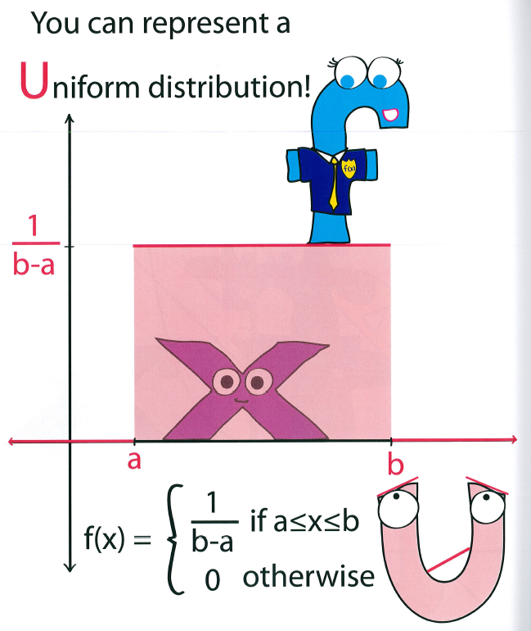
Distribution: Continuous Uniform
Random between a and b.
Since continuous (i.e., decimals allowed), the probability of equaling a single value is 0. Thus, we calculate probability over a range.
In Excel:
= a + (b – a)(RAND())
Where b > a
Picture From: Introductory Calculus: For Infants, O.M. Inouye
Notes:
7
7

Slide 8
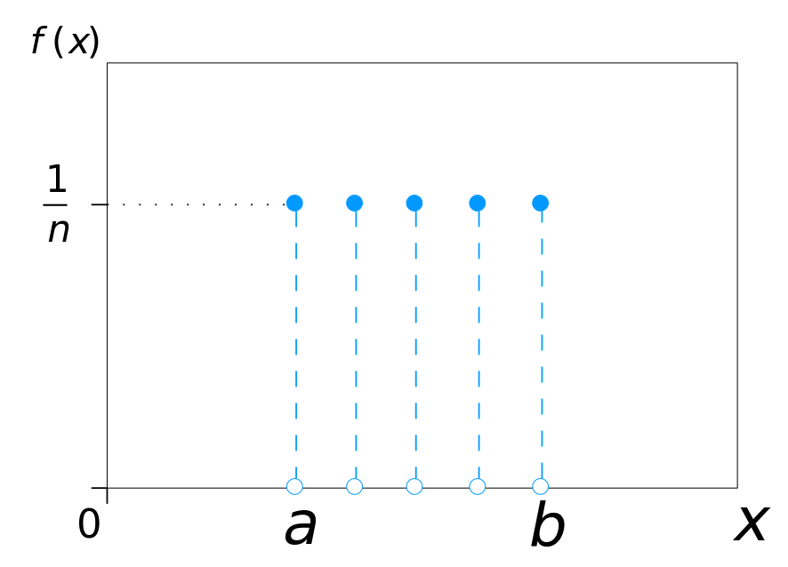
Distribution: Discrete Uniform
Random between a and b, but values must only be integers.
Since discrete (not continuous) a single value can have a probability.
In Excel:
= RANDBETWEEN(a,b)
Where, b > a.
(Note, you could use RAND() and manipulate from there, but RANDBETWEEN is easier)
Picture From: Wikipedia
Notes:
8
8

Slide 9
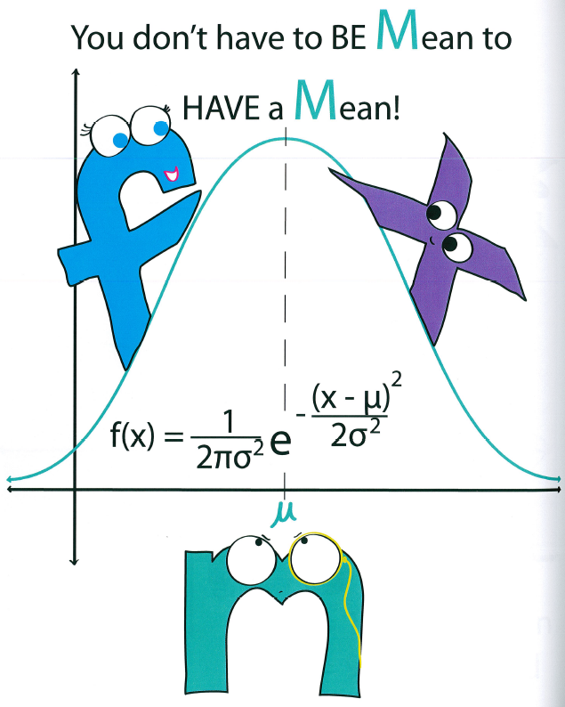
Distribution: Normal
Randomly pick an x value from a Normal Distribution with a given mean (average) and standard deviation (stdev).
In Excel:
= NORM.INV(RAND(),mean,stdev)
[mean and stdev should be numbers; stdev should be positive]
Picture From: Introductory Calculus: For Infants, O.M. Inouye
Notes:
9
9

Slide 10
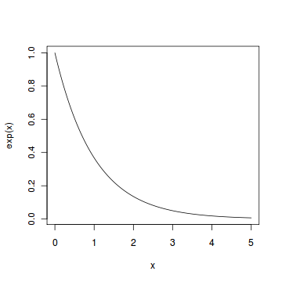
Distribution: Exponential
Randomly pick an x value from an Exponential with a given mean (average).
In Excel:
= –(mean)*LN(RAND())
or
= –(mean)*LN(1 – RAND())
LN is the natural log function in Excel
Note: 1 – RAND() is a random number between 0 and 1.
Picture From: R Tutorial
Notes:
10
10

Slide 11
Our Plan
Use Excel to build a simulation where we have a few parameters
Use “RAND()” or “RANDBETWEEN(a,b)” in combination with functions within Excel to generate random numbers to distributions
Use Data Tables to give us replications over a few input parameters
Note: we could use VBA to do replications instead of data tables and that is probably preferable if you are going to have many (> 1000) replications
Notes:
11
11

Slide 12
“Monte Carlo Simulation” Excel File
(Note, this example will only work on a PC version of Excel)
An example of using VBA programming and Excel as the “output” for your simulation model combining with some graphical tools in Excel as well.
Go to “Explanation” worksheet and click “Get Started” button in the middle of the sheet.
Then, it will move you to the “Main” worksheet and click “Monte Carlo Simulation” button and watch graphical charts complete as well as “Simulation” and “Results” worksheets complete.
If you want to view code, when the simulation is not running but the Excel file is open, select “Alt F11” there is code within the worksheets for the buttons.
Notes:
12
12

Slide 13
VBA Introduction
VBA (Visual Basic for Applications)
Short-Definition:
VBA is a programming language within Microsoft Office (e.g., Excel, Word) products that allows the user to develop applications/tools. VBA can be combined with “control” aspects such as menus, toolbars, etc. to create custom user forms and/or dialog boxes.
Notes:
13
13

Slide 14
Controls
Form controls basically are Object Linking and Embedding within Microsoft Office products using Macros. For example, Buttons, Check Boxes, etc. Form controls are built-in to Microsoft (i.e., preloaded/prepackaged).
ActiveX controls can be more advanced and can do other things (similar to if you purchased an Add-On Software for Excel). They are loaded separately from Excel and do not have to use Macros (can use code).
From a Developer standpoint, you will be asked to include VBA code or record a Macro immediately if using a Form control (but not if using an ActiveX control).
Notes:
14
14

Slide 15
Controls: Developer Ribbon Tab
Note, need to display “DEVELOPER” tab in Excel in order to use Forms.
Open Excel. To display the DEVELOPER tab, click on the File menu and then select Options from the drop down menu. When the Excel Options window appears, click on the Customize Ribbon option on the left. Click on the Developer checkbox under the list of Main Tabs on the right. Then click on the OK button.
Notes:
15
15

Slide 16
Resources
Handout 1: Reviews basic concepts of computer programming, data types, functions, procedures, objects, if-then-else, loops, nested control
Handout 2: User Forms Example (along with Loan-Example.xls)
Notes:
16
16

