Slide 1
Student Marks Analysis
Excel Dashboard and Teacher Insights

Slide 2
Executive Summary
• Total Students :50
• Pass Rate :100%
• Class Topper :Student7 (92.4%)

Slide 3
Grade Distribution
A+ :1student
A :20 students
B :27 students
C :2students

Slide 4
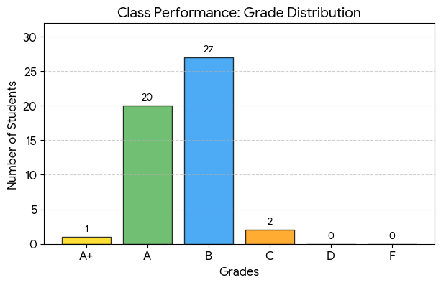

Slide 5
Individual Subject Toppers
English: Student 33 (97 Marks)
Maths: Student 7 (99 Marks)
Science: Student 17 (97 Marks)
Social: Student 21 (95 Marks)
Computer: Student 9 (100 Marks)

Slide 6
Key Insights
• Maths and Computer are strongest subjects
• Some students require extra academic support
• Balanced overall performance
Zero failures across all subjects.

Slide 7
Conclusion
This project is suitable for students mark analysis and academic submission.

