Slide 1

PITCH · OCTOBER 2026
Wealthy families pay to take the risk out of their journeys — and still carry it alone
Every supplier, deposit, border and member of staff is theirs to manage. Should a two-sided platform take it off them? A hypothesis we test in 90 days.
Otium Chigi Journeys · Rome · Southern Italy · Santa Catarina · Confidential
Notes:
Audience: regional partners, pilot families, family offices, suppliers and rails partners, and early investors. Ask: pilots and partners per region; capital only after the day-90 gate.

Slide 2
Families pay to remove risk from their journeys — yet still carry it alone. Should we build a platform that takes it off them?
SITUATION · COMPLICATION · QUESTION
Situation
Complication
Question
How we answer
557–714k UHNW people with about three homes each; single family offices 8,030 → 10,720 by 2030; 142k → 165k millionaires relocating. They already pay to remove risk: brokers take 10–20% partly to vouch; deposits run US$100k–1M.
Trips alone are copied (a curator scored 11/25, moat 1). No one assures suppliers and deposits across categories: audits cover aviation safety only, while >US$150M sat at risk at one jet provider (Sep 2026).
Should we create a two-sided platform that integrates exclusive luxury travel for UHNW and affluent families?
Map the pains and what families already pay, compare the options, and test the leading hypothesis in interviews and real sales before we build.
Source: Altrata 2026; Knight Frank 2026; Deloitte 2024; Henley 2025 (vendor projection); research/phase3_uhnw.md; research/opportunity_map.md; research/raw/uhnw_pains.md (OneFlight: press commentary, US private aviation).

Slide 3
UHNW families carry the risk of every supplier, deposit and border themselves — no one assures the whole journey
PROBLEM STATEMENT
Ultra-high-net-worth families build every journey from separate vendors and carry its risk alone: supplier solvency, deposits of US$100k–1M, staff who must cross borders lawfully, and their own privacy. When a supplier fails, the loss is theirs — JetSuite members lost more than US$50M; more than US$150M sat at stake at OneFlight (Sep 2026).
Who
557–714k UHNW people with about three homes each; 8,030 single family offices, rising to 10,720 by 2030
What hurts
Supplier failure and deposit loss · lawful staff mobility · scarce access and crowds · planning load
How much
Deposits US$100k–1M; brokers take 10–20% partly to vouch; a travelling nanny costs £55–110k a year; 16 hours to plan a trip
Why now
Provider failures 2020–2026; the UK domestic-worker route under review (Jun 2025); UAE fines AED 50–200k; family offices +4.9% a year (CALC)
So what: no one assures suppliers, deposits and people together — families pay each vendor separately and keep the risk.
Source: Altrata WUWR 2026; Knight Frank Wealth Report 2026; Deloitte Family Office Landscape 2024; research/phase3_uhnw.md; research/raw/uhnw_pains.md (JetSuite 2020; OneFlight, Sep 2026); Morgan & Mallet, Beyond The Butler 2025/26; Home Office PQ55427 (Jun 2025); UAE Decree-Law 9/2022; Priceline (Jan 2024, n = 3,024).

Slide 4
A luxury journey is bought from a dozen vendors — and the people who travel with the family cannot follow lawfully
THE PROBLEM
16 hours
9–23×
2.36%
~US$150M
to plan and book one trip — before any staff, access or paperwork
the standard ticket for private Vatican access: exclusivity is bought piece by piece
of one agency’s childcare candidates can work rotations that follow the family
of deposits at risk when a private-aviation provider paused flights (Sep 2026)
Families stitch it together themselves — and carry the legal and financial risk at every border.
Source: Priceline (Jan 2024, n = 3,024); The Roman Guy and operator listings (Vatican); Morgan & Mallet, Beyond The Butler 2025/26; press commentary on OneFlight (Sep 2026).

Slide 5
We detected the pain where money is spent and lost — supplier and deposit risk is the most severe and least served
PAIN DETECTION AND MEASURES
Pain | How we detected it | How big | Served today?
Supplier failure and deposit loss | Court filings and losses | Deposits US$100k–1M; >US$150M at stake at one jet provider (Sep 2026) | No
Lawful staff mobility | Rules enforced; scarce supply | Fines AED 50–200k; only 2.36% of candidates can rotate | Partly
Residency-day exposure | Audit records | ~US$67k per New York residency audit (CALC) | Partly
Scarce access and crowds | Price premiums paid | 9–23× for private Vatican access; up to 50,000 day visitors on Capri | Partly
Planning load | Time studies | 16 hours to plan one trip | Yes
We followed the money and the losses: they point to supplier, deposit and staff risk.
Source: Priceline (Jan 2024, n = 3,024); court filings and press (OneFlight, Sep 2026); UAE Decree-Law 9/2022; Morgan & Mallet 2025/26; NYSSCPA (2013–17 audits; CALC US$1bn ÷ 15,000); The Roman Guy; Euronews (Feb 2026).

Slide 6
UHNW travellers’ needs are not met: the most important needs are the worst served — integration is the improvement no single vendor offers
NEEDS NOT MET
Importance ↑
Potential for improvement
Unique value proposition (hypothesis H1)
For UHNW families and their family offices, who move people, money and plans across borders: one assured record that every journey runs on — every supplier filed, every deposit protected, every staff day lawful, every residency day signed off.
Unlike advisors, concierges, agencies and payroll firms, which each solve one piece, integration reuses one record across all of them: vetting once, one payment, staff days feeding the ledger.
Supplier and deposit security
Privacy and security
Service on the trip
Lawful travelling staff
Access without crowds
One responsibility, one payment
Residency days and records
Planning time
How well met today →
Integration is the improvement no single vendor can offer — whether families pay for it is what the interviews test.
Source: Importance and performance are our assessment (needs analysis: importance × performance); positioning is hypothesis H1, tested in the 90-day plan. Evidence: Private Jet Card Comparisons survey; research/phase3_uhnw.md; Morgan & Mallet 2025/26; our earlier Southern Italy research (24 suppliers in a 10-night trip); Flywire (Mar 2025; Jan 2026); research/raw/map_a.md (NYSSCPA; CALC US$1bn ÷ 15,000); Campden Wealth with Schillings (2025); The Roman Guy; Priceline (Jan 2024, n = 3,024). ‘How well met’ is our assessment of the alternatives in chapter 1.

Slide 7
Options to solve the pains, ranked by what families already pay — the assured record is our leading hypothesis, not a given
OPTIONS
Pain | Options that could solve it | What families already pay (WTP evidence) | WTP | Hypothesis
Supplier failure and deposit loss | Assured supplier files · staged escrow on deposits · insured deposit protection | Brokers take 10–20% partly to vouch; deposits US$100k–1M at stake | Inferred | H1 · lead
Lawful staff mobility | Compliance coordination for the family’s own staff · employed relief pool · agency referral | Travelling nanny £55–110k a year; agency fees 15–25%; EOR US$599–699 a month | Strong for staff | H2
Scarce access and crowds | Held tables and opening-time slots · exclusive peak-week houses · crowd-smart timing | 9–23× private-access premiums; resold tables above US$2,100; concierge clubs £2k–25k a year | Strong | H3
Residency-day exposure | Adviser-signed day ledger · day-count apps | ~US$67k per New York residency audit (CALC); TaxDay US$9.99 a month | Low today | H4
Planning load | Questionnaire with three proposals in 24 hours · advisors | 55% of US advisors charge fees, ~US$350 a trip | Served | H5
Payment friction | One price, one payment, across every supplier | 95% say easy payment matters; 72% worry about security | Medium | H5
The assured record is one option among these — our leading hypothesis, to be proven or rejected in interviews before we build.
Source: research/phase3_uhnw.md (broker markups, deposits); Morgan & Mallet 2025/26; agency fee schedules (2025–26); Deel and Remote pricing (2026); The Roman Guy; Nevada Current (Jun 2025); Stirling Access; research/raw/map_a.md (NYSSCPA; TaxDay); Travel Weekly (Aug 2025); Flywire (Mar 2025). WTP strength is our assessment of money already paid.

Slide 8
Two sides: multi-home families who need it all to work, and suppliers who want qualified guests without paying 16–30% to platforms
WHO FEELS IT
557–714k
8,030 → 10,720
16–30%
50%
ultra-high-net-worth people (US$30M+), about three homes each
single family offices, 2024 → 2030 (Deloitte)
what hotels and villas pay booking platforms: 16–18% in Brazil, up to 30% in Italy
average occupancy at Brazil’s leading luxury hotels (BLTA 2025)
Side | What they need
Families and family offices | One trusted place for the journey, the access and the people — lawful on every leg
Villas, hotels, hosts, access providers | Qualified, high-spending guests in every season, paid only on completed stays
Household staff | Steady, legal travelling work, with a record that follows them
Source: Altrata 2026; Knight Frank 2026; Deloitte Family Office Landscape 2024; UBS 2024; Airbnb host fee and Booking.com Preferred commission (Brazil, 2026); Direzione Hotel (Italy); BLTA 2025 via O Hoje (Aug 2026).

Slide 9
Every vendor solves one piece — no one integrates the journey, the access, the people and the trust
TODAY’S WORKAROUNDS
Advisors and DMCs
~US$350 fee; ~10–12% commission
Design the trip; not the staff, the legal status or the data
Concierge clubs
£2k–25k a year
Open doors; outside the family’s own journey and people
Staff agencies
15–25% of salary, once
Place a person; the family stays employer everywhere
Payroll and EOR
£276–474 a year; US$599–699 a month
One country, or built for companies
Audits and escrow
ARGUS, Wyvern; MYBA terms
Safety only, aviation only; escrow one operator at a time
One piece only
One piece only
One piece only
One piece only
One piece only
The family is the only integrator today — and EU package law protects package buyers only, not villa, boat or membership deposits.
Source: raw/alt_a–c.md and raw/fmo_competitors.md (Oct 2026); raw/novelty_uhnw.md and raw/novelty_1.md (ARGUS, Wyvern, MYBA, package protection); Stirling Access; agency fee schedules (2025–26); Travel Weekly (Aug 2025).

Slide 10
THE PROPOSED SOLUTION
Proposed solution (our leading hypothesis): four modules and an Intelligence engine on one Assured record
1
2
3
4
5
Journey design + booking
Three priced proposals in 24 hours, one price, one payment
Access + hosting
Held tables, private doors, a local host; first refusal on Jurerê peak weeks
Staff + compliance
Our vetted staff or the family’s own — counsel-led coordination across borders
Data + trust
Private supplier files and escrow deposit terms; an adviser-signed day ledger
Intelligence
Sells only what the record sees — never personal data
We start with module 4 — a family office orders a supplier file before a deposit, with zero suppliers on the platform — then run journeys, access and staff on the same record.

Slide 11
A two-sided platform useful from day one: family offices order supplier files, and suppliers sign Assured terms to stay eligible
HOW IT WORKS
Families
and family offices
Order a supplier file before any deposit; membership per household, ledger included
Otium Chigi Journeys
one Assured record
Suppliers
villas, boats, DMCs, hosts, access, staff
Sign data rights and staged-escrow terms; pay a take rate only on completed bookings
Assured moves into a vehicle co-owned with an insurer or broker; client deposits sit in segregated or escrow accounts; costs come only from earned fees. We never hold passports or give legal advice.
Source: Operating model: our moat red-team (Oct 2026) and the strategy deck. Partners named are candidates, not agreements.

Slide 12
Proposed wedge: the supplier file — useful to one family office alone, cash within 90 days, a path to a moat; to be proven in interviews
WEDGE
Candidate wedge | Useful with one side? | Time to cash | Competence fit | Capital | Moat path (yr 3) | Verdict
Assured supplier file + escrow terms | Yes: a family office orders it before a deposit | 30–90 days | Favourable: credit analysis | None | 3 | Lead wedge
Staff coordination and relief | Yes | Months 4–15+ | Less than favourable | Payroll float | 1 | Service; employment after T4–T5
Jurerê peak-week first refusal | No: needs families | Season 1 | Local founder | Paid consideration | 3 | Regional lock
Journeys (trip design and booking) | No: needs suppliers | After day 90 | Partly | Organiser licence €9.1k (CALC) | 1 | On top of the record
Family day ledger | Yes | Month 16+ | Partly | None | 2 | Retention
A wedge must work with one side, earn cash fast and lead to a moat — only the supplier file does all three.
Source: Our moat red-team (Oct 2026); research/opportunity_map.md (scores); research/phase4_5.md §4.4 (competences); research/fmo_strategy.md §5 (staff economics); organiser costs from our earlier Southern Italy model.

Slide 13
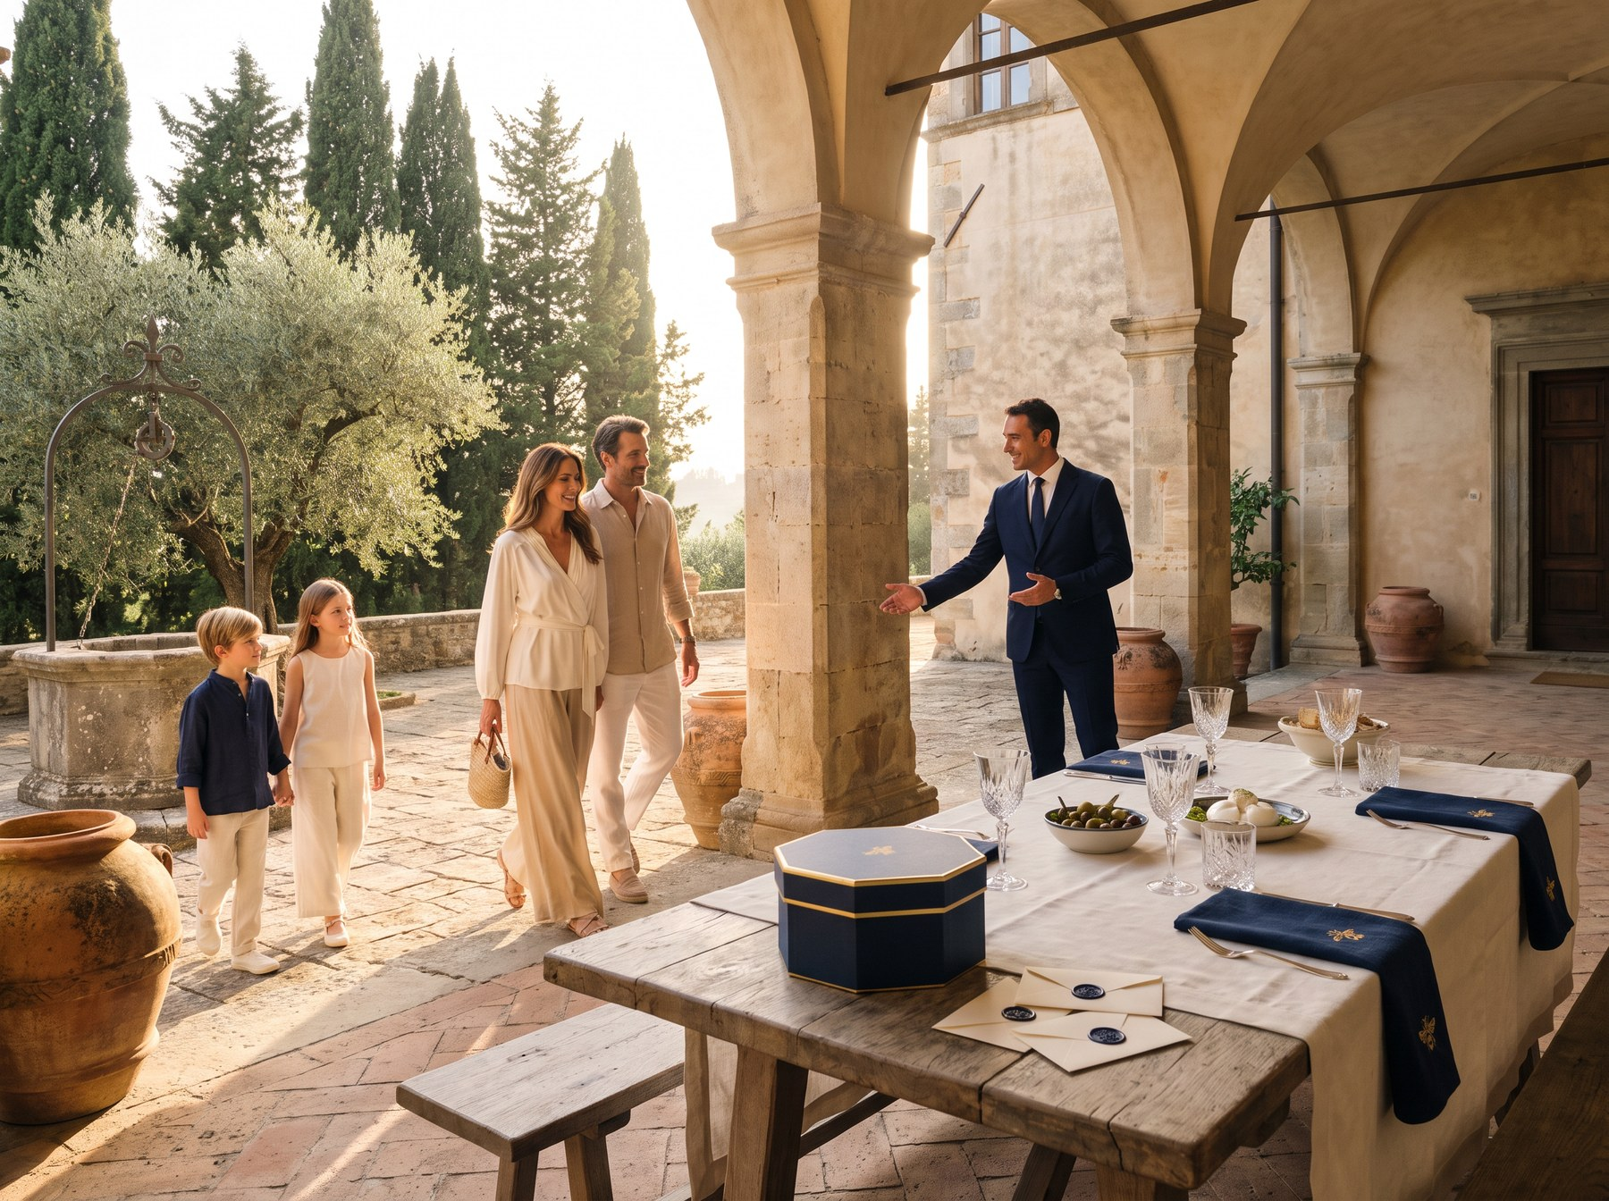
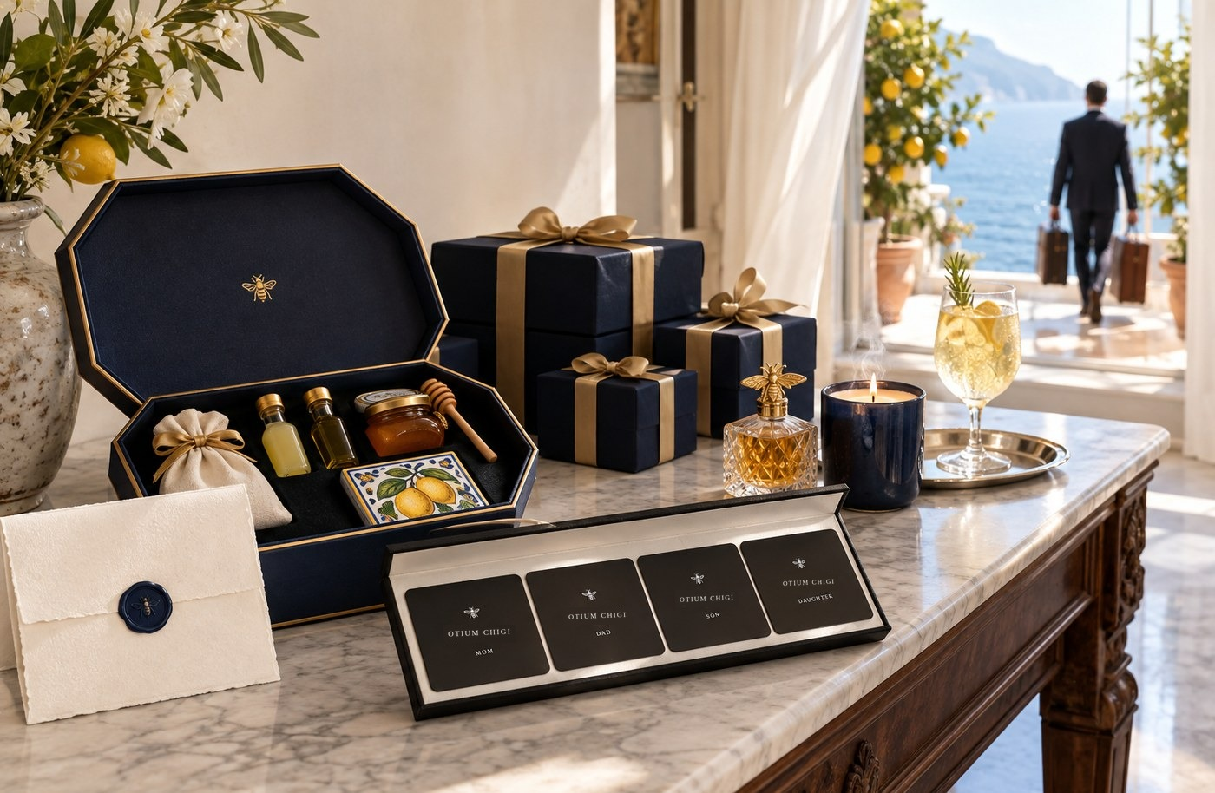


One family, one record: the arrival, the house, the boat and the family office all run on the same Assured record
THE EXPERIENCE
Arrival
A local host and the house ready; every deposit-holding supplier on Assured terms.
In the house
Amenities for each member of the family; one price, one payment.
At sea
The family’s own staff on board, lawful on every leg; the deposit in staged escrow.
Before the deposit
The family office orders an Assured file; the adviser signs off the day ledger.
The record, not the trip, is what a rival would have to copy.
Source: Illustrative images from our earlier Southern Italy work; not real clients or signed suppliers.

Slide 14
Moat: designed, not built — 1 today; a narrow 3 by year 3 in three layers, if dated tests pass
MOAT
L1 · Assured standard
Private supplier files plus staged-escrow deposit terms; suppliers sign data rights with their net rates
MT1 day 60: ≥ 5 of 10 sign and most refuse a rival · MT2 day 90: ≥ 3 of 5 files sell
1 → 3
L2 · Insurer or broker co-owner
A coverholder makes Assured a condition of deposit cover; we share in the line
MT4 day 90: a signed exclusive term sheet naming the mark
1 → 3
L3 · Santa Catarina peak weeks
Exclusive, paid first refusal on Jurerê peak weeks before an operator arrives
Day 60: ≥ 3 of 5 owners sign
1 → 3
Not moats: Italy access and the day ledger (2), staff, licences and crowd data (1) — features and minimum requirements.
Odds: 12.5% that the assurance path passes if each test is a coin flip — so we test before we build.
Source: Our moat red-team (Oct 2026): three designs, a judge and three skeptics. Moat gate ≥ 3 (research/opportunity_map.md). Odds assume each test is a coin flip (ASSUMPTION).

Slide 15
We envelop single-function rivals around our families — and make the bigger players co-owners, not envelopers
COMPETITION
Risk assured: suppliers, deposits, people ↑
Who envelops whom
We envelop where we hold the family: trip-only design, day-count apps, deposit vouching, villa concierge in Santa Catarina.
Banks, insurers and advisors hold the families and could envelop us — so they become co-owners and licensees of Assured, on data-right terms. Aviation we concede.
Otium Chigi Journeys
Morgan & Mallet
Staff agencies
Booking platforms
Payroll / EOR
Advisors and DMCs
Concierge clubs
Breadth of the journey covered →
Source: Envelopment per the network-markets framework; our moat red-team (Oct 2026); raw/fmo_competitors.md and raw/alt_a–c.md; our positioning assessment.

Slide 16
Switching costs are low today — the record, escrow terms and insurer cover make leaving costly, while export stays free
SWITCHING COSTS
Type | Families today | Families with us | Suppliers today | Suppliers with us
Procedural (set-up, learning) | Low: advisors and agencies are easy to swap | Record, staff files and preferences set up once; export stays free | Low: they list everywhere | One audit and one data-rights letter, reused across every buyer
Financial | Low | Escrowed deposits and insured cover tied to Assured suppliers (MT4) | None | Eligibility for insured deposits lost on leaving
Relational and data | Medium: trust in a known advisor | Years of adviser-signed day counts; staff continuity across legs | Low | Payment and delivery history that earns better terms
Contractual | Staff contracts of 6–12 months | Contracts and cover that follow the family across legs | None | Staged-escrow terms; exclusive first refusal on Jurerê peak weeks
We raise switching costs by being useful, not by locking in: export stays free and staff own their record.
Source: Switching-cost types per the market-entry questions (features that overcome switching costs). Our moat red-team (Oct 2026); research/fmo_strategy.md §3 (contracts 6–12 months); research/raw/uhnw_pains.md (96% rely on advisors, Flywire).

Slide 17
Four revenue lines on one family: supplier files, a take rate on bookings, a membership — and Intelligence once the record is deep enough
BUSINESS MODEL
Assured files
US$500–2,000 a file
Take rate on bookings
10–15%
Household membership
Per family, per year
Staff + Intelligence
Later
Ordered by family offices before a deposit
Year 1: US$2.5–20k (CALC)
Licensed checks later, via the co-owned vehicle
Paid by suppliers, only on completed stays
Below platforms’ 16–30%
Or one price: 30% markup on net cost, VAT on the margin only
Fixed fee that captures surplus
Day ledger included (£1.5k value, assumption)
Set by trade-off interviews
Staff: coordination and referral now; employment after its gates
Intelligence: €0 until 120+ journeys a year per region
Opposite seasons — Italy Apr–Oct, Santa Catarina Dec–Mar — keep the same families and suppliers active all year.
Source: Levels are ASSUMPTIONS until the trade-off interviews. research/phase4_5.md (US$500–2,000 per report); platform fees 16–30% (Brazil 2026; Italy, Direzione Hotel); merchant model from our earlier Southern Italy research; staff CALC in research/fmo_strategy.md.

Slide 18
Files pay first, journeys follow, staff waits for its gates — year-1 revenue is small and earned
UNIT ECONOMICS
US$2.5–20k
Assured files, year 1
5–10 files ordered before deposits
€24.3–36.5k
Journeys take, year 1
10 trips at a 10–15% take, sold only after day 90
€9.1k + €6–12k a year
Organiser licence cost
Through a licensed partner first; our own once margins cover it
−£7.6k to −£13.9k
Staff wedge, per position-year
Deferred: employment waits for T4 and T5
No founder capital: costs are paid only from earned fees, margins or partner contributions; client deposits sit in segregated or escrow accounts.
Source: CALC from ASSUMPTIONS: files 5–10 × US$500–2,000; journeys 10 trips × €24,300 × 10–15%; organiser licence from our earlier Southern Italy model; staff wedge research/fmo_strategy.md §5.3 (London rates).

Slide 19
Economic value: US$5.0–11.5k a year at stake on a US$200k deposit — a US$500–2,000 file prices well inside it
ECONOMIC VALUE
Own diligence avoided
10 h × US$100–150 of analyst or adviser time (assumption)
US$1.0–1.5k
+ Expected loss at stake
US$200k deposit × 2–5% failure risk a year (CALC, assumption)
US$4–10k
= Economic value to the family
Ceiling for the price
US$5.0–11.5k
Our price
Per Assured file
US$500–2,000
Our marginal cost
4–8 analyst hours (assumption)
US$200–400
The family keeps most of the value: a US$500–2,000 file against US$5.0–11.5k of value — price shares the wedge, never cost-plus.
Source: Economic value to the customer = next best alternative + differences (value map). CALC: US$200k × 2–5% = US$4–10k; US$1.0k + 4k = 5.0k; US$1.5k + 10k = 11.5k. Report price band from research/phase4_5.md; hours and rates are ASSUMPTIONS until the trade-off interviews. Staff value map: pages that follow.

Slide 20
Utility value: certainty, discretion, control, time and access — each measured by trade-off, never by asking
UTILITY VALUE
Utility | Evidence it matters | How we measure it (trade-off) | What we offer
Certainty: the supplier delivers and the money is safe | 35.8% of jet-card buyers call provider stability critical; 44.1% important but hard to judge; 72% worry about payment security | Pay the deposit as today vs Assured file + staged escrow for a fee X | Assured file; staged escrow
Discretion and privacy | Close protection US$1,800–4,000 a day; 37% of family offices hit by a cyber attack in 24 months | Share preferences with family-held keys vs keep them offline | Private files; minimum cell of 10; no GPS
Control over who is in the home | Families prefer known staff and stay the employer | Your own nanny + a named relief carer vs an agency temp, for X | Staff coordination; named relievers
Time and effort | 16 hours per trip; 47% say less planning would lower stress | Three proposals in 24 hours vs today’s process, for X | Questionnaire; one price, one payment
Access and exclusivity | 93% say luxury is about access; 9–23× private-access premiums | A held slot or peak week vs the standard option + X | Held tables; Jurerê first refusal
Utility is priced from switching points in face-to-face trade-off interviews — we never ask ‘what would you pay?’
Source: Private Jet Card Comparisons survey; Flywire (Mar 2025; Jan 2026); Campden Wealth with Schillings (2025); research/fmo_strategy.md (needs N1–N9); Priceline (Jan 2024); The Roman Guy. Method: Trade-Off Method protocol (easy opener, unanchored X, iteration).

Slide 21
Three waves: Rome, Southern Italy and Santa Catarina first — opposite seasons, partners on the ground
WAVES
Wave 1
Rome · Southern Italy · Santa Catarina
Wave 2
Rest of Italy · Greece · Ibiza · the Alps
Wave 3
Global
Rome: private access at 9–23× the standard ticket
Southern Italy: up to 50,000 day visitors a day on Capri; Pompeii capped at 20,000
Santa Catarina: a third of Rio’s violent-death rate; seclusion by villa and boat
Santa Catarina and Rome first; Southern Italy once its seat is confirmed
Trigger: Assured standard or Santa Catarina supply reaches 3
Trigger: ≥ 20 suppliers on Assured terms per region
Summer islands and winter ski for the same families
Trigger: repeat families across ≥ 2 regions
Partner-led; never own homes, yachts or aircraft
Go region by region: a region enters the next stage only when its own gates pass.
Source: Euronews (Feb 2026: Capri); Made in Pompei (Feb 2025); The Roman Guy; Congresso em Foco (Jul 2026); NSC Total (Dec 2025); Civitatis via Brasilturis (Dec 2025). Triggers are assumptions.

Slide 22
Prove the assured record in 90 days with no capital, pilot it with paying families in Wave 1, then scale the co-owned standard
ROADMAP
Days 0–90
Validate
Counsel note, supplier terms, files sold, insurer or broker term sheet, licensee and bundle tests. ~161 hours, no capital, no journeys sold
Months 4–15
Pilot Wave 1
Assured files and Journeys with paying families; Jurerê first refusal; co-owned vehicle by month 12
Months 16–36
Scale
Licensees, ledger seats, first insured line; staff employment only after T4 and T5; Wave 2 on its triggers
GO only if the counsel note, MT1, MT2 and MT4 or MT5 pass — otherwise we stop with nothing lost.
Source: Strategy deck operational plan; our moat red-team (Oct 2026); research/fmo_strategy.md §8–9. Thresholds and hours are assumptions.

Slide 23
Partners on the ground: named targets in every Wave-1 region — deposit-holding intermediaries asked to sign data rights and escrow terms
PARTNERS
 | Rome | Southern Italy | Santa Catarina
Stays | Hotel de la Ville · Hotel Hassler · Six Senses Rome · Bulgari Hotel Roma | Le Sirenuse · Il San Pietro di Positano · Monastero Santa Rosa · Capri Palace · Punta Tragara · direct villa owners | Awasi Santa Catarina (Relais & Châteaux) · pousadas at Praia do Rosa · Jurerê houses
Access + dining | Vatican before opening · Colosseum underground · palazzo dinners · La Pergola · Imàgo · Il Pagliaccio | Pompeii archaeological park (early access) · Don Alfonso 1890 · Torre del Saracino · Zass · L’Olivo · George | P12 Parador Internacional · Café de la Musique · whale watching at Praia do Rosa (Jul–Nov) · sailing the bay
Mobility | Licensed NCC chauffeurs · a helicopter to the Amalfi Coast | Muto Travel NCC · Hoverfly (Naples–Capri from ~€1,900) · Amalfi Coast Dream (yacht days from ~€4,500) · D-Marin marinas (warm contact) | Chauffeurs · boats · a helicopter
Local care + chefs | To source, same vetting standard | Amalfi Sitters · International Sitters · licensed home-care agencies · Take a Chef (client price: nanny €247, companion €221 a day) | To source, same vetting standard
One warm channel today (D-Marin marinas); every other name is a prospect, not an agreement — Le Collectionist is invited in as an Assured supplier.
Source: Our earlier target lists for Rome, Southern Italy and Santa Catarina, and our Southern Italy supplier, partnership and pricing sheets (Sep 2026). Prospects, not agreements; licences, prices and MICHELIN stars confirmed at contracting.

Slide 24
What we prove in 90 days: each hypothesis has a pass mark set in advance, tested by interviews and real sales
HYPOTHESES
Hypothesis | What must be true | Interview or test | Pass mark | By
H1 · Assured record (lead) | Family offices pay for a supplier file and escrow terms before a deposit | Trade-off interviews with family offices; 5 files offered for sale (MT2) | ≥ 3 of 5 files sell | Day 90
H1b · Suppliers accept | Deposit-holding suppliers sign data rights and escrow terms | 10 supplier meetings per region (MT1) | ≥ 5 of 10 sign; most refuse a rival | Day 60
H1c · A co-owner exists | An insurer or broker makes the mark a condition of cover | Insurer and broker meetings (MT4, MT5) | Signed term sheet, or ≥ 3 of 5 licensees | Day 90
H2 · Staff coordination | Families value lawful, guaranteed staff cover above its cost | Trade-off interviews: own nanny + named relief vs agency temp (T1) | Value ≥ £13.6–19.9k per position-year | Day 90
H3 · Access and peak weeks | Owners grant exclusive first refusal; families pay for held slots | 5 Jurerê owners; held-slot trade-off question | ≥ 3 of 5 sign | Day 60
H4–H5 · Ledger, journeys | An adviser relies on our day ledger; families buy the bundle | One tax adviser (MT3); bundle trade-off (T1) | Written reliance; bundle valued above parts | Day 90
We never ask ‘what would you pay?’ — every hypothesis is tested by switching points or by a real sale.
Source: Trade-Off Method protocol (easy opener, unanchored X, iteration); our moat red-team (Oct 2026); research/fmo_strategy.md §9 (T1); pass marks are ASSUMPTIONS set before the interviews.

Slide 25
Conclusion: trips alone are copied — a platform can hold a moat only as the assured record its journeys run on
CONCLUSION
What we conclude
Trips alone are copied. A platform for UHNW families can hold a moat only as the assured record its journeys run on — supplier files, escrow deposit terms and the family’s own record — co-owned so bigger players license it rather than envelop it.
What must be true
Family offices pay for files before a deposit (H1); suppliers sign data rights and escrow terms (H1b); an insurer or broker co-owns the standard (H1c). Moat 1/5 today; a narrow 3 by year 3 if these pass.
What we do next
Interviews and real sales in 90 days, ~161 hours, no capital. GO region by region only if the tests pass; otherwise stop, or keep files as a service.
A hypothesis, not a verdict: the interviews decide.
Source: Chapters 1–5 of this deck; research/moat_intelligence.md.

Slide 26
A founder and two regional partner seats — one team across Rome, Southern Italy and Santa Catarina
TEAM
Calebe Garcia
Founder · Santa Catarina, Brazil
Regional partner · Rome
Partner seat
Regional partner · Southern Italy
Partner seat · to be confirmed
10+ years in investment banking, corporate finance and strategy, incl. Advent International and Whirlpool
MBA and Master of Finance (Hult)
Portuguese, Spanish and English
Private doors and HNW client relationships in Rome
Hospitality operations and B2B pricing
Italian and English
Naples, Amalfi Coast and Capri supply on the ground
Local hosts, boats, chefs and access
Italian
We hire | We partner
An operator to run supplier files, onboarding and staff coordination | Insurer or broker co-owner, licensed organiser, counsel, employer of record
Source: Founder profile (Oct 2026). Regional seats describe roles; partners to be confirmed.

Slide 27
THE ASK
The ask: a co-owner, file buyers, intermediaries and Jurerê owners in each Wave-1 region — no capital until the gate passes
1
insurer or broker
to co-own the Assured standard (MT4)
5
file buyers
family offices that order a file before a deposit (MT2)
10
intermediaries per region
who sign data rights and escrow terms (MT1)
5
Jurerê owners
for an exclusive, paid first refusal on peak weeks
1
partner per region
Rome and Southern Italy, alongside Santa Catarina
Investors: introductions only until the day-90 GO — then we talk with measured demand, signed terms and a co-owner in hand.
Calebe Garcia · algar.calebe@gmail.com · +1 617 949 6729

