Slide 1
X10
Sam, Chris

Slide 2

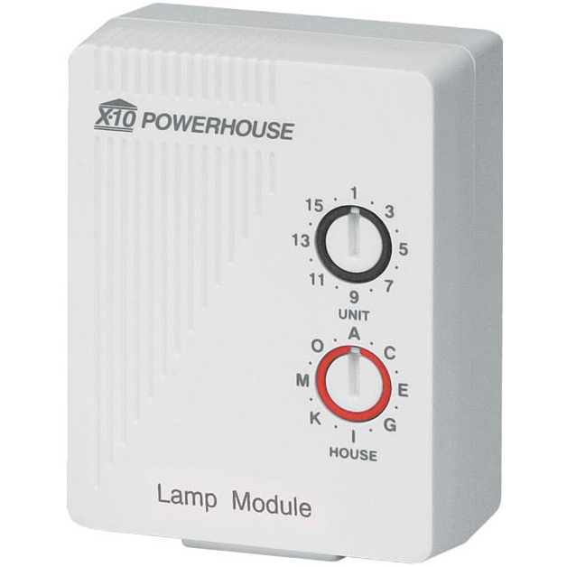
What is X10?
X10 is a communication protocol for electronic devices used for home automation.
it uses power line wiring for signaling and control
short radio frequency bursts hold the digital information

Slide 3
Power line carrier control
the digital data is send on the electrical wiring of the household devices and light wiring
the data is encoded on a 120 kHz carrier frequency, transmitted as short bursts
data consists of an address and a command
data is sent from controller to the device
advanced devices can receive/request with a more advanced status
status may be: on/off, dimming level, temperature or other sensing reading.
up to like 3 rooms
if two X10 signals are transmitted at the same → collision
better devices can avoid those collisions

Slide 4
Protocol
The transmitted X10 packages consists:
4bit house code followed by 1-4bit unit codes followed by 4bit command
for more convenient system configuration:
house code is selected as a letter from A - P
unit code is a number from 1 - 16
each device is configured to respond to one of the 256 possible addressed (16 x 16)
the device reacts to commands specifically addressed to it, or to a broadcast
transmitted message example:
"select A3" followed by "turn on", which means:
unit "A3" should turn on its device
One-way devices: only receive commands and do not ACK their status
Two-way devices: ACK their status to the network. More expensive

Slide 5
Hardware support: 1- Device Modules
Depending on the load that is to be controlled, different modules must be used.
Incandescent lamp : Triac-based lamp module or wall switch
Fluorescent lamps: appliance module
High – intensity discharge lamps: appliance module
switch modules offer a feature called local dimming. on/off control with no possibility of locally dimming the controlled lamp. However, appliance module is an automatic mode. For instance, if the module is switched off, operating the power switch on the lamp or appliance will cause the module to turn on
There are sensor modules that sense and report temperature, light, infra-red, motion, or contact openings and closures. Device modules include thermostats, audible alarms and controllers for low voltage switches.

Slide 6
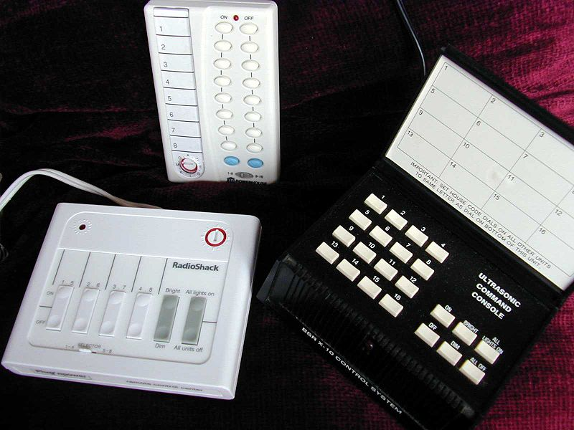
2- Controllers:
X10 controllers range from extremely simple to very sophisticated.
The simplest controllers are:
Unit 1 on/off
Unit 2 on/off
Unit 3 on/off
Unit 4 on/off
Brighten/dim (last selected unit)
All lights on/all units off

Slide 7
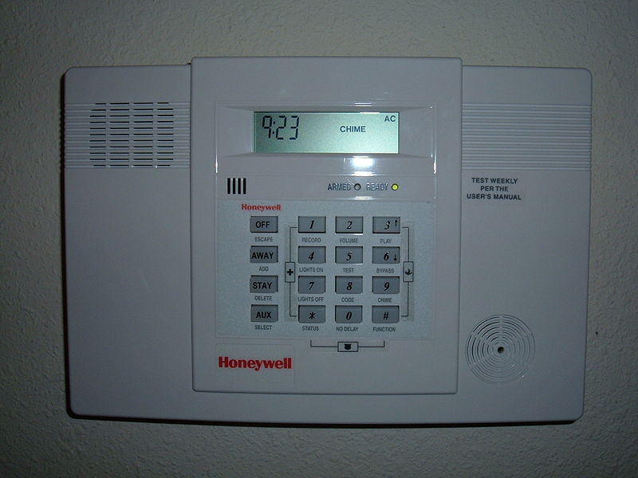
Wireless home alarm system control panel

Slide 8
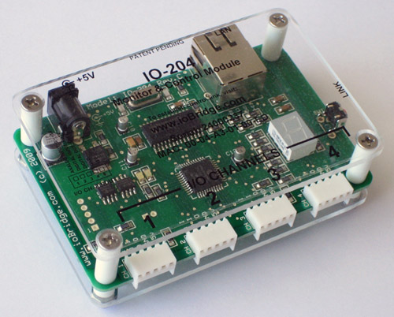
3- Bridges:
ioBridge can be used to translate the X10 protocol to a web service API via the X10 PSC04 Powerline Interface Module.
The magDomus home controller from magnocomp allows interconnection and inter-operation between most home automation technologies.

