Slide 1

Design & Analysis of Algorithms
Dr. Alakesh Kalita
Mathematics and Computing
IIT ISM Dhanbad

Slide 2
Introduction to Data Structures
&
Algorithms

Slide 3
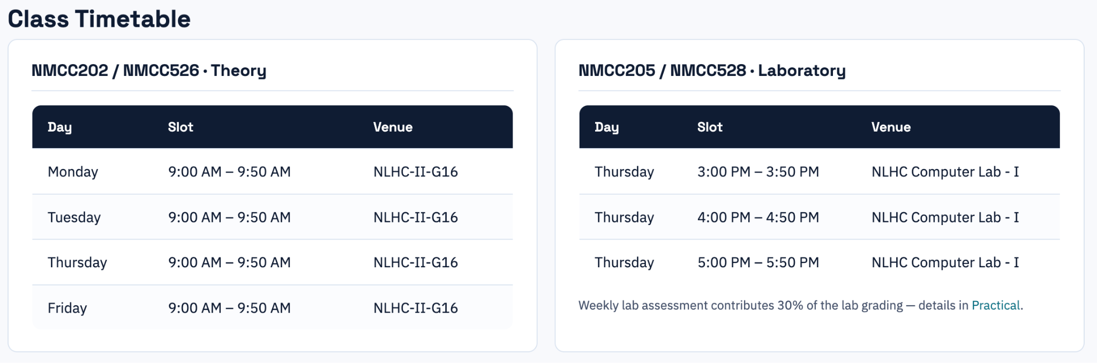
Design and Analysis of Algorithms
Theory: 3; Tutorial: 1

Slide 4
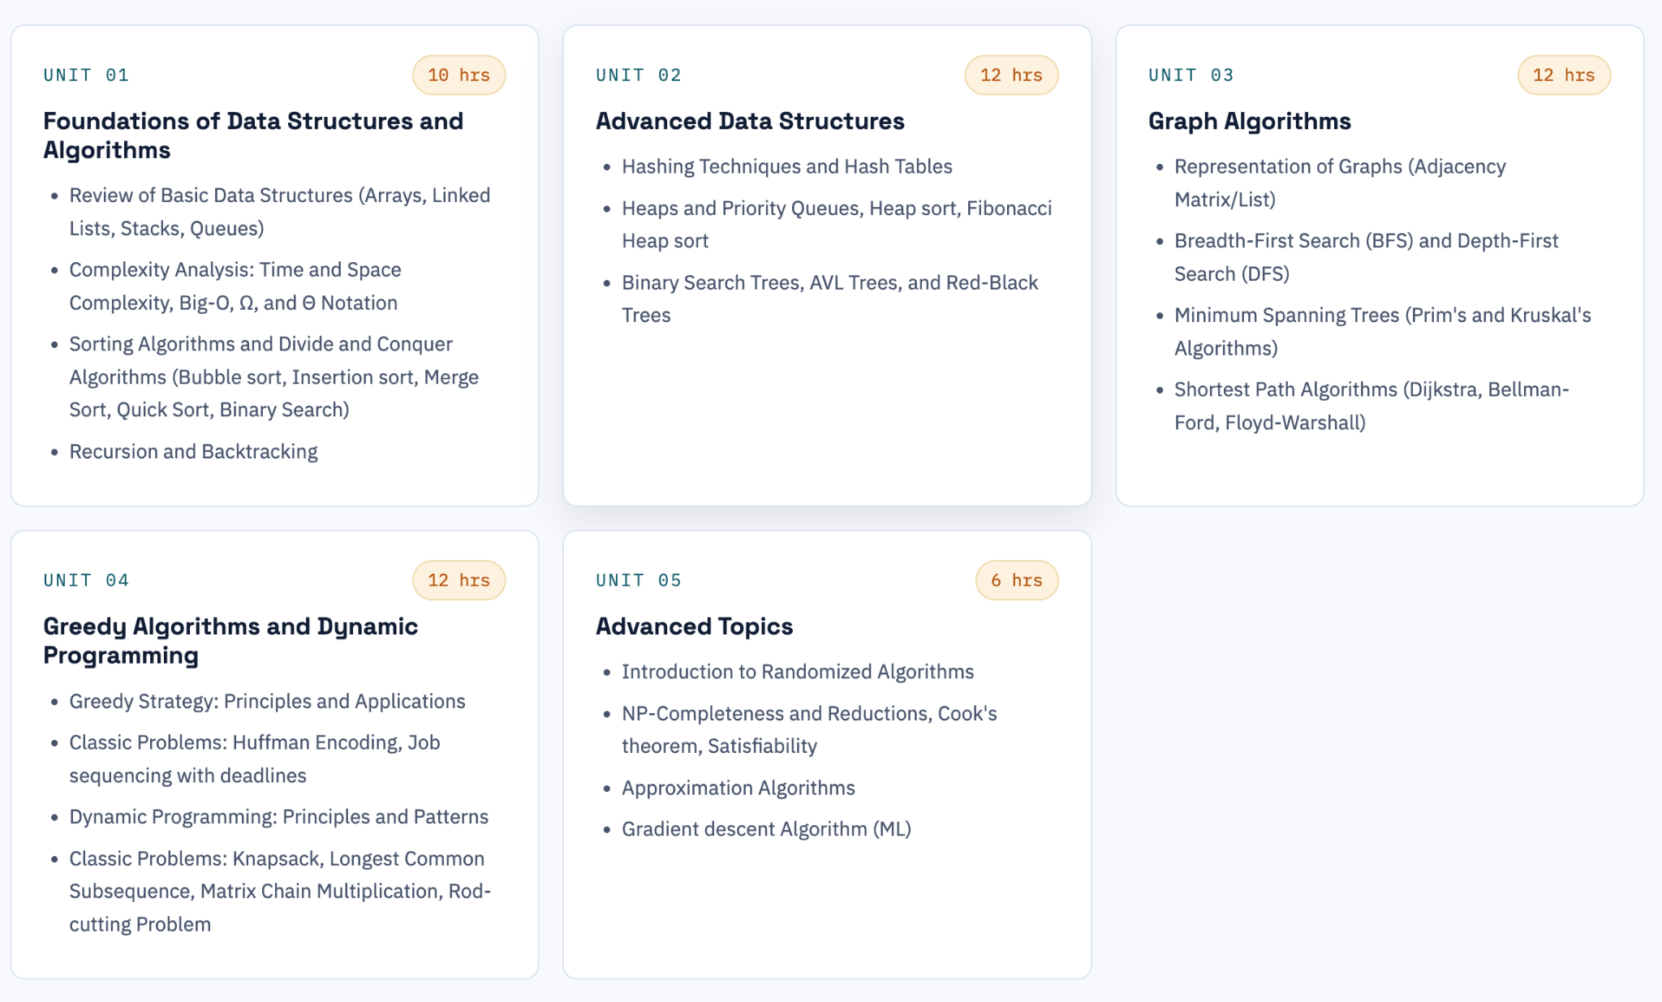
Syllabus
Text Book
T. H. Cormen, C. E. Leiserson, R. L. Rivest, C. Stein: Introduction to algorithms, PHI, 3rd
Edition, 2010

Slide 5

Assessment Structure:
Quizzes: 20% (Class Participation)
Mid-term Exam: 30%
Final Exam: 50%
Tuesday: Tutorial (9 - 9.30 AM)
Tutorial topic will be announced on Soon !!!

Slide 6

Lab Assessment Structure:
Every week assessment (30% final grading)
Every Tuesday, at most 10 Lab questions will be given
At most 3 questions need to be solved
Without any external help

Slide 7
Any Question?
Let’s begin …

Slide 8
Data and Information
What is data?
Any fact that can be recorded or stored. Ex: number, image, video, audio
What is information?
Processed data or add meaning to the data. Ex: 5 years

Slide 9
Information
Information
Field
Record
File
Single element of information: Eg. Age
Collection of records: Eg. All the employees of a company
Collection of field values: Eg. An employee of a company (name, age, dept.)

Slide 10
Data Structure
File can be very large in size
Data Structure
Need to perform various operations on files
Insertion
Deletion
Updation
Searching
Viewing (Traversing)
Finding the employee with the maximum salary
Many more
Efficiently
Organized the data in our computer memory

Slide 11
Data Structure
Data Structure: refers to the way of organizing and storing data in computer memory following some logical or mathematical models.
Data Structures
Sequential
Non-Sequential
Hierarchical
Graphical
Graphs
Array
Linked lists
Tree, Heaps

Slide 12
Importance of DS
Operation | Insert | Search | Find Min | Delete Min
Unsorted Array | O(1) | O(n) | O(n) | O(n)
Sorted Array | O(n) | O(log n) | O(1) | O(n)
Linked List | O(1) | O(n) | O(n) | O(n)
Min Heap | O(log n) | O(n) | O(1) | O(log n)

Slide 13
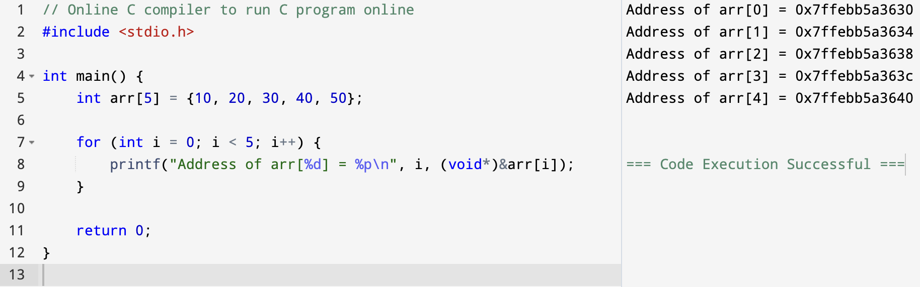
Arrays
It is the simplest linear data structure,
Stored in contiguous block of memory,
Same data type and,
Random access
Example:
int arr[5] = {10, 20, 30, 40, 50};

Slide 14
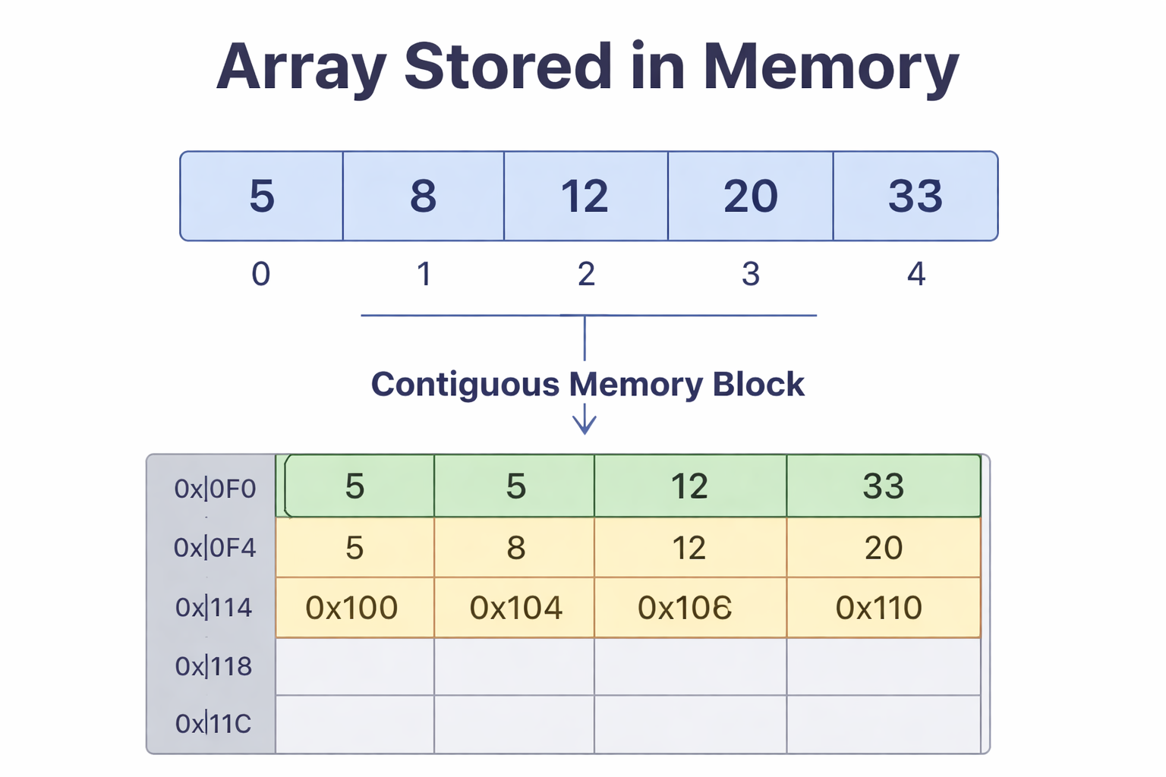
Arrays: indexing (offset or position)
int arr[5] = {10, 20, 30, 40, 50};
0-Based Indexing: Indices start from 0 (most common in programming languages).
10
20
30
40
50
0
1
2
3
4
2. 1-Based Indexing: Indices start from 1. (only in theories)
10
20
30
40
50
1
2
3
4
5

Slide 15
Arrays: Operations
Traversal: Iterating through elements.
for (int i = 0; i < n; i++) {
printf("%d ", A[i]);
}
Insertion: Adding an element at a specific index.
A [index] = 5
Deletion: Removing an element at a specific index (requires shifting).
for (int i = index; i < n - 1; i++) {
A[i] = A[i + 1];
} n--;
Search: Finding an element (Linear or Binary Search).
Update: Modifying an element.

Slide 16
Arrays: indexing
Strengths:
Fast access to elements via index.
Easy to implement and use.
Limitations:
Fixed size; resizing requires creating a new array.
Costly insertions and deletions (due to shifting).

Slide 17
Arrays: Addressing
0-Based Indexing: Indices start from 0 (most common in programming languages).
10
20
30
40
50
0
1
2
3
4
Address of the element at the index: i = Base_address + data_size * i
2. 1-Based Indexing: Indices start from 1. (only in theories)
10
20
30
40
50
1
2
3
4
5
Address of the element at the index: i = Base_address + data_size *(i -1)

Slide 18
2 Dimensional (2D) Arrays
A 2D array is an array of arrays, representing data in rows and columns (matrix format).
Elements are accessed using two indices:
Row index
Column index
Ex: A[i][j]
int arr[3][4] = {
{1, 2, 3, 4},
{5, 6, 7, 8},
{9, 10, 11, 12}
};

Slide 19
2D Arrays: Memory Representation
int arr[3][4] = {
{1, 2, 3, 4},
{5, 6, 7, 8},
{9, 10, 11, 12}
};
00, 01, 02, 03
10, 11, 12, 13
20, 21, 22, 23
3 x 4
Row-major order: Elements of a row are stored sequentially. [1, 2, 3, 4, 5, 6, 7, 8, 9, 10, 11, 12]
Column-major order: Elements of a column are stored sequentially. [1, 5, 9, 2, 6, 10, 3, 7, 11, 4, 8, 12]

Slide 20
2D Arrays: 0 addressing
int arr[3][4] = {
{1, 2, 3, 4},
{5, 6, 7, 8},
{9, 10, 11, 12}
};
00, 01, 02, 03
10, 11, 12, 13
20, 21, 22, 23
3 x 4
arr[i=2][j=2] = Base_address + ((i * 4) + j)*size (in row major order)
Address = Base Address + ((i * Number of Columns) + j) × Size of Data Type
Address = Base Address + ((j × Number of Rows) + i ) × Size of Data Type (in column major order)

Slide 21
Question
An character array A [1…10] [1…15] stored in the computer memory following the row major order. The base address of the array is 100. What is the address of the element A[i][j]?
Ans: 15i + j + 84

Slide 22
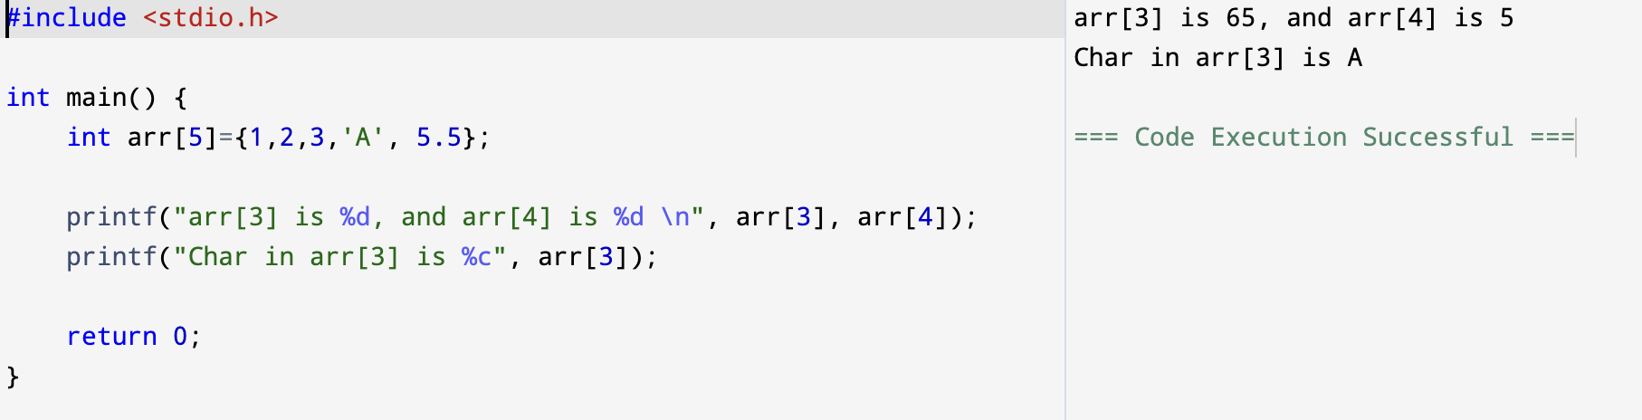
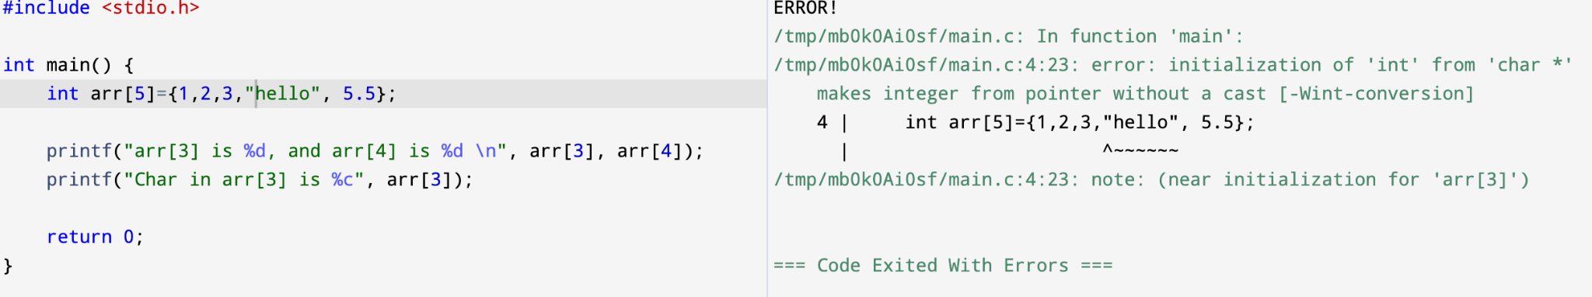
Observations

