Slide 1

Design & Analysis of Algorithms
Dr. Alakesh Kalita
Mathematics and Computing
IIT ISM Dhanbad

Slide 2
Greedy Algorithms
A greedy algorithm always makes the choice that looks best at the moment.

Slide 3
Introduction to Greedy Algorithm
Greedy Algorithms
Many
Solutions
Solve
Impose constraints
Optimization Problems
Feasible
Solutions
Find
Maximize
Profit
Reliability
Trust
Efficiency
Minimize
Cost
Risk
Latency
Optimal
Solutions

Slide 4
Introduction to Greedy Algorithm
A greedy algorithm builds a solution step by step, always choosing the locally optimal choice hoping it leads to the global optimum.
  Local optimal choice leads to a global solution
Used in problems where optimal substructure and greedy choice property hold.
  Optimal Substructure: An optimal solution to a problem contains optimal solutions to subproblems
Often leads to efficient solutions.

Slide 5
Steps to Design a Greedy Algorithm
Choose a greedy strategy (sorting, selection criteria, etc.).
Iterate through elements (input). Works in stages
Check feasibility of the selected solution.
  If an optimal feasible input, add to the solution set
  Step 2
Obtain the final solution.
Algorithm Greedy (input (A[]), size of input (n))
{
for i in range n:
if A[i] is feasible:
Solution += solution(A[i])
}

Slide 6
Fractional Knapsack Problem

Slide 7
Knapsack Problem -1
Maximum bag (knapsack) capacity, m = 20
Number of items, n = 3
Input
Given n items with weights and values.
A knapsack can hold weight W.
Goal
Maximize total profit by selecting items optimally.
 | Item 1 | Item 2 | Item 3
Profit | 25 | 24 | 15
Weight | 18 | 15 | 10

Slide 8
Knapsack Problem -1
Maximum bag (knapsack) capacity, m = 20
Number of items, n = 3
Greedy about Profit
2
2
 | Item 1 | Item 2 | Item 3
Profit | 25 | 24 | 15
Weight | 18 | 15 | 10
20
18
Earned Profit = 25 + (24/15)*2 = 28.2
Earned Profit = 25

Slide 9
What will the profit be if we prioritize selecting a larger number of items (choosing items with less weight first)?
Greedy about more items
Ans: 31

Slide 10
Knapsack Problem -1
Greedy about Profit/Weight
Maximum bag (knapsack) capacity, m = 20
Number of items, n = 3
5
5
15
20
 | Item 1 | Item 2 | Item 3
Profit | 25 | 24 | 15
Weight | 18 | 15 | 10
P/W | 1.4 | 1.6 | 1.5
Earned Profit = 24
Earned Profit = 24 + (15/10)*5 = 31.5

Slide 11
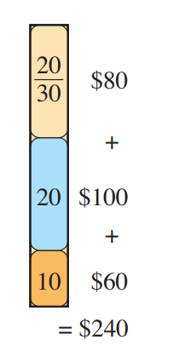
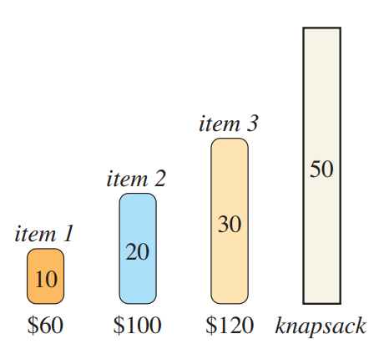
Knapsack Problem -2

Slide 12
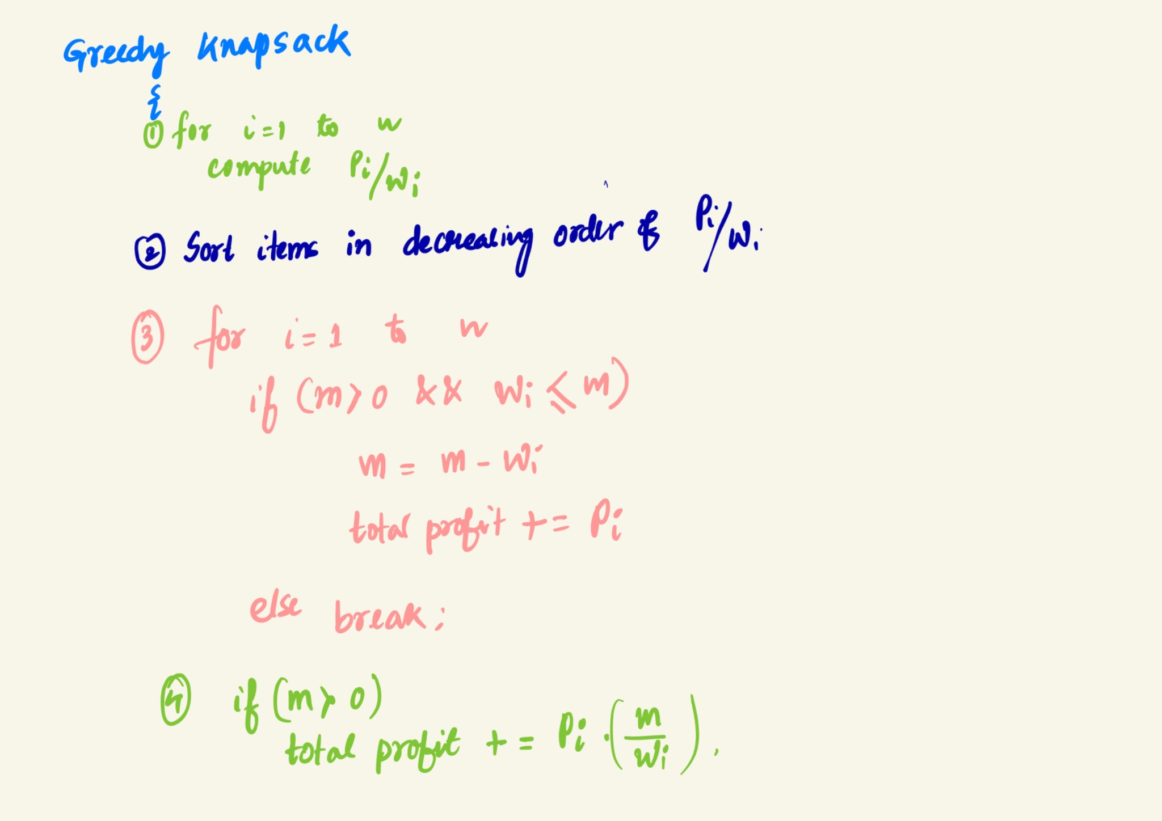
Knapsack Algorithm

Slide 13

Huffman Coding

Slide 14
Huffman Coding
Huffman coding is a greedy algorithm used for data compression.
  saves around 20% to 90% data, depending on the characteristics of the data being compressed.
It assigns variable-length codes to characters based on frequency.
More frequent characters get shorter codes, minimizing overall storage.

Slide 15
Given Characters and Frequencies
5 characters with given frequencies:
A | E | I | O | U
5 | 7 | 3 | 6 | 4
Total characters = 25

Slide 16
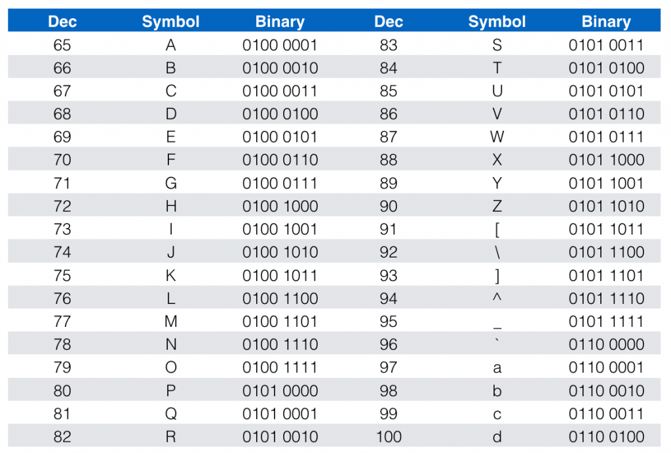
Given Characters and Frequencies
In general, ASCII (American Standard Code for Information Interchange) are used to encode characters
Each ASCII code is 8-bits long
Char | Freq. | ASCII | Total bits
A | 5 | 01100001 | 5*8= 40
E | 7 | 01100101 | 56
I | 3 | 01001001 | 24
O | 6 | 01001111 | 48
U | 4 | 01010101 | 32
Total |  |  | 200

Slide 17
Given Characters and Frequencies
Char | Freq. | ASCII | Total bits
A | 5 | 01100001 | 5*8= 40
E | 7 | 01100101 | 56
I | 3 | 01001001 | 24
O | 6 | 01001111 | 48
U | 4 | 01010101 | 32
Total |  |  | 200
Can we reduce the total bits?

Slide 18
Given Characters and Frequencies
ASCII Encoding:
Fixed 3-bit Encoding:
5 characters need log₂(5) = 3 bits.
Mapping Table
Char | Freq. | ASCII
A | 5 | 01100001
E | 7 | 01100101
I | 3 | 01001001
O | 6 | 01001111
U | 4 | 01010101
Total |  | 200
Char | Freq. | Fixed
A | 5 | 000
E | 7 | 001
I | 3 | 010
O | 6 | 011
U | 4 | 100
Total |  | 75
A | 01100001 | 000
E | 01100101 | 001
I | 01001001 | 010
O | 01001111 | 011
U | 01010101 | 100
Total | 40 | 15
Can we still reduce the total bits?
Total = 75 + 40 + 15 = 130 bits

Slide 19
Huffman coding
0
25
Steps
Merge two least frequent characters
1
14
1
2) Repeat till the tree gets constructed
0
3) Add 0 to the left edges
7
11
0
1
0
1
4) Add 1 to the right edges
E | I | U | A | O
7 | 3 | 4 | 5 | 6
5) Traverse from root to the leaf to get the code
00 | 010 | 011 | 10 | 11
Huffman codes

Slide 20
Huffman coding
0
25
1
Char | Freq. | Huffman | Total bits
A | 5 | 10 | 10
E | 7 | 00 | 14
I | 3 | 010 | 9
O | 6 | 11 | 12
U | 4 | 011 | 12
Total |  |  | 57
14
1
0
7
11
0
1
0
1
E | I | U | A | O
7 | 3 | 4 | 5 | 6
Mapping Table ???
00 | 010 | 011 | 10 | 11

Slide 21
Huffman coding
Mapping Table
Char | Freq. | Huffman | Total bits
A | 5 | 10 | 10
E | 7 | 00 | 14
I | 3 | 010 | 9
O | 6 | 10 | 12
U | 4 | 011 | 12
Total |  |  | 57
A | 01100001 | 10
E | 01100101 | 00
I | 01001001 | 010
O | 01001111 | 11
U | 01010101 | 011
Total | 40 | 12
Total Huffman bits= 57 + 40 + 12 = 109 bits

Slide 22
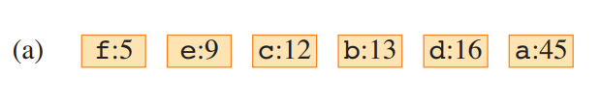
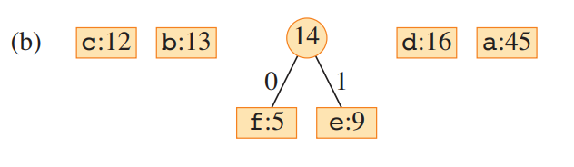
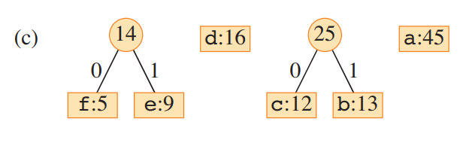
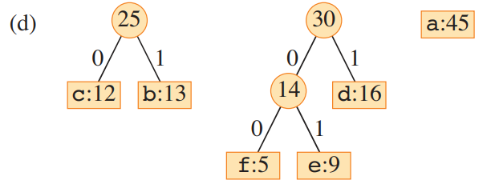
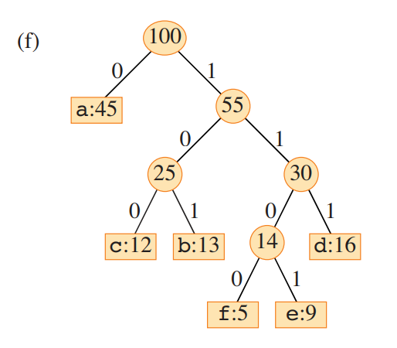
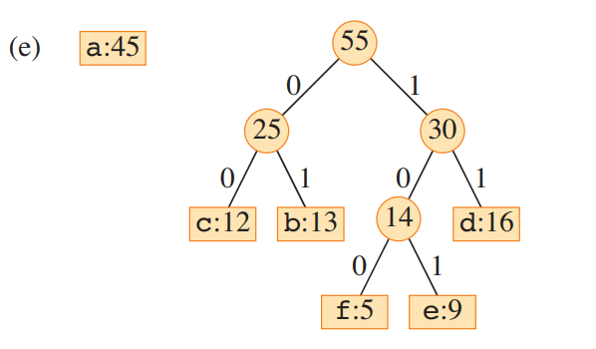

Slide 23
Building a Tree: Priority Queue
Create binary tree nodes with character and frequency of each character
Place nodes in a priority queue (min-heap w.r.t freq)
  The lower the occurrence, the higher the priority in the queue
priority queue
I : 3
U : 4
A : 5
O : 6
E : 7

Slide 24
Building a Tree: Priority Queue
While priority queue (Q) contains two or more nodes
Q
  Create new node, z
I : 3
U : 4
A : 5
O : 6
E : 7
IU : 7
  X = Extract_Min()
  Y = Extract_Min()
  Z.left = X
  Z.right = Y
Z
7
  Z.freq = X.freq + Y.freq
  Insert(Q, z)
X =
I : 3
Y =
U : 4

Slide 25
Building a Tree: Priority Queue
While priority queue (Q) contains two or more nodes
Q
  Create new node, z
A : 5
O : 6
E : 7
IU : 7
AO : 11
  X = Extract_Min()
  Y = Extract_Min()
  Z.left = X
  Z.right = Y
Z
11
  Z.freq = X.freq + Y.freq
  Insert(Q, z)
X =
A : 5
Y =
O : 6

Slide 26
Building a Tree: Priority Queue
While priority queue (Q) contains two or more nodes
Q
  Create new node, z
E : 7
IU : 7
AO : 11
EIU : 14
  X = Extract_Min()
  Y = Extract_Min()
  Z.left = X
  Z.right = Y
Z
14
  Z.freq = X.freq + Y.freq
  Insert(Q, z)
X =
E : 7
Y =
IU : 7

Slide 27
Building a Tree: Priority Queue
While priority queue (Q) contains two or more nodes
Q
  Create new node, z
AO : 11
EIU : 14
AOEIU : 25
  X = Extract_Min()
  Y = Extract_Min()
  Z.left = X
  Z.right = Y
Z
25
  Z.freq = X.freq + Y.freq
  Insert(Q, z)
X =
AO : 11
Y =
EIU : 14

Slide 28
Building a Tree: Priority Queue
Q
I : 3
U : 4
A : 5
O : 6
E : 7
IU
I : 3
U : 4

Slide 29
Building a Tree: Priority Queue
Q
Z
E : 7
7
Z
11
I : 3
Y =
U : 4
A : 5
O : 6

Slide 30
Building a Tree: Priority Queue
Q
Z
AO : 11
14
E : 7
IU
I : 3
U : 4

Slide 31
Building a Tree: Priority Queue
Q
25
Z
14
11
A : 5
O : 6
E : 7
IU
I : 3
U : 4

Slide 32
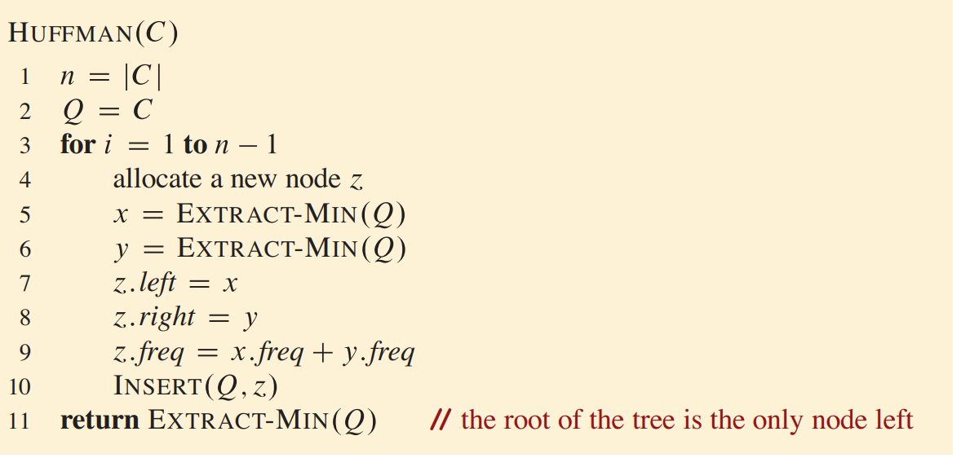

Slide 33
Resulting tree
100
Symbol frequencies
0
1
Symbol
Frequency
F(45)
55
A
5
0
1
B
9
25
30
C
12
D
13
0
1
0
1
E
16
C(12)
D(13)
14
E(16)
F
45
0
1
A(5)
B(9)

Slide 34
Mapping table
Encode the message
F
0
FACE
Replace each symbol by its Huffman code
C
100
F
A
C
E
D
101
0
1100
100
111
A
1100
B
1101
Concatenate the codes — no separator is required
E
111
FACE →
01100100111

Slide 35
F
0
A
1100
C
100
B
1101
D
101
E
111
Received bitstream
01100100111
0
0 is a valid code
F
1100
1 → 11 → 110: no match; 1100 matches
A
100
1 → 10: no match; 100 matches
C
111
1 → 11: no match; 111 matches
E
Therefore:
0 | 1100 | 100 | 111
→
FACE

Slide 36
Prefix-free property
Decoder rule
No valid Huffman code is the prefix of another valid code.
1
Start at the first unread bit.
Example:
2
Keep appending bits.
F = 0
C = 100
D = 101
A = 1100
B = 1101
E = 111
Because 0 already means F, no other valid code begins with 0.
3
When the sequence matches a mapping-table code, output that symbol.
4
Continue with the next unread bit.
01100100111 → FACE

Slide 37
Job sequencing with deadline
What is Job Sequencing?
Given n jobs, each job has:
  Deadline: The latest time by which it should be completed
  Profit: The reward for completing the job before or on the deadline
The goal is to maximize total profit by scheduling jobs optimally.
Example Applications:
Task scheduling in operating systems
Project management
Manufacturing processes
Jobs | J1 | J2 | J3 | J4 | J5
Profit | 20 | 18 | 15 | 15 | 14
Deadline | 3 | 1 | 3 | 2 | 3
Each job takes one unit of time to finish.

Slide 38
Job sequencing with deadline
Brute Force
Try all possible permutations of jobs.
Time Complexity: O(n!)
  (Exponential, impractical for large n).
Jobs | J1 | J2 | J3 | J4 | J5
Profit | 20 | 18 | 15 | 15 | 14
Deadline | 3 | 1 | 3 | 2 | 3
Each job takes one unit of time to finish.

Slide 39
Job sequencing with deadline
Jobs | J1 | J2 | J3 | J4 | J5
Profit | 20 | 18 | 15 | 15 | 14
Deadline | 3 | 1 | 3 | 2 | 3
J1
J4
J3
If the highest deadline is k and each job takes one unit of time, we can schedule at most k jobs.
0 - 1
1 - 2
2 - 3
Total Profit = 20 + 15 + 15 = 50
Can we increase the profit further?

Slide 40
Job sequencing with deadline
Jobs | J1 | J2 | J3 | J4 | J5
Profit | 20 | 18 | 15 | 15 | 14
Deadline | 3 | 1 | 3 | 2 | 3
J3
J2
J1
0 - 1
1 - 2
2 - 3
Total Profit = 15 + 18 + 20 = 53

Slide 41
Job sequencing with deadline
Jobs | J1 | J2 | J3 | J4 | J5
Profit | 20 | 18 | 15 | 15 | 14
Deadline | 3 | 1 | 3 | 2 | 3
Algorithm Steps:
Sort jobs in decreasing order of profit.
Iterate over jobs and place them in the latest available slot (before or on the deadline).
Total Time Complexity
Sorting: O(nlog⁡n)
Job Placement: O(n²)
Overall Complexity: O(n log⁡n)+O(n²) = O(n²)
J2
J3
J1
0 - 1
1 - 2
2 - 3

Slide 42
Exercise
Jobs | C | E | D | B | A
Profit | 27 | 15 | 25 | 19 | 100
Deadline | 1 | 3 | 1 | 1 | 2
C
A
E
0 - 1
1 - 2
2 - 3
Total Profit = 27 + 100 + 15 = 142

Slide 43
Optimal Merge Pattern

Slide 44
Merge operation
A
1
3
5
6
B
2
4
8
9
i
i
i
j
j
j
if B[j] > A[i]:
C[m] = A[i]
m++
i++
if A[i] > B[j]:
C[m] = B[j]
m++
j++
Merging: O(n+m)
C
1
2
3
4
5
6
8
9
m
m
m
m

Slide 45
Problem Statement
File | A | B | C | D
Sizes | 30 | 20 | 10 | 5
Given n sorted files with sizes S₁,S₂,...,S_{n}​, merge them in pairs to minimize the total merging cost.
Cost of merging two files = Sum of their sizes.
The goal is to find the optimal order (pattern) of merging that minimizes the total cost
ABCD:65
ABC:60
Cost of merging = 50 + 60 + 65 = 175
AB:50
Can we reduce the merging cost further?
A: 30
B: 20
C: 10
D: 5

Slide 46
Problem Statement
File | A | B | C | D
Sizes | 30 | 20 | 10 | 5
ABCD:65
ABCD:65
BCD:35
AB:50
CD:15
CD:15
A: 30
B: 20
C: 10
D: 5
A: 30
B: 20
C: 10
D: 5
Cost of merging = 50 + 15 + 65 = 130
Cost of merging = 15 + 35 + 65 = 115
(Optimal)

Slide 47
Greedy Algorithm Approach
Key Idea: Always merge the two smallest files first.
Steps:
  Insert all file sizes into a Min Heap (Priority Queue).
  Repeat until one file remains:
    Extract two smallest files.
    Merge them (add their sizes).
    Insert the merged file back into the heap.
  Total cost = sum of all merging operations.
O(n)
O(n)
O(log n)
O(1)
O(log n)
Final Time Complexity:
O(n) + O(n log n)

Slide 48
Greedy Algorithm Approach
If file sizes are different, the order of merging matters, and the optimal merge pattern (min-heap approach) is efficient
If file sizes are equal, any merging order results in the same total cost and does not require optimization.

Slide 49
Real-World Applications
Huffman Coding (used in data compression)
External Sorting (for large datasets in databases)
Data Merge Operations (log file merging, distributed computing)

Slide 50
Homework
If the total file size we need to merge is n, and there are a total of 4 subfiles, what would be the worst-case merging time in terms of n?

