Slide 1

Design & Analysis of Algorithms
Dr. Alakesh Kalita
Mathematics and Computing
IIT ISM Dhanbad

Slide 2
Asymptotic Notations

Slide 3
Asymptotic Notation
What is Asymptotic Notation?
In Mathematics, it describes the growth rate of a function.
f(n) = 2n + 3
How the f(n) is growing w.r.t the value of n
The term 2𝑛 dominates the growth; constant 3 becomes negligible when n is very large.
Asymptotic notation is used in computer science to describe the running time or space requirements of an algorithm in terms of input size n, as the size n approaches infinity.

Slide 4
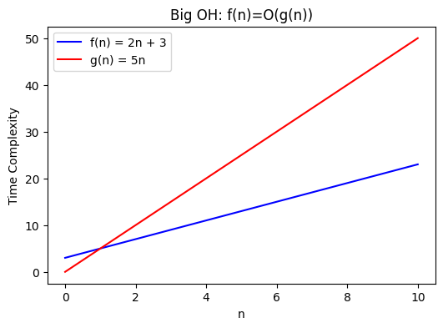
Big O notation
Suppose, there are two functions as follows:
f(n) = 2n + 1
g(n) = 3n
Big O: The function f(n)= O(g(n)) (pronounced, f of n is Big-O of g of n.) iff for some +ve constants C and n_{0,} such that
f(n) ≤ C. g(n) ∀ n ≥ n_{o}
f(n) will not grow faster than g(n),
g(n) is the upper bound of f(n)
g(n) should be closest to f(n), i.e., usually g(n) = n^{c} is not considered where c ≥ 2

Slide 5
Big O notation
f(n) = 2n² + 3 g(n) = 500n
Can we write f(n)= O(g(n)) ?
Let n = 1000
f(n) = 2,000,003
g(n) = 500,000
Here, f(n) > g(n), which means f(n) is not O(g(n)).

Slide 6
Big O notation
Show that n³ - 100n² does not belong to O(n²)
Suppose: n³ - 100n² = O(n²)
⇒ n³ - 100n² ≤ C·n² for some constant C and sufficiently large n
Divide both sides by n²
⇒ n - 100 ≤ C
⇒ n > C + 100
Regardless of what value we choose for constant C, this inequality does not hold for any value of n > C + 100.
Therefore, n³ - 100n² ∉ O(n²)

Slide 7
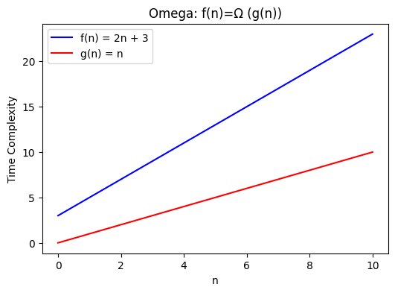
Omega (𝝮) notation
Omega: The function f(n) = 𝝮(g(n)), iff for some +ve constant C and n₀ , such that
f(n) ≥ C . g(n) ; ∀ n ≥ n₀
𝝮-notation characterizes a lower bound on the asymptotic behavior of a function.
g(n) is the lower bound of f(n)
g(n) should be closest to f(n)

Slide 8
Omega notation
f(n) = log n g(n) = n
Can we write f(n)= 𝝮(g(n)) ?
f(n) ≠ Ω(n)

Slide 9
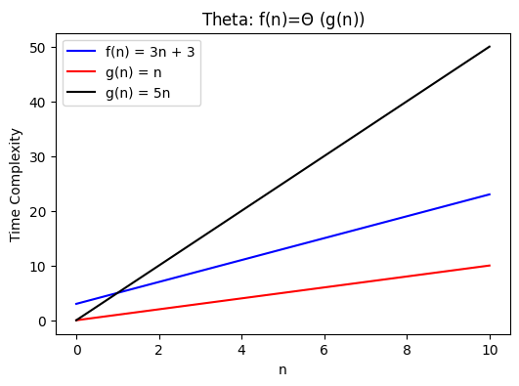
Theta (𝚹) notation
Theta: The function f(n) = 𝚹(g(n)), iff for some +ve constant C₁, C₂, and, n₀ ,such that
C₁ . g(n) ≤ f(n) ≤ C₂ . g(n) ; ∀ n ≥ n₀
𝚹-notation characterizes a tightly bound on the asymptotic behavior of a function.

Slide 10
Precise notation
if a function f(n), is both O(g(n)) and 𝝮(g(n)) for some function g(n), then f(n) is also 𝚹(g(n)).
E.g. 7n³ + 100n² - 20n + 6 is both O(n³) and 𝝮(n³), it is also 𝚹(n³)
Finding the largest/smallest element in an array, time complexities are
Upper bound: O(n)
Lower bound: 𝝮(n), so we can write
Running time of the above problem is 𝚹(n)

Slide 11
Precise notation
Is this statement true? Insertion sort running time: Θ(n²)
Is this statement true? Insertion sort worst-case running time: Θ(n²)
Incorrect to say Θ(n²) for all cases because:
Best-case running time is O(n)
Θ(n²) covers all cases, which is not correct
Is this statement true? Insertion sort running time: Ω(n)

Slide 12
Notes
Suppose a random algorithm has running time: 3n² + 20n in all cases, then running time of the algorithm is?
The running time is: Θ(n²)
Technically, we can also say:
O(n³) → Less precise
Θ(3n² + 20n) → Unnecessarily complex
Sometimes, we can write:
2n² + 3n + 1 as: 2n² + O(n),
where O(n) denotes as anonymous function

Slide 13
Exercise
“The running time of algorithm A is at least O(n²)”
Is this statement asymptotically correct ?

Slide 14
Exercise
Is 2^{n+1} = O (2^{n})? Is 2^{2n} = O (2^{n})?
(n+k)^{m} = O (?), if n > k

Slide 15
Small o-notation
Small o-notation: The function f(n)= o(g(n)) (pronounced, f of n is small-o of g of n.) iff there is a positive constant C such that
f(n) < C. g(n) ∀ n ≥ n_{o} and C > 0
o(g(n)) asymptotically tighter than O(g(n)).
For example, 2n = o (n²), but 2 n² ≠ o(n²).
Same for ω(g(n)) and 𝝮 (g(n)), ω(g(n)) is tighter.

Slide 16
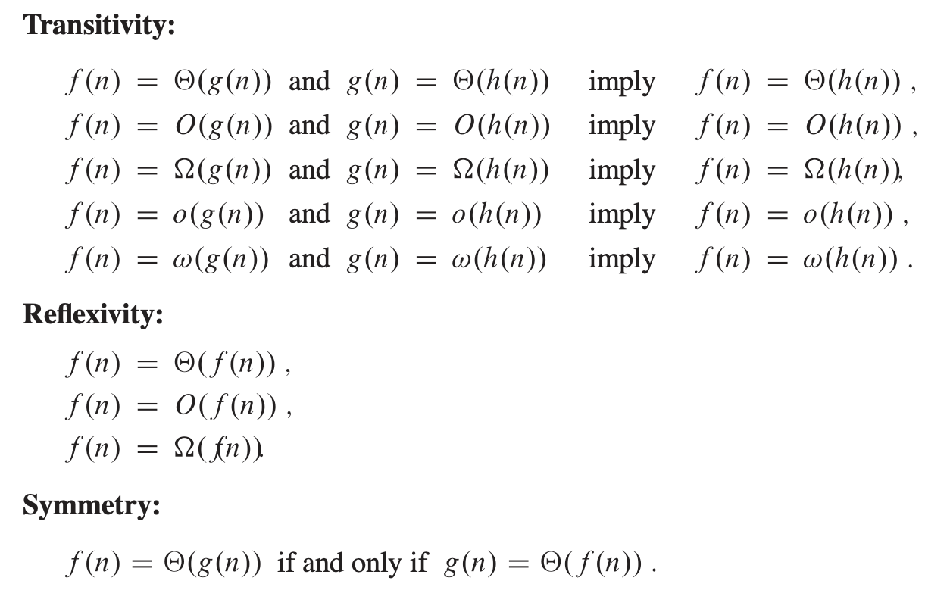
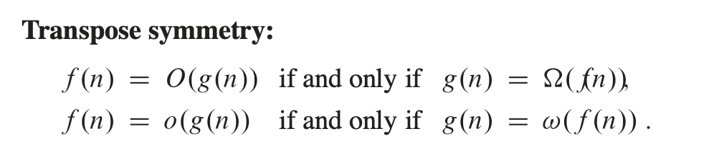
Properties of asymptotic notations

Slide 17
Exercise: Find the asymptotic relations
f(n) = n²⁰ log n g(n) = n log n¹⁰
f(n) = 3 n^{√n} g(n) = 2^{√n log n}
f(n) = n ^{logn} g(n) = 2^{√n}
Can we write worst/general case running time of binary search is 𝚹(logn) ?

Slide 18
Exercise: Find the asymptotic relations
Q. Suppose that for inputs of size n on a particular computer, insertion sort runs in 8n² steps and merge sort runs in 64 n lg⁡ n steps. For which values of n does insertion sort beat merge sort?
Q. What is the smallest value of n such that an algorithm whose running time is 100n² runs faster than an algorithm whose running time is 2^{n} on the same machine?
Q. Determine the worst-case running time of the insertion sort algorithm in small‑o notation.
O (n^{k}), k > 2

