Slide 1

Design & Analysis of Algorithms
Dr. Alakesh Kalita
Mathematics and Computing
IIT ISM Dhanbad

Slide 2
Basics of Algorithms

Slide 3
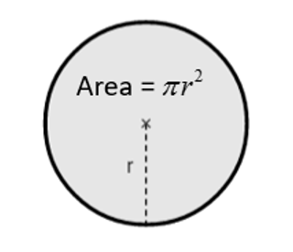

Algorithm: definition
Definition (Algorithm): An algorithm is a finite sequence of instructions, typically used to solve a computation task or transform the I/P to O/P
Example: Compute the area of a circle with radius 10 using a calculator.
Type 𝟏𝟎,
Type multiply key,
Type 𝟏𝟎,
Press equal/enter key,
Type multiply key,
Type 𝜋,
Press equal key again,
Display output
import math
# Define the radius of the circle
radius = 10
# Calculate the area of the circle
area = math.pi * radius**2
# Print the result
print("The area of the circle with radius", radius, "is:", area)
Algorithm
Python Code

Slide 4
Introduction to Algorithm
Before solving a problem, we write down a possible solution on piece of paper in our native language.
We call it Algorithm.
Algorithm | Program
For human being | For Computer
Native Language | Programming language, syntax and rules must be followed
Piece of Paper and Pen | Programming Environment / Hardware
Independent of any specific programming language | Dependent on Programming environment

Slide 5
The life of a programmer
Identify a problem.
Come up with an algorithm to solve it.
Represent the algorithm as a program, using a chosen programming language.
Execute the program on a computer!
Find Error : Goto step 2
No error (receive desired output)
Deliver the output
Goto Step 1 :)
source: Google Image

Slide 6
Sorting Algorithms

Slide 7
In this class, we will learn
What is sorting algorithm and its’ requirement
Bubble sort and its’ implementation
Optimised Bubble sort

Slide 8
Can you find the smallest number ?
53, 21, 38

Slide 9
Can you find the smallest number ?
89, 42, 17, 76, 8, 93, 58, 23, 66, 4, 32, 87, 50, 65, 2, 19, 88, 14, 61, 29, 95, 31, 72, 3, 40, 96, 48, 69, 37, 51, 20, 94, 70, 26, 82, 12, 97, 73, 21, 45, 83, 55, 10, 60, 35, 74, 13, 54, 7, 85, 39, 67, 15, 80, 41, 77, 25, 79, 47, 9, 75, 91, 64, 1, 86, 57, 24, 5, 38, 92, 22, 84, 46, 78, 28, 68, 6, 59, 30, 81, 43, 63, 0, 99, 33, 98, 27, 11, 56, 16, 49, 71, 90, 18, 34, 53, 62, 36, 44, 52.
Unorganized data
Sorting
Organized data
0, 1, 2, 3, 4, 5, 6, 7, 8, 9, 10, 11, 12, 13, 14, 15, 16, 17, 18, 19, 20, 21, 22, 23, 24, 25, 26, 27, 28, 29, 30, 31, 32, 33, 34, 35, 36, 37, 38, 39, 40, 41, 42, 43, 44, 45, 46, 47, 48, 49, 50, 51, 52, 53, 54, 55, 56, 57, 58, 59, 60, 61, 62, 63, 64, 65, 66, 67, 68, 69, 70, 71, 72, 73, 74, 75, 76, 77, 78, 79, 80, 81, 82, 83, 84, 85, 86, 87, 88, 89, 90, 91, 92, 93, 94, 95, 96, 97, 98, 99.

Slide 10
Application of sorting
E-commerce Websites
Sorting algorithms are utilized to arrange products in search results based on relevance, price, ratings, or popularity.
Flight Booking Systems
Sorting algorithms help to organize flight options based on factors like price, departure time, duration, or number of stops to find suitable flights
Finding the trending Youtube Videos

Slide 11
Bubble Sort
Bubble sort is one of the simplest sorting algorithm
It forms the foundation for understanding other sorting algorithms.

Slide 12
Input: 19, 18, 14, 61, 9
Bubble Sort: How it works
19, 18, 14, 61, 9
18, 14, 19, 9, 61
14, 9, 18, 19, 61
14, 18, 9, 19, 61
18, 19, 14, 61, 9
14, 18, 19, 9, 61
9, 14, 18, 19, 61
18, 19, 14, 61, 9
14, 18, 9, 19, 61
14, 18, 19, 9, 61
9, 14, 18, 19, 61
18, 14, 19, 61, 9
14, 9, 18, 19, 61
14, 18, 19, 9, 61
18, 14, 19, 61, 9
14, 9, 18, 19, 61
9,14, 18, 19, 61
14, 18, 9, 19, 61
18, 14, 19, 61, 9
14, 18, 9, 19, 61
14, 9, 18, 19, 61
9,14, 18, 19, 61
18, 14, 19, 9, 61

Slide 13
Bubble Sort: Implementation
N-1 Iterations
Outer loop: k=1 to n-1
i = 0
j = 1
Inner loop: j=1 to n-1
19, 18, 14, 61, 9
Start from the first and second elements
i = j-1
i = 0, j = 1
18, 19, 14, 61, 9
If the first element is greater than the next one, swap them
if A[i]> A[j]:
i
j
N-1 Comparison
temp =A[i]
A[i] =A[j]
A[j] =temp
18, 19, 14, 61, 9
18, 14, 19, 61, 9
Move to the next pair of adjacent elements
i +=1
j +=1
i
j
18, 14, 19, 61, 9
Do comparison and swap process
4 x 4 = 16 comparisons !!!
i=3
j=4
Repeat until the end of array
18, 14, 19, 61, 9
Repeat the above steps until the entire array is sorted.
18, 14, 19, 9, 61

Slide 14

Can we reduce the number of comparisons?

Slide 15
Optimised Bubble Sort
19, 18, 14, 61, 9
18, 14, 19, 9, 61
14, 18, 9, 19, 61
14, 9, 18, 19, 61
18, 19, 14, 61, 9
14, 18, 19, 9, 61
Outer loop: k=1 to N-1
9, 14, 18, 19, 61
Inner loop j=1 to n-1
Inner loop j=1 to n-1
18, 19, 14, 61, 9
14, 18, 9, 19, 61
i = j-1
9, 14, 18, 19, 61
14, 18, 19, 9, 61
18, 14, 19, 61, 9
14, 9, 18, 19, 61
if A[i]> A[j]:
14, 18, 19, 9, 61
temp =A[i]
A[i] =A[j]
A[j] =temp
18, 14, 19, 61, 9
14, 9, 18, 19, 61
9,14, 18, 19, 61
14, 18, 9, 19, 61
n=n-1
18, 14, 19, 61, 9
14, 18, 9, 19, 61
9,14, 18, 19, 61
18, 14, 19, 9, 61
14, 9, 18, 19, 61
Unordered
4 + 3 + 2 +1 =10 comparisons !!!

Slide 16
Input: 99, 1, 2, 3,4
Optimised Bubble Sort
Outer loop: k=1 to n-1
while (swap):
99, 1, 2, 3,4
Let’s stop when no swapping is done in the previous iteration.
1, 99, 2, 3,4
Inner loop: j=1 to n-1
swap = false
Inner loop: j=1 to n-1
if A[j-1]> A[j]:
1, 99, 2, 3,4
if A[j-1]> A[j]:
temp =A[j-1]
A[j-1] =A[j]
A[j] =temp
1, 2, 99, 3,4
temp =A[j-1]
A[j-1] =A[j]
A[j] =temp
1, 2, 99, 3,4
n =n-1
1, 2, 3, 99,4
n =n-1
swap = true
1, 2, 3, 99,4
4 + 3 + 2 +1 =10 comparisons !!!
4 + 3 =7 comparisons !!!
1, 2, 3, 4,99

Slide 17
Input: 3, 2, 1, 7, 8
3, 2, 1, 7, 8
2, 1, 3, 7, 8
swapping
2, 3, 1, 7, 8
1, 2, 3, 7, 8
2, 3, 1, 7, 8
2, 1, 3, 7, 8
2, 1, 3, 7, 8
2, 1, 3, 7, 8
Optimised Bubble Sort
m = i
Unordered
while (swap):
What if we remember the point where the last swapping is done.
swap = false
Inner loop: j=1 to m
if A[j-1]> A[j]:
temp =A[j-1]
A[j-1] =A[j]
A[j] =temp
last_swap = j
swap = true
4 + 1 =5 comparisons !!!
m= last_swap -1

Slide 18
But, a computer can do the comparison easily. In very less amount of time.
Why do we need to worry?
Can large input
size be a problem?

Slide 19
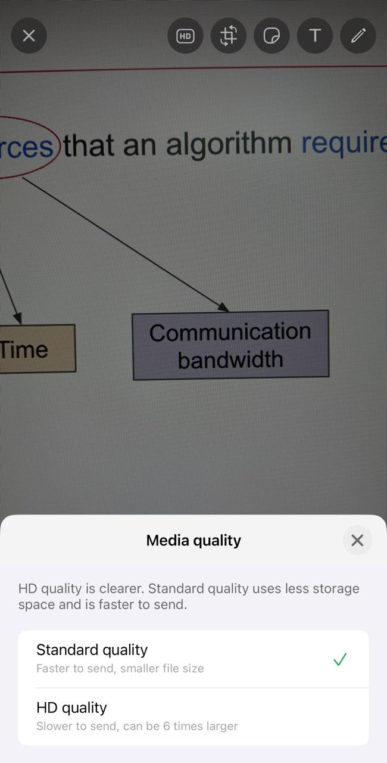
Algorithm analysis
Predicting the resources that an algorithm requires to complete a given task.
Memory
Time
Communication bandwidth
Energy
CPU Registers

Slide 20
Performance of an Algorithm
Performance of an algorithm depends on
Computing device
Input size/type
Compiler/interpreter
Libraries
Running Background processes

Slide 21
What is Time Complexity?
Definition: Time complexity is a measure of the computational time an algorithm takes to run a program as a function of the size of the input.
Categories:
Constant Time: The execution time is fixed, irrespective of input size.
Linear Time: Execution time grows linearly with input size.
Other complexities: Quadratic, Logarithmic, etc.

Slide 22
Constant Time Operation
Example: a = a + b
High-Level View: The operation involves a single assignment and addition.
Machine-Level Breakdown:
Load 'a' into register R1: MOV R1, a
Load 'b' into register R2: MOV R2, b
Perform addition: ADD R1, R2
Store result back to 'a': MOV a, R1

Slide 23
Constant Time Operation
Machine-Level Breakdown:
Load 'a' into register R1: MOV R1, a (fetch, decode, execute, or write-back)
Load 'b' into register R2: MOV R2, b
Perform addition: ADD R1, R2
Store result back to 'a': MOV a, R1
Independent of input size and type
Time Analysis:
Each instruction (MOV, ADD) takes different number of CPU cycles.
Total time = Sum of individual instruction times = Constant.

Slide 24
Examples of Constant time taking statements
int x = 10;
int y = x + 5;
int z = arr [5];
void printMessage() {
printf("Hello, World!\n"); }
int result = a & b; (bitwise operation a AND b)
return x;

Slide 25
Understanding Loops
Example: For Loop:
for (int i = 0; i < n; i++) {
sum += i;
}
Breakdown:
Initialization: int i = 0 (fixed/constant time).
Condition Check: i < n (executed n+1 times; each execution takes constant time).
Body Execution: sum += i (executed n times; each execution takes constant time).
Increment: i++ (executed n times; each execution takes constant time).

Slide 26
Understanding Loops
Breakdown:
Initialization: int i = 0 (fixed/constant time).
Condition Check: i < n (executed n+1 times).
Body Execution: sum += i (executed n times).
Increment: i++ (executed n times).
Example: For loop:
for (int i = 0; i < n; i++) {
sum += i;
}
Total Time: Initialization + (Condition Check + Increment + Body Execution).
Total = 3n + 1 =~ n

Slide 27
Understanding Loops
Example: For loop:
for (int i = n; 0 < i; i–-) {
sum += i;
}
Total Time: n

Slide 28
Understanding Nested loops
Example: Nested For loop:
for (int i = 0; i < n; i++) {
for (int j = 0; j < n; j++) {
sum += i + j;
}}
Outer loop
Inner loop
Breakdown:
Outer loop runs n times.
Inner loop runs n times for each iteration of the outer loop
sum += i + j executed n*n times
Total Time: Outer Loop x Inner Loop = n * n = n².

Slide 29
Examples on Nested loops
for (int i = 0; i < n; i++) {
for (int j = 0; j < n; j++) {
sum += i + j;
}
sum += i + j;
for (int k = 0; k < n; k++) {
sum += i + j + k;
}
}
Ans: n² + n + n² = 2n² + n =~ 2n² =~ n²

Slide 30
Examples on Nested loops
for (int i = 0; i < n; i++) {
for (int j = 0; j < n; j++) {
for (int k = 0; k < n; k++) {
sum += i + j + k;
}
}
}
Ans: n³

Slide 31
Examples on Nested loops
p = 0
for (int i = 1; p < n; i++) {
p = p + i
}
Ans: √n

Slide 32
Examples on Nested loops
for (int i = 1; i < n; i = i*2) {
p = p + i
}
Ans: log n

Slide 33
Examples on Nested loops
for (int i = n; 1 < i; i = i/2) {
p = p + i
}
Ans: log n

Slide 34
Examples on Nested loops
for (int i = 1; i * i < n; i = i+1) {
p = p + i
}
Ans: √n

Slide 35
Examples on Nested loops
for (int i = 0; i < n; i++) {
for (int j = 1; j < n; j = j*2) {
sum += i + j;
}}
Ans: n logn

Slide 36
Examples on Nested loops
for (int i = 1; i < n; i = i * 2) {
p = p + 1
}
for (int j = 1; j < p ; j = j*2) {
sum += i + j;
}
Time complexity of the second loop?
Ans: log log n

Slide 37
Examples on Nested loops
for (int i = 1; i < n; i *= 2) {
for (int j = 0; j < i; j++) {
sum += i + j;
}
}

Slide 38
Characteristics of an Algorithm
Input
Output
Definiteness (no vague statement)
Finiteness (must stop)
Effectiveness
An algorithm for a computational problem is correct if, for every problem instance provided as input, it halts its computing in finite time and outputs the correct solution to the problem instance.
Incorrect algorithms (does not halt for some instances) can sometimes be useful, if we can control
their error rate
E.g. Miller–Rabin Primality Test; Goal: Check if a number 𝑛 is prime.

Slide 39
Algorithms for …
Are there only sorting algorithms available?
Determining gene sequences
Finding the best route for downloading movie from the internet
Finding the shortest path in the Zomato app
Cryptography
Handling millions of connection requests (e.g., by Jio Hotstar)
Many more …

Slide 40
Classification of Algorithms
Deterministic Algorithm: Deterministic steps.
Non-deterministic Algorithm: Some steps are not defined.
Parallel Algorithm: An algorithm that performs multiple operations simultaneously using multiple processors or cores.
Approximation Algorithm: An algorithm that finds near-optimal solutions for hard problems within a guaranteed bound.
Online Algorithm: The input actually arrives over time, and the algorithm must decide how to proceed without knowing what data will arrive in the future

Slide 41
Algorithm Design Paradigms
Brute Force: Tries all possible solutions to find the correct one; simple but inefficient for large inputs.
Greedy Algorithm: Makes the best local choice at each step hoping to find a global optimum.
Dynamic Programming (DP): Breaks problems into overlapping subproblems, solves each once, and stores the result.
Divide and Conquer: Divides problems into independent subproblems, solved recursively, and combines solutions.
Branch and Bound: Explores all possible solutions but uses bounding techniques to eliminate suboptimal solutions early.

Slide 42
Algorithms as a technology
If computers were infinitely fast and computer memory were free, would you have any reason to study algorithms?
Yes, to be certain that solution method terminates and does so with the correct answer.

Slide 43
ML Vs Algorithm
Machine learning automates algorithm design for complex, poorly understood problems,
but it does not replace traditional algorithms, especially for tasks where efficient solutions already exist.
During training:
The ML system learns a model from data (e.g., a decision tree.)
This learning process is done using optimization algorithms (like gradient descent).
After training:
It takes input and follows a set of steps (e.g., matrix multiplication in a neural network) to produce output.

Slide 44
Hard Problems
There are some problems, for which there is no known polynomial time taking algorithms.
TSP
Resource allocation in Edge and Cloud computing environment
0/1 Knapsack Problem
Graph colouring problem
Why these problems are interesting:
If we solve one such kind of problem, then we can solve all the problems

