Slide 1

Design & Analysis of Algorithms
Dr. Alakesh Kalita
Mathematics and Computing
IIT ISM Dhanbad

Slide 2
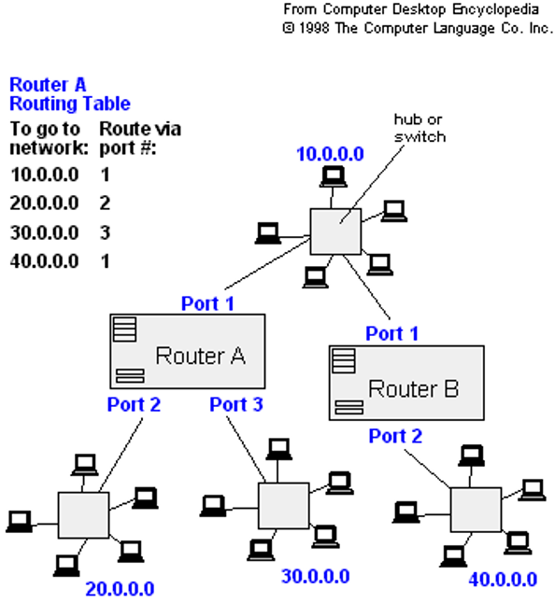
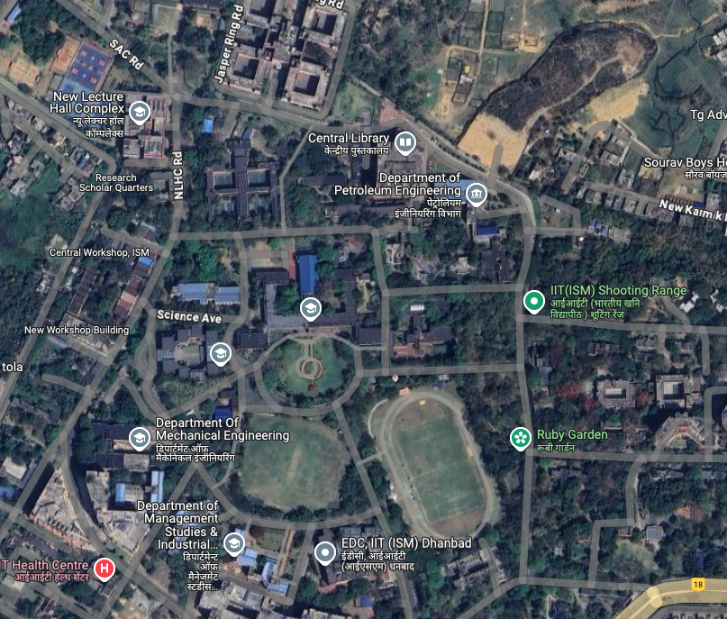

Single Source Shortest path Algorithms (SSSA)

Slide 3
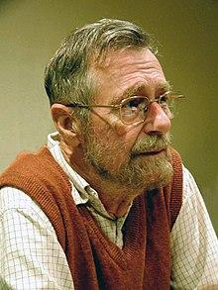

SSSA (Weighted graphs)
Can we use BFS algorithm to find the shortest path from source ( ) to destination ( ) for the below graphs?
S
D
S
S
1
1
7
5
M
N
M
N
Dijkstra’s
1
2
1
1
D
D
Note: BFS cannot guarantee that the front vertex of the queue is the closest to the source

Slide 4
SSSR algorithms
Source
Source
KFC
KFC
2
2
1
1
Amber
Ruby
Amber
Ruby
1
1
1
Diamond
Diamond

Slide 5
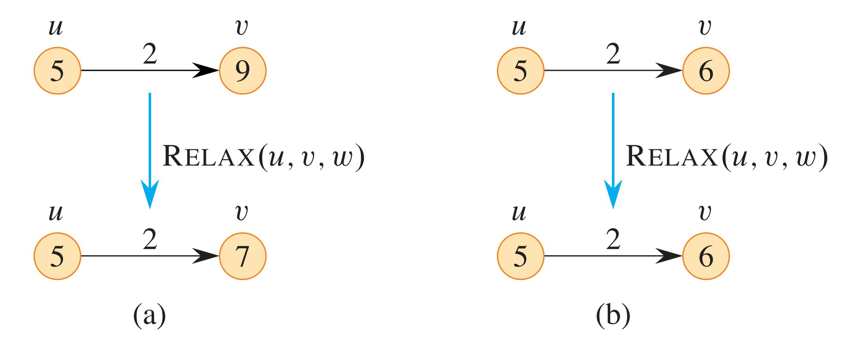
Relaxing an edge operation
Source
KFC
if d(R) > d(D) + cost (D → R):
d(R) = d(D) + cost (D → R)
Constant time operation O(1)
Diamond
Ruby
2
d(D) = 10
d(R) = 15
Relax (D → R) = min (d(D) + cost (D → R), d(R))

Slide 6
Dijkstra’s Algorithm (Weighted graphs)
∞
1
∞
1
∞
10
10
8
14
10
10
9
9
0
2
3
4
6
0
2
3
4
6
7
5
5
7
5
7
∞
7
5
5
∞
5
∞
2
2
1
9
1
14
13
8
9
8
8
10
8
14
10
13
10
0
2
3
4
6
2
3
0
4
6
7
7
5
5
5
7
7
2
5
7
2

Slide 7
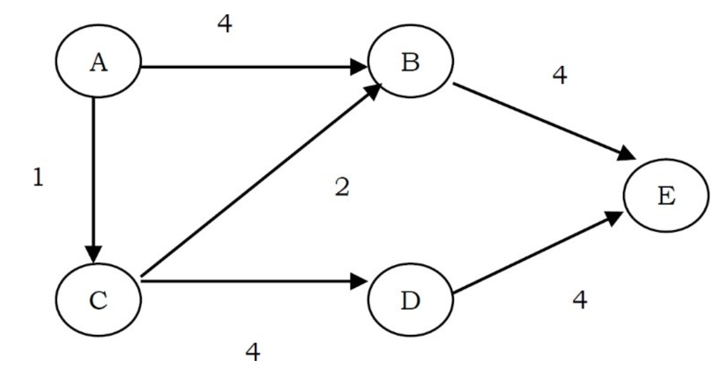
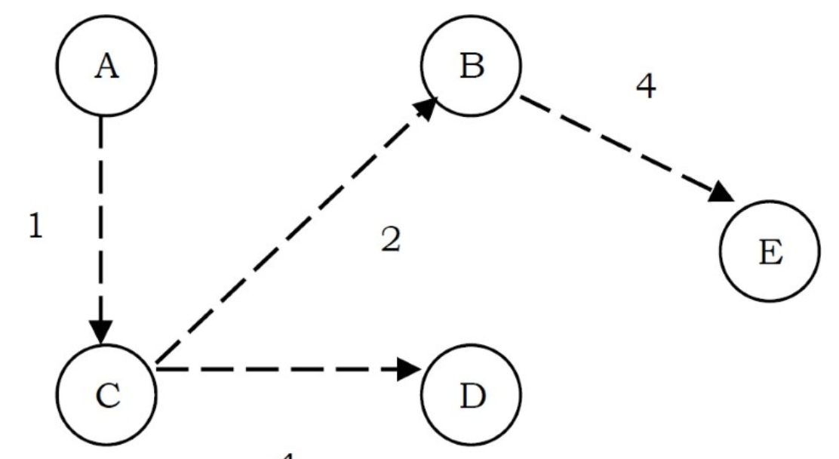
Exercises
Source
1
1
1
2
1
4
2
1
4
2
S
6
1
S
6
4
1
Source
3
2
Source
3
2
7
7
2
7
2
3

Slide 8
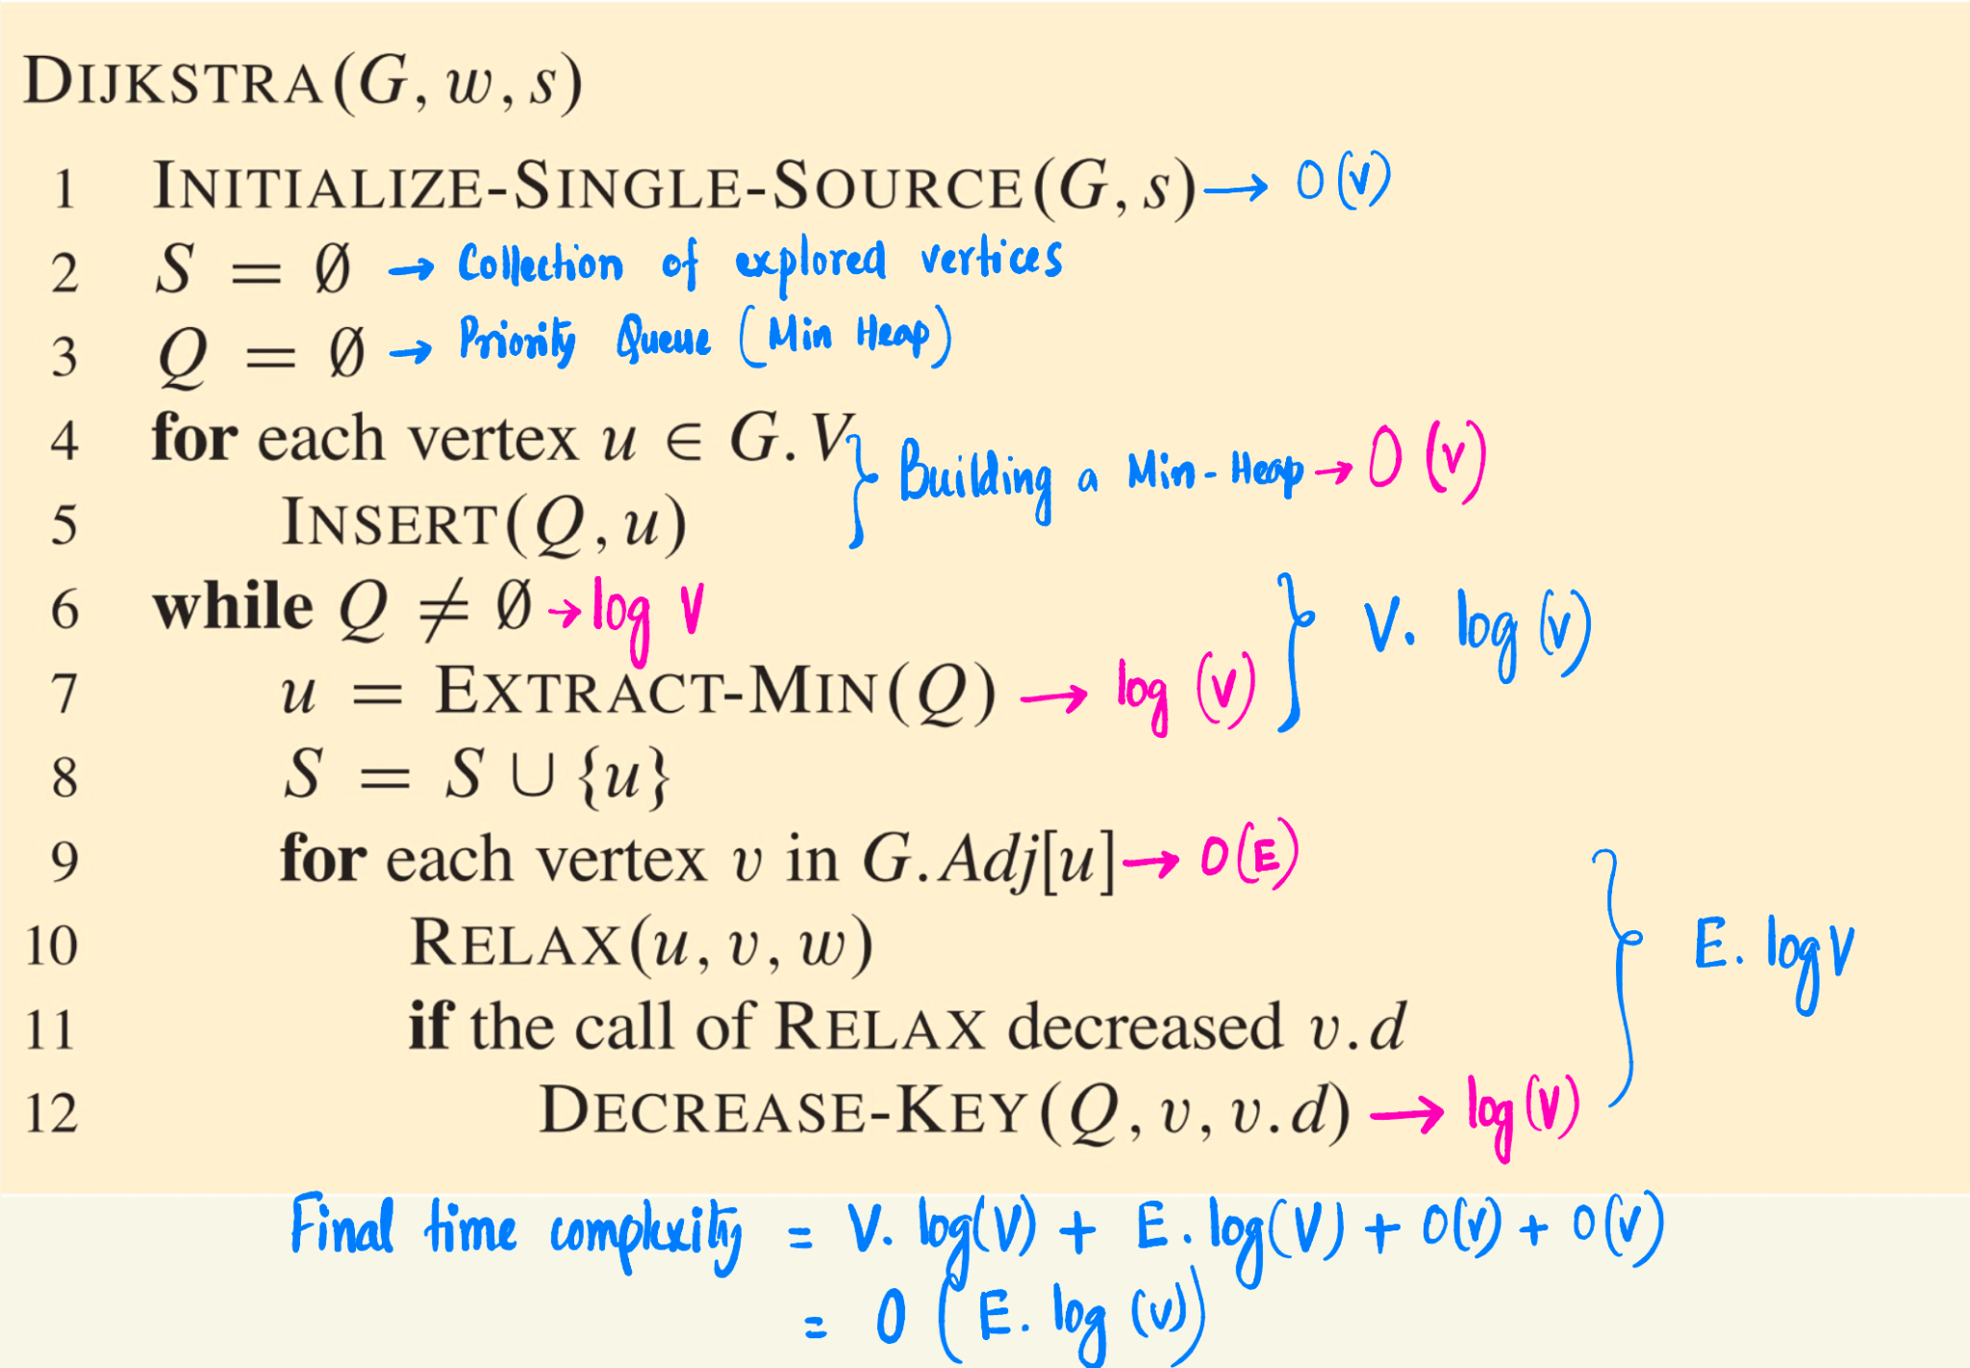
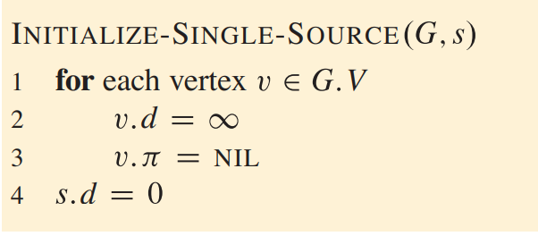
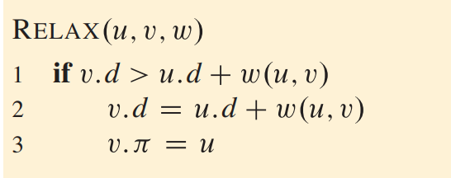
Dijkstra’s Algorithm
O(V)
V
O(1) if distance info is stored in an Array
O(logV) if distance info is stored in a Heap

Slide 9
Graph with Negative edge
Will Dijkstra’s algorithm work for the below graph?
M
N
D
1
2
-2
S
∞
∞
∞
DA works with -ve edge
M
N
D
1
2
-2
S
∞
1
1
∞
∞
3

Slide 10
Graph with Negative edge
Will Dijkstra’s algorithm work for the below graphs?
-3
-6
M
N
D
M
N
D
1
2
2
1
2
2
S
∞
∞
∞
S
∞
∞
∞
DA fails !!
-3
-6
M
N
D
M
N
D
1
2
2
1
2
2
S
∞
S
5
∞
∞
5
1
∞
3
∞
1
∞
3
-1
1
3
DA works for this graph !!!
-3
-1
1

Slide 11
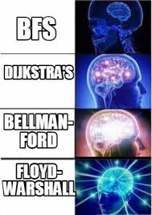
Graph with Negative edge
Dijkstra’s algorithm fails for the below graph. Why ???
Dijkstra’s algorithm fails to find out
-6
Graph
M
N
D
1
2
2
S
∞
∞
∞
Has -ve Cycle ?
DA fails !!
-6
M
N
D
1
2
2
S
∞
∞
5
1
∞
3
Yes
No
-1
1
3
-3
-1
1
Bellman Ford solved the problem

Slide 12
Bellman Ford Algorithm
Bellman Ford’s Algorithm can tell
Graph
-6
M
N
D
1
2
2
Has -ve Cycle ?
S
∞
∞
∞
Yes
No
Return False
Return True

Slide 13
Bellman Ford Algorithm
If a graph contains n nodes, how many edges (at most) will be there in any shortest path?
Ans: n -1
Bellman Ford’s Algorithm:
Relax each edge n−1 times
Relax each edge one more time
  If the cost of any vertex changes, then there is a cycle present in the graph;
  otherwise, no cycle present

Slide 14

Bellman Ford Algorithm
-6
M
N
D
Bellman Ford’s Algorithm:
Relax each edge n−1 times
Relax each edge one more time
  If the cost of any vertex changes, then there is a cycle present in the graph;
  otherwise, no cycle present
1
2
2
S
∞
∞
∞
-6
M
N
D
1
2
2
1.
S
1
∞
∞
-6
M
N
D
2.
1
2
2
S
1
3
∞
-6
M
N
D
1
2
2
-6
S
1
3
5
M
N
D
3.
1
2
2
S
1
3
5
-1
-ve weight Cycle detected !!!

Slide 15
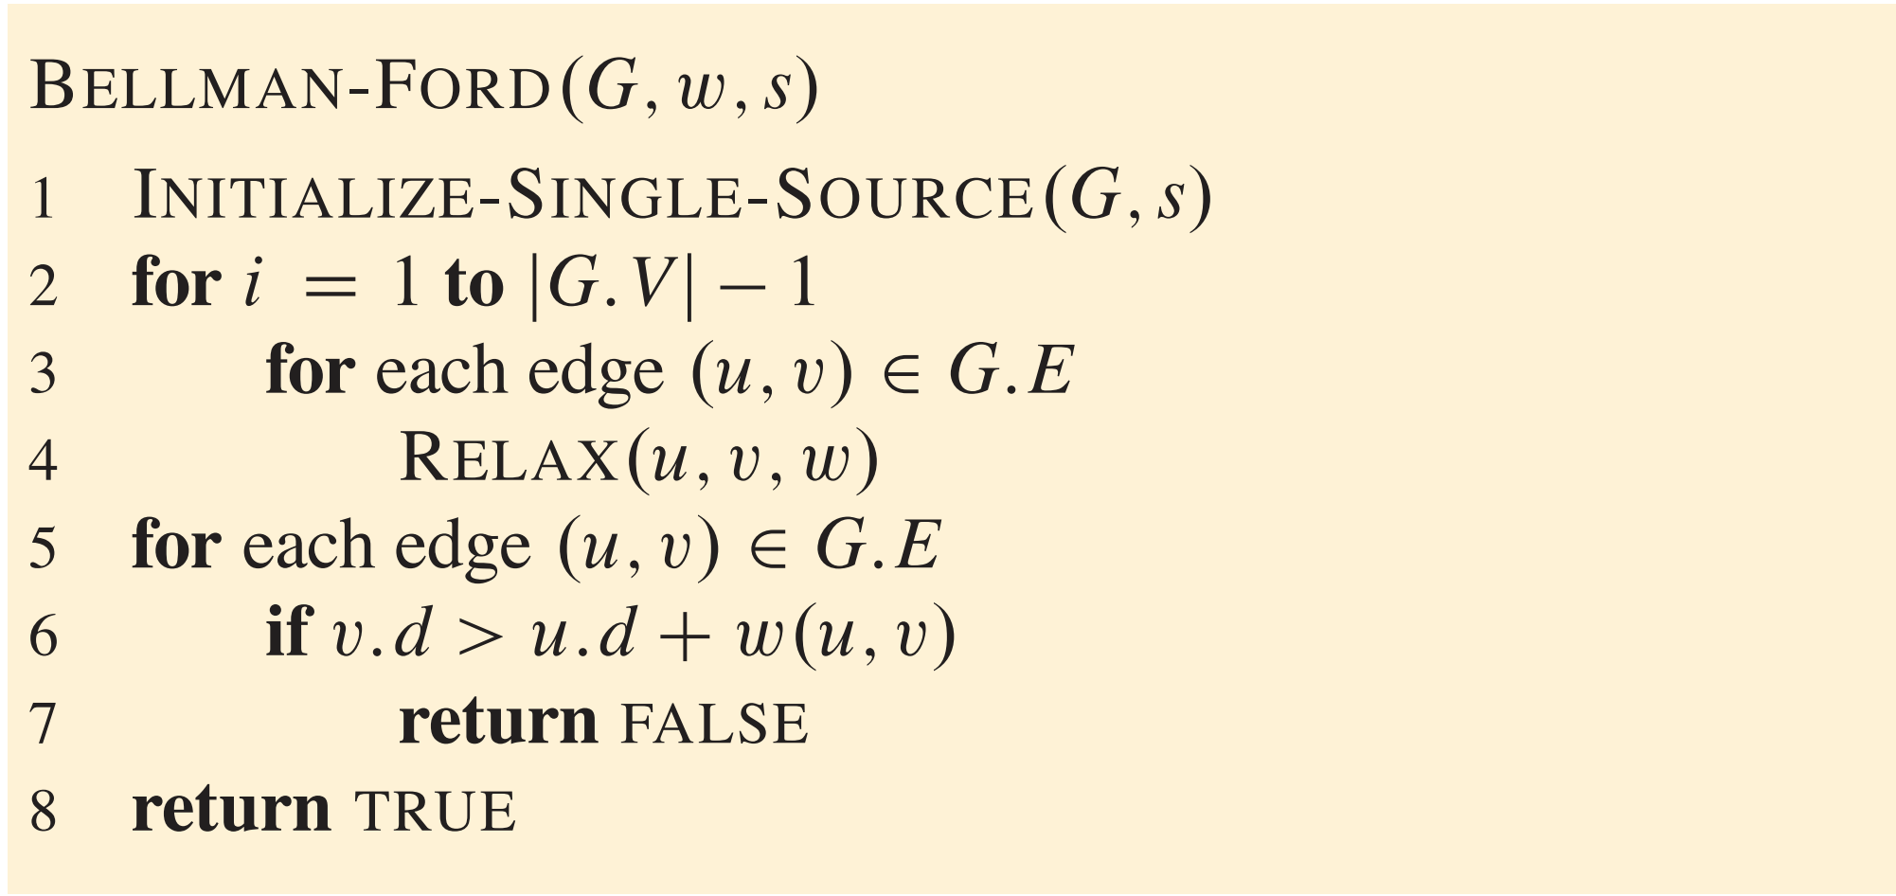
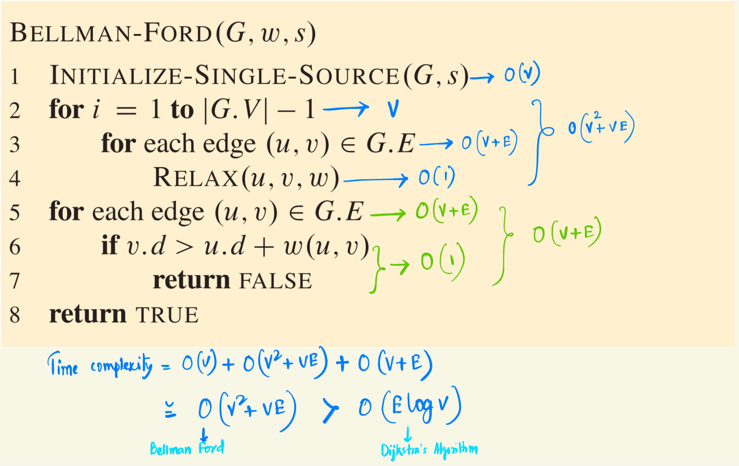
Bellman Ford’s Algorithm
Bellman Ford’s Algorithm:
Relax each edge n−1 times
Relax each edge one more time
  If the cost of any vertex changes, then there is a cycle present in the graph; Return False
  otherwise, no cycle present, Return True

Slide 16
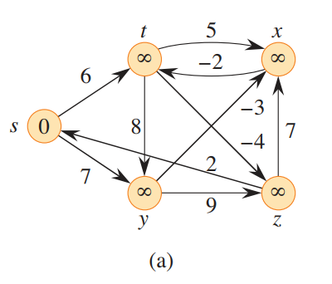
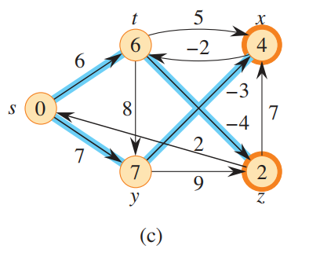
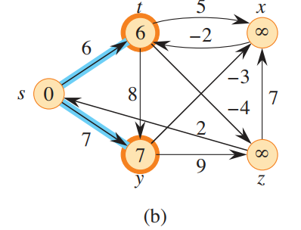
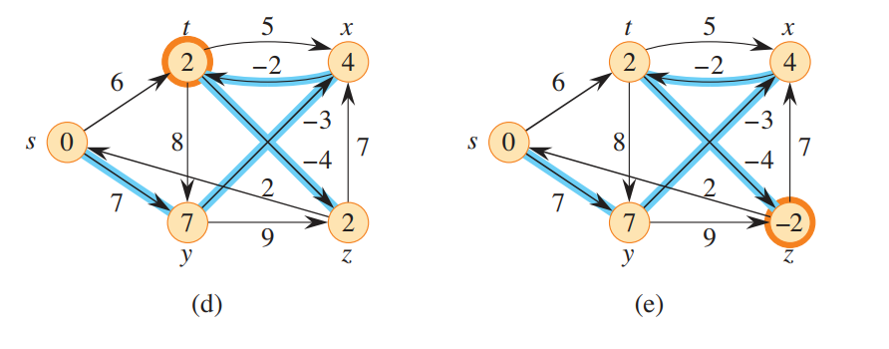
Example
The Bellman-Ford algorithm returns TRUE in this example, i.e., there is no -ve weight cycle

Slide 17
Variants of shortest path algorithm problem
Single-destination shortest-paths problem
  From each vertex to a single destination
  By reversing the direction of each edge in the graph, you can reduce this problem to a single-source problem.
1
1
4
2
6
1
S
Source
3
2
7
2
Single-pair shortest-path problem
  Shortest path from u to v for given vertices u and v.
  If you solve the single-source problem with source vertex u, you solve this problem also
All-pairs shortest-path problem
  Find a shortest path from u to v for every pair of vertices u and v
  Run single-source algorithm once from each vertex.

Slide 18
Shortest path algorithms (Unweighted graph)
Use BFS vs DFS:
0
Why BFS?
BFS explores level by level (or layer by layer) from the source node.
The first time BFS reaches a node, it guarantees the shortest path to that node because BFS always takes the smallest number of edges to reach a node.
1
3
6
2
Searching the path to reach
6
Why not DFS?
DFS explores depth-first without considering the shortest path.
It may take a long detour before finding the target.
DFS does not work for shortest paths in general graphs.
4
5

Slide 19
Minimum spanning tree (MST)

Slide 20
Minimum spanning tree (MST)
A spanning tree of a graph is a subgraph that is a tree and includes all vertices.
The subgraph should be connected,
Should not contain any cycle (Tree),
Need not to be unique. Can have multiple spanning trees of a single graph (N^{(N-2)} for complete graph, otherwise use Kirchoff Algo).
1
1
1
1
1
2
1
2
1
2
1
2
1
1
1
1
A minimum spanning tree (MST) is a spanning tree with the minimum possible total edge weight. It is also called minimum weighted spanning tree.
  Minimum cost
1
Can we get more than one MST?
There are two famous algorithms for this problem:
Prim’s Algorithm
Kruskal’s Algorithm
1
1

Slide 21
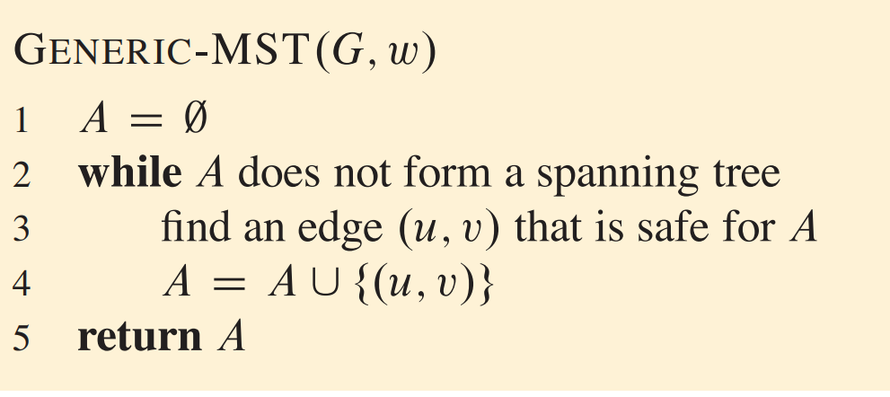
Minimum spanning tree (MST)
MST
How to find a safe edge?
Prim’s Algorithm
Kruskal’s Algorithm

Slide 22
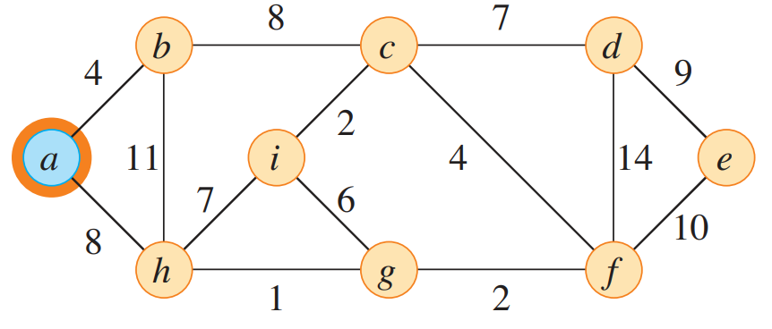
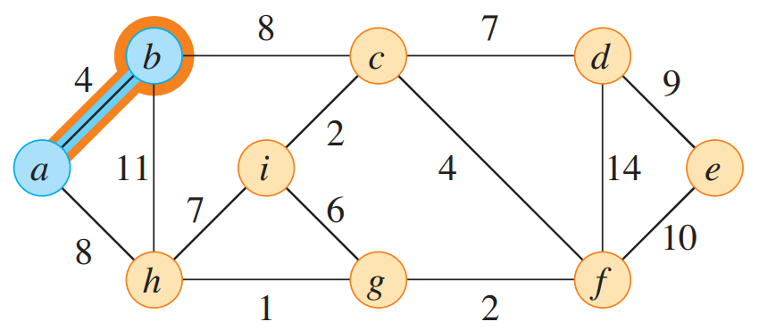
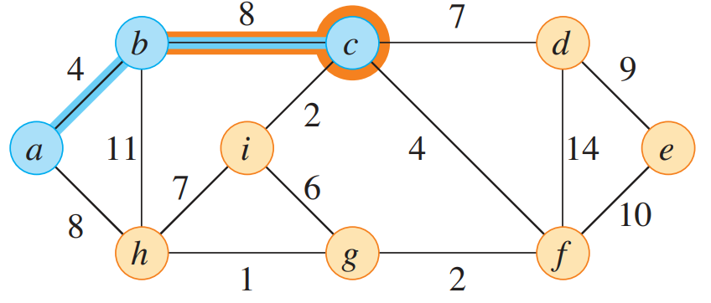
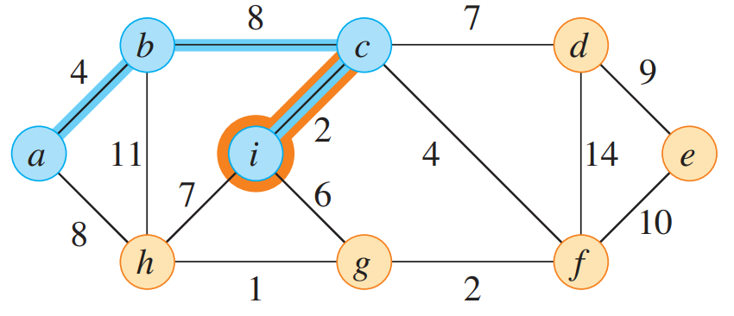
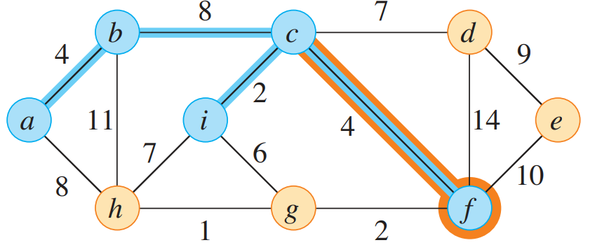
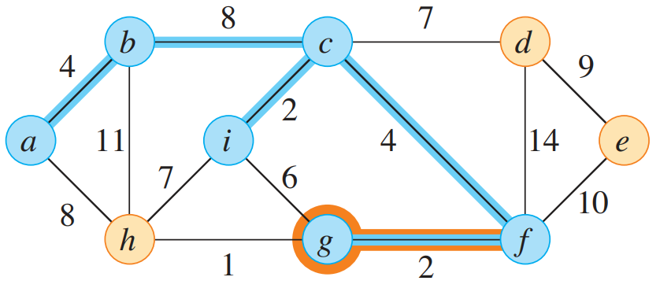
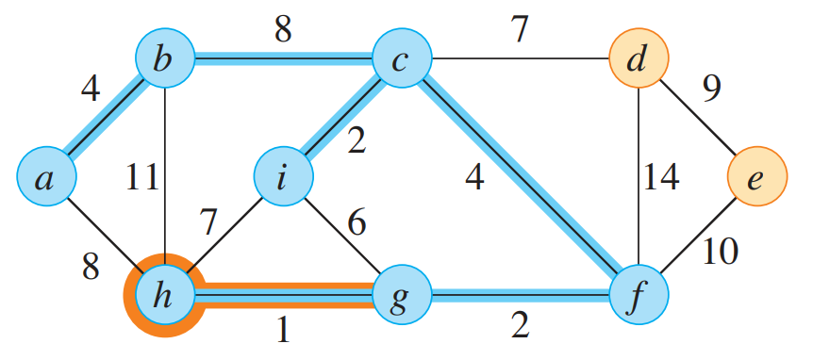
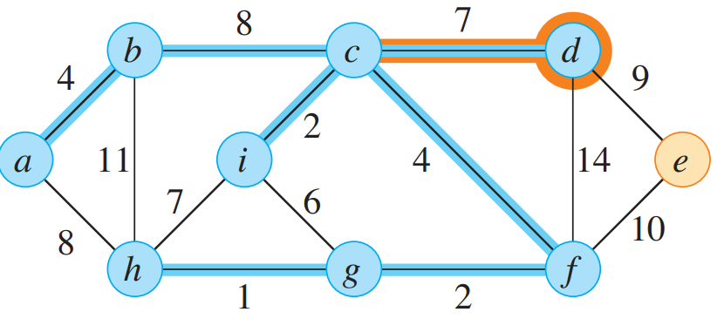
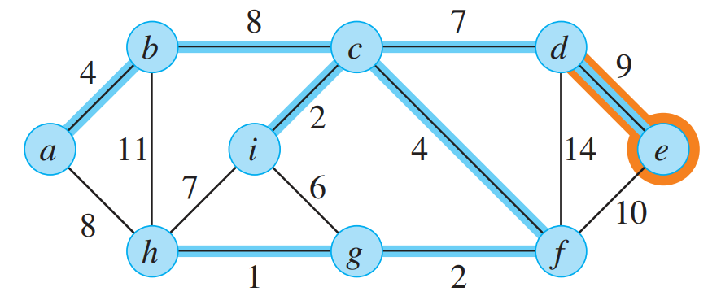
Prim’s Algorithm

Slide 23
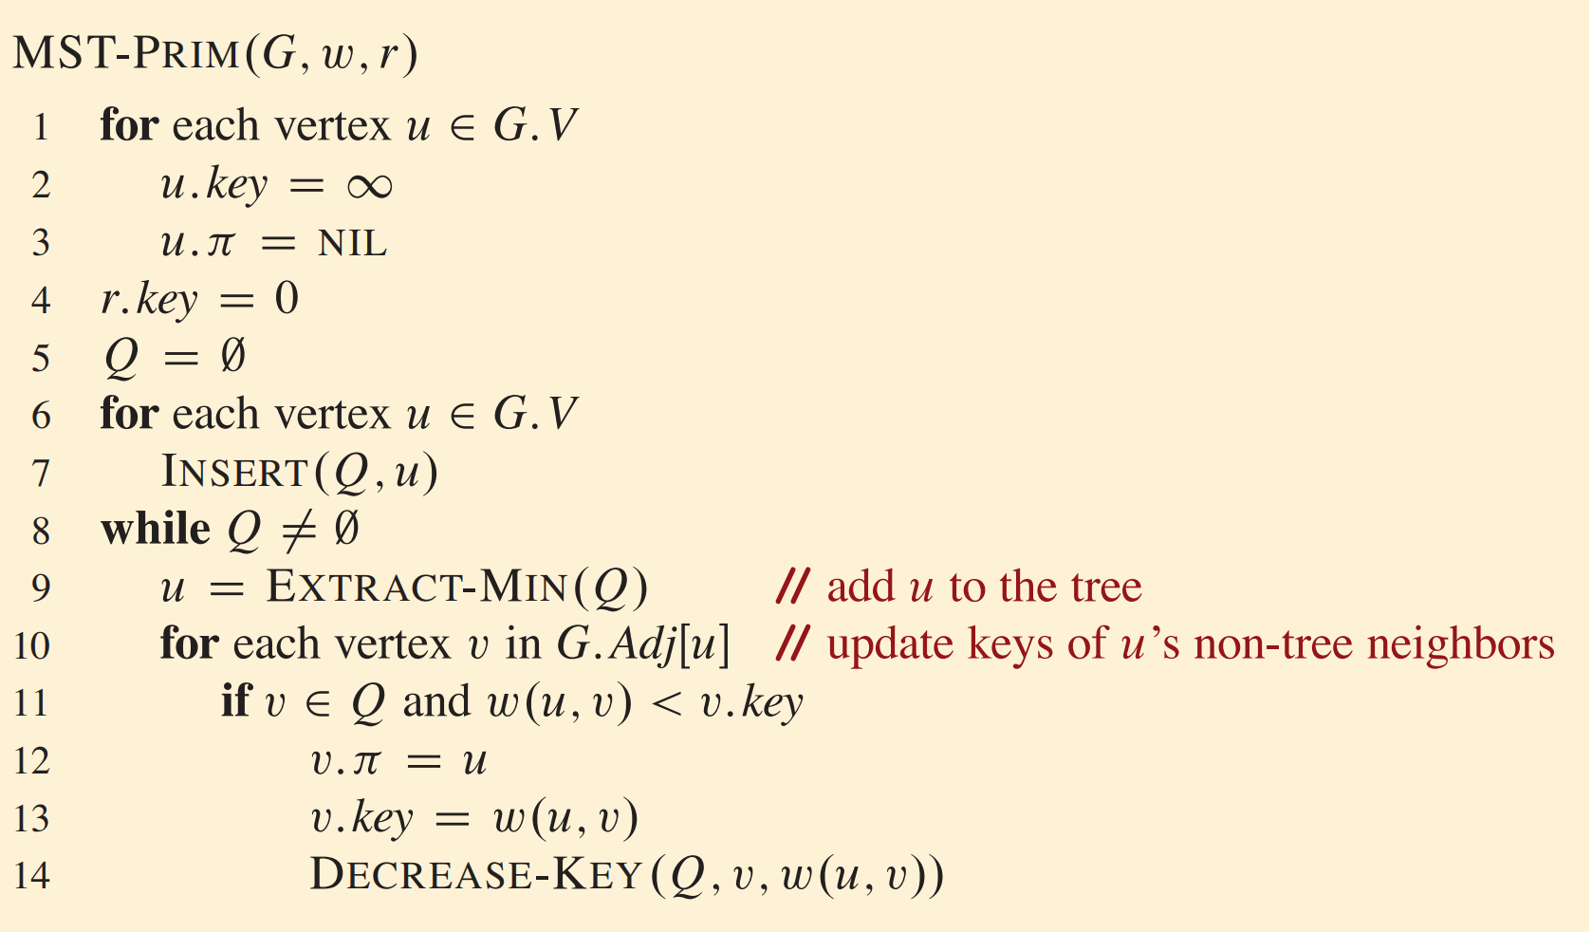
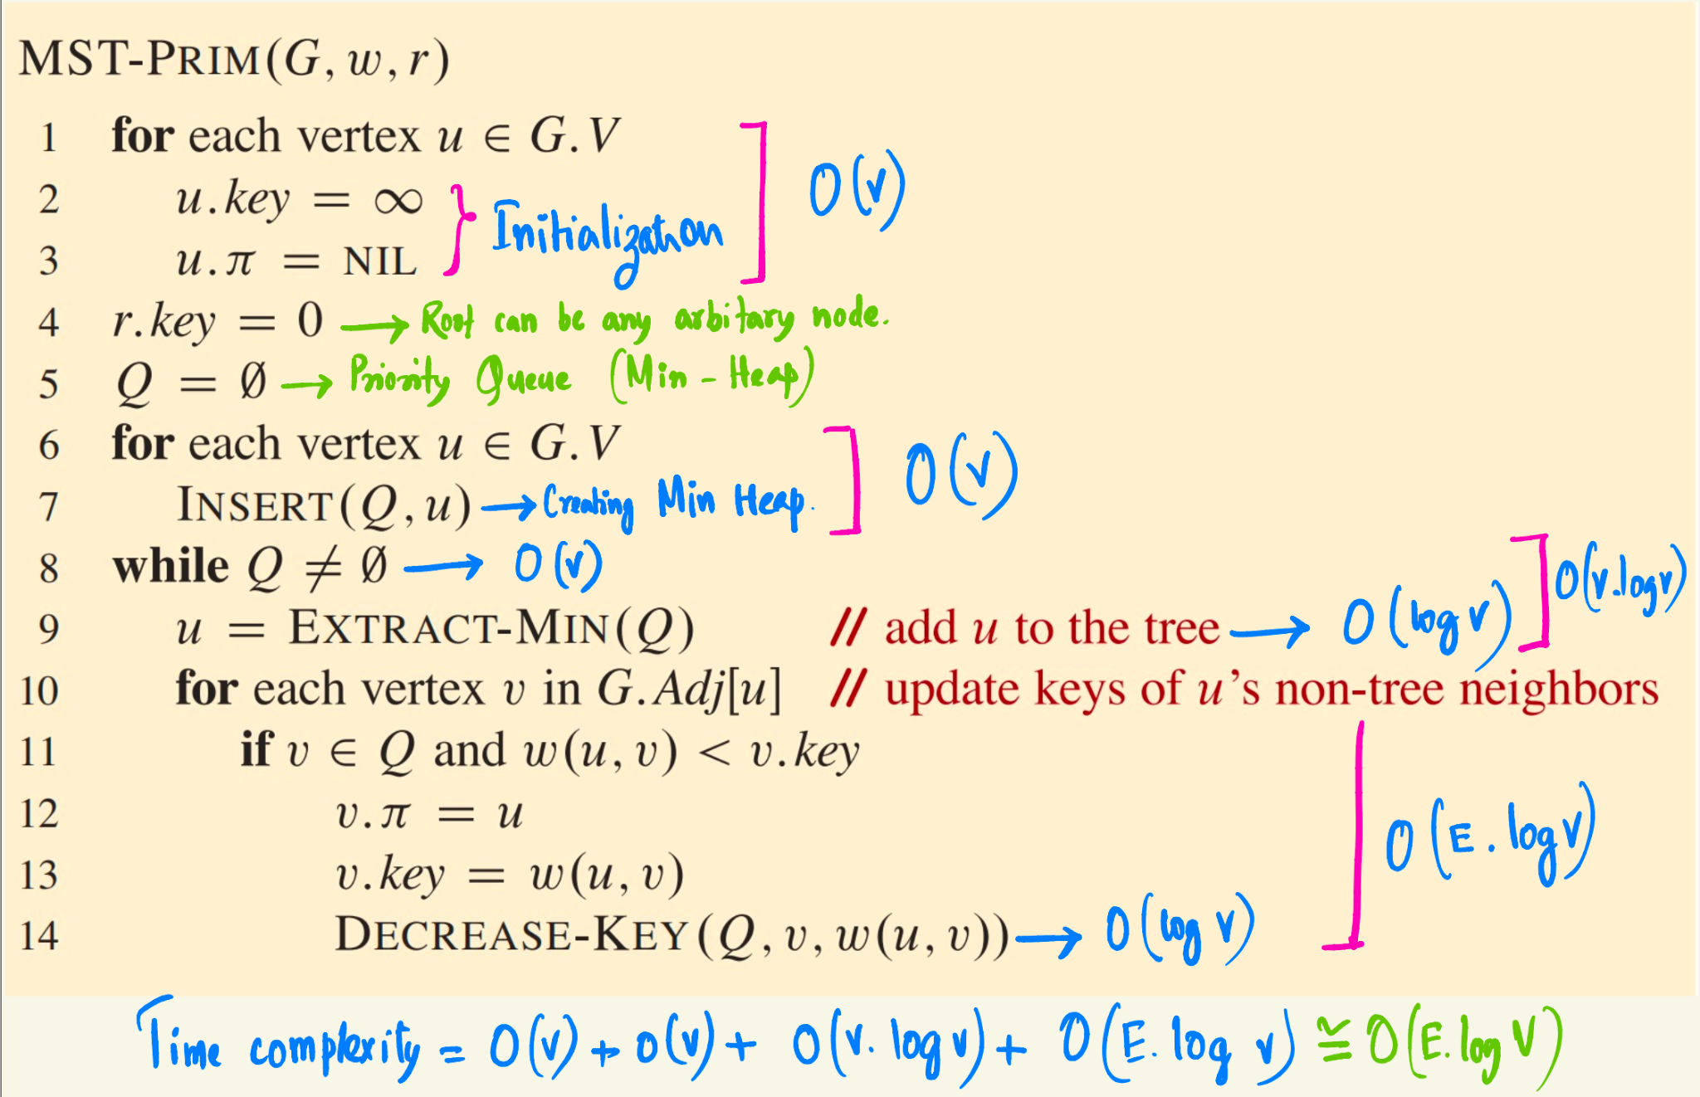
Prim’s Algorithm
The attribute v.key is the minimum weight of any edge connecting v to a vertex in the spanning tree.

Slide 24
Questions
If a Fibonacci heap holds V elements, an EXTRACT-MIN operation takes O(log V) amortized time and each INSERT and DECREASE-KEY operation takes only O(1) amortized time. Then what would be the time complexity for the Prim’s
Algorithm?
Ans: O(E+ V logV)

Slide 25
Questions
The running time of Prim’s algorithm is O(V²) without heaps [good for dense graphs], and O (E logV) using binary heaps
[good for sparse graphs]. Why and how to implement prim’s algorithm without using heap?

Slide 26
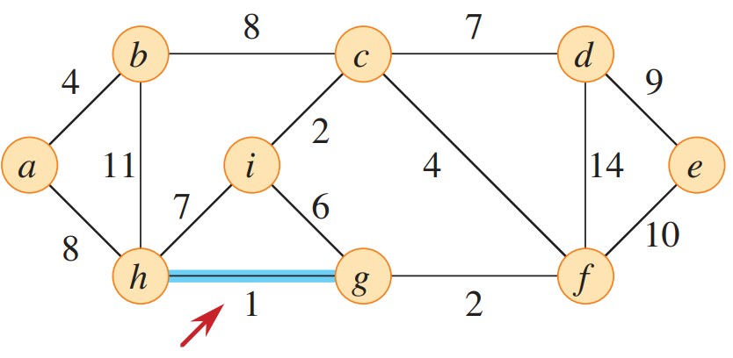
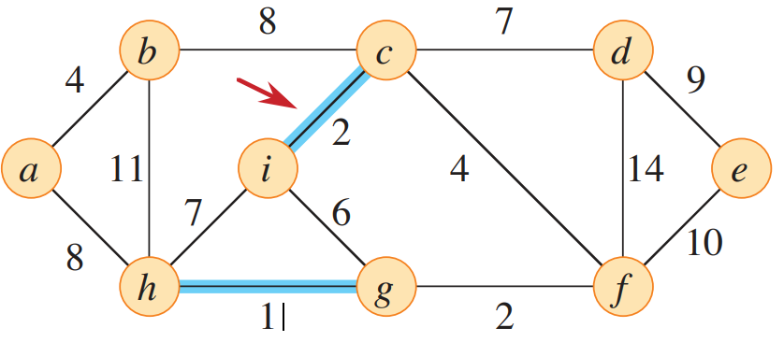
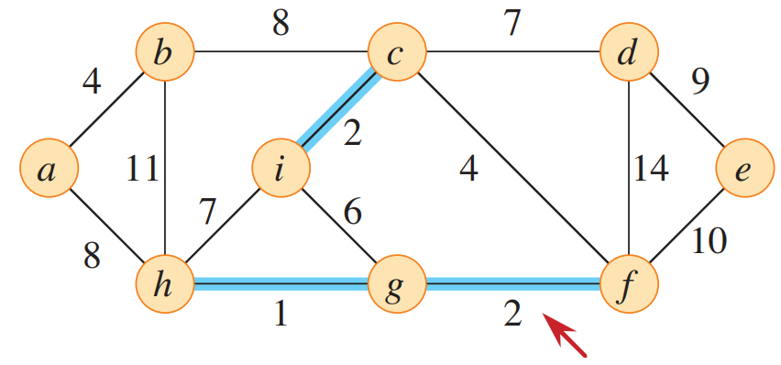
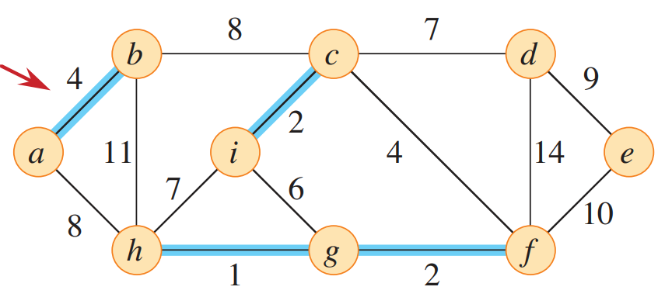
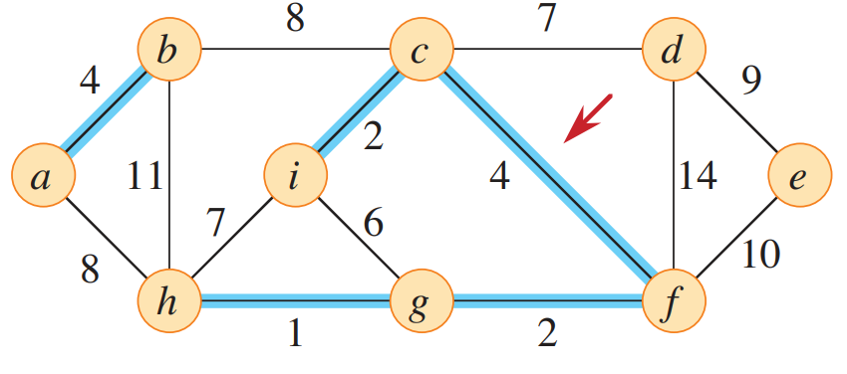
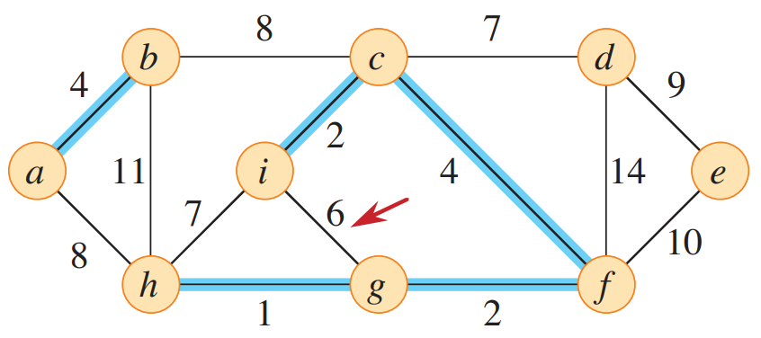
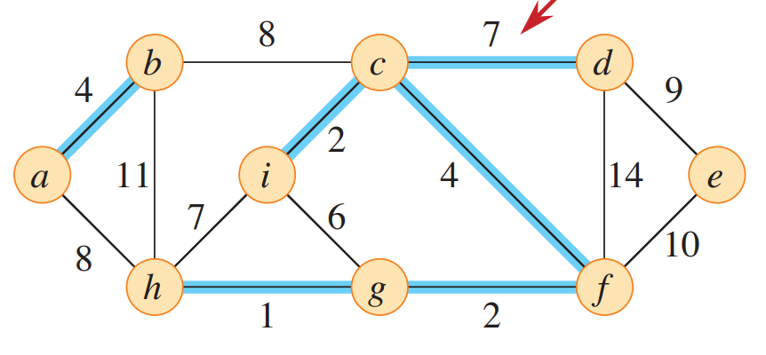
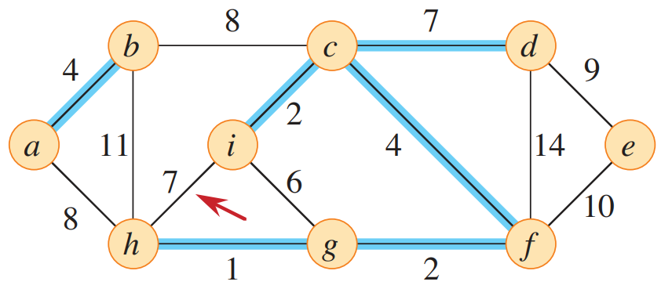
Kruskal’s Algorithm

Slide 27
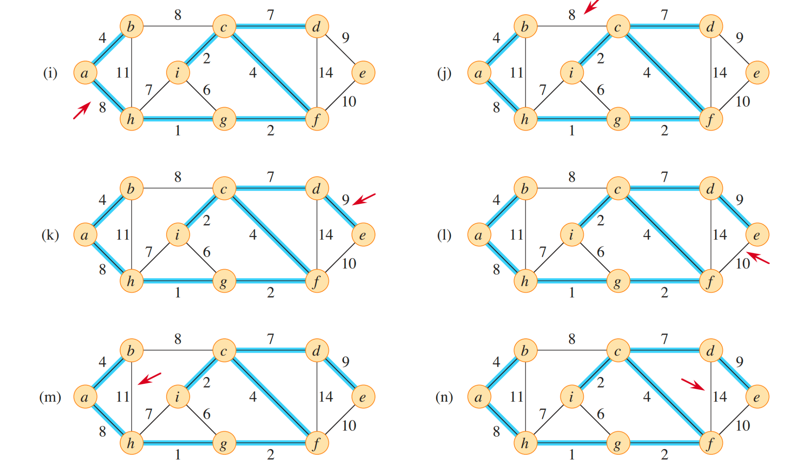
Kruskal’s Algorithm

Slide 28
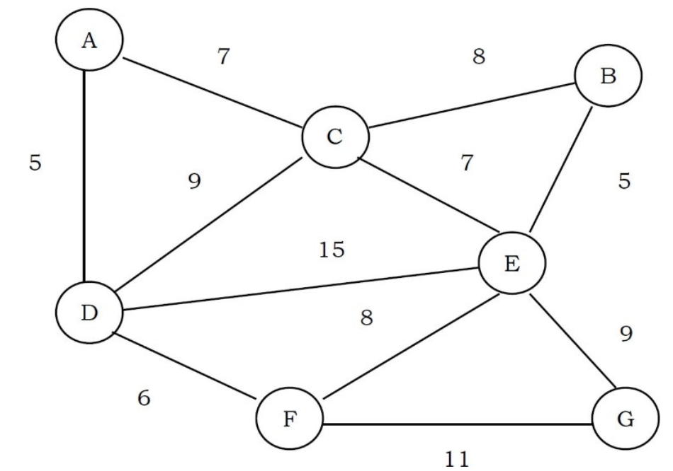
Exercises
Find the MST using Prim’s and Kruskal Algorithms. Show the values of each internal step (keys and parents) of Prim’s algorithm.

Slide 29
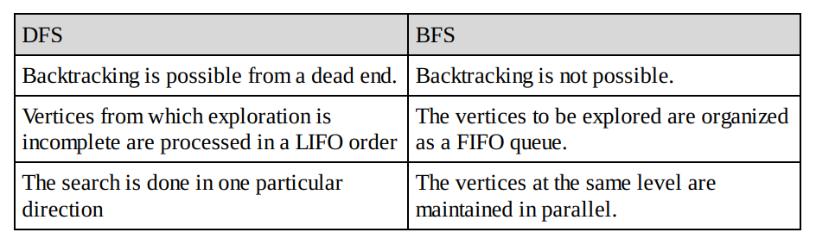
Exercises
What are the differences between DFS and BFS?

Slide 30
Exercises
Q. All pairs shortest path problem: Find the shortest graph distances between every pair of vertices in a given graph. Let us assume that the given graph does not have negative edges.
Ans: We can apply Dijkstra’s algorithm on each vertex of the given graph. This algorithm does not work if the
graph has edges with negative weights.
Q. At a university, students must complete certain prerequisite courses before enrolling in advanced courses. Given N courses (numbered from 0 to N-1) and a list of prerequisite pairs (x, y) where course x depends on course y (i.e., y must be completed before x), determine the order in which a student can complete all courses.
If no valid order exists due to circular dependencies, return "Not possible
Ans: Need to use topological sort.

Slide 31
Exercises
Q. What is the difference between Dijkstra’s and Prim’s algorithm?
Ans: Dijkstra’s algorithm is almost identical to that of Prim’s. The algorithm begins at a specific vertex and extends outward within the graph until all vertices have been reached. But, in Prim’s, you can take any arbitrary vertex as the starting vertex. The only distinction is that Prim’s algorithm stores a minimum cost edge whereas Dijkstra’s algorithm stores the total cost from a source vertex to the current vertex.
More simply, Dijkstra’s algorithm stores a summation of minimum cost edges whereas Prim’s algorithm stores at most one minimum cost edge
Q. Reversing Graph: Give an algorithm that returns the reverse of the directed graph (each edge from v to w is replaced by an edge from w to v). What is the time complexity for it?
Ans: O(V+E)

Slide 32
Exercises
Q. What is the worst – case memory usage of DFS?
0
Ans: O (V)
1
2
4
5

